Slide 1
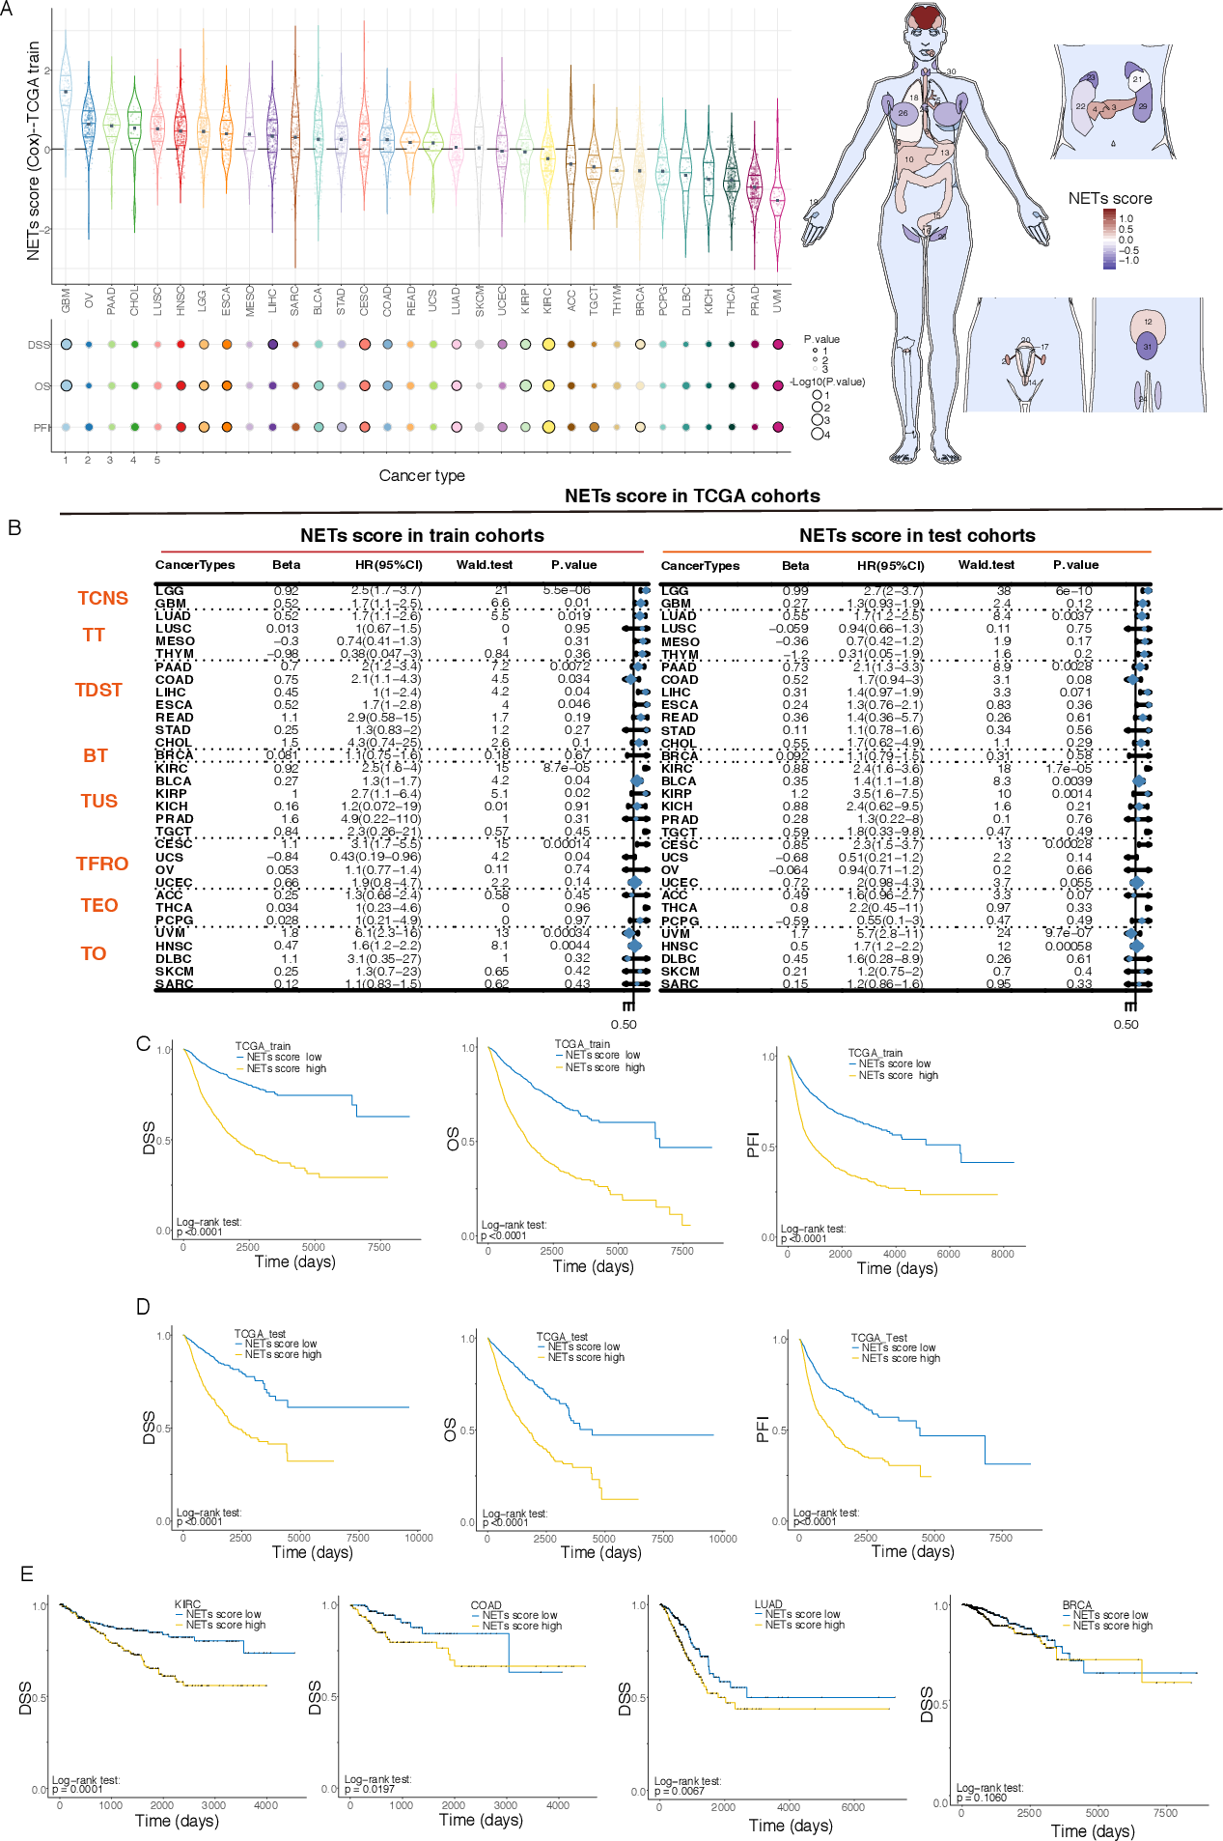
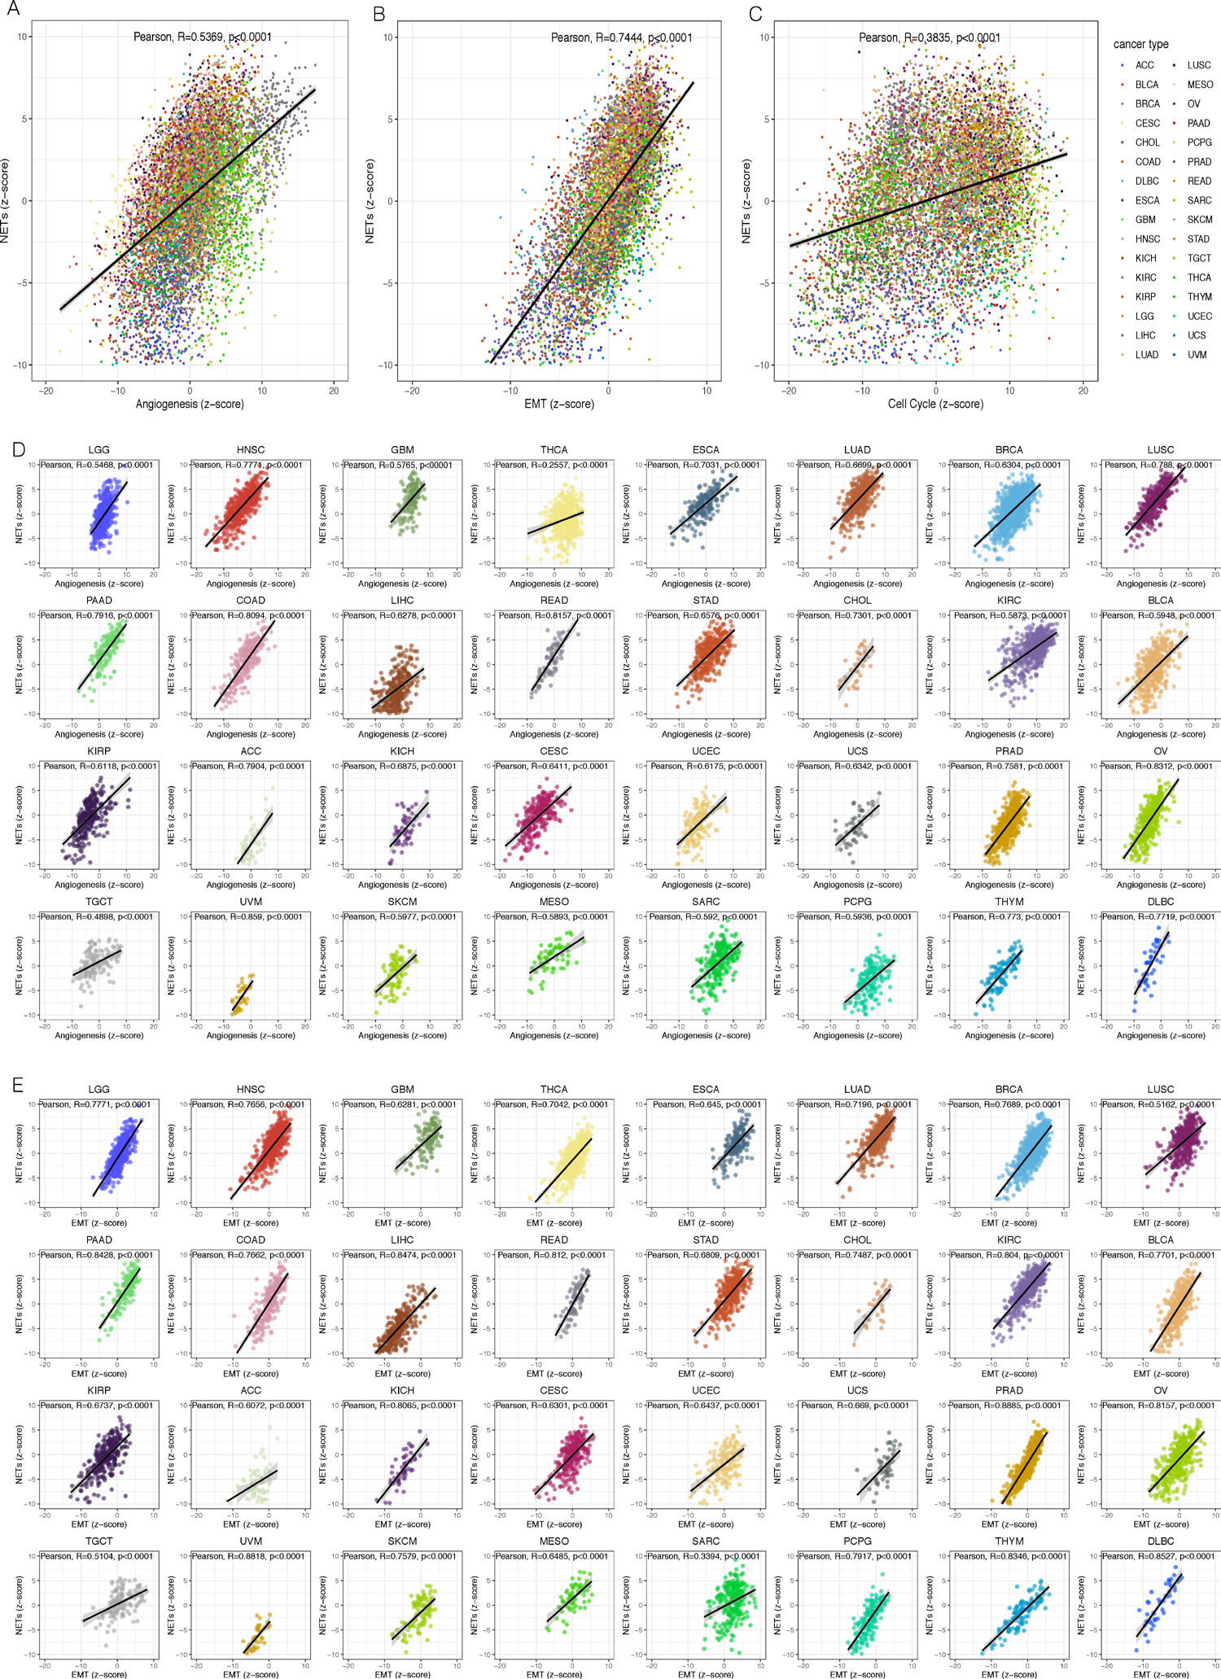
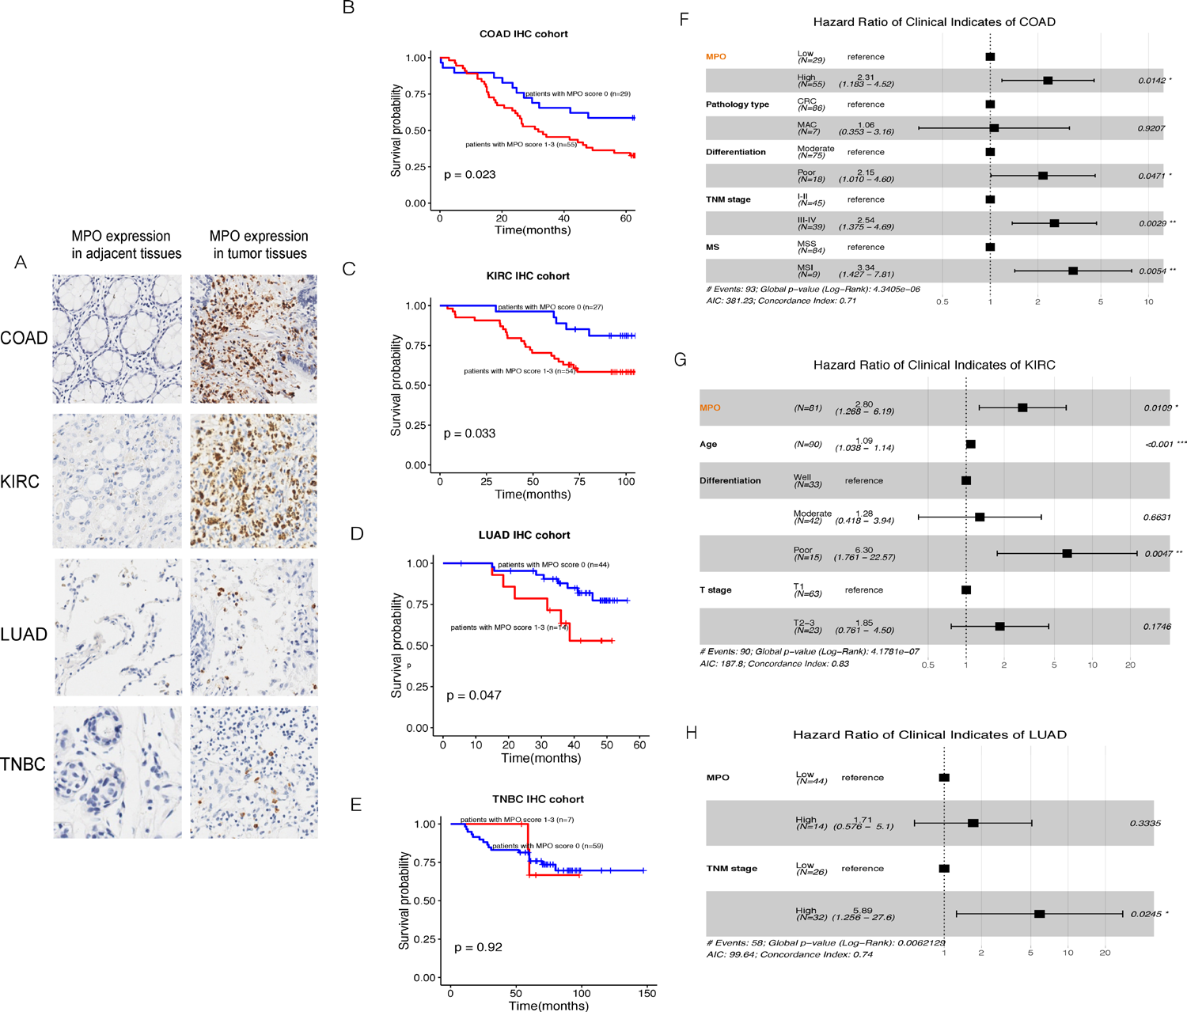
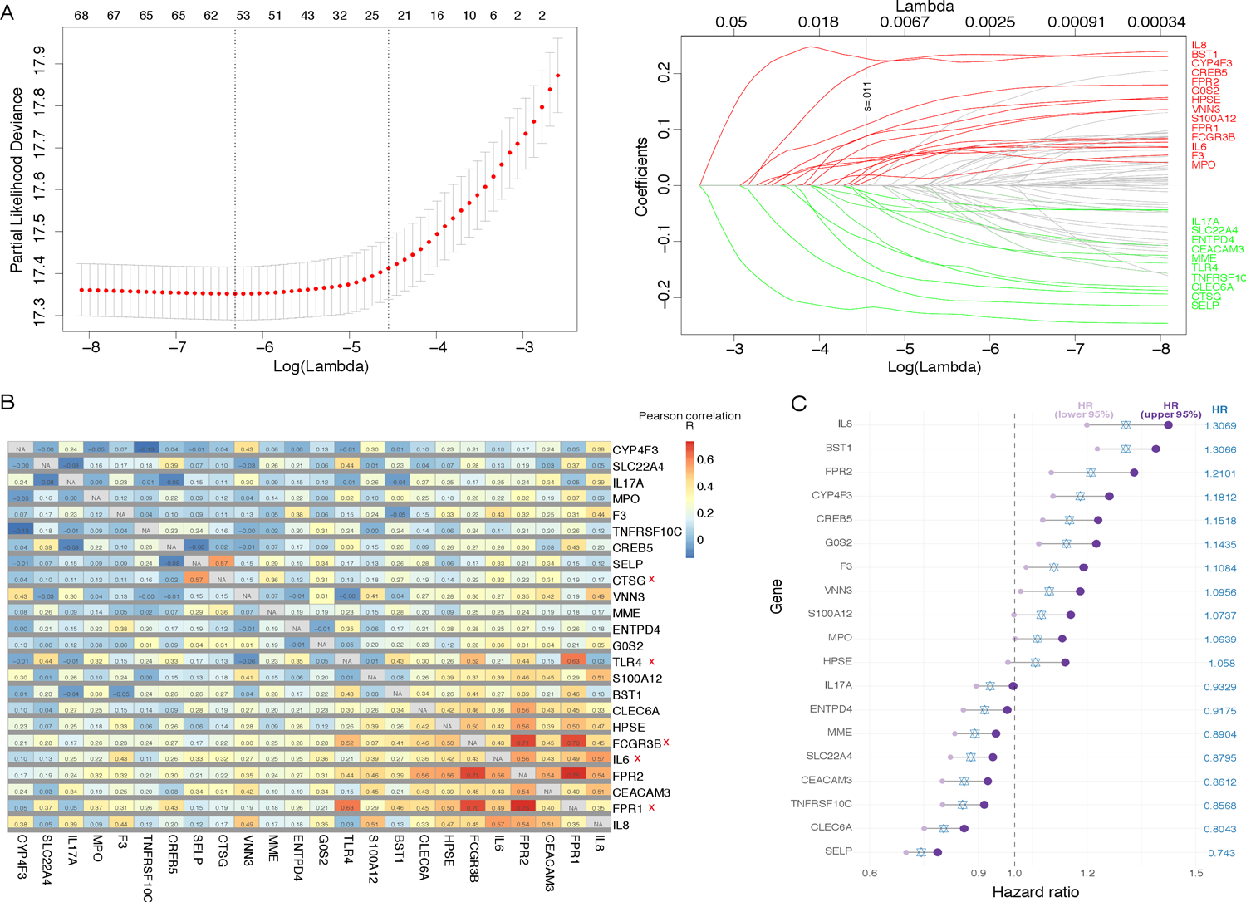
A signature for pan-cancer prognosis
based on neutrophil extracellular traps
Institution logo
19
8,739
4
Yi Zhang, Liping Guo, Qichen Dai, Bingqing Shang, Ting Xiao, Xuebing Di, Kaitai Zhang, Lin Feng, Jianzhong Shou & Yipeng Wang
genes in the NETs signature
TCGA pan-cancer cases
IHC validation cohorts
National Cancer Center / Cancer Hospital, CAMS & PUMC · Peking University People's Hospital · collaborating centers
J Immunother Cancer 2022 · DOI 10.1136/jitc-2021-004210
Why NETs?
Higher NETs score identified patients with poorer survival
Malignant biology
Neutrophil extracellular traps (NETs) can support tumor progression and dissemination. The study asked whether transcriptomic NETs-formation potential could stratify prognosis across cancer types.
R=0.7444
R=0.5369
R=0.3835
Worse DSS, OS and PFI across most cancer types
Epithelial-mesenchymal transition
Angiogenesis
Cell cycle
Evidence: Results, p. 4; Figure 2
Evidence: Abstract and Introduction, pp. 1-2
Pan-cancer prognostic performance
All correlations p<0.0001 · Results, p. 6
Model construction
1
69 initial NETs biomarkers
2
LASSO retained 24 genes
3
Correlation pruning removed 5 genes
4
19-gene Cox-derived NETs score
DATA FOUNDATION
TCGA: n=8,739, 32 tumor types
Training: n=6,117 · Test: n=2,622
CGGA: n=651 · METABRIC: n=1,868 · GEO: n=2,459
IHC: LUAD n=58 · COAD n=93 · KIRC n=90 · TNBC n=80
Figure 5 · NETs activity aligns with aggressive tumor programs
Source paper, p. 8 · original colors locked
Evidence: Methods, pp. 2-3
Clinical IHC validation
From biomarkers to signature
Figure 2 · NETs score distribution and survival performance
Source paper, p. 5 · original colors locked
Independent and external validation
• TCGA test cohort: OS HR=1.22, p=0.0070 after adjustment for cancer type.
• External cohorts supported prognostic value in glioma and LUAD.
• Results were not consistent in breast cancer (7/8 cohorts non-significant) or LUSC.
• Tumor-type context remains essential for interpretation.
Figure 6 · MPO stratified outcomes in COAD, KIRC and LUAD, not TNBC
Source paper, p. 9 · original colors locked
Conclusion
A 19-gene transcriptomic signature captured clinically relevant NETs-formation potential, prognosis and malignant biology across cancers.
Limitations: few NETs markers, limited cancer-specific IHC cohorts and insufficient H3Cit positivity; broader multi-marker validation is required.
Figure 1 · Construction of the pan-cancer NETs signature
Evidence: Results, pp. 4-6
Source paper, p. 4 · original colors locked
Nomogram AUC improved: 0.700→0.726 (train) · 0.661→0.718 (test)
Evidence: Discussion and Conclusions, p. 10
Zhang et al. J Immunother Cancer. 2022;10:e004210 · CC BY-NC · traceable paraphrase
Approvals current · scientific figure colors locked
Notes:
[Sources]
- /Users/qichen_dai/Documents/Codex/2026-08-06/referenced-chatgpt-conversation-this-is-an/outputs/postex-v0.1/examples/sci02jitc/SCI02JITC.pdf
- 10.1136/jitc-2021-004210
- palette approval sha256:1046a396ac28389a2a39c7e93d6002ca6ac6a0ed54ef043f014da5e74439d63a
- deletion approval sha256:3f7de758a1ffc62f53bc50fab271cc5b41c4fc956f05dcfbf25609acd0309c88
[/Sources]

