Slide 1

Neural Network Attributions:
A Causal Perspective
Aditya Chattopadhyay, Piyushi Manupriya, Anirban Sarkar, Vineeth N Balasubramanian
ICML 2019
Presenter: Zhe Wang
Date: 02/27/2020
https://qdata.github.io/deep2Read/

Slide 2


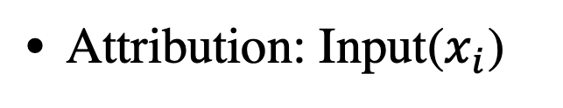
Motivation
Before motivation:
$$y_{j}$$
Attribution: Input($x_{i}$)
Output( )
Causality is not equivalent to correlation
Why:
Interpretability of a trained neural network
In this work, they focus on a specific method: attribution
Notes:
The motivation of this project

Slide 3
Background
Five axioms for attribution methods:
Conservativeness
Sensitivity
Implementation invariance
Symmetry preservation
Input variance

Slide 4
Related Work
Perturbation based methods:
Analyze the effect of small perturbation
For example: gradient based methods
Regression based method:
Using well-studied classifier to mimic the local
decision boundary of neural networks.
For example: decision tree and multinomial model

Slide 5



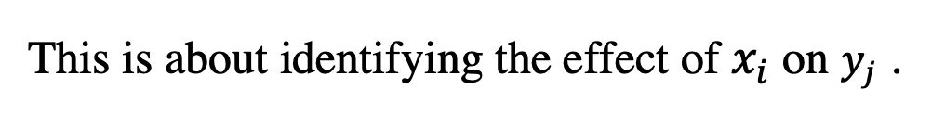

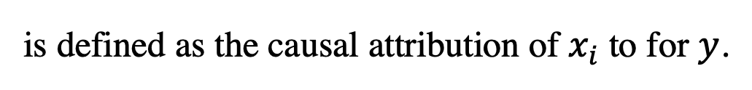
Claim / Target Task
Note: This is not about or
$$A→B$$
$$B→A$$
This is about identifying the effect of $x_{i}$ on $y_{j}$ .
How to quantify?
Def (Average Causal Effect)
The ACE of a binary value variable x on another random variable y is defined as:
$$𝔼(y|do(x=1))−𝔼(y|do(x=0)).$$
For continuous random variable, ACE is defined as:
$$ACE_{do(x_{i}=a)}^{y}=𝔼(y|do(x_{i}=a))−baseline.$$
is defined as the causal attribution of $x_{i}$ to for $y$.
$$ACE_{do(x_{i}=a)}^{y}$$
Notes:
Here, we make the claim of this project.

Slide 6
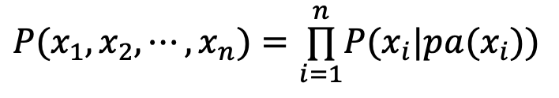
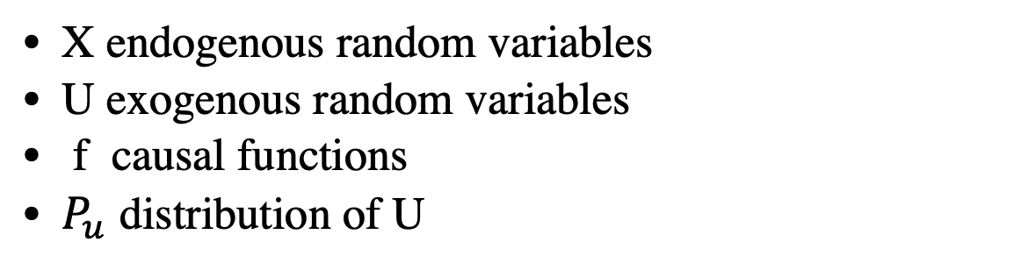
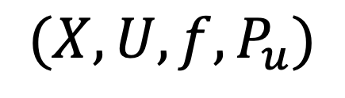
Causality
Structural Causal Models (SCM)
$$(X,U,f,P_{u})$$
X endogenous random variables
U exogenous random variables
f causal functions
$P_{u}$ distribution of U
Local Markov property for DAG:
$$P(x_{1},x_{2},⋯,x_{n})=\overset{n}{\underset{i=1}{∏}}P(x_{i}|pa(x_{i}))$$
Notes:
Here, we make the claim of this project.

Slide 7
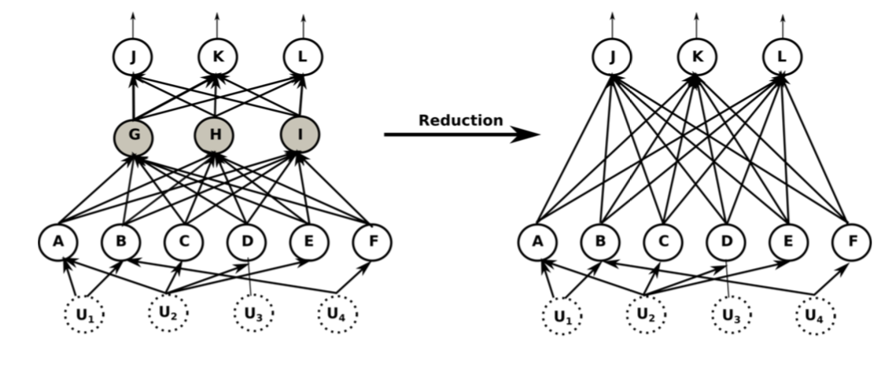


Fold NN as SCMs
Following the tradition on SCMs, each NN can be viewed as:
$$([l_{1},l_{2},⋯,l_{n}],U,[f_{1},f_{2},⋯,f_{n}],P_{u}).$$
marginalizing out all hidden neurons, we get:
$$([l_{1},l_{n}],U,f^{′},P_{u}).$$
Basic assumption: there is no causal relation for input variables
Notes:
Here is our proposed solution.

Slide 8
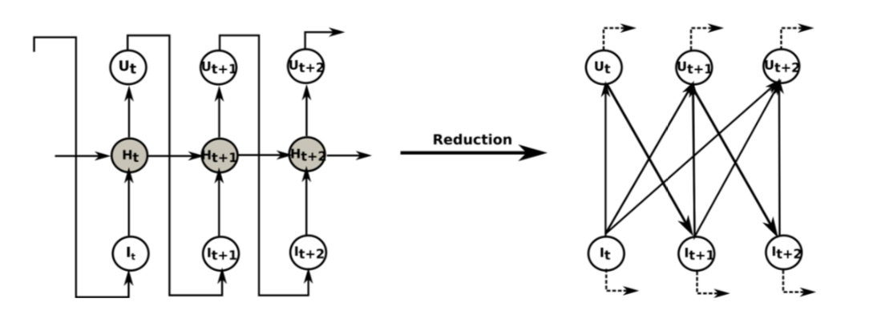
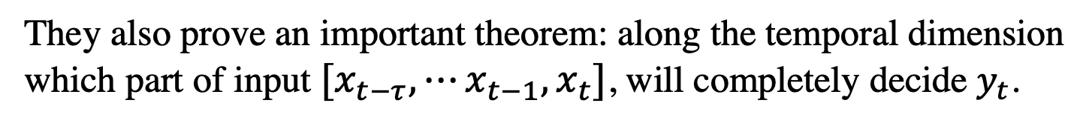
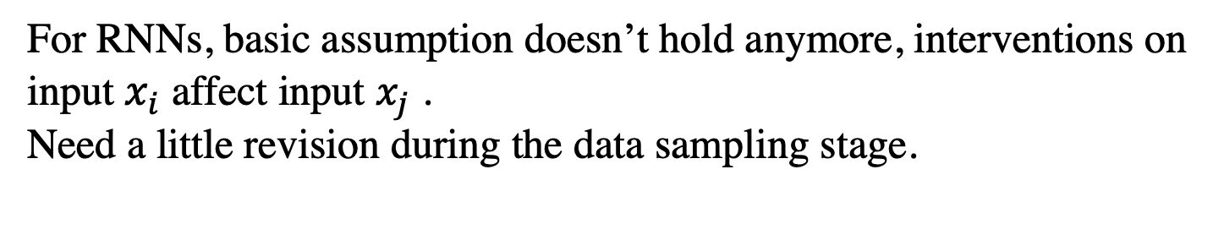
RNN as SCMs
For RNNs, basic assumption doesn’t hold anymore, interventions on input $x_{i}$ affect input $x_{j}$ .
Need a little revision during the data sampling stage.
They also prove an important theorem: along the temporal dimension
which part of input $[x_{t−τ},⋯x_{t−1},x_{t}]$, will completely decide $y_{t}$.
Notes:
In the rest of this presentation, I’m going to talk about following contents:

Slide 9


Implement
Average causal effect is defined as:
$$ACE_{do(x_{i}=a)}^{y}=𝔼(y|do(x_{i}=a))−baseline,$$
baseline is calculated as:
$$baseline=𝔼_{x_{i}}𝔼_{y}(y|do(x_{i}=a)),$$
If there is a strong known domain knowledge
$$baseline=𝔼_{y}(y|do(x_{i}=\overset{̂}{a})),$$
You can do sampling and then calculation but no…
Notes:
In the rest of this presentation, I’m going to talk about following contents:

Slide 10
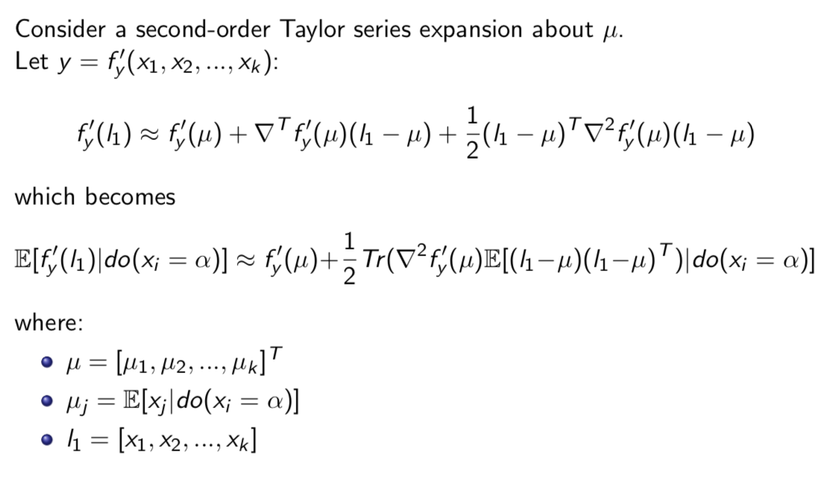
Implement
Notes:
In the rest of this presentation, I’m going to talk about following contents:

Slide 11
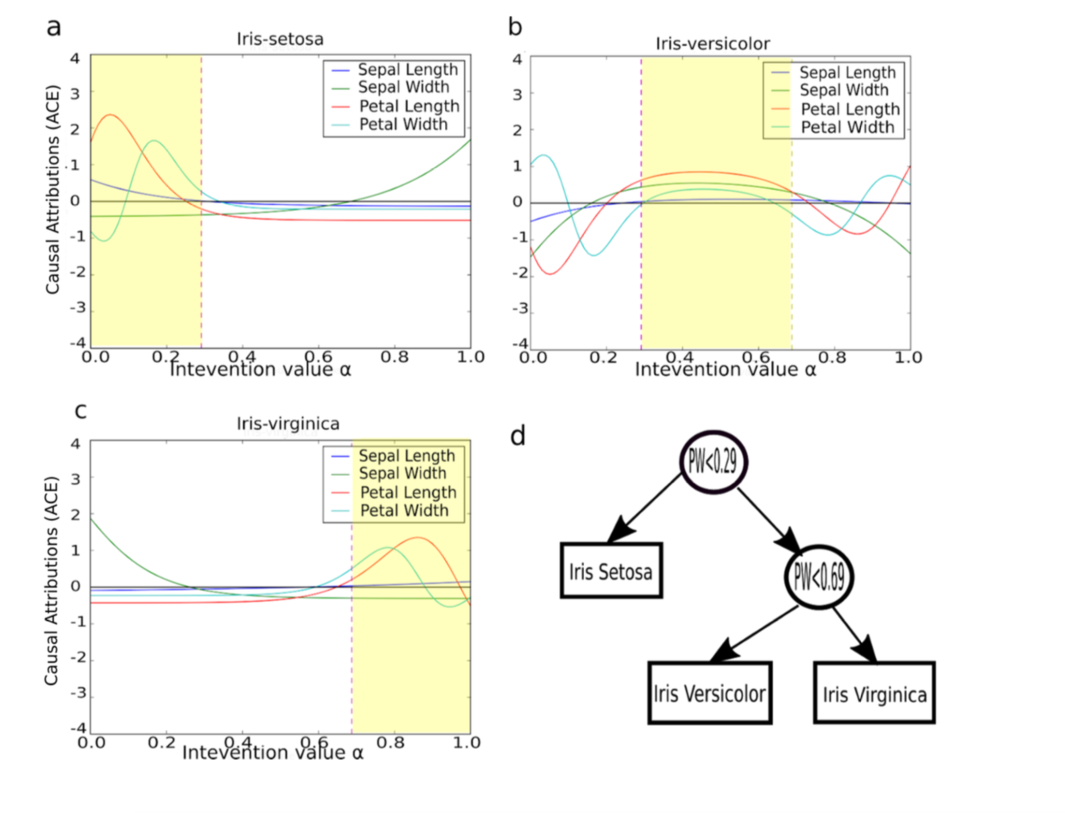
Experimental Results
3-layer CNN for Iris data classification (4 inputs + 3 outputs)
Notes:
In the rest of this presentation, I’m going to talk about following contents:

Slide 12
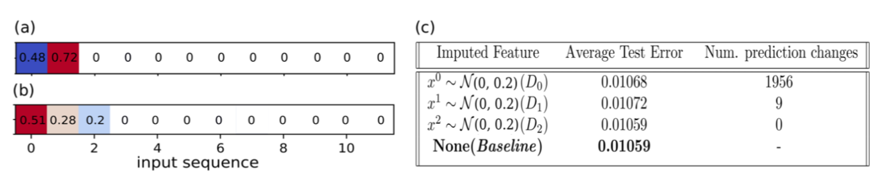
Experimental Analysis
Simulated Sequence data
Data generation: output depends on first 3 inputs, len(input) = [10, 15]
Model: GRU
Generated saliency maps
Manipulated first three inputs
Notes:
In the rest of this presentation, I’m going to talk about following contents:

Slide 13
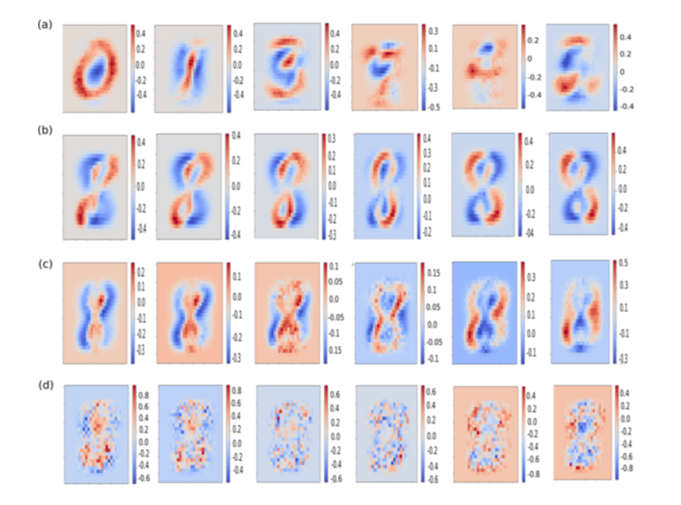
Experimental Analysis
MNIST with $β−VAE$ with 20 hidden dimensions, experiments on decoder.
first 10 on class, remaining on rotation, scale, etc.

Slide 14
Conclusion
View MLP as SCMs
Analyze the contribution of each input to the output
Scalability to high-dimensional data
Provide interpretability for neural networks

