Slide 1
Retrofitting Word Vectors to Semantic Lexicons
https://qdata.github.io/deep2Read/
Manaal Faruqui Jesse Dodge Sujay K. Jauhar Chris Dyer Eduard Hovy Noah A. Smith
Language Technologies Institute, CMU
Presentation by Jack Morris

Slide 2
Word embeddings
A system that maps words from a vocabulary to meaningful vectors
Data driven: trained on text
Popular word embeddings: word2vec, glove
Can be used for identifying relationships between pairs of words

Slide 3
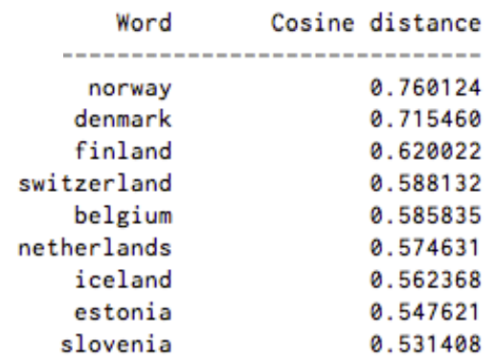
GloVe Demo
nearest_neighbors(‘sweden’)
Finding the nearest neighbors of sweden

Slide 4
Semantic lexicons
Human-written rules about vocabulary words and their relationships to one another
Contain synonyms, hypernyms, hyponyms, paraphrase relationships
Popular semantic lexicons: WordNet, FrameNet, Paraphrase Database

Slide 5
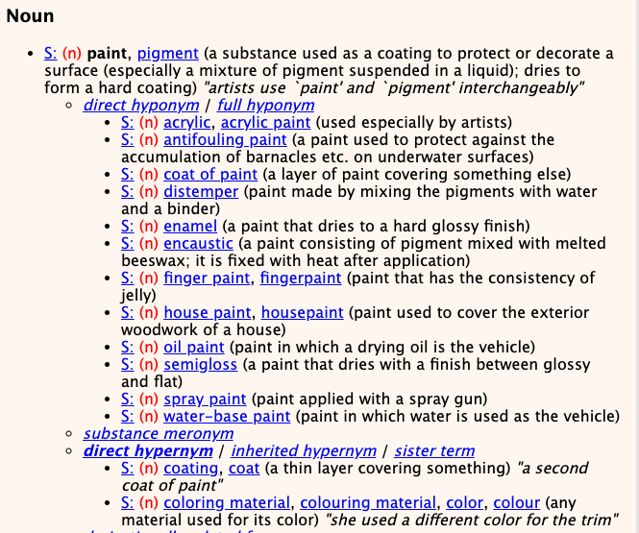
WordNet Demo
Finding hypernyms and hyponyms of paint

Slide 6
Problem: Improving word embeddings
Unsupervised learning of word embeddings is good, but has problems
Plus, we have databases of carefully arranged categorized information about our language (semantic lexicons)
How can we use our domain knowledge to improve word embeddings?

Slide 7
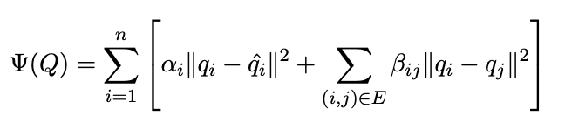
Solution
Idea: balance distance from original vector in embedding space with distance between word and its associations from semantic lexicon
Retrofitting Word Vectors to Semantic Lexicons
Can do this by minimizing:
Turns out, ψ is convex in Q, so we can solve it using gradient descent

Slide 8
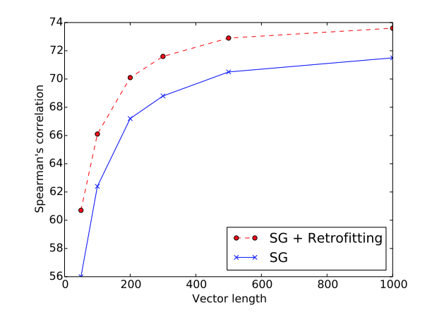
Retrofitting word vectors: Results
Retrofitted vectors outperform their original counterparts, as well as prior work that tried to incorporate information from semantic lexicons during training
The process is very fast -- takes 5 seconds for a graph of 100,000 words and vector length 300
Multilingual: this technique works on embeddings & lexicons from any language

Slide 9
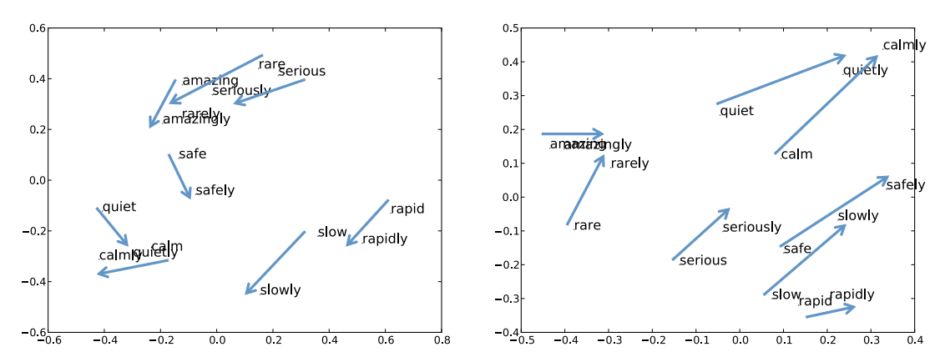
Retrofitting word vectors: Results
Modeling relationships: “adjective to adverb”
before
after

