Slide 1
On Evaluation of Adversarial Perturbations for Sequence-to-Sequence Models
Paul Michel, Xian Li, Graham Neubig, Juan Miguel Pino
Language Technologies Institute, Carnegie Mellon University
Facebook AI
Presentation by Jack Morris
https://qdata.github.io/deep2Read/

Slide 2
Background
Adversarial attacks for NLP are not well defined “In discrete spaces such as natural language sentences, the situation is problematic; even a flip of a single word or character is generally perceptible by a human reader. Thus, most of the mathematical framework in previous work is not directly applicable to discrete text data.”

Slide 3
Background
Adversarial attacks for NLP are not well defined “Moreover, there is no canonical distance metric for textual data like the `p norm in real-valued vector spaces such as images, and evaluating the level of semantic similarity between two sentences is a field of research of its own.”

Slide 4
This elicits a natural question: what does the term “adversarial perturbation” mean in the context of natural language processing?

Slide 5
Their proposal for NLP adversarial perturbations
“adversarial examples should be meaning-preserving on the source side, but meaning-destroying on the target side”
Idea: we should balance “meaning preserving” with “meaning destroying”
Basically: any meaning-preserving perturbation that results in the model output changing drastically highlights a fault of the model.

Slide 6
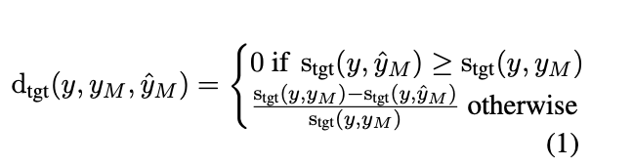
First, how can we compare similarity?
The “target relative score decrease”, calculated as a function of the original translation “meaning similarity” and the new translation
Then measure attacker success like this:
S := s_{src} + d_{tgt}
Success = (amount source meaning preserved) + (amount target meaning destroyed)
TLDR: incorporate meaning preservation into loss function

Slide 7
So now we know how to calculate similarity.
Human evaluation is the best way to evaluate similarity in NLP. However, using human evaluation for all samples is not time or cost effective.
There are different computable scores for sentence similarity, like BLEU and METEOR.
But which should we use?

Slide 8
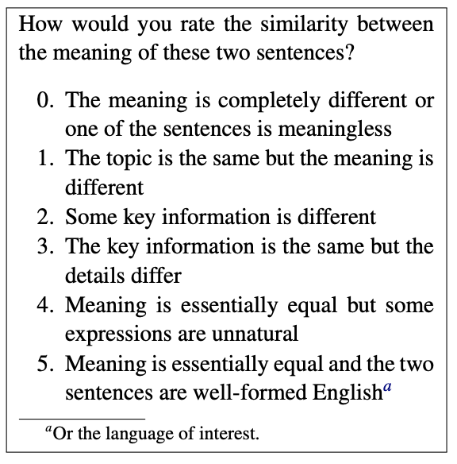
Idea
Give humans a quiz on meaning similarity.
Then, see which metric scores most similarly to human judgement.

Slide 9
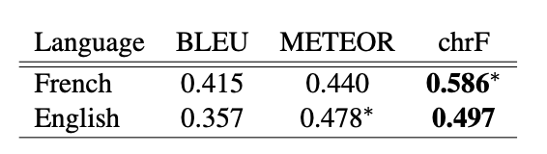
chrF is best
Researchers compared BLEU, METEOR, and chrF scores as they correlated with human judgement.
chrF won, and it wasn’t particularly close.

Slide 10
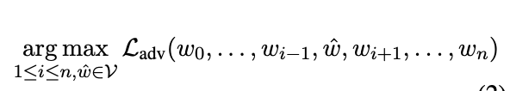
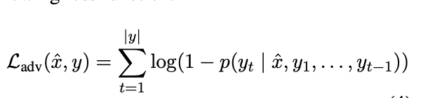
A general framework for adversarial attacks

Slide 11
A general framework for adversarial attacks
Three methods to test:
Brute force. Turns out that this isn’t as slow as you’d think. It’s O(n|V|) where n is the number of words in the sentence and V is the vocabulary size. Not too bad for calculating a single example.
K-Nearest-Neighbor. This is very similar to our work. They took the 10 closest words to each word in the embedding space and tried those.
CharSwap. Also similar to our work! Swap two characters in a word such that the new word is out-of-vocabulary. (If you cannot find such a word, repeat the last character until you have found one.)

Slide 12
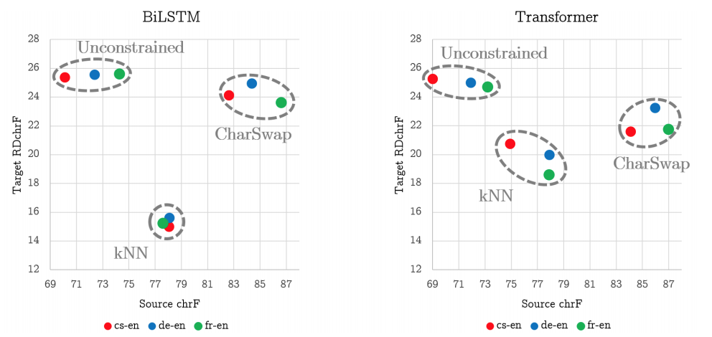
Results
Notes:
-RDchrf = Relative Decrease in
-Top right is best
-source chrF Highlights the Effect of Adding Constraints -- unconstrained has the worst source chrF
- high RDchrF of CharSwap for wordbased model is “yet another indication” of their known shortcomings when presented with words out of their training vocabulary
- interestingly, Transformer models appear to be less robust to small embedding perturbations (kNN attacks) compared to LSTM
- Char- Swap constraint is the only one that consistently produces attacks with > 1 average success

Slide 13

Bonus: Adversarial Training with Meaning-Preserving Attacks
Use adversarial loss function (Goodfellow, 2014):
Previous research (Ebrahimi, 2018) suggested that adversarial training improves robustness but hurts test performance
They tested using “unconstrained” adversarial examples, and with CharSwap
Both increased robustness. Unconstrained AEs did decrease performance on test set. But CharSwap test set performance increased!

