Slide 1

Shapley Value
Summary for A value for n-person games
Lloyd S. Shapley
Presenter: Zijie Pan
https://qdata.github.io/deep2Read/
2/28/2020

Slide 2
Motivation
Concept in Game Theory
To each cooperative game it assigns a unique distribution (among the players) of a total surplus generated by the coalition of all players
Notes:
The motivation of this project

Slide 3
Example:
A: Boss B: Engineer C and D are workers
only A： 0
A+B working together: Total monthly profit : $30k
A+B+C working together: Total monthly profit : $60k
A+B+C+D working together: Total monthly profit : $90k
A+C+D (no engineer) : 0
Question : How to distribute $90k fairly.
It seems like the marginal profit for each worker is $30k, they deserve more money
By Shapley (Based on contribution ): A:3.5 B:3.5 C:1 D:1

Slide 4
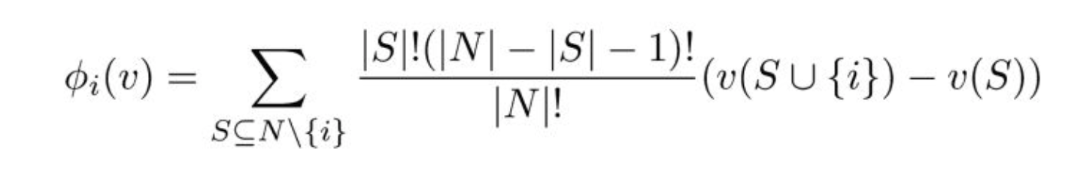
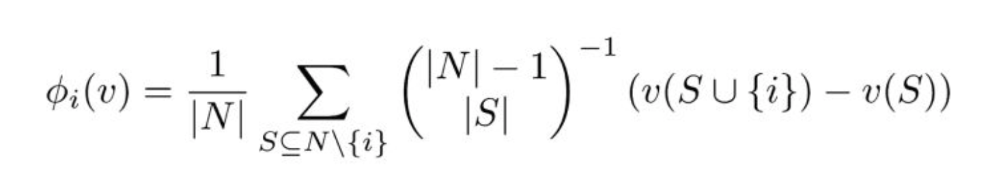

Shapley Value Formula:
is the shapley value for i, which quantify the contribution
v is game function, like v(A+B+C+D) = $90k (total value for the coalition)

Slide 5
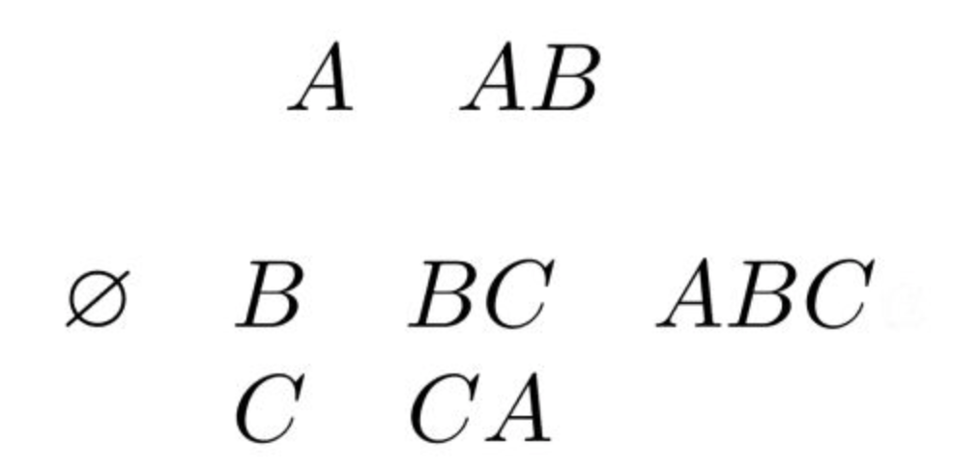
In previous example: N ={A,B,C,D}
Let’s focus on D, so i =D
S are the potential subsets that exclude D, and we need to sum and get average

Slide 6
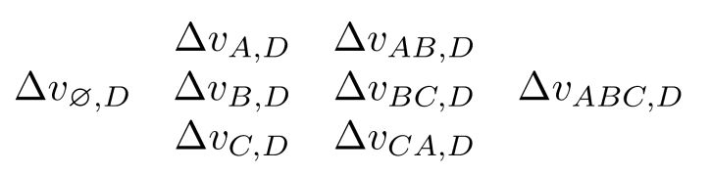
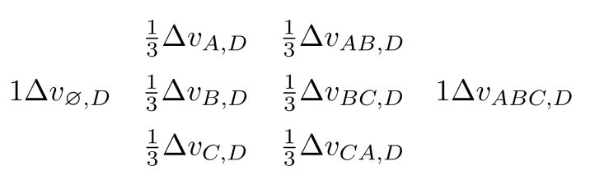
The change of value if we add i in:
1 ⅓ ⅓ 1
Notes:
The change of payout if we add i in for each subset, for example v(abcd)-v(abc)

Slide 7


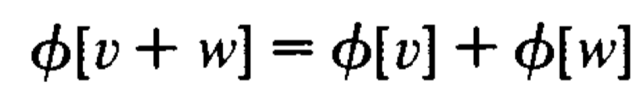
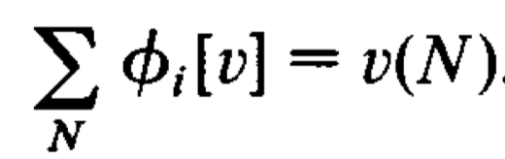
Axiom of Shapley:
- Symmetry :
For any v, if i and j are interchangeable, then they should receive the same payments or share the same contribution.
=
- Linearility
If the game can be separated into two parts, the payments can also be divided
- Efficiency or Completeness
Dummy player should receive 0 payments

Slide 8
Connect Shapley with Attribution
Shapley: Assign results based on individual contribution
Attribution: Quantify the feature importance to the result
Shapley -> additive feature attribution methods:
Satisfy: completeness, dummy, implementation invariance
Shapley is used in machine learning interpretability

Slide 9
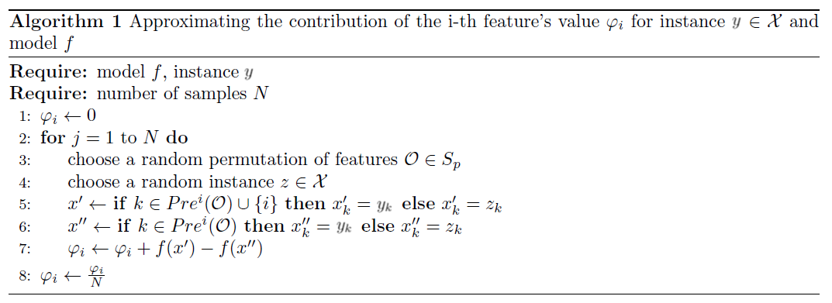
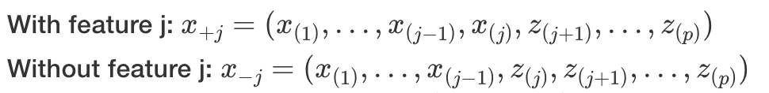
Using sampling to approximate Shapley estimation for single feature value

Slide 10
The Shapley value of a feature value is not the difference of the predicted value after removing the feature from the model training. The interpretation of the Shapley value is: Given the current set of feature values, the contribution of a feature value to the difference between the actual prediction and the mean prediction

Slide 11
Other Work
SHAP (SHapley Additive exPlanations), DeepSHAP(deeplift+shapley),KernelSHAP(LIME + shapley), TreeSHAP in A Unified Approach to Interpreting Model Predictions

