Slide 1

“Why Should I Trust You?”Explaining the Predictions of Any Classifier
M. T. Ribeiro, S. Singh, C. Guestrin
02/27/2020
Presenter: Yu Yang
https://qdata.github.io/deep2Read/

Slide 2
Introduction
Two problems:
How does one…
P1) Trust a prediction
Prediction of importance: medical diagnosis, terrorism attack
P2) Trust a model
Real-world data are often different from datasets
Metrics may not be indictive of the end goal
Solution:
Inspecting the prediction and explanation of sampled individual samples
Explanation for each sample (P1)
Multiple samples (P2)
Notes:
The motivation of this project

Slide 3
Introduction
Solution:
Inspecting the prediction and explanation of sampled individual samples
Explanation for each sample (P1)
Multiple samples (P2)
LIME:
provides explanation for individual samples (Solution to P1)
SP-LIME:
selects a set of representative instances with explanation
addresses ‘explanation of the model’ using explanations of the most representative samples (Solution to P2)
Comprehensive evaluation with…
Simulated User Subjects
Human Subjects
Notes:
The motivation of this project

Slide 4
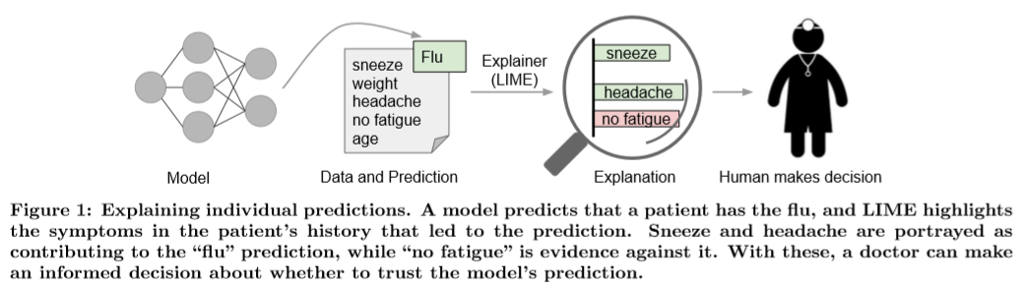
The Case for Explanations
When human make decisions with the help of predictions, trust is a fundamental concern.
A model can go wrong in several ways:
Data leakage
Dataset shift
Explanations can help us identify what went wrong and fix it fast.
Notes:
The motivation of this project

Slide 5
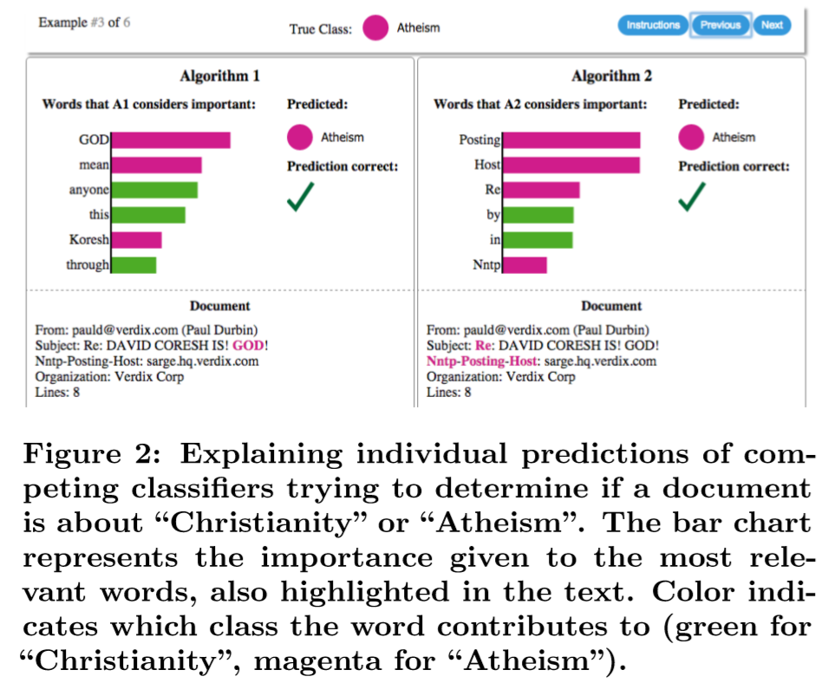
The Case for Explanations
Notes:
The motivation of this project

Slide 6
Proposed Solution
Desired Characteristics for Explainers:
Interpretable
Should be easy to understand by human
Local fidelity
Reflects how the model behaves in the vicinity of the instance being predicted
Model-agnostic
Providing global perspective
Accuracy may not be sufficient to explain a model
We want to explain the model, not just individual predictions.
Notes:
Here is our proposed solution.

Slide 7


3 LIME
LIME: Local Interpretable Model-Agnostic Explanations
Overall goal: identify an interpretable model over the interpretable representation that is locally faithful to the classiﬁer.
the original representation of an instance
A binary vector for its interpretable representation
Notes:
In the rest of this presentation, I’m going to talk about following contents:

Slide 8






Fidelity-Interpretability Trade-off
Definitions:
g is the explanation, G is a class of potentially interpretable models
A measure of complexity of explanation g
The model being explained
Proximity measure around the instance x (locality)
Measures how unfaithful g is in approximating f in the locality defined by
We want to minimize locally-aware loss:
Notes:
In the rest of this presentation, I’m going to talk about following contents:

Slide 9
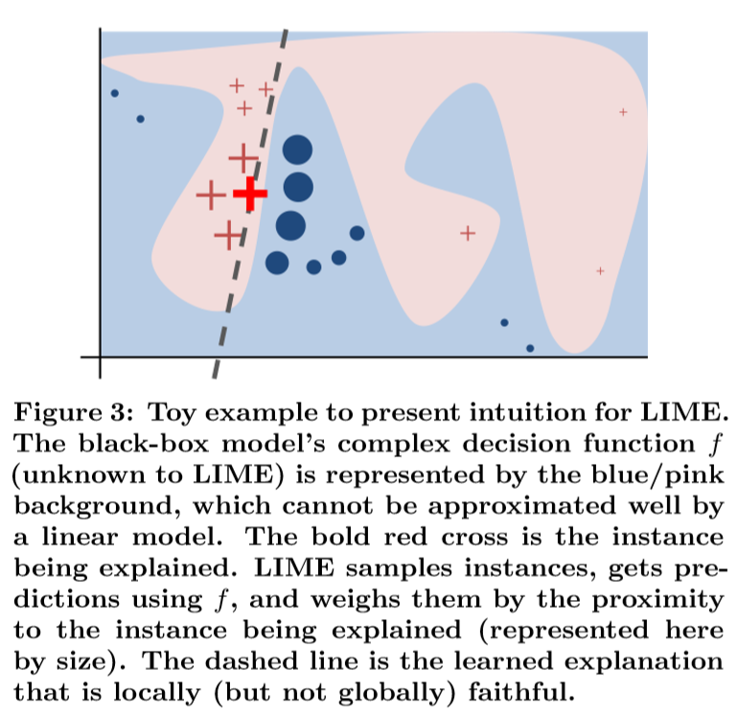

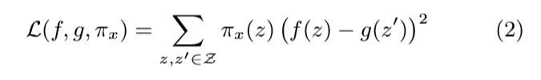
Sampling for Local Exploration
In order to learn the local behavior of f as the interpretable inputs vary, we approximate L(f,g,πx) by drawing samples, weighted by πx.
Notes:
In the rest of this presentation, I’m going to talk about following contents:

Slide 10
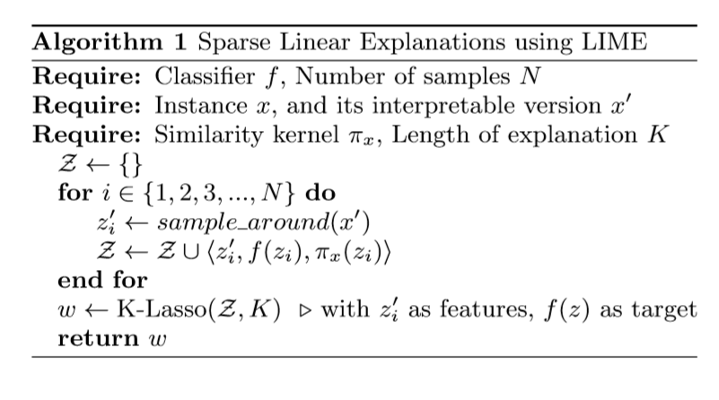
LIME Algorithm
In
Notes:
In the rest of this presentation, I’m going to talk about following contents:

Slide 11
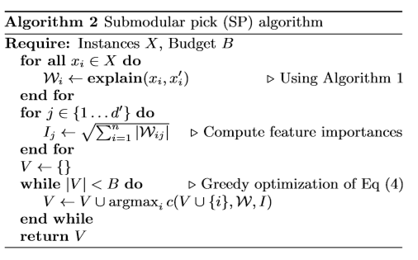
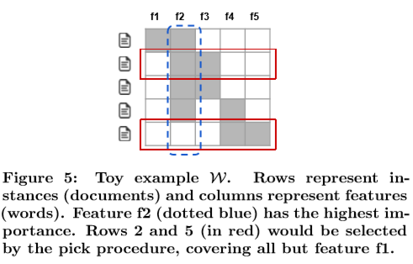
SP-LIME
Notes:
In the rest of this presentation, I’m going to talk about following contents:

Slide 12
5 - Simulated User Experiment
Experiment Set-up:
Two datasets: Books, DVDs (2000 samples each)
Different models:
Decision trees (DT)
Logistic regression with L2 regularization (LR)
Nearest neighbors (NN)
SVM with RBF kernels (SVM)
Random forest w/ 1000 trees (RF)
Feature: bag of words
Notes:
In the rest of this presentation, I’m going to talk about following contents:

Slide 13
5.1 – Experiment Set up
Methods to Compare:
LIME
parzen
Greedy procedure
Random procedure
Where there is a Pick procedure
Random pick (RP)
Submodular pick (SP)
Parameters:
K – # of features with highest absolute gradients
N – Cross validation
K = 10
N = 15000
Questions to ask:
5.2 Are explanation faithful to the model?
5.3 Should I trust this prediction?
5.4 Can I trust this model?
Notes:
In the rest of this presentation, I’m going to talk about following contents:

Slide 14
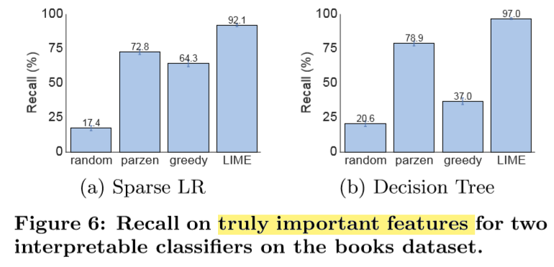
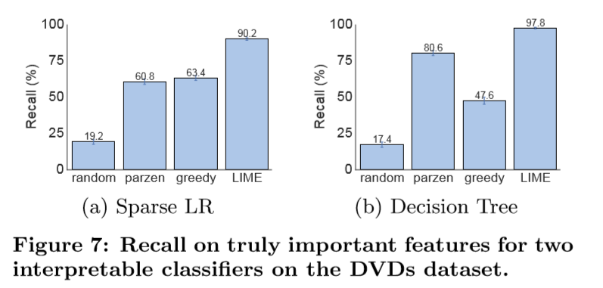
5.2 Are predictions faithful?
Measure faithfulness of explanation on classifiers that are interpretable:
Sparse logistic regression
Decision trees
Procedure:
Train both classifiers s.t. maximum number the model use is 10
Compute the fraction of “gold” features that are recovered by the explanation.
Report averaged recall over all the test instances (Fig.6. Books; Fig. 7. DVDs)
Notes:
In the rest of this presentation, I’m going to talk about following contents:

Slide 15
5.3 Should I trust this prediction?
Procedure:
Randomly select 25% of the features to be “untrustworthy”
Assumption:
Users can identify these “untrustworthy” features
Would not want to trust these features
Develop the oracle “trustworthiness” of a prediction
Untrustworthy if the prediction changes after removing all untrustworthy features
Trustworthy, otherwise.
Deem if a prediction is trustworthy or not
LIME or parzen:
untrustworthy if prediction from linear approximation changes after removing untrustworthy features from explanation
Greedy or random:
untrustworthy if any untrustworthy features show up in explanation
Report F1 on trustworthy predictions (averaged over 100 runs)
Notes:
In the rest of this presentation, I’m going to talk about following contents:

Slide 16
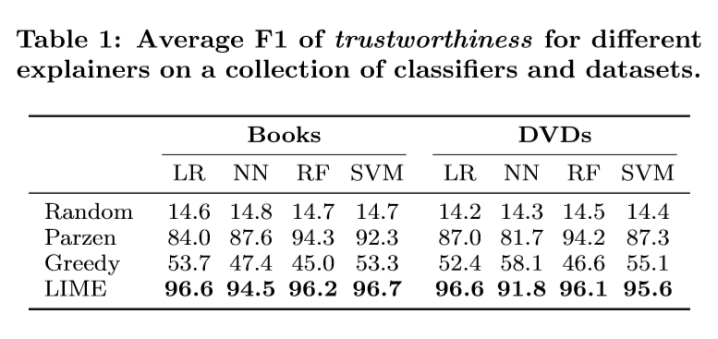
5.3 Should I trust this prediction?
Results
LIME dominates by p =0.01, on both dataset, on all models
Other methods achieved either
Low recall; or
Low precision
while LIME maintain high recall and precision.
Notes:
In the rest of this presentation, I’m going to talk about following contents:

Slide 17
5.4 Can I trust this model?
Goal:
to evaluate whether a user can identify the better classiﬁer based on the explanations of B instances from the validation set
Procedure:
Add 10 artificially “noisy” features
On training/validation (80/20) sets, each artiﬁcial feature appears in 10% of the examples in one class, and 20% of the other.
On test set, each artiﬁcial feature appears in 10% of the examples in each class.
Create pairs of competing classiﬁers by repeatedly training pairs of model
Random forest with 30 trees
Their validation accuracy is within 0.1% of each other
But their test accuracy diﬀers by at least 5%
Simulated user choose which predictions are untrustworthy
Untrustworthy if artificial features appear in explanation
Count # of trusted predictions
Notes:
In the rest of this presentation, I’m going to talk about following contents:

Slide 18
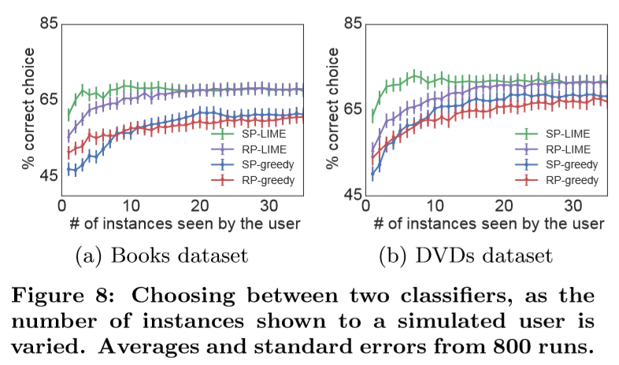
5.4 Can I trust this model?
Procedure (Continued):
Choose the model with fewer untrusted predictions
Compare if the choice is consistent with test set performance
Inconsistent if the chosen model performs worse on test set
Present Accuracy of picking correct classifier (avrg. over 800 runs) as B varies
Notes:
In the rest of this presentation, I’m going to talk about following contents:

Slide 19
6 Evaluation with Human Subjects
Goal: recreate three scenarios in machine learning that require trust and understanding of predictions and models
Three questions/situations:
6.2 Can users choose which of two classiﬁers generalizes better
6.3 Can users perform feature engineering to improve the model, based on the explanations
6.4 Are users able to identify and describe classiﬁer irregularities by looking at explanations

Slide 20
6.1 Set up
For first two questions
Data: 20 newsgroup
Task: distinguish “Christianity” and “Atheism”
Evaluation dataset:
A new religion dataset
Downloaded from DMOZ 819 websites in each class (Christianity, Atheism)
Model:
SVM with RBF kernel
Hyperparameters turned via cross-validation
Notes:
In the rest of this presentation, I’m going to talk about following contents:

Slide 21
6.2 Can users select the best classifier?
Goal: to evaluate whether explanations can help users decide which classiﬁer generalizes better.
Task: User decide between two classifiers:
SVM w. RBF trained on 20 newsgroup dataset
Accuracy on test set during train/test split: 94.00%
Accuracy on religion: 57.3%
Same classifier trained on a “cleaned” dataset (features that do not generalize well are removed)
Accuracy on test set during train/test split: 88.60%
Accuracy on religion: 69.0%
Human subjects:
Recruited on Amazon Mechanical Turk
(no ML experts, but with basic religion knowledge)
Notes:
In the rest of this presentation, I’m going to talk about following contents:

Slide 22
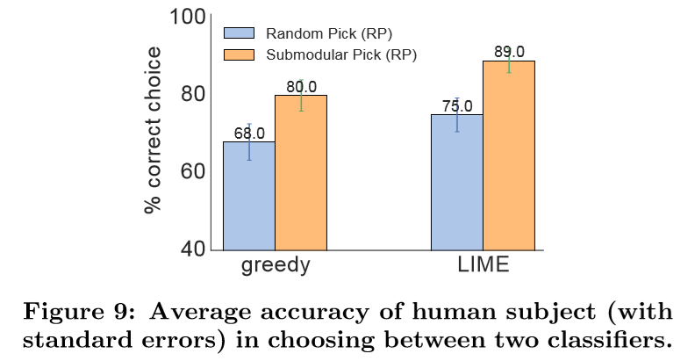
6.2 Can users select the best classifier?
Procedure:
Show B predictions, each with K explanations
B = 6, K = 6
Order of showing samples are randomized
Explanations are produced by greedy or LIME
Instances are selected by either RP or SP
Users examine samples
Users asked to select which
algorithm will perform better
in real world, and explain why
Notes:
In the rest of this presentation, I’m going to talk about following contents:

Slide 23
6.2 Can users select the best classifier?
Result:
All models good at identifying the better classifier
Explanations are useful in determining which to trust
SP performs better than RP
User’s reason for their selection:
If the model utilizes more
semantically meaningful words
Notes:
In the rest of this presentation, I’m going to talk about following contents:

Slide 24
6.3 Can non-expert improve a classifier?
Basis: removing features that the users feel do not generalize to improve generality.
Procedure (3 rounds):
(Round 1)
Show B predictions, each with K explanations
B = 10, K = 10
Explanation instances are produced by SP-LIME or RP-LIME
Users examine samples (10 users)
User marks words for deletion
No access to religion dataset
Train 10 classifiers for each subject (with their modification)
Notes:
In the rest of this presentation, I’m going to talk about following contents:

Slide 25
6.3 Can non-expert improve a classifier?
Procedure (Continued)
(Round 2)
Same set up
5 users examine each of the 10 new classifiers
Resulting in 50 classifiers in total
(Round 3)
Repeat Round 2
Resulting in 250 classifier
Report averaged accuracy on religion at each round for paths originating from the original 10 subjects (shaded line), and average across all path (solid line)
Notes:
In the rest of this presentation, I’m going to talk about following contents:

Slide 26
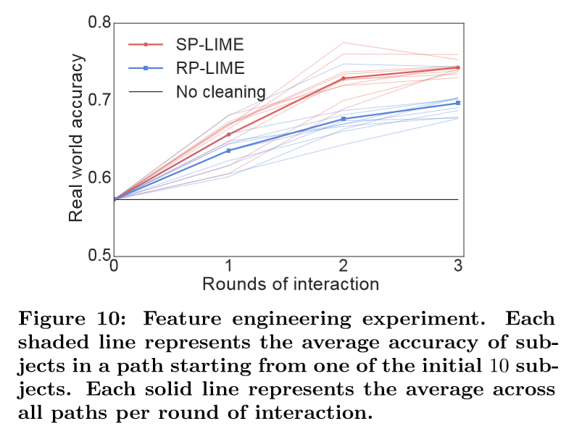
6.3 Can non-expert improve a classifier?
Procedure (Continued)
Report averaged accuracy on religion at each round for paths originating from the original 10 subjects (shaded line), and average across all path (solid line)
Results:
Non-experts can improve a classifier
SP performs better than RP
Explanations make it easy to improve untrustworthy model
Notes:
In the rest of this presentation, I’m going to talk about following contents:

Slide 27
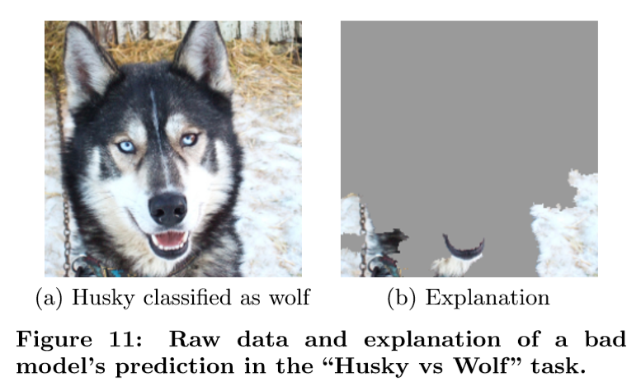
6.4 Do explanations provide insights?
Problem: undesirable correlations that the classiﬁers pick up during training are difficult to identify by looking at raw data and predictions.
Set up:
Dataset: photos of Wolves and Huskies (Eskimo Dogs)
Training set: 20 images (manually-selected)
All wolves pictures have snow in the back
All huskies pictures do not
Features: max-pooling layer of
Google’s Inception NN
Human subjects: graduate students
who have taken at least one graduate
machine learning course
Notes:
In the rest of this presentation, I’m going to talk about following contents:

Slide 28
6.4 Do explanations provide insights?
Procedure:
Present to user a balanced set of 10 test predictions w/o explanations
Where one wolf is not in snowy background and one husky is
Other 8 examples are classified correctly.
Ask the subject the following questions
Do they trust this algorithm to work well in the real world, (2)
why, and (3)
how do they think the algorithm is able to distinguish between these photos of wolves and huskies.
Show the subjects samples w/ explanations
Ask the same questions
Have 3 independent evaluator read the responses and determine if each subject mentioned snow, background, or equivalent as a feature the model may be using
Notes:
In the rest of this presentation, I’m going to talk about following contents:

Slide 29
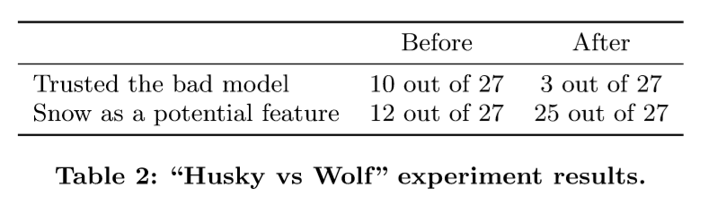
6.4 Do explanations provide insights?
Procedure (Continued):
Report the majority to decide whether the subject was correct about the insight
Results:
Changes number of subjects who noticed in snow pattern
Drop in trust in classifier
Demonstrates the utility of explaining individual predictions for getting insights into classiﬁers knowing when not to trust them and why.
Notes:
In the rest of this presentation, I’m going to talk about following contents:

Slide 30
Conclusion and Future Work
Conclusion & Summary:
Trust is crucial for eﬀective human interaction with machine learning systems
Explaining individual predictions is important in assessing
Proposing LIME for a modular and extensible approach to faithfully explain the predictions of any model in an interpretable manner.
Introducing SP-LIME for selecting representative and non-redundant predictions
Explanation are useful for trust-related tasks

Slide 31
Conclusion and Future Work
Future Work:
Did not mention ho to perform pick step for images
More exploration in domain and model agnosticism, and its application in speech, video and medical domains
Exploration in theoretical properties and computational optimizations

Slide 32
References
[1] S. Amershi, M. Chickering, S. M. Drucker, B. Lee, P. Simard, and J. Suh. Modeltracker: Redesigning performance analysis tools for machine learning. In Human Factors in Computing Systems (CHI), 2015.
[2] D. Baehrens, T. Schroeter, S. Harmeling, M. Kawanabe, K. Hansen, and K.-R. M¨uller. How to explain individual classiﬁcation decisions. Journal of Machine Learning Research, 11, 2010.
[3] A. Bansal, A. Farhadi, and D. Parikh. Towards transparent systems: Semantic characterization of failure modes. In European Conference on Computer Vision (ECCV), 2014.
[4] J. Blitzer, M. Dredze, and F. Pereira. Biographies, bollywood, boom-boxes and blenders: Domain adaptation for sentiment classiﬁcation. In Association for Computational Linguistics (ACL), 2007.
[5] J. Q. Candela, M. Sugiyama, A. Schwaighofer, and N. D. Lawrence. Dataset Shift in Machine Learning. MIT, 2009.
[6] R. Caruana, Y. Lou, J. Gehrke, P. Koch, M. Sturm, and N. Elhadad. Intelligible models for healthcare: Predicting pneumonia risk and hospital 30-day readmission. In Knowledge Discovery and Data Mining (KDD), 2015.
[7] M. W. Craven and J. W. Shavlik. Extracting tree-structured representations of trained networks. Neural information processing systems (NIPS), pages 24–30, 1996.

