Slide 1

INTERPRETATIONS ARE USEFUL: PENALIZING EXPLANATIONS TO ALIGN NEURAL NETWORKS WITH PRIOR KNOWLEDGE
By Laura Rieger, Chandan Singh, W.James Murdoch, Bin Yu
03/05/2020
Presenter: Zijie Pan
https://qdata.github.io/deep2Read/

Slide 2
Motivation
Explanation methods must provide both insights and suggest corresponding actions for a objective to be effective
Often, methods are able to provide insights but have no way to take actions.
- Ex. Models learned spurious correlations to achieve high accuracy
Explanation method uncover the relationships but is unable to alter the model.
Notes:
The motivation of this project

Slide 3

Background
Explanation Methods:
- Gradient based
- Decomposition based
Contextual decomposition(CD):
For a given DNN f(x), outputs can be represented as a SoftMax on composition of logits functions
and CD algorithm decomposes the logits g(x) into a sum of two terms. β captures the self-contribution while γ captures the interaction contributions

Slide 4
Claim / Target Task
Using CD as the explanation functions
Augment the prediction loss and explanation loss to make model learn correct predictions as well as correct explanations.
propose contextual decomposition explanation penalization (CDEP), which penalizes the CD scores of features that a user does not want the model to learn to be important
Notes:
Here, we make the claim of this project.

Slide 5
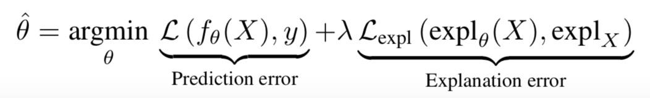
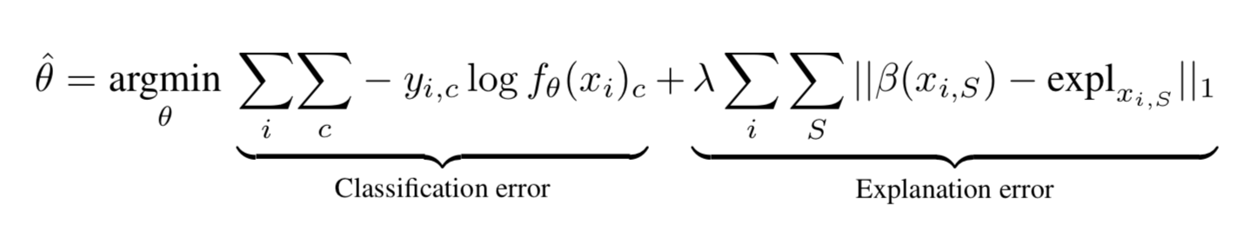
Proposed Solution
Objective function:
Notes:
The objective function is minimizing sum up the prediction loss and the explanation loss and find the corresponding parameter. I actually have some question for this formula. This paper said user-provided label for explX, I’m kind confused how this implement. Label each pixel? Also the beta here, Is this same as the beta in CD, if yes, which means we only consider self-contribution for CD score

Slide 6
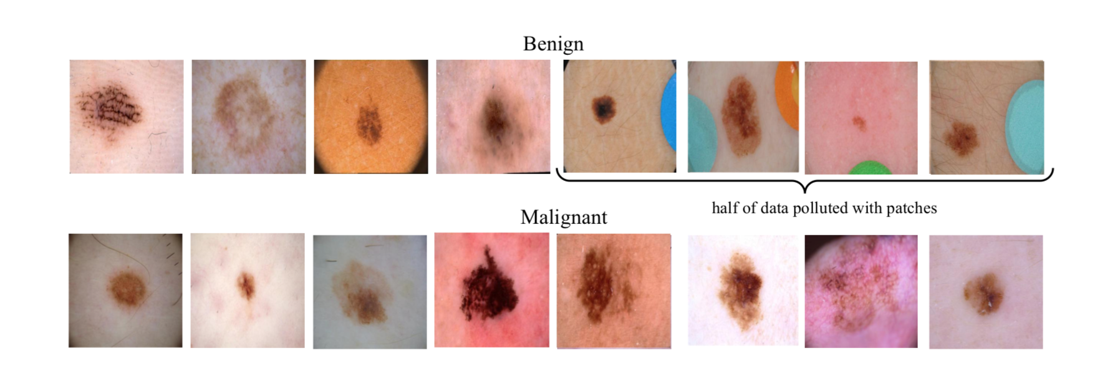
Data Summary
Ignore spurious feature (data bias):
Cancer images from ISIC (International Skin Imaging Collaboration):
Half benign images contains colorful patches, but none in the malignant images.
21,654 images (19,372 benign)

Slide 7
Model Architecture
VGG16 architecture pre-trained on the ImageNet Classification task
Freeze the weights of early layers so that only the fully connected layers are trained

Slide 8
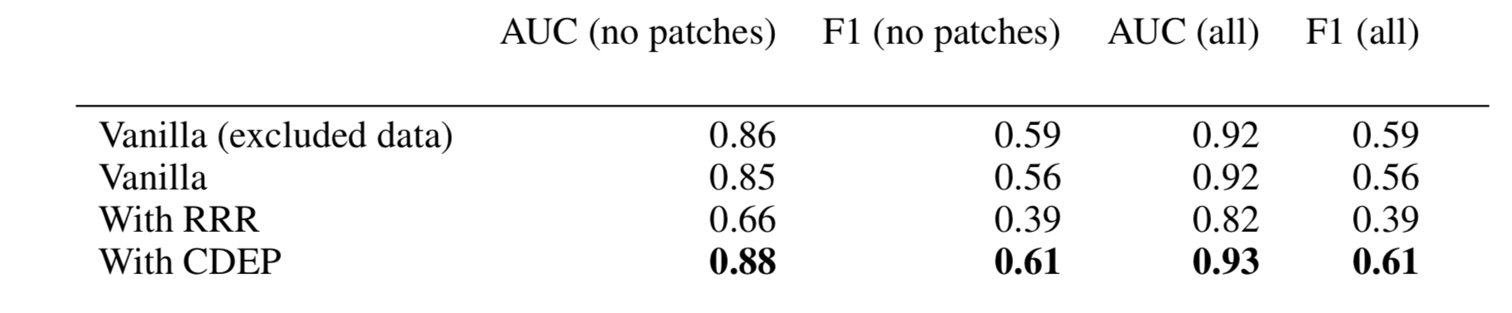
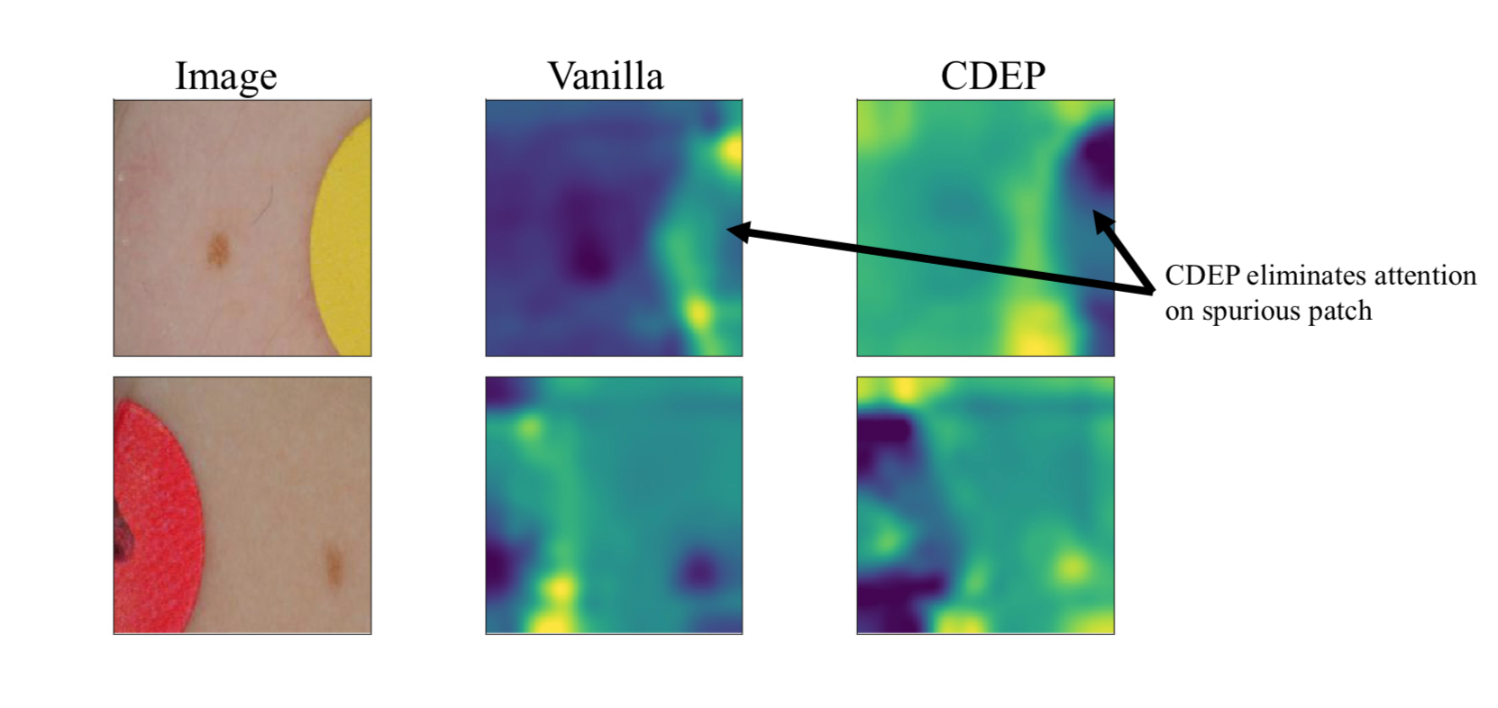
Experimental Results
Notes:
In the rest of this presentation, I’m going to talk about following contents:

Slide 9
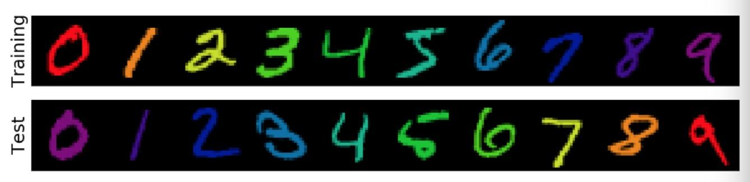
Experiment 2
Colored MNIST:
Training: assign each class a distinct color
Testing: each class will have a different color compared with training
Notes:
Add extra spurious features that entangled with current features. without regualization, model will learn this fake correlations and result nearly 0 prediction accuracy. CDEP increase performance lot

Slide 10
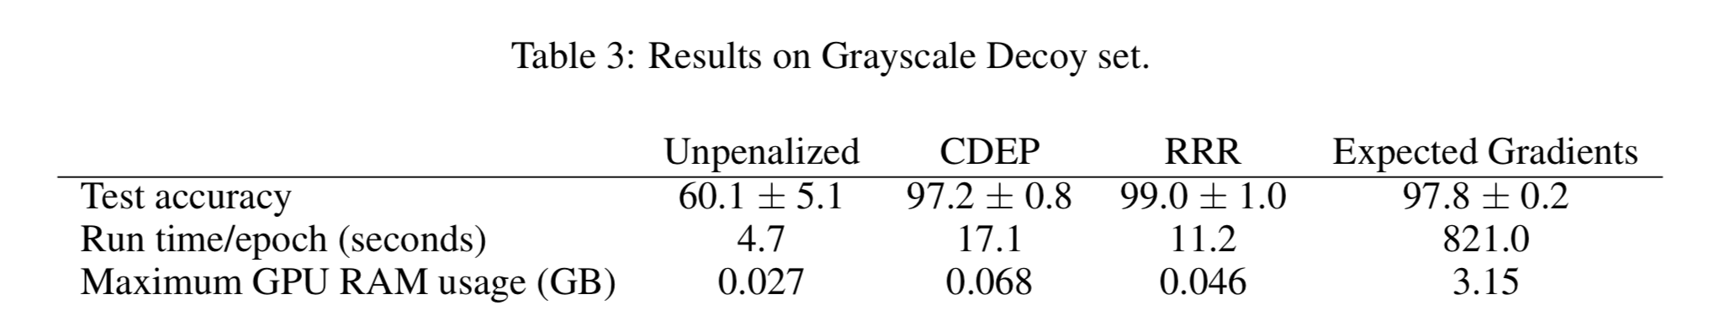
Experiment 3
Decoy MNIST:
DecoyMNIST adds a class-indicative gray patch to a random corner of the image
spurious features are not entangled with any other feature and are always at the same
location
Notes:
In the rest of this presentation, I’m going to talk about following contents:

Slide 11
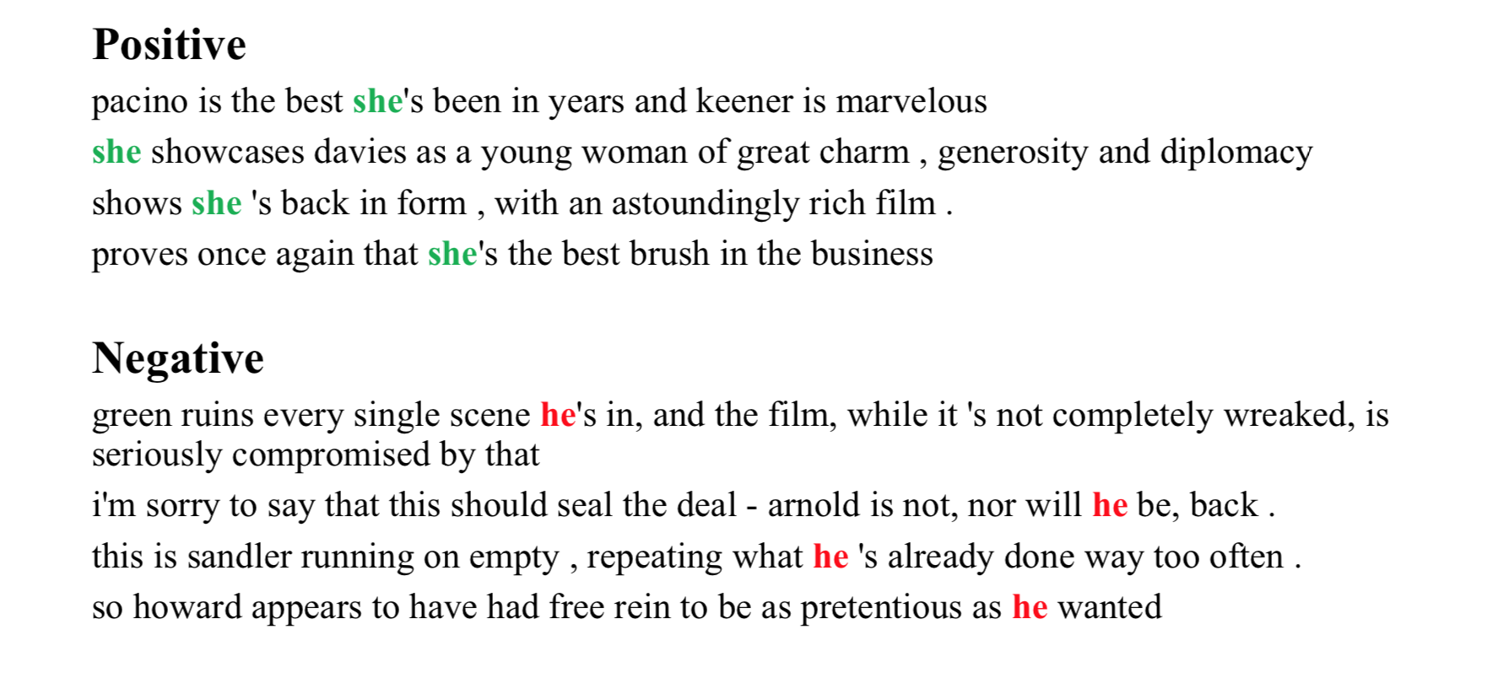
Experiment 4
SST dataset with spurious signals:
Injecting indicator words to each class at random positions.
Notes:
experiment for is SST positive and negative classification. For each class, we inject target word at random positon. Essentially, they replace a/the for positive/negative classes

Slide 12
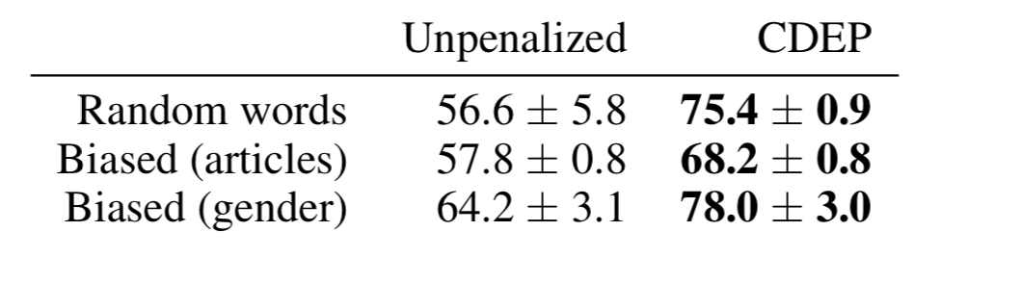
Results
Experiments above only compared the training results of unpenalized model and CDEP model. It is better to show the results on unpolluted data to have concrete evidence (to show unpenalized model performance actually drops )

Slide 13
Conclusion and Future Work
CDEP can penalize complex features and feature interactions.
CDEP is more computationally efficient than previous work and does not rely on backpropagation, enabling its use with more complex neural networks.
CDEP can be used to remove bias and improve predictive accuracy on a variety of toy and real data.

