Slide 1
https://qdata.github.io/deep2Read/
Attention is All You Need
Vaswani et al.
2017
Presented by Eli Lifland, 2/23/2020

Slide 2
Background
CNN-based methods popular
Difficult to learn dependencies between distant positions
RNNs SOTA: LSTMs, Gated RNNs
Generate sequence of hidden states h_{t} as function of h_{t-1}, input at position t
Sequential nature doesn’t allow for parallelization within training examples
Encoder-decoder architectures
Attention allows modeling of dependencies without regard to distance between positions
Before: used with RNNs
But attention is all you need! Transformers use no RNNs or convolution
Notes:
The motivation of this project

Slide 3
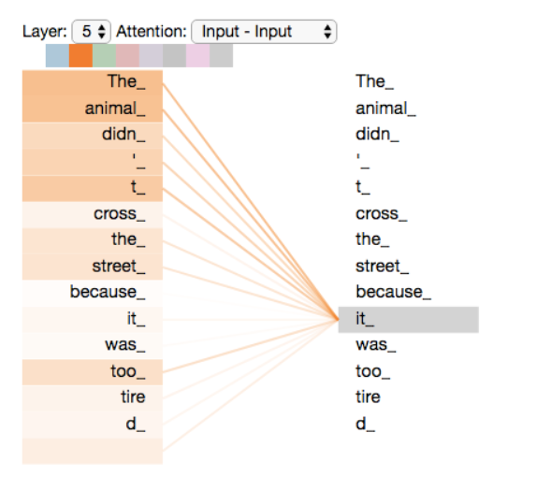
Attention: General Idea

Slide 4
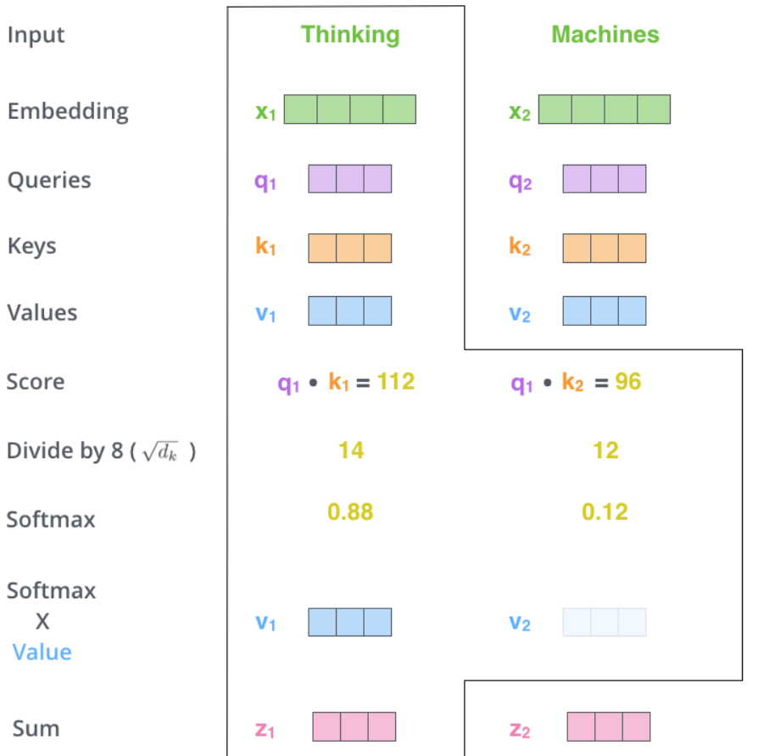
Attention: Scaled Dot-Product

Slide 5
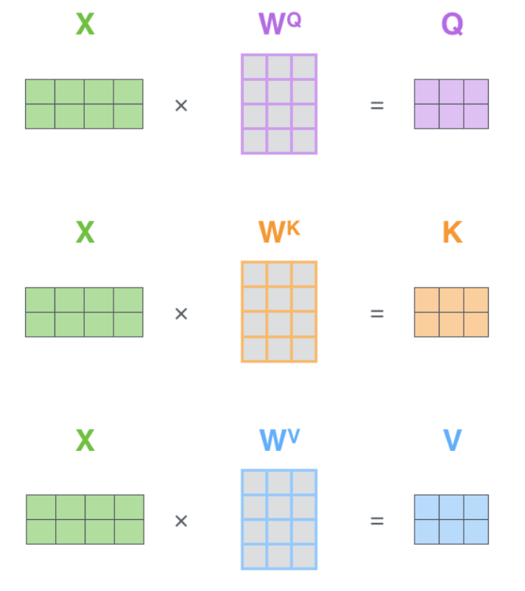
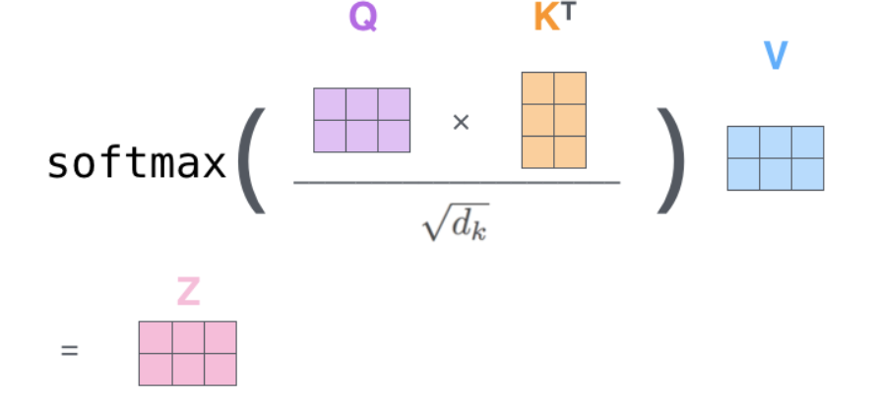
Attention: Matrix Operations

Slide 6
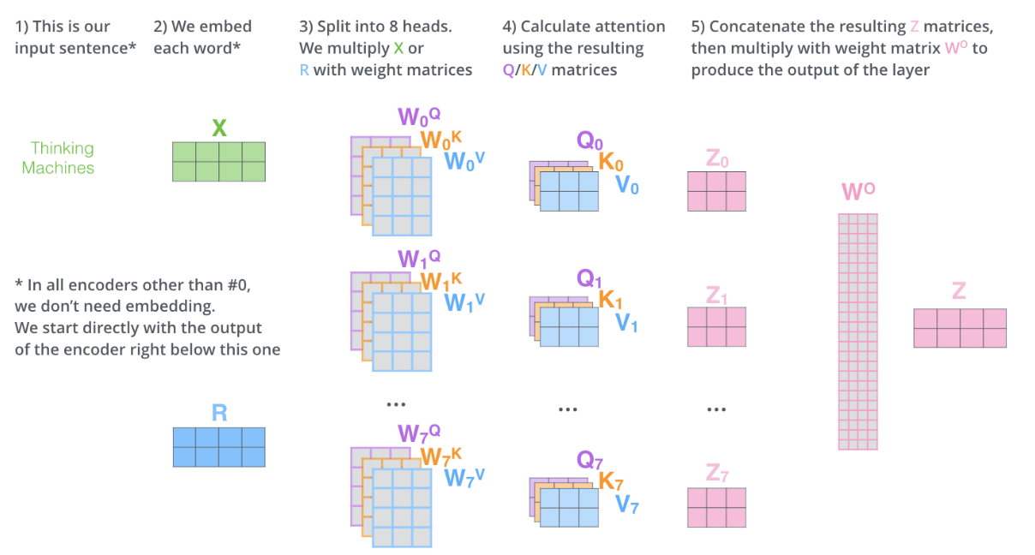
Attention: Multi-Head

Slide 7
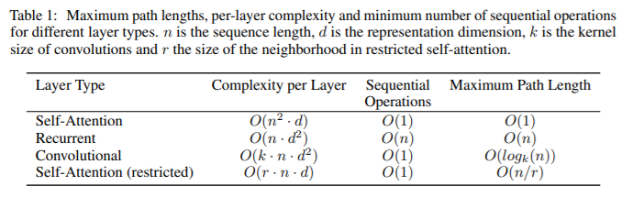
Why Attention?
Low computational complexity per layer
High level of parallelizability (low number of sequential operations required)
Low path length between long-range dependencies
Easier to learn long-range dependencies even though in principle possible with RNNs, CNNs

Slide 8
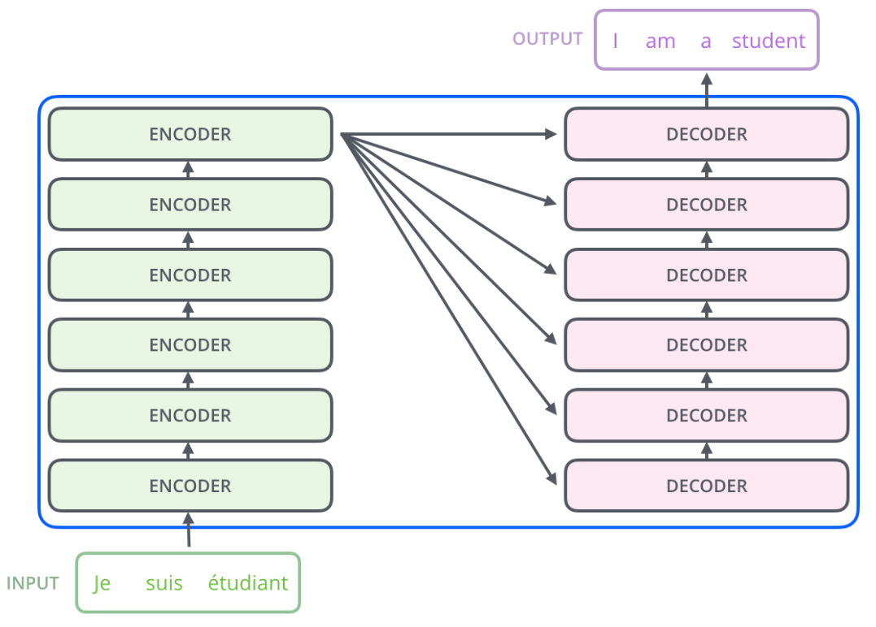
Transformer Architecture: Encoder-Decoder Structure

Slide 9
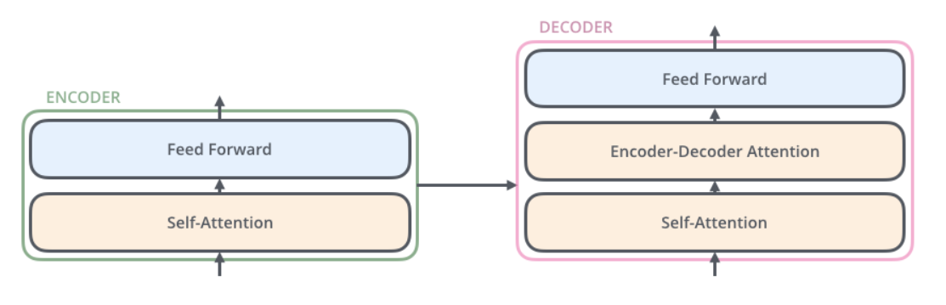
Transformer Architecture: Architecture of Encoders, Decoders
Modify self-attention layers in decoder to prevent positions from attending to subsequent positions (masking)
This unidirectionality later removed for BERT

Slide 10
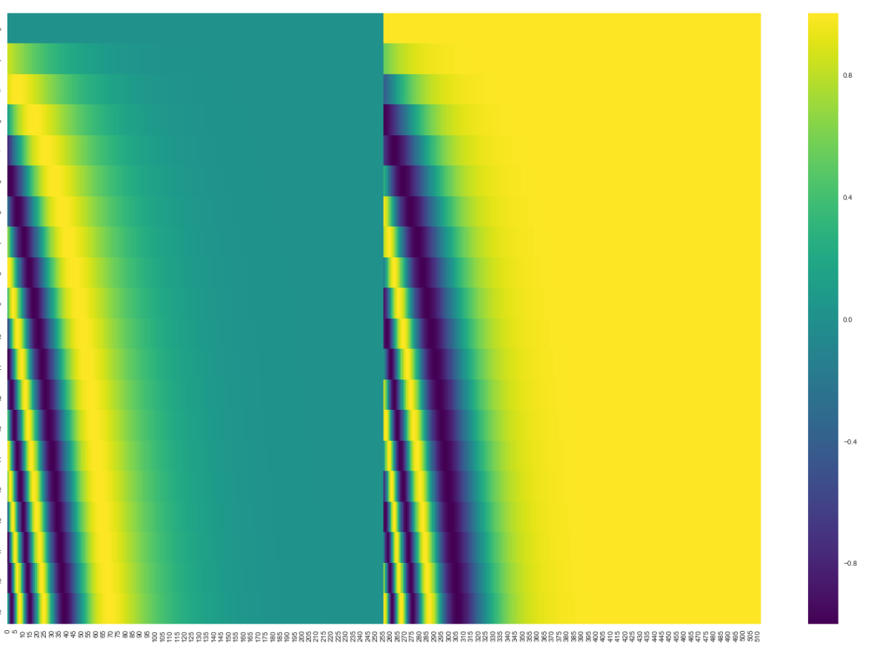

Transformer Architecture: Positional Encoding

Slide 11
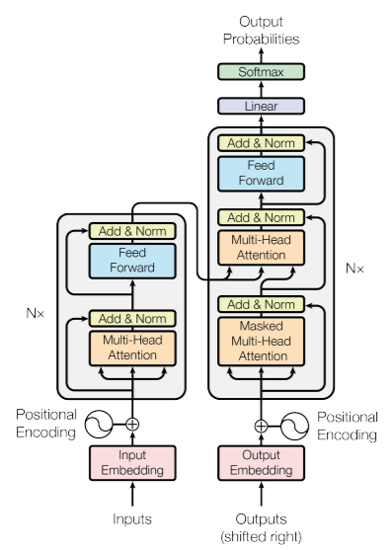
Transformer Architecture: Full

Slide 12
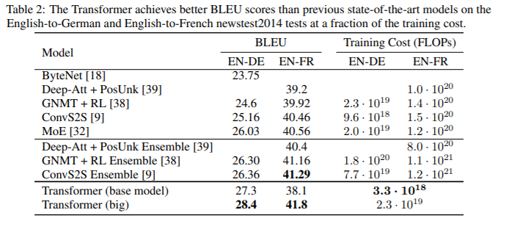
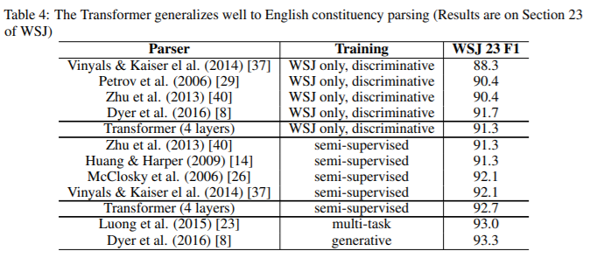
Results

Slide 13
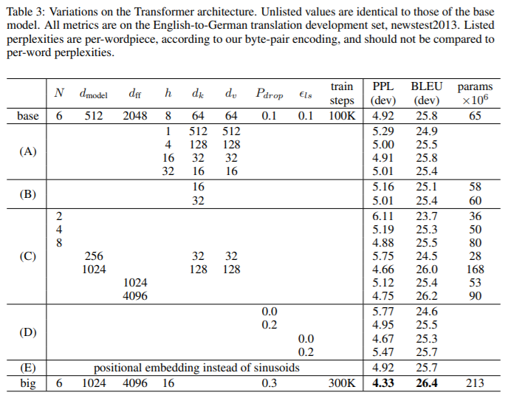
Results: Ablation

