Slide 1
https://qdata.github.io/deep2Read/
Parsimonious Black-Box Adversarial Attacks Via Efficient Combinatorial Optimization
Seungyong Moon, Gaon An, Hyun Oh Song
ICML 2019
Presented by Eli Lifland, 8/30/2019

Slide 2
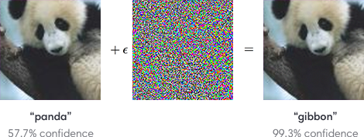
Adversarial Perturbations
Notes:
The motivation of this project

Slide 3
White vs Black Box Attacks
White Box: access to parameters and therefore gradient
Fast Gradient Sign Method (FGSM): perturb in direction of gradient
Projected Gradient Descent (PGD): multiple iterations of FGSM
Black Box: only query access
Substitute networks: train a network to match predictions of target network
Gradient estimation: directly estimate gradient via queries
Outperforms substitute networks

Slide 4
Motivation
Focus on black-box, which is more realistic in practice
Problems with current black-box methods
Substitute network attacks don’t always transfer to target networks
Robustness of gradient estimation affected by choice of hyperparameters
E.g. learning rate, decay rates, update rule

Slide 5

Problem formulation
Create imperceptible perturbations x_{adv} under L∞ radius with limited query budget to maximize loss
Attacker only has access to loss function, l(x,y)

Slide 6

FGSM Approximation
Where the ≤ is element-wise inequality and 1 is a vector of ones
Optimal solution will be obtained at extreme point of feasible set, or a vertex of the L∞ ball
PGD on Cifar-10 does give solutions close to vertices of L∞ ball

Slide 7
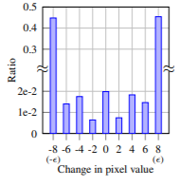
PGD Pixel-level Perturbations

Slide 8

Discrete formulation
Only consider pixel perturbations of +/- ϵ
f(x) = l(x,y_{gt}) for untargeted attacks, -l(x,y_{target}) for targeted attacks
Set maximization problem in which we choose from all pixels V a set S with +ϵ perturbations, with the rest having -ϵ perturbations

Slide 9
Submodularity
Define F(S U {e}) - F(S) as the marginal gain from adding pixel e to S
Submodularity implies that this marginal gain will be smaller when S has more elements
“Diminishing returns”
This is not completely true but algorithm assumes it is approximately true to cut save queries

Slide 10
Lazy Greedy Insertion
First, query marginal gain for all elements not in S, and insert these elements into a max heap
this is treated as an upper bound because of submodularity
While the heap isn’t empty:
Pop the top element, update its upper bound
If it’s greater than the new top element
If it’s > 0, add it to S
else, end
If it’s less than the new top element
Add it back to the heap

Slide 11
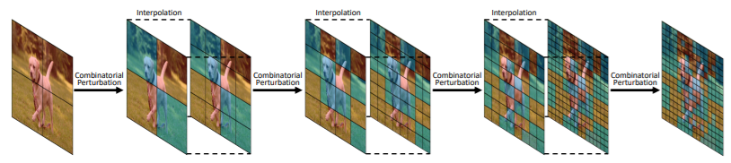
Implementation
Exploit locally regular structure to do hierarchical evaluation
At each level, do one iteration of lazy insertion then lazy deletion
Terminate when converges or query limit reached

Slide 12

Diminishing gains
Submodular set functions are set functions who exhibit diminishing returns
Basically: as the size of the input set increases, the value that a single element adds decreases

Slide 13
Our problem: approximate submodularity
As it turns out, our problem is not technically submodular
However, as long as submodularity is not “severely deteriorated” (Zhou & Spanos, 2016), submodular maximization algorithms still work very well
This means that we can compute an approximately optimal solution with a greedy algorithm!

Slide 14
Local-search optimization
Notation
P is all pixels,
S is pixels to add +ε to
P\S are pixels to add -ε
Basically, we can greedily choose to insert a pixel into S if the marginal gain is strictly positive, and remove it from S if the marginal gain is strictly negative
Then once the algorithm converges, it will converge to a local optimum
End up with a set of pixels S to perturb the input image with +ε, and P\S to perturb with -ε

Slide 15
Speedup #1: Acceleration with lazy evaluations
At each step we have to find the element that maximizes the marginal gain
Therefore, our greedy algorithm has to make O(|P| |S|) queries
This may be impractical for query-limited black-box attacks
Speed this up: use the Lazy-Greedy algorithm (Minoux, 1978)
Instead of re-computing the marginal gain for each pixel at each iteration, keep the upper bounds on the marginal gains in a max-heap
Theoretically has the same worst-case number of function evaluations but provides a speedup of several orders of magnitude in practice!
Why? Because of submodularity! (wow)

Slide 16
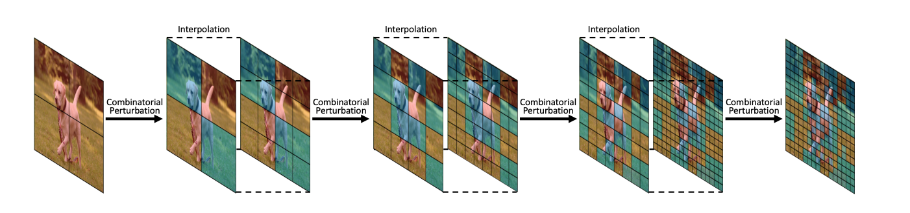
Speedup #2:
Hierarchical lazy evaluation
Exploit the locally regular structure of most images and do this on a hierarchical scale for another speed boost
Blue squares are in S, red squares are in P\S

Slide 17
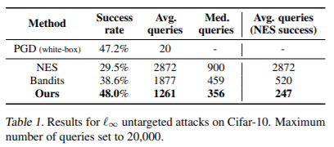
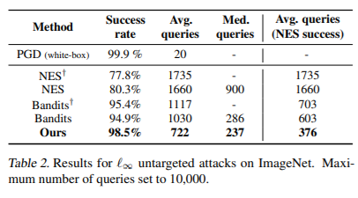
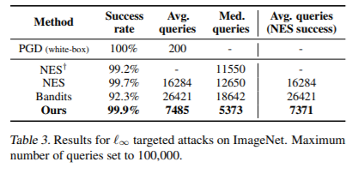
Experimental Results
Notes:
In the rest of this presentation, I’m going to talk about following contents:

Slide 18
Conclusion
Practical method for black-box adversarial attacks
No gradient estimation required
No update hyperparameters
State of the art success and query rates for both targeted and untargeted attacks

