Slide 1

Robust Attribution Regularization
By Jiefeng Chen Xi Wu Vaibhav Rastogi Yingyu Liang Somesh Jha
02/14/2019
Presenter: Zijie Pan
https://qdata.github.io/deep2Read/

Slide 2
Motivation
Deep Learning is treated as black box, which is too much to understand or interpret
Robust attribution plays important fundamental role for humans in classification tasks, but only recently, draw attentions to ML area
Lack of attention makes DL vulnerable to adversarial examples:
Brittle predictions: model robustness
Brittle attributions: Explanation robustness
Notes:
The motivation of this project

Slide 3
Proposed Solution
Add robust attribution regularization term in training
RAR aims to regularize the training so the resulting model will have robust attributions that are not substantially changed under minimal input perturbations.
Notes:
Here is our proposed solution.

Slide 4

Preliminary Concept
- Attribution:
Compare the DNN output F(x) to what its output would have been if the input feature were xi were not active (replace by some information-less baseline value bi)
Formula：

Slide 5
Preliminary Concept
- Axiom of Attribution:
Completeness or Additivity: Sum of feature attribution equals to F(x)
Sensitivity: For non-zero feature and F(x)≠0,attribution of that feature is not zero
Implementation Variance: When two neural network compute the same mathematical function, regardless how differently they are implemented, the attributions for all features should be the same

Slide 6
Preliminary Concept
- Axiom of Attribution Cont.:
Linearity: compose two NN,H = aF+bG, indicates attributions are the weighted sum
Symmetry-Preserving: For any input x where the values for two symmetric features (interchange them does not change the function mathematically) are the same, the attributions should be the same.
Symmetric features Ex: F(x) = min(1,x1+x2)

Slide 7
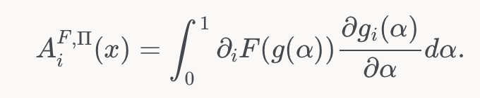
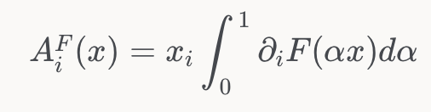
Related Work
Based on proof from economic side knowledge(Friedman, Eric J et al..):
Path Integrated Gradient method to calculate attribution satisfies all axioms except last one.
Path function: x=g(α). Infinite number of possible paths available
The attribution of the feature at dimension i can be calculated as:
Paper by Sundararajan et. al states that attribution using the Integrated Gradient along the straight line from the origin to x is the unique Path Method that also satisfies the last axiom.
uniformly scaling: gi(α) = αxi, so the derivative term equals xi and the function simplifies to:
The paper uses the general formulation

Slide 8
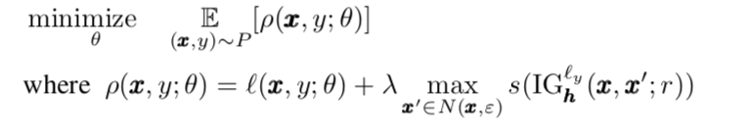
Claim / Target Task
Using IG method to quantify attributions
Robust Attribution Regularization:
P : data distribution
θ: Model parameter set
λ：regularization parameter
x: input
x’: perturbed input
IG:Give the attribution of features respect to the changes of loss value (apply to intermediate layer h)
s: size function
Notes:
Here, we make the claim of this project.

Slide 9

Formula Insight
RAR gives principled generalizations of objective designed for robust predictions in both uncertainty set model and distributional robustness model
Uncertainty set model:
(Madry et al) λ =1 and size function is Sum() and L∞-Norm bounded perturbation
ρ(x,y;θ) =
Input gradient regularization
Regularization by attribution of the loss output:
Distributional Robustness Model
Wasserstein prediction robustness
Notes:
Here, we make the claim of this project.

Slide 10
Formula Insight Cont.
for 1-layer neural networks, RAR naturally degenerates to max-margin training.
Notes:
Here, we make the claim of this project.

Slide 11


Implementation
IG-NORM: Size function is L1-Norm
IG-SUM-NORM: s(·) = sum(·) + β*L1-Norm(·)
SGD Training
Attack: PDG attack
Notes:
In the rest of this presentation, I’m going to talk about following contents:

Slide 12
Data Summary
MNIST, Fashion-MNIST, GTSRB, Flower
Evaluation: Accuracy+Kendall’s tau rank order correlation+Top-k intersection
Notes:
In the rest of this presentation, I’m going to talk about following contents:

Slide 13
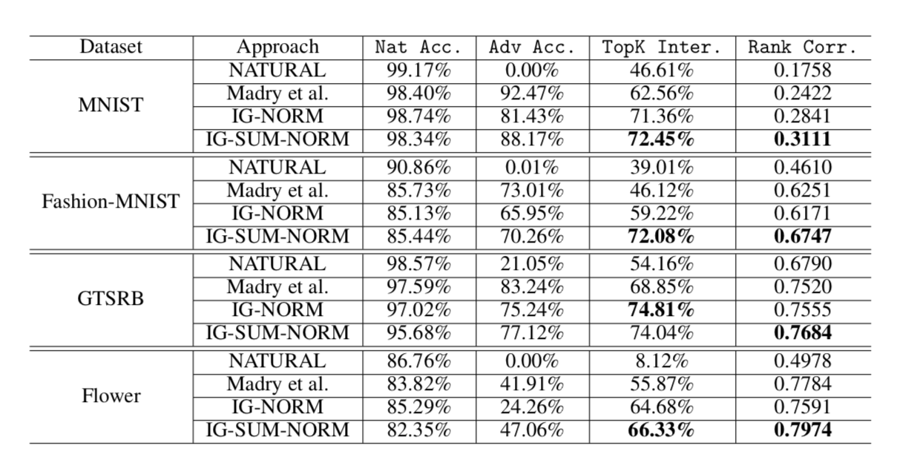
Experimental Results
Notes:
In the rest of this presentation, I’m going to talk about following contents:

Slide 14
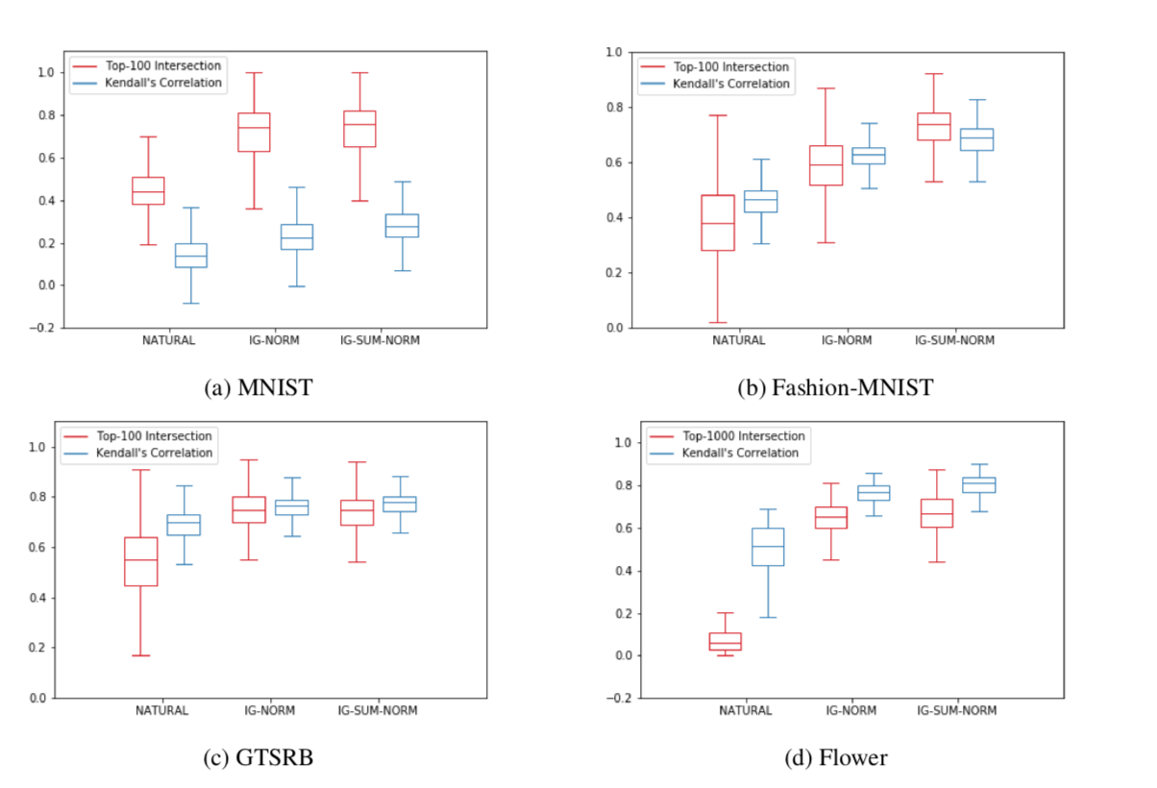
Experimental Results
Compared with naturally trained model, RAR only sacrifice small drops on testing accuracy. (Right thing to do, not learning spurious relationships)
But gives robust predictions and robust attribution
Notes:
In the rest of this presentation, I’m going to talk about following contents:

Slide 15
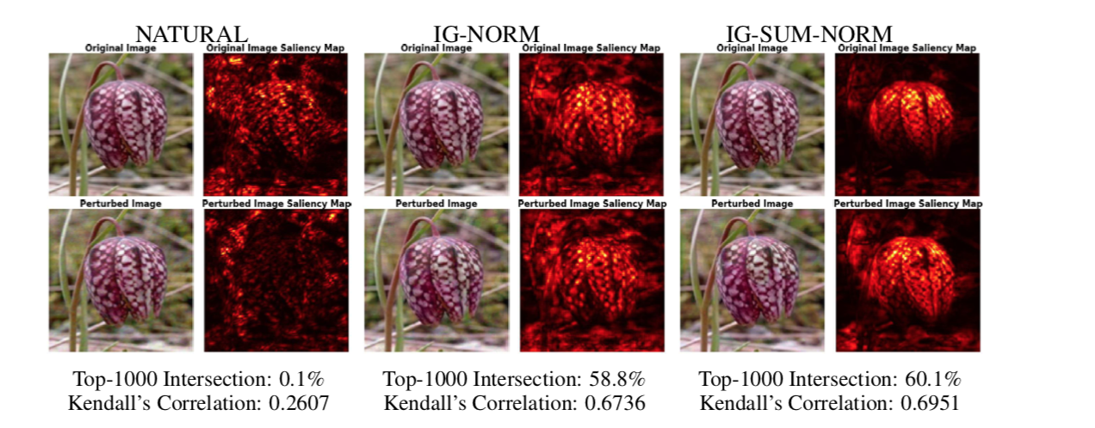
Experimental Results
Very Interesting: RAR leads to much human aligned attributions
We can explicitly see the highlighted attributions are flower-shaped.
Notes:
In the rest of this presentation, I’m going to talk about following contents:

Slide 16
Project Idea
Model to learn robust attributions and connect to explainable model.
Using robust attribution training as feature extractions and feed into looks like model

