Slide 1

This Looks Like That: Deep Learning for Interpretable Image Recognition
02/07/2020
Presenter: Zijie Pan
https://qdata.github.io/deep2Read/

Slide 2
Motivation
How human classify images? : We would focus on parts of the image and compare them with prototypical parts of images from a given class.
Apply this decision making to neural network classification so that the model is interpretable
Notes:
The motivation of this project

Slide 3
Claim / Target Task
Propose the architecture of prototypical part network (ProtoPNet)
Propose a form of interpretability (This Looks Like That)
The model is able to identify several parts of the image where it thinks that this identified part of the image looks like that prototypical part of some training image, and makes its prediction based on a weighted combination of the similarity scores
Notes:
Here, we make the claim of this project.

Slide 4
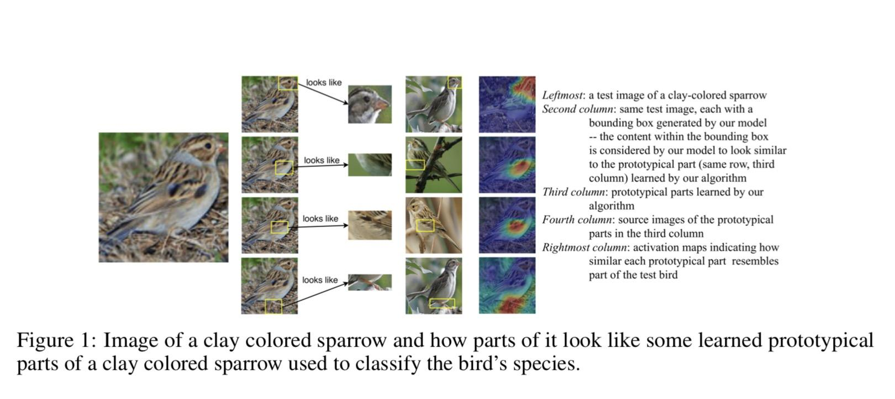
An Intuitive Figure Showing WHY Claim
Notes:
Here, we make the claim of this project.

Slide 5
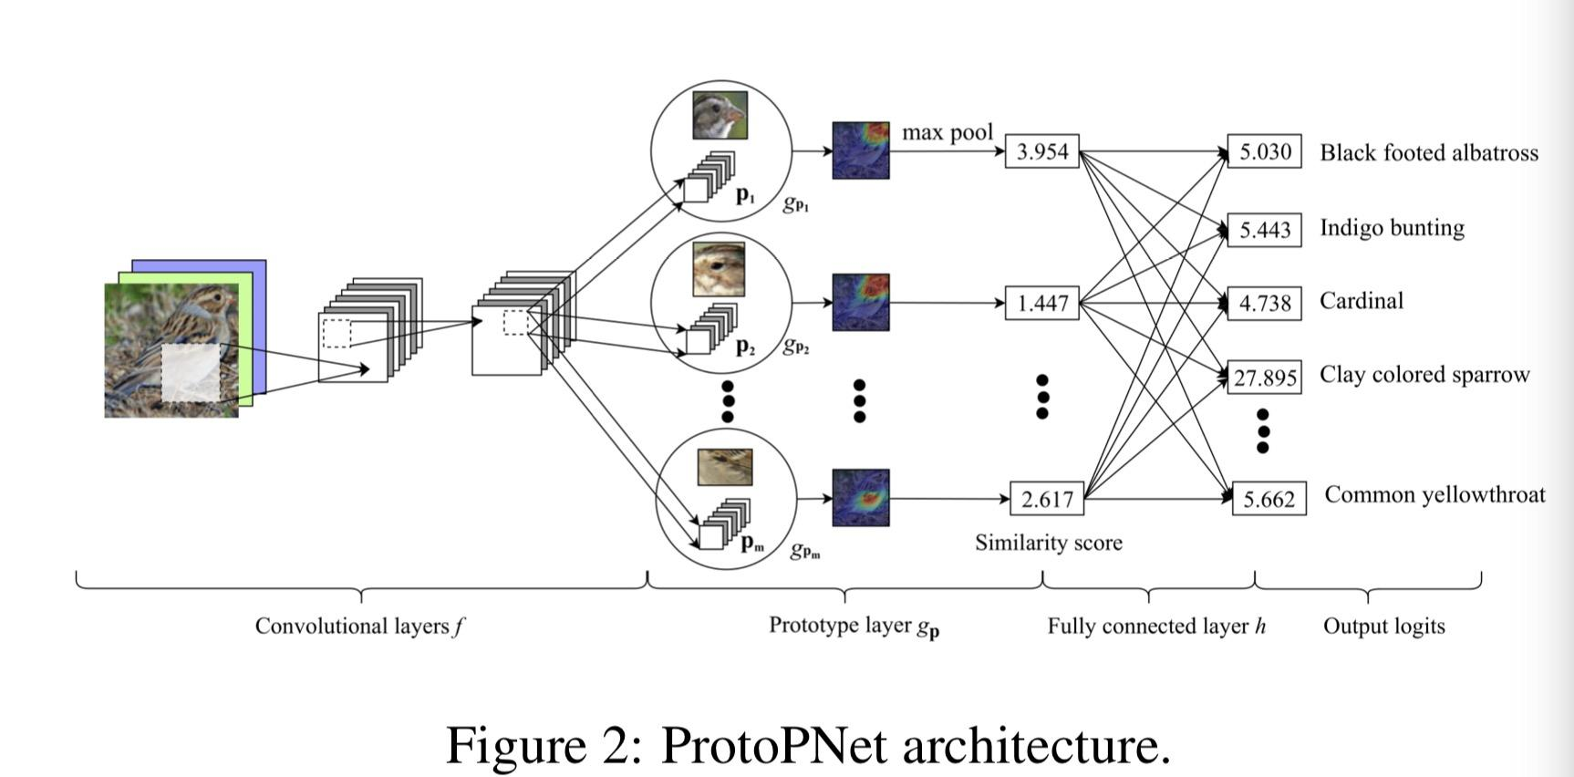
Model Architecture
Notes:
Here is our proposed solution.

Slide 6
Model Architecture Cont.
Initially we have the first 13 layers of the VGG-16 (or other existing )network ,followed by 2 , 1x1 convs
The network learns m prototypes (pj) , with a predefined number of prototypes for each class .
Each prototype is applied to all the patches of the conv output , and using the L2 distance , a similarity score is produced for a single prototype for all the patches , this can also be used to make a heatmap of similarity .
Then global pooling is applied to convert this into a single score gpj.Which represents the strongest similar finding of that prototype in the image.
Then the m global similarity scores are feeded in the FC layer to have weight combination to perform classification.
Notes:
In the rest of this presentation, I’m going to talk about following contents:

Slide 7
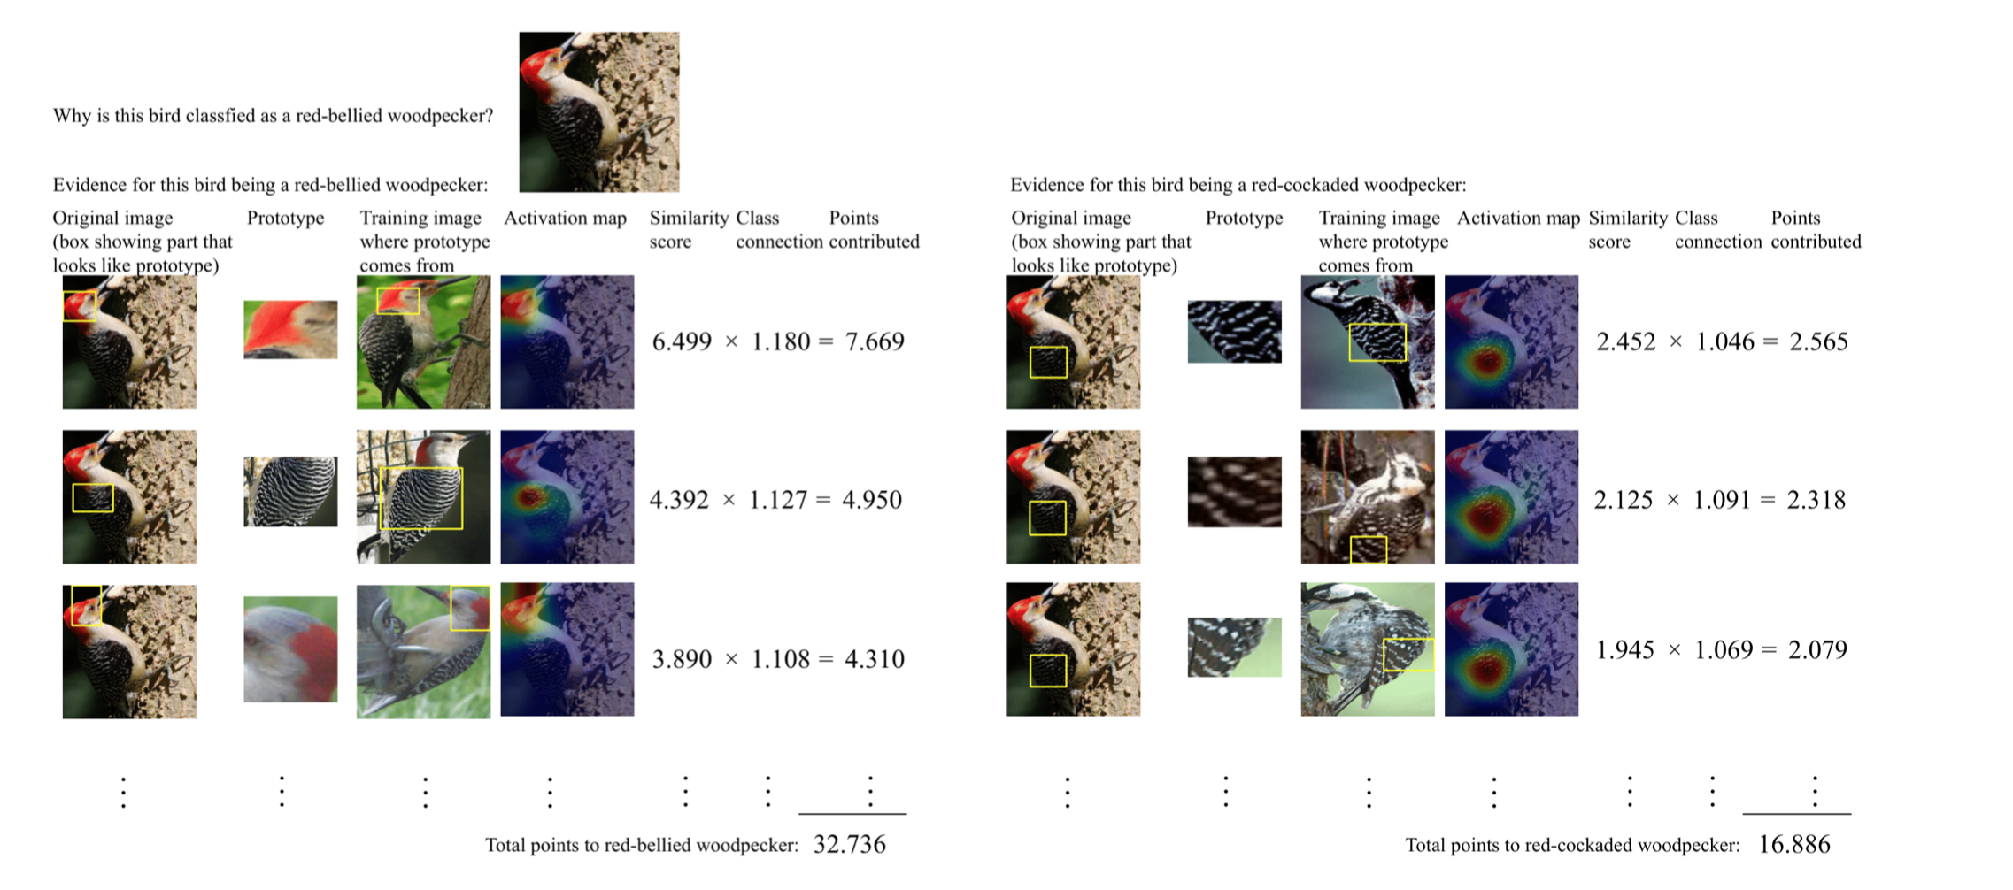
Classification Process

Slide 8
Training Algorithm
SGD of the layers before the FC layer h :This aims to learn a meaningful latent space where the most important patches for classifying images are clustered around prototypes associated with their own classes (Clustering Cost), and those important patches from different classes will be separated into distinct clusters(Separation Cost) . The loss function is sum of the cross entropy loss , the clustering cost and the separation cost .
Projection of the prototypes onto the closest latent representations of training image patches from the same class as that of the prototype. :We push each prototype pj onto the closest latent representation of training image patches from the same class as that of pj . So effectively each prototype now corresponds to some patch of a image in the training set
Convex optimization of the last layer h.- The parameters of the conv , and the prototype layers are fixed . Also the weights of the last layer are encouraged to be sparse by adding L1 regularisation.
Notes:
In the rest of this presentation, I’m going to talk about following contents:

Slide 9
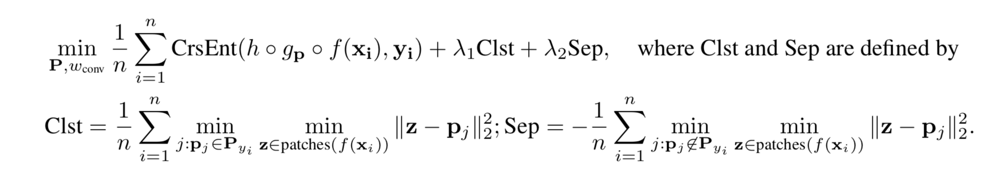
Training Algorithm
SGD Training Before FC layer
Notes:
In the rest of this presentation, I’m going to talk about following contents:

Slide 10
Experimental Analysis
Prototype Projection
FC Layer Parameter Training
Notes:
In the rest of this presentation, I’m going to talk about following contents:

Slide 11
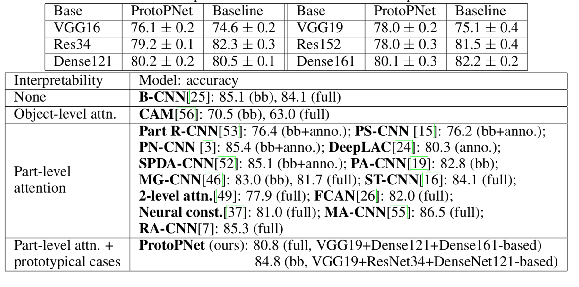
Experiment Results:
Test Dataset: cropped bird images of CUB-200-2011

Slide 12
Comments:
Strength: The classification process is very interpretable and can reach comparable accuracy with its standard non-interpretable counterpart as well as other interpretable deep models
Weakness: What if prototypes lack of representational power
What if similar prototypes from other classes can also create high similarity scores, may cause misclassification.

