Slide 1

BERT (Bidirectional Encoder Representation for Transformers): Pre-training of Deep Bidirectional Transformers for Language Understanding
(Google AI Language)
February 7, 2020
Presenter: Rishab Bamrara
https://qdata.github.io/deep2Read/

Slide 2
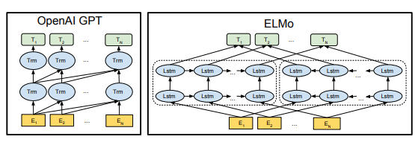
Motivation
When applying pre-trained language representations to downstream task such as Natural Language Inference (NLI), NER or Q/A, two strategies are currently employed:
Feature Based (ELMO) → uses task specific architectures
Fine-tuning (OpenAI GPT) → fine tunes all pre-trained params.
However, both of them use unidirectional language models to learn general language representations and this limits the choice of architectures that can be used during pre-training.

Slide 3
Background
Masked Language Model (MLM): This model randomly masks some of the tokens from the input and the objective is to predict the original vocabulary id of the masked word based only on its context. This model also enables the representation to fuse the right and left context.
Pretraining: Here the model is trained on unlabeled data over different pre-training tasks.
Fine-Tuning: Taking pre-trained parameters the model is initialized, and then all the parameters are fine-tuned using labeled data from the downstream tasks.

Slide 4
Related Work
ELMO: Matthew Peters, Mark Neumann, Mohit Iyyer, Matt Gardner, Christopher Clark, Kenton Lee, and Luke Zettlemoyer. 2018a. Deep contextualized word representations. In NAACL.
OpenAI GPT: Alec Radford, Karthik Narasimhan, Tim Salimans, and Ilya Sutskever. 2018. Improving language understanding with unsupervised learning. Technical report, OpenAI.
Transformer: Ashish Vaswani, Noam Shazeer, Niki Parmar, Jakob Uszkoreit, Llion Jones, Aidan N Gomez, Lukasz Kaiser, and Illia Polosukhin. 2017. Attention is all you need.
WordPiece embeddings: Yonghui Wu, Mike Schuster, Zhifeng Chen, Quoc V Le, Mohammad Norouzi, Wolfgang Macherey, Maxim Krikun, Yuan Cao, Qin Gao, Klaus Macherey, et al. 2016. Google’s neural machine translation system: Bridging the gap between human and machine translation.

Slide 5
Claim / Target Task
Authors present BERT to improve fine-tuning based approaches. They claim that BERT alleviates unidirectionality constraint by using a “masked language model” (MLM) pre-training objective.
Notes:
Here, we make the claim of this project.

Slide 6
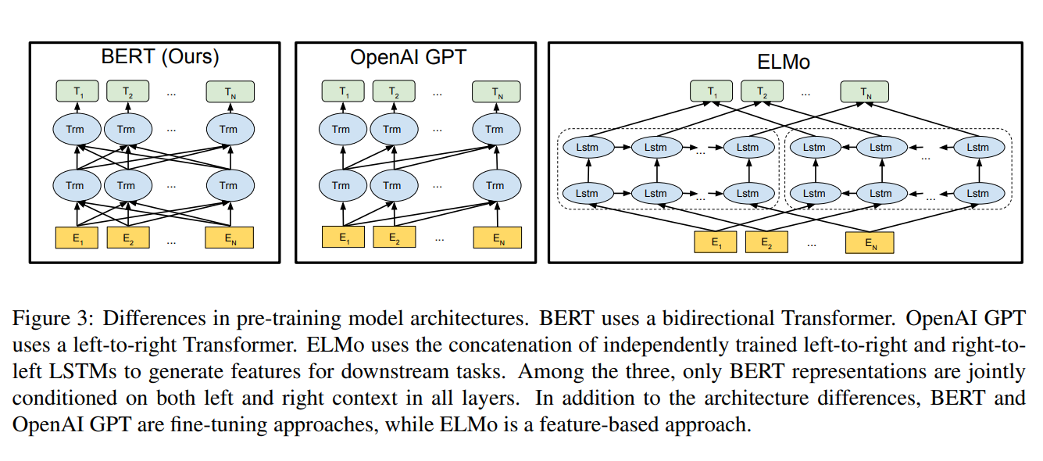
An Intuitive Figure Showing WHY Claim
Notes:
Here, we make the claim of this project.

Slide 7
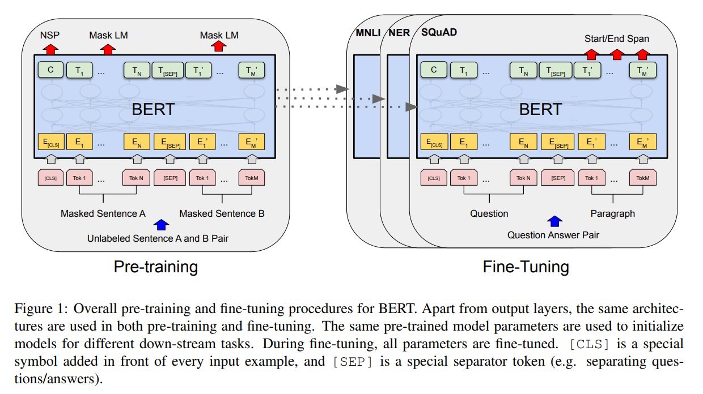
Proposed Solution
Notes:
Here is our proposed solution.

Slide 8
Model Architecture
BERT’s model architecture is a multi-layer bidirectional Transformer encoder based on the original implementation described in Vaswani et al. (2017) and released in the tensor2tensor library.
Used 2 model sizes:
BERT_{BASE}: (L=12, H=768, A=12, Total Parameters=110M)
BERT_{LARGE}: (L=24, H=1024, A=16, Total Parameters=340M)
Here, L: number of layers (i.e., Transformer blocks), H: the hidden size, A: and the number of self-attention heads.
BERT_{BASE} was chosen to have the same model size as OpenAI GPT for comparison purposes.
Notes:
In the rest of this presentation, I’m going to talk about following contents:

Slide 9
Input/Output Representations
Used token sequence to represent both a single sentence and a pair of sentences.
WordPiece Embeddings with a 30k token vocab.
First token of every sequence is a special classification token [CLS]. The final hidden state of this token is used for classification tasks.
Sentences are seperated with special token [SEP] and a learned embedding to every token indicating whether it belongs to sentence A or B.
Similar to Transformers, input representation is constructed by summing the corresponding token, segment with positional embeddings.

Slide 10
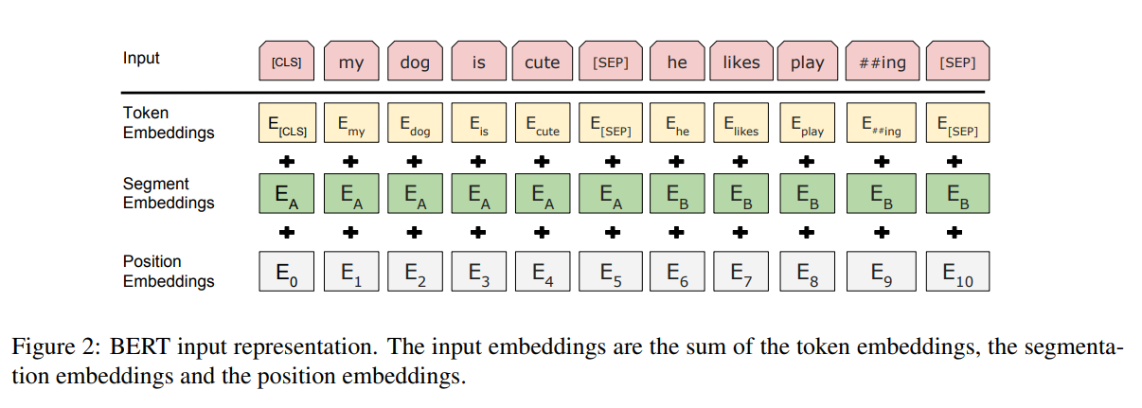
Input/Output Representations (Fig.)

Slide 11
Pre-training BERT
Pre-training was done using two unsupervised tasks: MLM and NSP.
Task 1: MLM
Simply mask some percentage of the input tokens at random, and then predict those masked tokens. The final hidden vectors corresponding to the mask tokens are fed into an output softmax over the vocabulary.
A downside is that we are creating a mismatch between pre-training and fine-tuning, since the [MASK] token does not appear during fine-tuning.
The training data generator chooses 15% of the token positions at random for prediction. If the i-th token is chosen, we replace the i-th token with (1) the [MASK] token 80% of the time (2) a random token 10% of the time (3) the unchanged i-th token 10% of the time.

Slide 12
Pre-training BERT
Task 2: NSP
Beneficial for many downstream tasks such as QA and NLI which are based on relationship between two sentences.
For this, they chose two sentences A and B for each pre-training example. 50% of the time, the second sentence is logical continuation of first (labeled as IsNext), and 50% of the times the second sentence is any arbitrary sentence (labeled as NotNext).
Final hidden state of the [CLS] token, “C”, is used for this task as it is a binary level classification task.

Slide 13
Pre-training Data
Follow the existing literature on language model pre-training.
BookCorpus (800M words) and English Wikipedia (2,500M words). For Wikipedia, only text passages were extracted and list, tables and headers were ignored.
Critical to use a document-level corpus rather than a sentence-level corpus in order to extract long contiguous sequences.

Slide 14
Fine-tuning BERT
Very straightforward as Transformer allows BERT to model many downstream tasks containing a single text or text pairs.
For text pairs, independently encode text pairs before applying bi-directional cross attention.
For each task, simply plug the task-specific inputs and outputs into BERT and fine-tune all parameters end-to-end.
At input, sentence A and B from pretraining are analogous to o (1) sentence pairs in paraphrasing, (2) hypothesis-premise pairs in entailment, (3) question-passage pairs in question answering, and (4) a degenerate text-∅ pair in text classification or sequence tagging.
At the output, token representations are fed into an output layer for token-level tasks, such as sequence tagging or QA, and [CLS] representation is used for classification such as entailment or sentiment analysis.

Slide 15
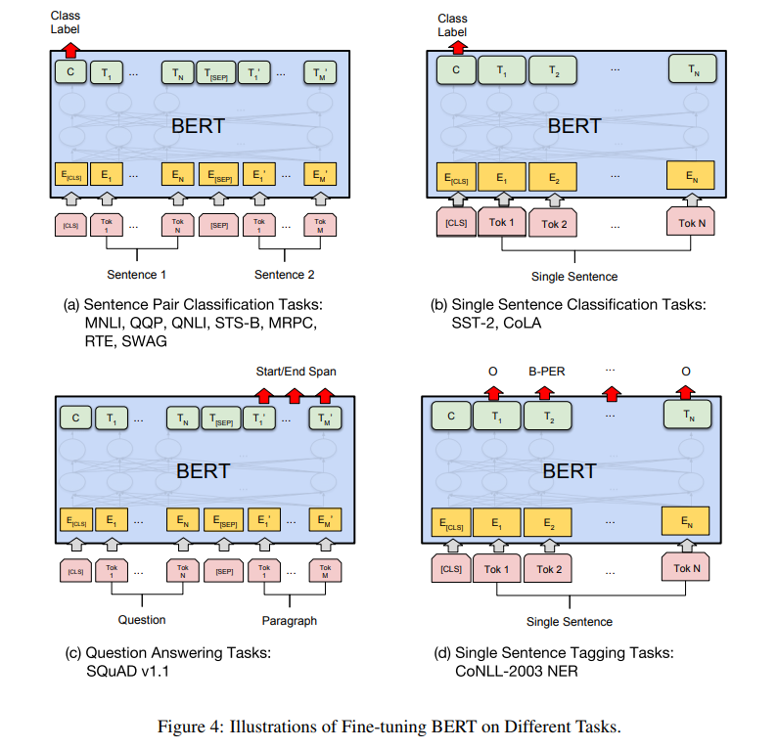
Fine-tuning BERT

Slide 16
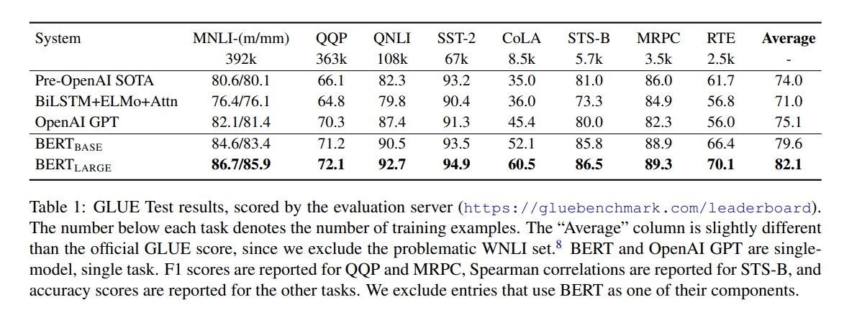
Experimental Results and Analysis
Notes:
In the rest of this presentation, I’m going to talk about following contents:

Slide 17
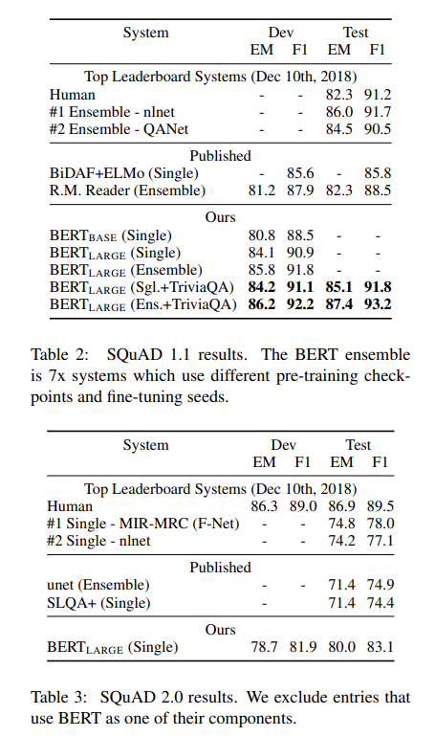
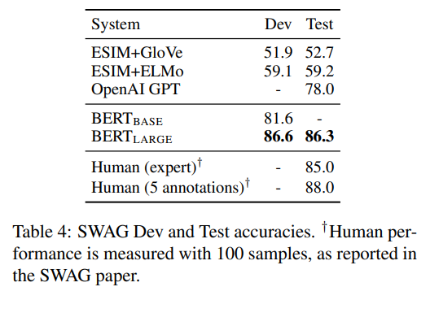
Experimental Results and Analysis
Notes:
In the rest of this presentation, I’m going to talk about following contents:

Slide 18
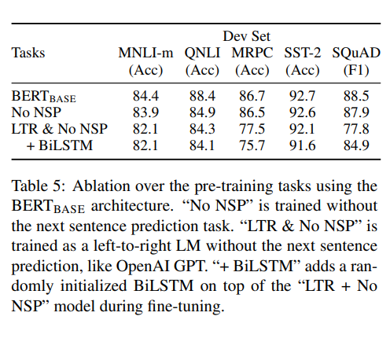
Ablation Studies
(Effect of Pre-training Tasks)
Removing NSP hurts performance significantly on QNLI, MNLI, and SQuAD 1.1.
The LTR model performs worse than the MLM model on all tasks, with large drops on MRPC and SQuAD.
Even after adding a random BiLSTM on top of LTR and No NSP, it hurts performance on the GLUE tasks.
Notes:
In the rest of this presentation, I’m going to talk about following contents:

Slide 19
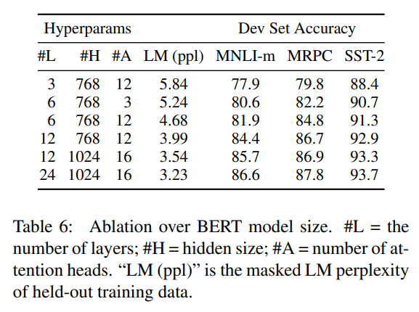
Ablation Studies
(Effect of Model Size)
It has long been known that increasing the model size will lead to continual improvements on large-scale tasks such as machine translation and language modeling
This is the first work to demonstrate convincingly that scaling to extreme model sizes also leads to large improvements on very small scale tasks, provided that the model has been sufficiently pre-trained.
Notes:
In the rest of this presentation, I’m going to talk about following contents:

Slide 20
Conclusion and Future Work
Recent empirical improvements due to transfer learning with language models have demonstrated that rich, unsupervised pre-training is an integral part of many language understanding systems.
Major contribution is further generalizing these findings to deep bidirectional architectures, allowing the same pre-trained model to successfully tackle a broad set of NLP tasks.

Slide 21
References
Matthew Peters, Mark Neumann, Mohit Iyyer, Matt Gardner, Christopher Clark, Kenton Lee, and Luke Zettlemoyer. 2018a. Deep contextualized word representations. In NAACL.
Alec Radford, Karthik Narasimhan, Tim Salimans, and Ilya Sutskever. 2018. Improving language understanding with unsupervised learning. Technical report, OpenAI.
Ashish Vaswani, Noam Shazeer, Niki Parmar, Jakob Uszkoreit, Llion Jones, Aidan N Gomez, Lukasz Kaiser, and Illia Polosukhin. 2017. Attention is all you need.
Yonghui Wu, Mike Schuster, Zhifeng Chen, Quoc V Le, Mohammad Norouzi, Wolfgang Macherey, Maxim Krikun, Yuan Cao, Qin Gao, Klaus Macherey, et al. 2016. Google’s neural machine translation system: Bridging the gap between human and machine translation.
Rami Al-Rfou, Dokook Choe, Noah Constant, Mandy Guo, and Llion Jones. 2018. Character-level language modeling with deeper self-attention. arXiv preprint arXiv:1808.04444.
Ronan Collobert and Jason Weston. 2008. A unified architecture for natural language processing: Deep neural networks with multitask learning. In Proceedings of the 25th international conference on Machine learning, pages 160–167. ACM.
William B Dolan and Chris Brockett. 2005. Automatically constructing a corpus of sentential paraphrases. In Proceedings of the Third International Workshop on Paraphrasing (IWP2005).
Yacine Jernite, Samuel R. Bowman, and David Sontag. 2017. Discourse-based objectives for fast unsupervised sentence representation learning. CoRR, abs/1705.00557.
Z. Chen, H. Zhang, X. Zhang, and L. Zhao. 2018. Quora question pairs.

