Slide 1

How Does BERT Answer Questions? A Layer-Wise Analysis of Transformer Representations
Betty van Aken, Benjamin Winter, Alexander Löser, Felix A. Gers
CIKM 2019
February 14, 2020
Presenter: Rishab Bamrara
https://qdata.github.io/deep2Read/

Slide 2
Motivation:
Bidirectional Encoder Representations from Transformers (BERT) reach state-of-the-art results in a variety of Natural Language Processing tasks.
However, understanding of their internal functioning is still insufficient and unsatisfactory.
Hence most of the times these deep learning models are treated as black box as they lack transparency, reliability and prediction guaranty.
Transformers are moderately interpretable by their attention values, however this may not always be the case.

Slide 3
Related Work:
Tenney et al. : a novel "edge-probing" framework (9 tasks)
2. Yoav Goldberg. 2019. Assessing BERT’s Syntactic Abilities (More tasks)
3. Qiao et al. : focus specifically on analysing BERT as a Ranking model.
4. Zhang and Zhu, Visual interpretability for deep learning: limited to CNNs
5. Liu et al. :perform a layer-wise analysis of BERT’s token representations.

Slide 4
Background:
Edge Probing: Translates core NLP tasks into classification tasks by focusing solely on their labeling part.
Named Entity Labeling (NEL): Given a span of tokens the model has to predict the correct entity category.
Coreference Resolution: Predict whether two mentions within a text refer to the same entity.
Relation Classification: Predict which relation type connects two known entities.
Question Type Classification: Correctly identify question type.
Supporting Facts: Predict whether a sentence contains supporting facts regarding a specific question or whether it is irrelevant.
Dimensionality Reduction: Process of reducing the number of random variables under consideration. (t-SNE, PCA, ICA).

Slide 5
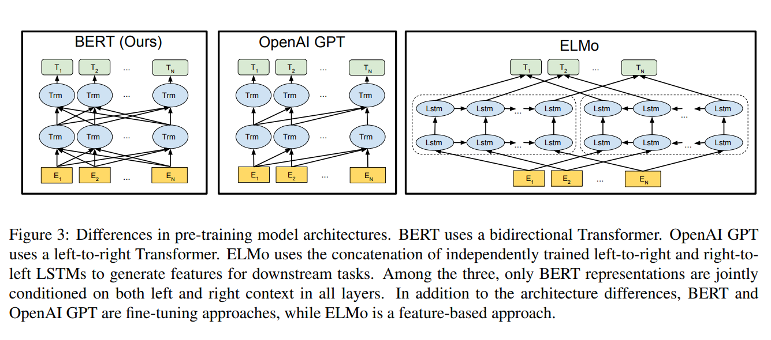
Background:
K-Means Clustering: Clustering based on mean.
BERT: A method of pre-training language representations.
BERT (Bidirectional Encoder Representation for Transformers): Pre-training of Deep Bidirectional Transformers for Language Understanding

Slide 6
Claim / Target Task:
Unlike previous research, which mainly focuses on explaining Transformer models by their attention weights, authors argue that hidden states contain equally valuable information.
Notes:
Here, we make the claim of this project.

Slide 7
Proposed Solution:
Embed input tokens for each probing task sample with fine-tuned BERT model. Every layer is taken into account.
Use only the output embedding from n-th layer at step n.
Tokens are first pooled for a fixed-length representation.
Feed tokens into a two-layer Multi-layer Perceptron (MLP) classifier, that predicts label-wise probability scores
Notes:
Here is our proposed solution.

Slide 8
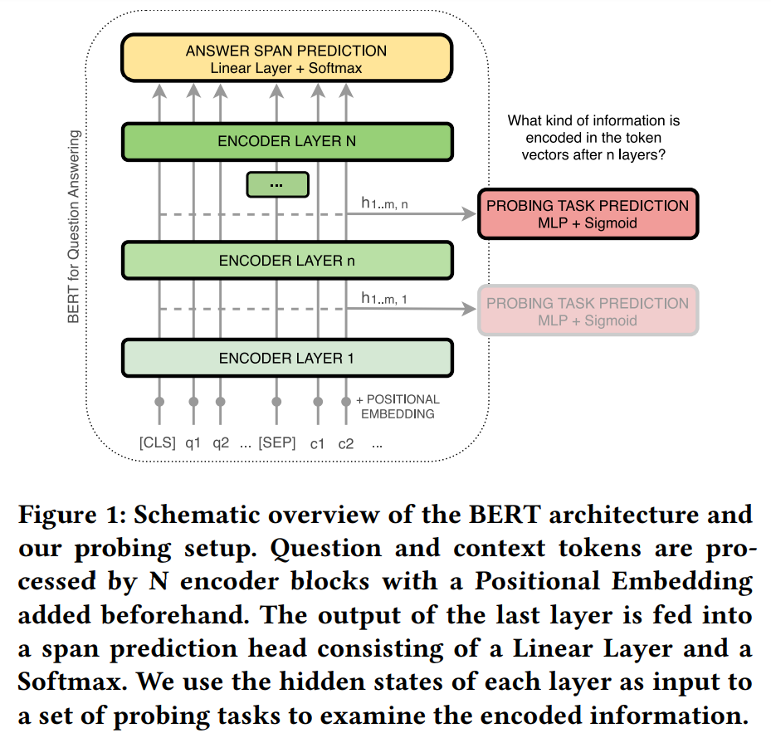
Proposed Solution (Fig.):
Notes:
Here is our proposed solution.

Slide 9
Datasets:
SQuAD 1.1: Contains 100,000 natural question-answer pairs on 500 Wikipedia articles. Don’t use version 2.0 as it contains some unanswerable questions as well.
HotpotQA: This Multihop QA task contains 112,000 natural question-answer pairs. The questions are especially designed to combine information from multiple parts of a context.
bAbI: Set of artificial toy tasks developed to further understand the abilities of neural models. The 20 tasks require reasoning over multiple sentences (Multihop QA) and are modeled to include Positional Reasoning.

Slide 10
Models:
BERT: 12 transformer blocks for base and 24 for large.
GPT-2 (small): 12 transformer blocks. Large was not released.
Both are fine tuned on each of the datasets before applying probing to QA.

Slide 11
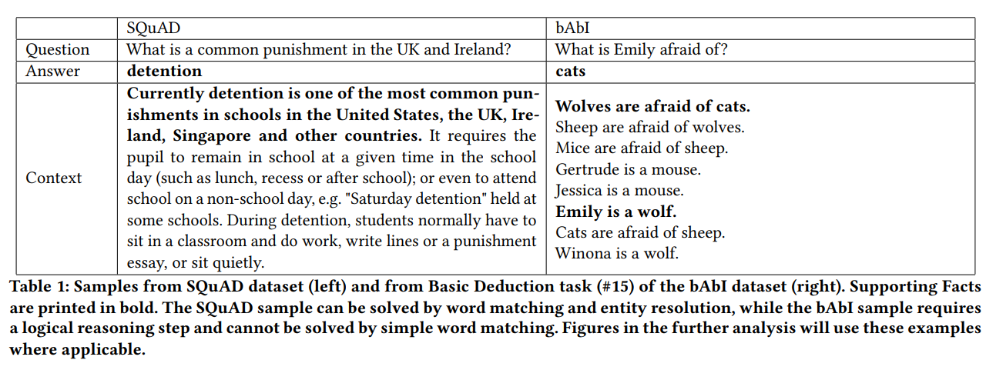
Results and Discussion:

Slide 12
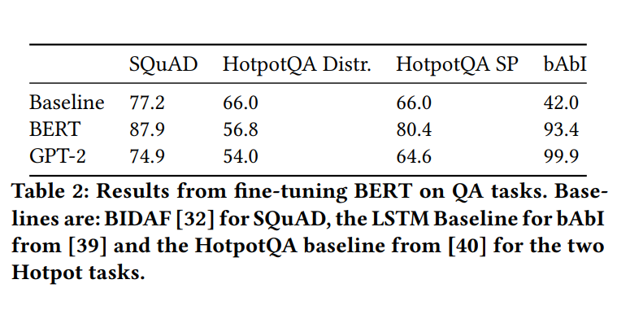
Results and Discussion:
Accuracy on the SQuAD task is close to human performance.
Tasks derived from HotpotQA prove much more challenging.
bAbI was easily solved by both BERT and GPT-2. But, GPT-2 performed better.
Most of BERT’s error in the bAbI multi-task setting comes from tasks that require positional or geometric reasoning, this is a skill where GPT-2 is better than BERT’s reasoning capabilities

Slide 13
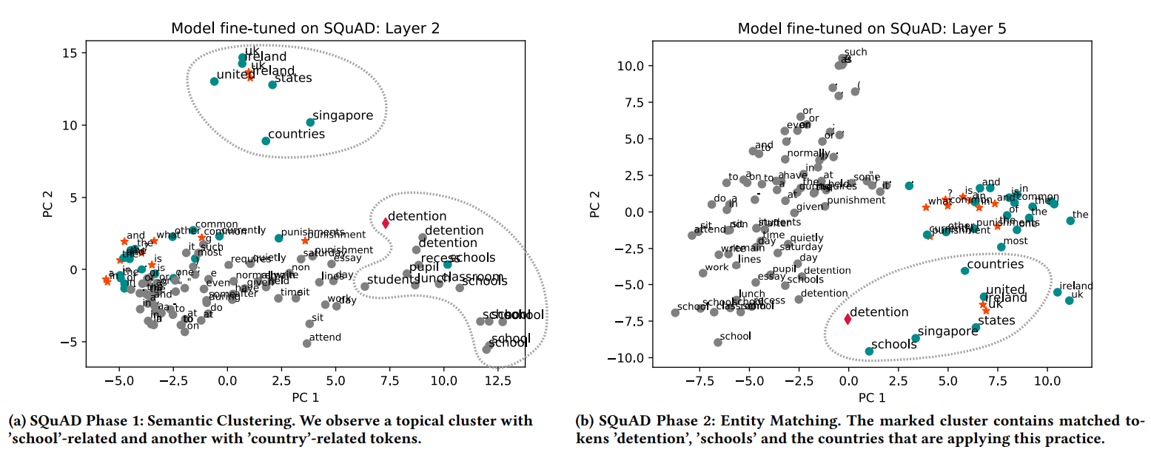
Results and Discussion:
The PCA representations of tokens in different layers suggest that the model is going through multiple phases while answering a question.
Semantic Clustering: Early layers within the BERT-based models group tokens into topical clusters. Therefore, these initial layers reach low accuracy on semantic probing tasks.

Slide 14
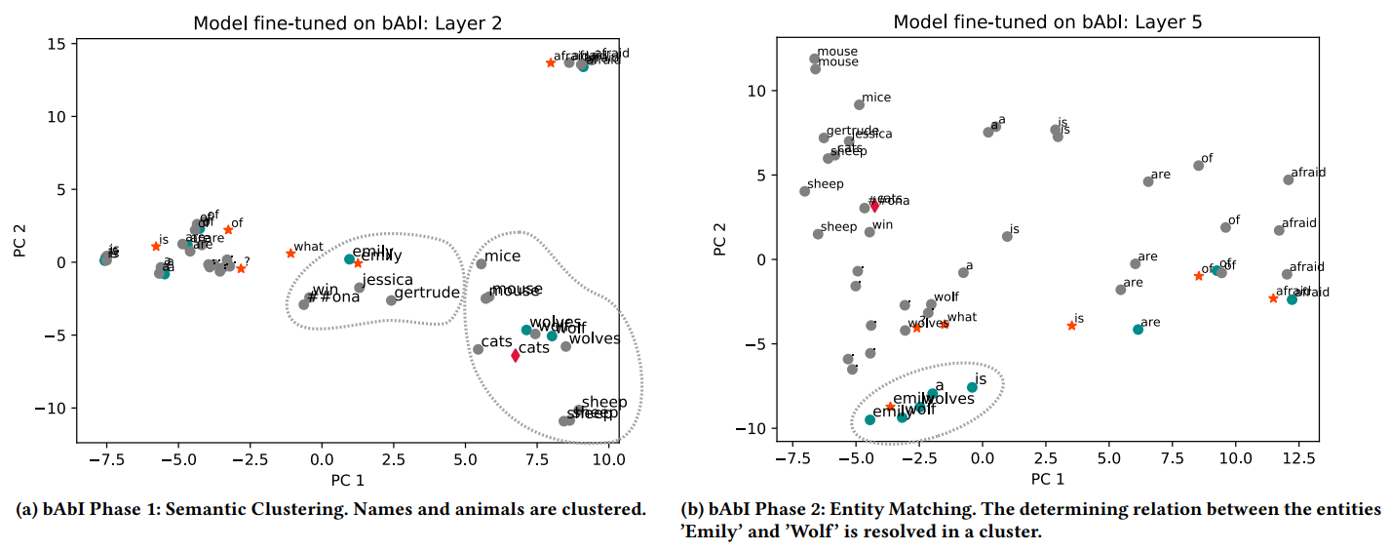
Results and Discussion:

Slide 15
Results and Discussion:
2. Connecting Entities with Mentions and Attributes: In the middle layers of the observed networks clusters of entities are less connected by their topical similarity rather, they are connected by their relation within a certain input context.
This cluster helps to solve the question "What is a common punishment in the UK and Ireland?".

Slide 16
Results and Discussion:
Challenge within this sample is to identify the two facts that Emily is a wolf and Wolves are afraid of cats.

Slide 17
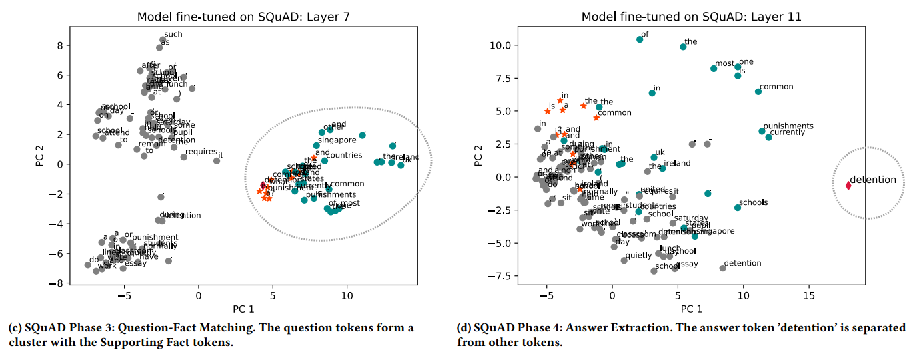
Results and Discussion:
3. Matching Questions with Supporting Facts: Identifying relevant parts of the context is crucial for QA and Information Retrieval in general. BERT models perform a comparable step by transforming the tokens so that question tokens are matched onto relevant context tokens.

Slide 18
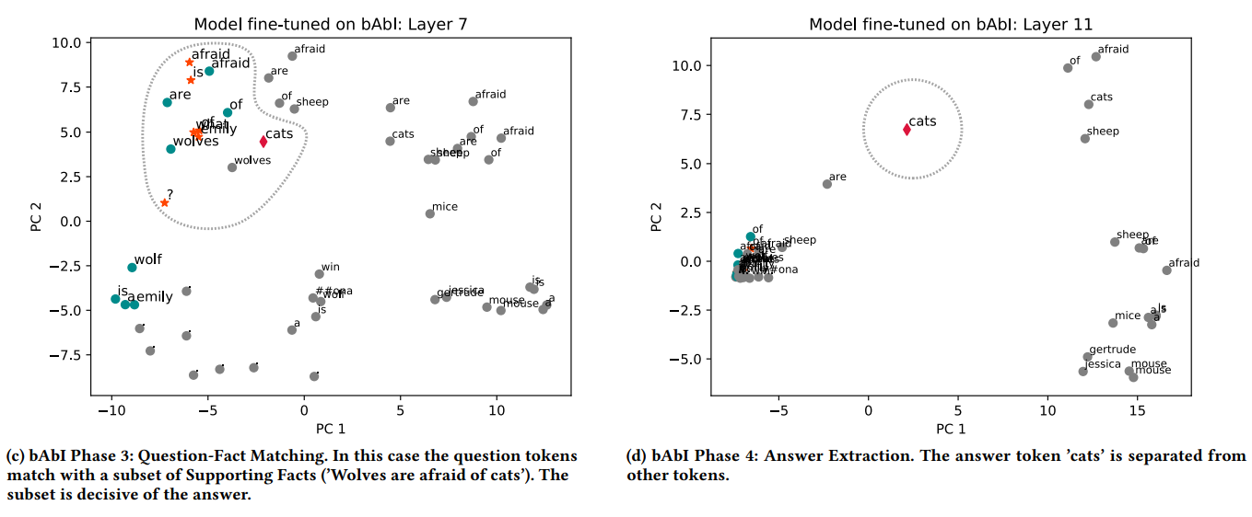
Results and Discussion:
Model transforms the token representation of question and Supporting Facts into the same area of the vector space.

Slide 19
Results and Discussion:
4. Answer Extraction: In the last network layers the model dissolves most of the previous clusters. Model separates the correct answer tokens, and sometimes other possible candidates, from the rest of the tokens. The remaining tokens form one or multiple homogeneous clusters. The vector representation at this point is largely task-specific and learned during fine-tuning.

Slide 20
Results and Discussion:

Slide 21
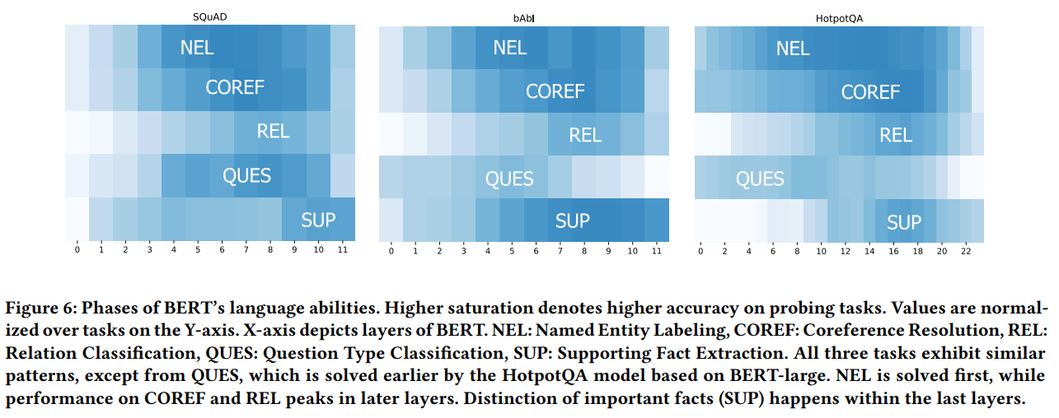
Results and Discussion:

Slide 22
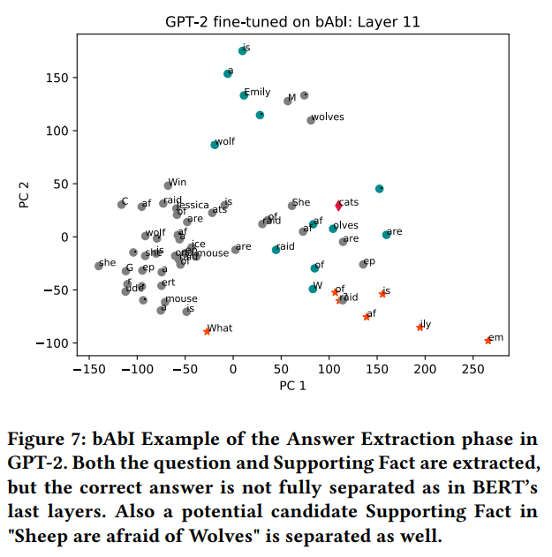
Comparison to GPT-2:

Slide 23
Observation of Failure States:
Rough difficulty of a specific task can be discerned by a glance at the hidden state representations. While for correct predictions the transformations run through the phases discussed in previous sections, for wrong predictions there is a possibility that:
If a candidate answer was found that the network has a reasonable amount of confidence in, the phases will look very similar to a correct prediction, but now centering on the wrong answer.
Inspecting early layers in this case can give insights towards the reason why the wrong candidate was chosen, e.g. wrong Supporting Fact selected, mis-resolution of co-references etc.

Slide 24
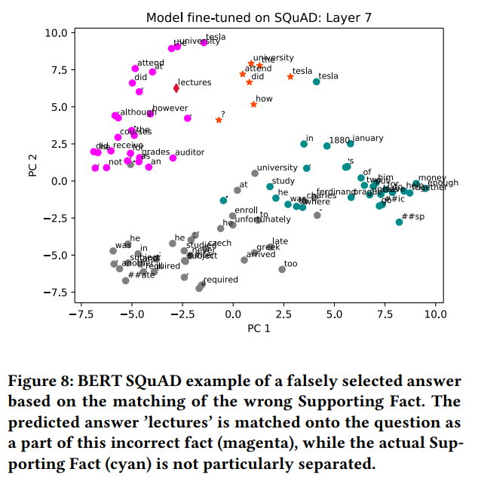
Observation of Failure States:

Slide 25
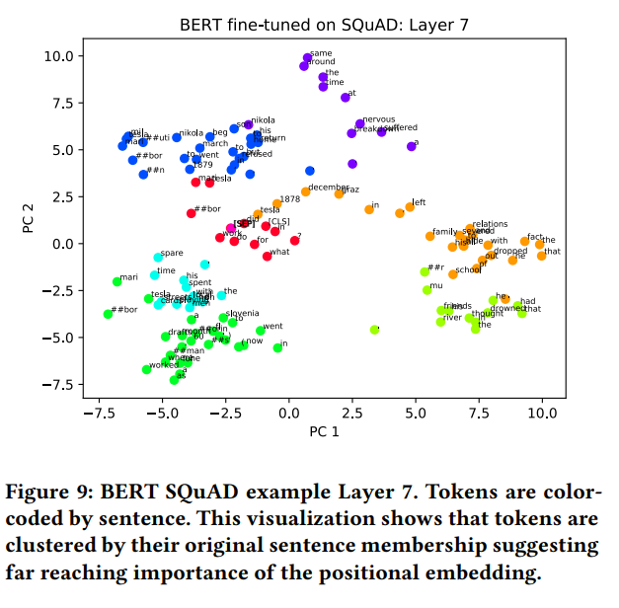
Maintained Positional Embedding:

Slide 26
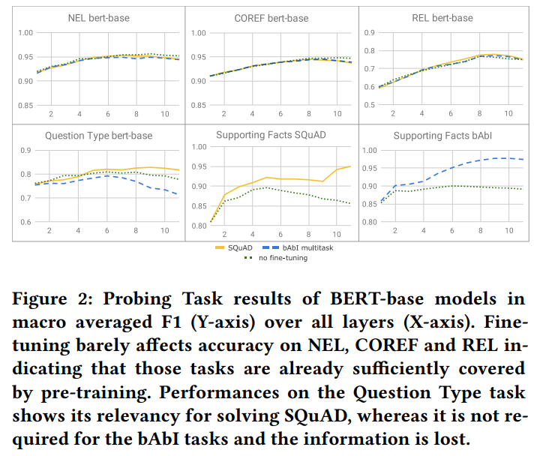
Abilities to resolve Question Type:
Model fine-tuned on the bAbI tasks, loose part of its ability to distinguish question types during fine-tuning. This is likely caused by the static structure of bAbI samples, in which the answer candidates can be recognized by sentence structure and occurring word patterns rather than by the question type.

Slide 27
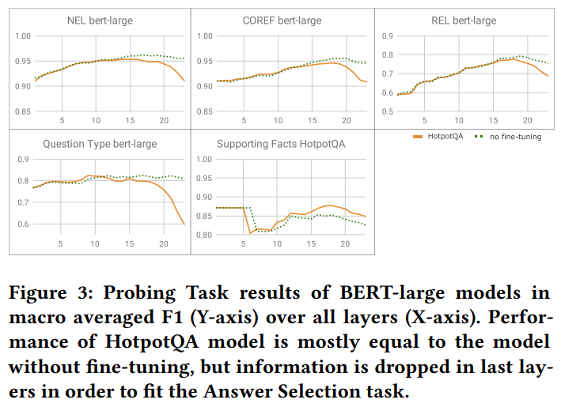
Abilities to resolve Question Type:
Surprisingly, model fine-tuned on HotpotQA does not outperform the model without fine-tuning. Both models can solve the task in earlier layers, which suggests that the ability to recognize question types is pre-trained in BERT-large.

Slide 28
Conclusion and Future Work:
Work reveals important findings about the inner functioning of Transformer networks.
Interpretability: The qualitative analysis of token vectors reveals that there is indeed interpretable information stored within the hidden states of Transformer models.
Transferability: We further show that lower layers might be more applicable to certain problems than later ones.
Modularity: Our findings support the hypothesis that not only do different phases exist in Transformer networks, but that specific layers seem to solve different problems. This hints at a modularity that can potentially be exploited in the training process

Slide 29
References:
Ian Tenney, Patrick Xia, Berlin Chen, Alex Wang, Adam Poliak, R Thomas McCoy, Najoung Kim, Benjamin Van Durme, Sam Bowman, Dipanjan Das, and Ellie Pavlick. 2019. What do you learn from context? Probing for sentence structure in contextualized word representations. In Proceedings of ICLR 2019.
Pranav Rajpurkar, Jian Zhang, Konstantin Lopyrev, and Percy Liang. 2016. SQuAD: 100, 000+ Questions for Machine Comprehension of Text. In Proceedings of EMNLP 2016.
Yifan Qiao, Chenyan Xiong, Zheng-Hao Liu, and Zhiyuan Liu. 2019. Understanding the Behaviors of BERT in Ranking. CoRR (2019).
Yoav Goldberg. 2019. Assessing BERT’s Syntactic Abilities. CoRR (2019).
Quan-shi Zhang and Song-chun Zhu. 2018. Visual interpretability for deep learning: a survey. Frontiers of IT & EE (2018).
Nelson F. Liu, Matt Gardner, Yonatan Belinkov, Matthew Peters, and Noah A. Smith. 2019. Linguistic Knowledge and Transferability of Contextual Representations. In Proceedings of NAACL 2019.
Stuart P. Lloyd. 1982. Least squares quantization in PCM. IEEE Trans. Information Theory (1982).
Dieuwke Hupkes, Sara Veldhoen, and Willem H. Zuidema. 2017. Visualisation and ’diagnostic classifiers’ reveal how recurrent and recursive neural networks process hierarchical structure. In Proceedings of IJCAI 2018.

