Slide 1

Benchmarking Graph Neural Networks
Vijay Prakash Dwivedi Chaitanya K. Joshi Thomas Laurent Yoshua Bengio Xavier Bresson
20 March 2020
Presenter: Sanchit Sinha
https://qdata.github.io/deep2Read/

Slide 2
Motivation
Need for Benchmarking:
GNNs are thought of as much more generalisable
Graph data holds a lot more information
Not well explored
Problems with Benchmarking:
Datasets: The datasets which exist are not representative/challenging
Performance: Some GNN models don’t perform as well as non-GNNs
Settings: Experimental settings are not yet standardized
Notes:
The motivation of this project

Slide 3
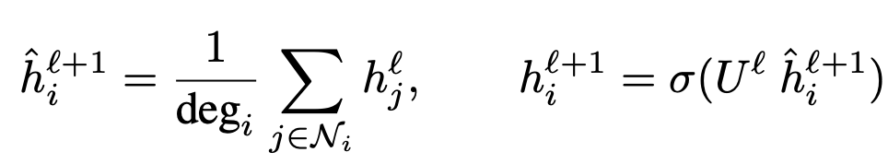
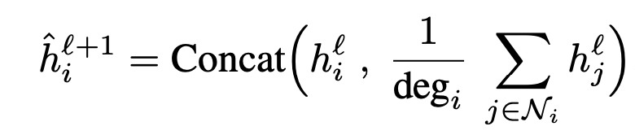
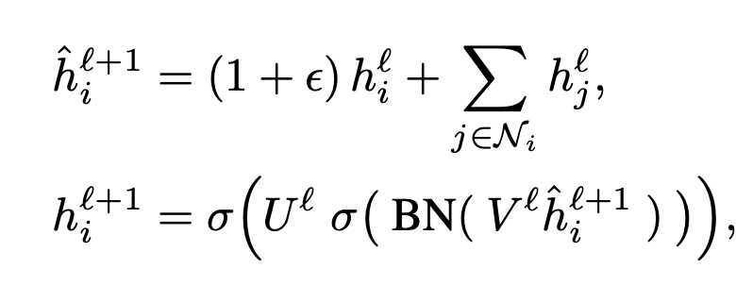
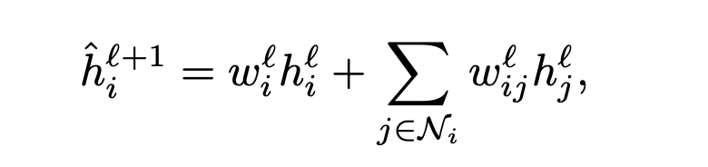
Background
Graph Neural Networks (only a few used in this paper):
Basic:
Mean GraphStage:
GIN:
Anisotropic:

Slide 4
Claim / Target Task
Propose a benchmark, with plug and play methods - model and datasets
Create new datasets by converting well known datasets into graphs
Proposed/tested building blocks of GNN
Compare performance
Notes:
Here, we make the claim of this project.

Slide 5
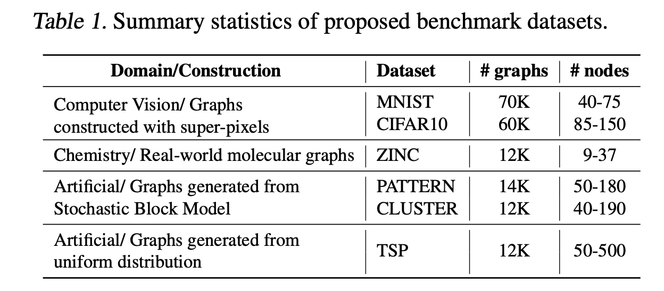
Data Summary
Old Graph Datasets:
CORA
TU
Converted Datasets:
Notes:
In the rest of this presentation, I’m going to talk about following contents:

Slide 6
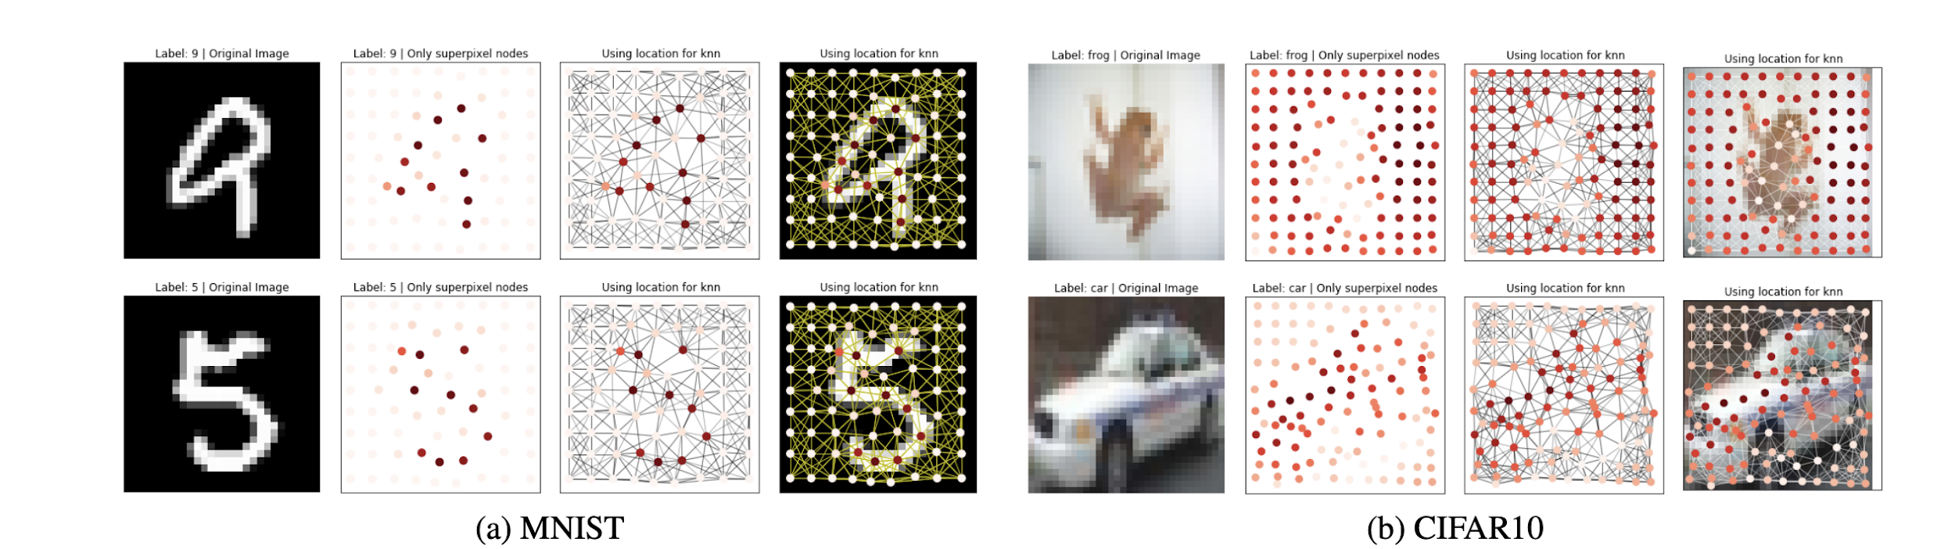
Proposed Solution - Superpixel
Notes:
Here is our proposed solution.

Slide 7
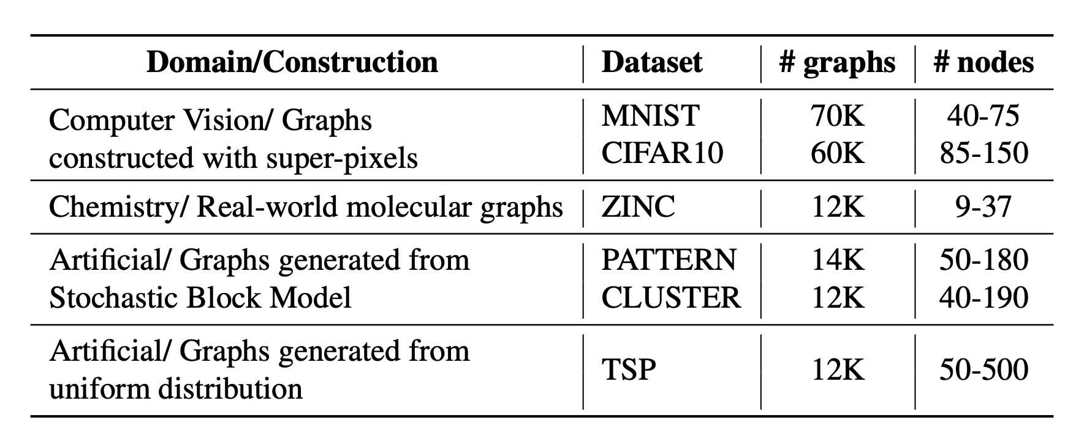

Slide 8
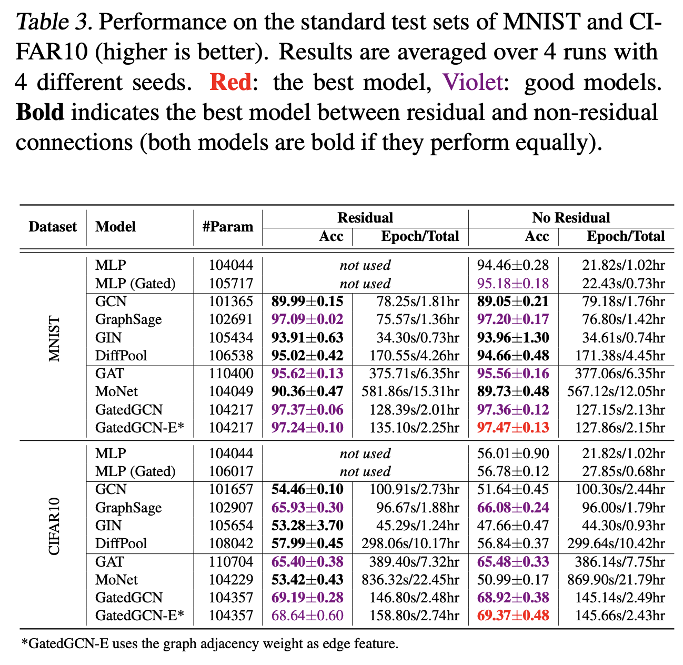
Experimental Results

Slide 9
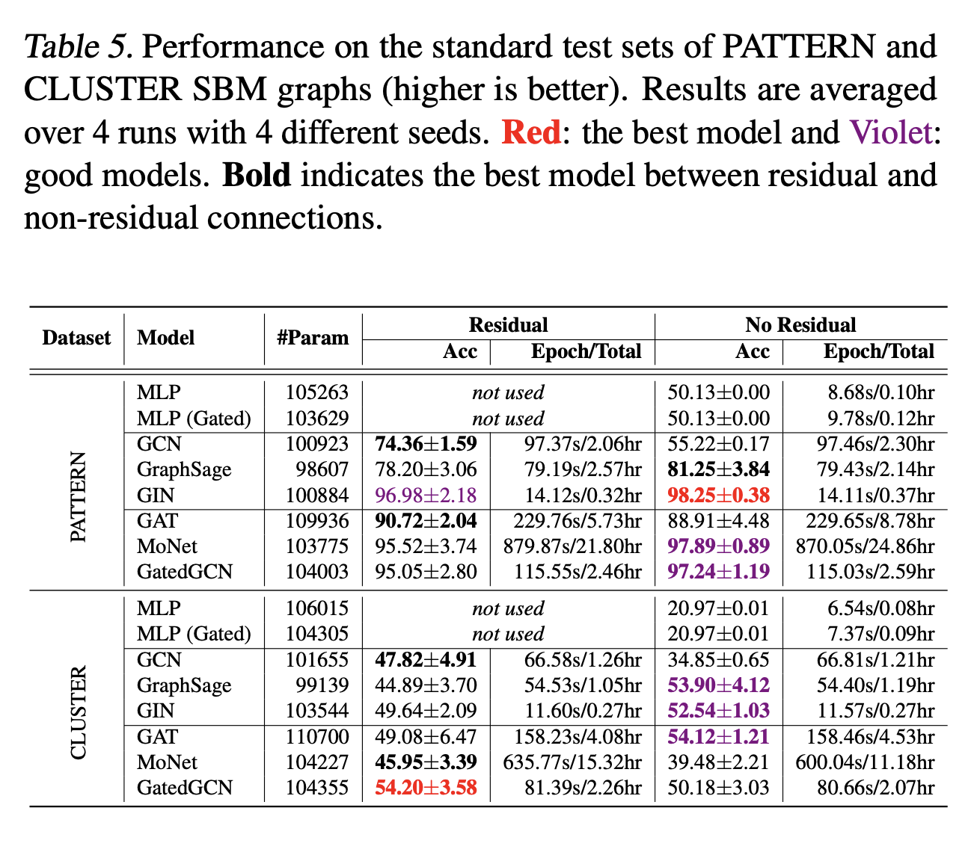
Experimental Results
Notes:
In the rest of this presentation, I’m going to talk about following contents:

Slide 10
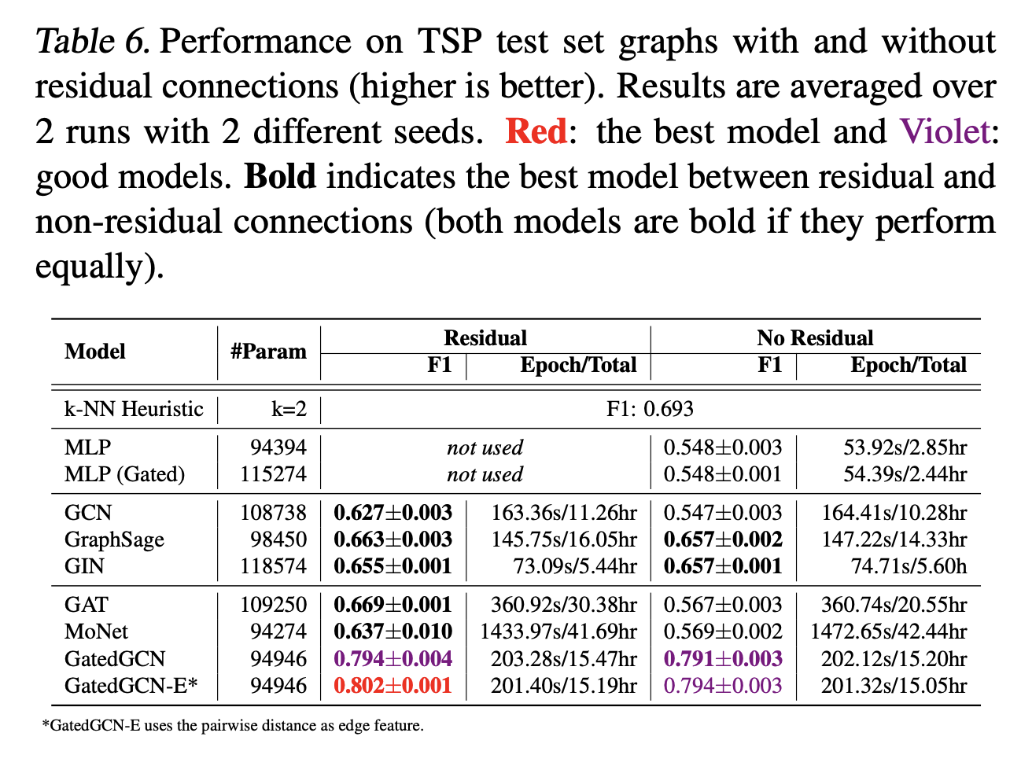

Slide 11
Generating correlated features (for images) - ?

Slide 12
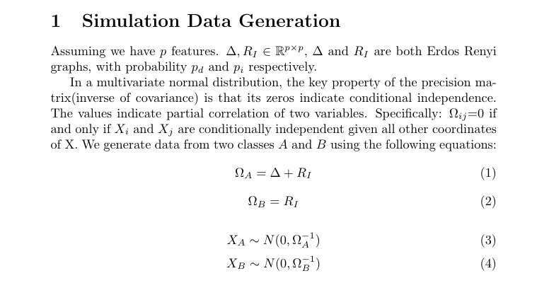

Slide 13
Main takeaway: Generating the covariance matrix
In the code a random E-R graph is made and its adjacency matrix’ inverse is taken as covariance matrix to the normal distributions

