Slide 1

Hierarchical interpretations for neural network predictions
21 Jan 2020
Presenter: Sanchit Sinha
https://qdata.github.io/deep2Read/

Slide 2
Motivation
Explanation of DNNs outputs and predictions required for several purposes included reducing bias, regulatory, etc.
Bottom up - Agglomerative Clustering type approach which is the most intuitive to general users can be used to explain DNN predictions
Can be used to compare models with similar output - the ones with better explanation can be used with confidence
Explanation methods should have robustness against adversarial perturbations
Can give hierarchical saliency - identify parts which have the maximum influence in predictions
Notes:
The motivation of this project

Slide 3
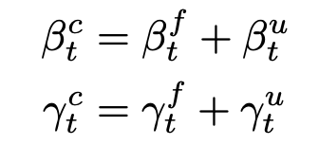
Background
Contextual Decomposition: Assigns scores to phrases in an LSTM setting to measure their importance with respect to the actual prediction made
CD is limited to memory networks, need to expand it to CNNs.
Locality importance has limitations - no idea what the intermediate layers of the DNN is learning. For eg. word level score although important is not the ultimate way of deciding polarity o sentiment
Agglomerative Hierarchy is a good intuitive way of understanding explanations

Slide 4
Related Work
W James Murdoch, Peter J Liu, and Bin Yu. Beyond word importance: Contextual decomposition to extract interactions from lstms. arXiv preprint arXiv:1801.05453, 2018.
Sebastian Bach, Alexander Binder, Gregoire Montavon, Frederick Klauschen, Klaus-Robert Muller, ¨ and Wojciech Samek. On pixel-wise explanations for non-linear classifier decisions by layer-wise relevance propagation. PloS one, 10(7):e0130140, 2015.
W. James Murdoch, Chandan Singh, Karl Kumbier, Reza Abbasi-Asl, and Bin Yu. Interpretable machine learning: definitions, methods, and applications. arXiv preprint arXiv:1901.04592, 2019.

Slide 5
Claim / Target Task
Generalize the CD score calculation to CNNs with convolutional layers and max-pooling layers
Use the CD scores as measures to build explanations in a bottom up way kind of like clustering
The CD scores are used to combine the candidates and generate new candidates at every level
Make algorithm explain the phrase level sentiment
Make algorithm explain bias in datasets and ensure robustness against adversarial perturbations
Notes:
Here, we make the claim of this project.

Slide 6
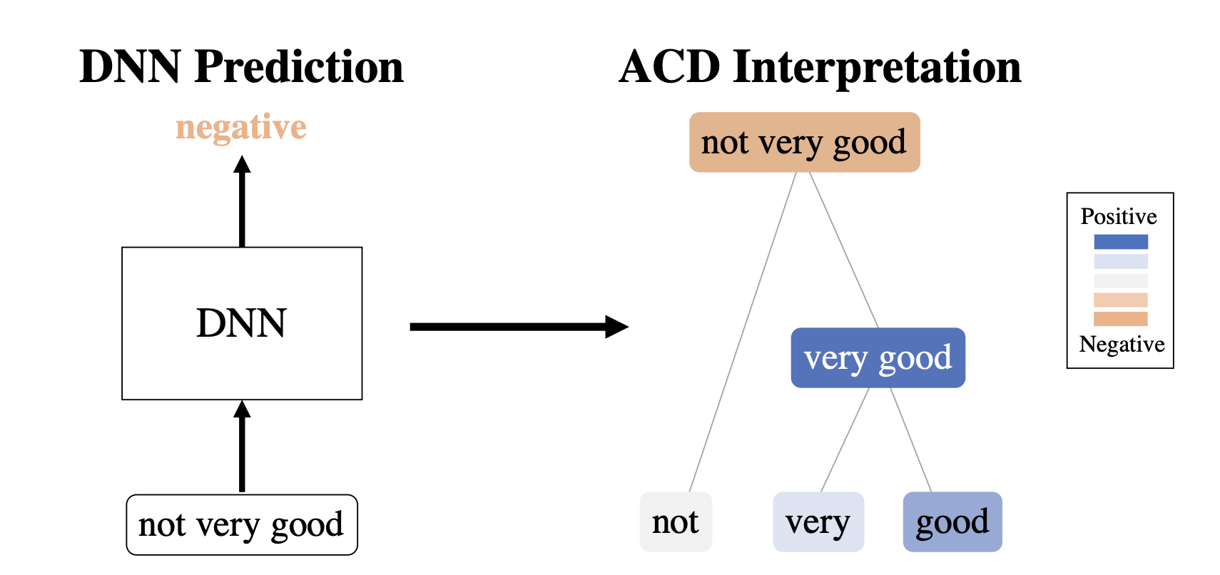
An Intuitive Figure Showing WHY Claim
Notes:
Here, we make the claim of this project.

Slide 7
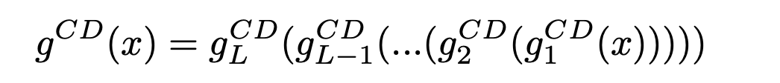
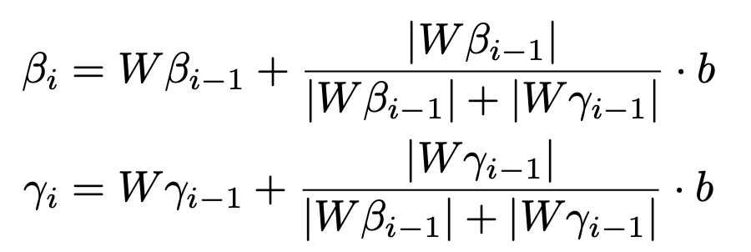
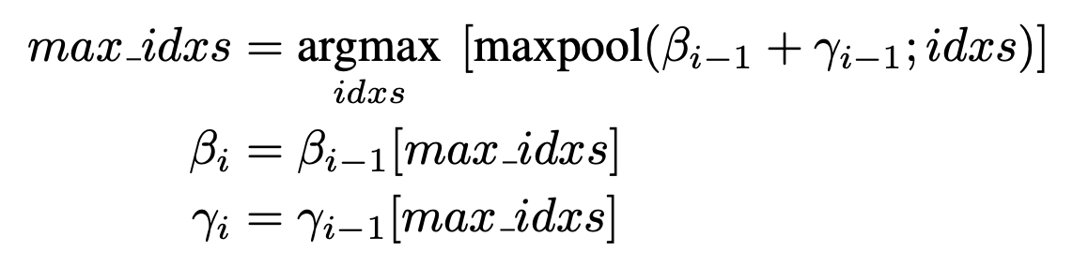
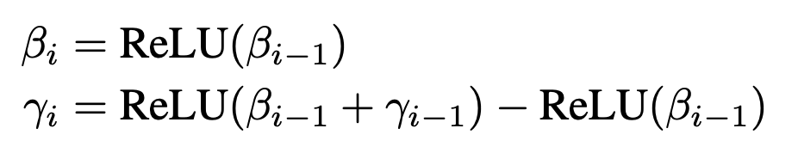
Proposed Solution
Expanding CD to general multilayer DNN:
Expressing contribution of every layer importance as sum of feature set and non-feature set.
For a convolution layer:
For max-pool layers:
For ReLU:
Notes:
Here is our proposed solution.

Slide 8
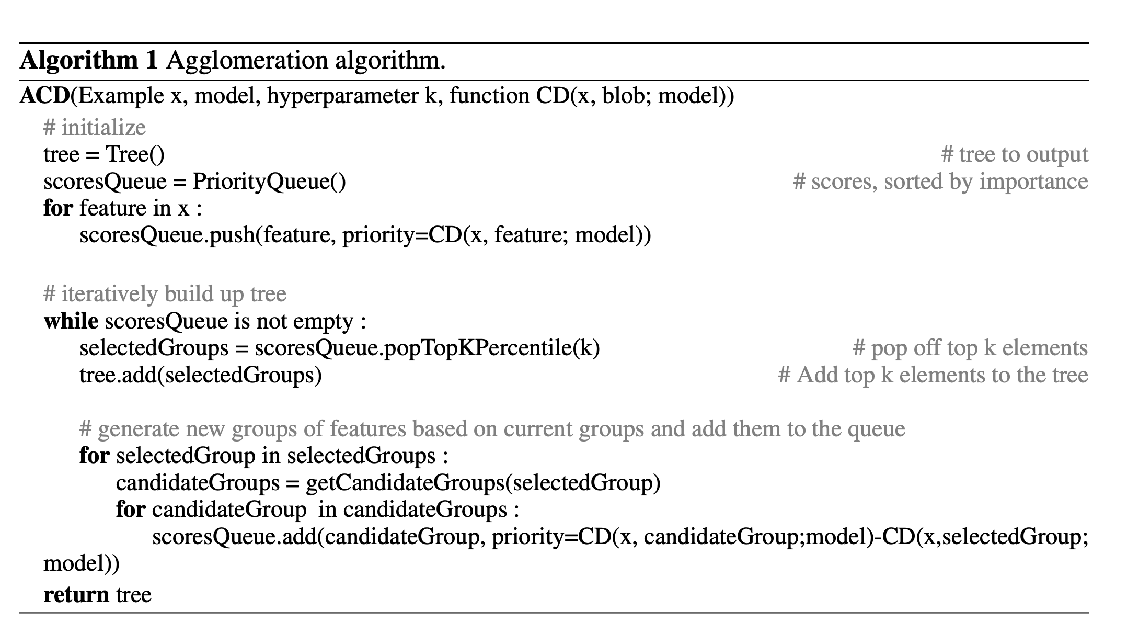
Implementation
Notes:
In the rest of this presentation, I’m going to talk about following contents:

Slide 9
Data Summary
Imagenet
MNIST
SST
Notes:
In the rest of this presentation, I’m going to talk about following contents:

Slide 10
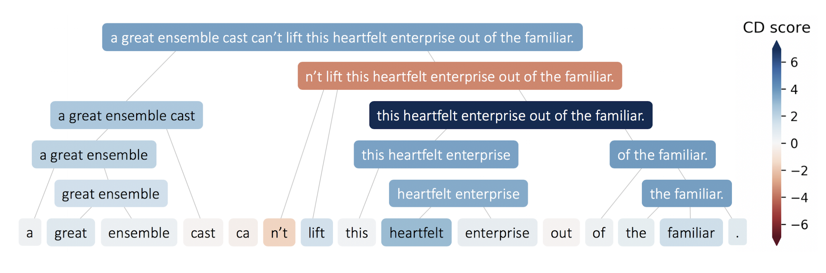
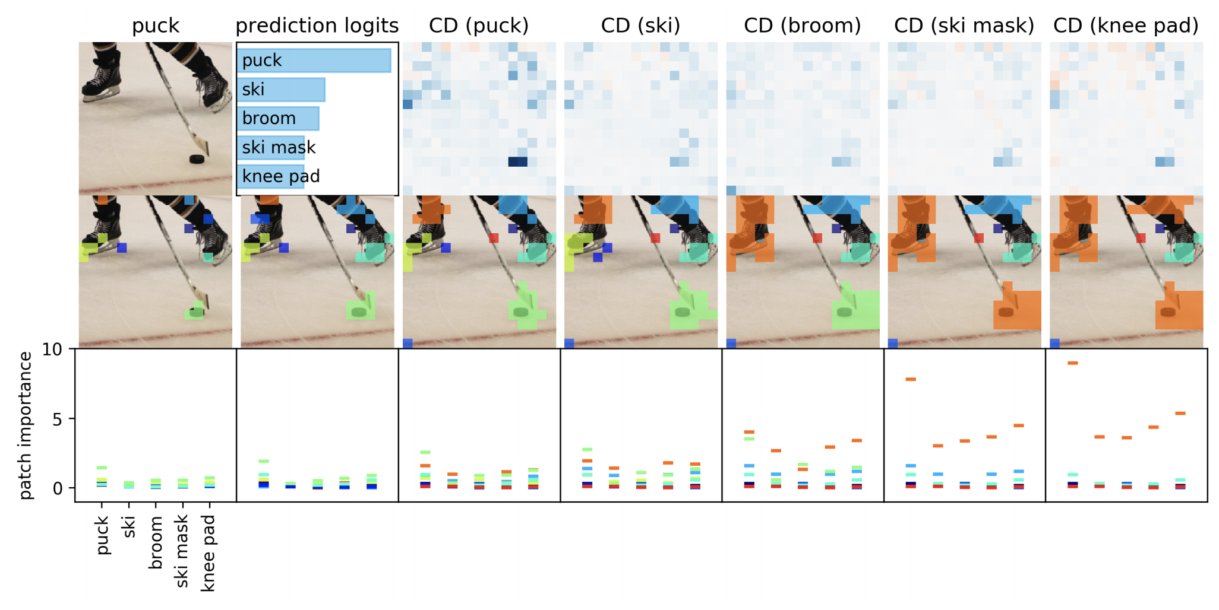
Experimental Results
Notes:
In the rest of this presentation, I’m going to talk about following contents:

Slide 11
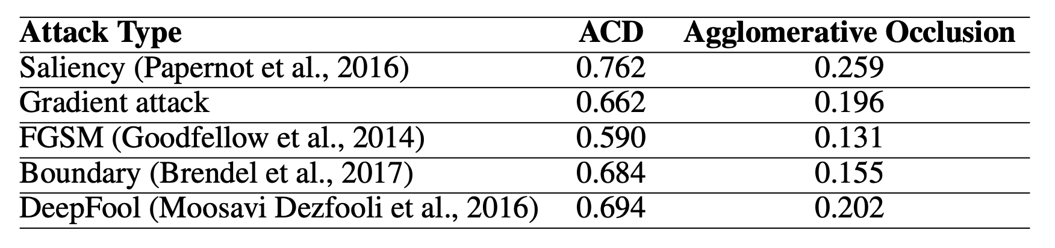

Slide 12
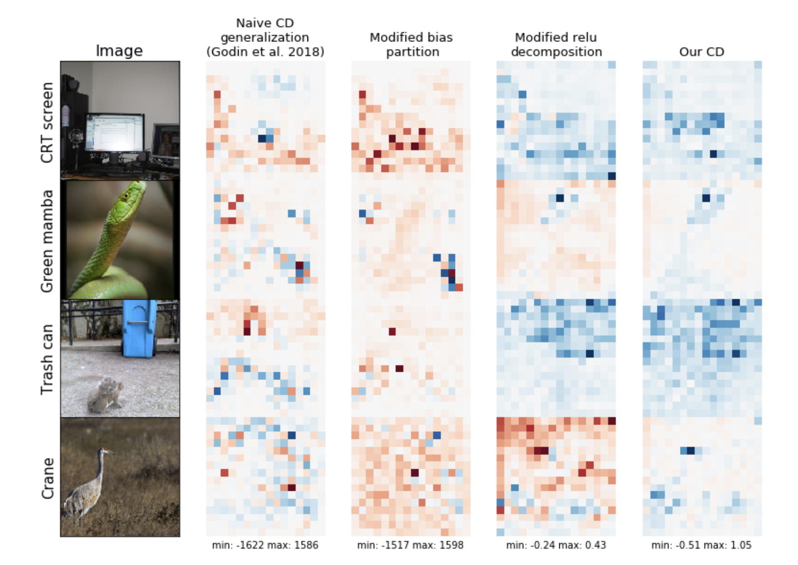
Experimental Analysis
The hockey and puck example highlights a glaring bias in the system. The detection of puck is dependent upon the presence of skates in the system.
Now if a similar object is replaced in position of puck with same backgrounds and settings, the model will tend to call it a puck
Notes:
In the rest of this presentation, I’m going to talk about following contents:

Slide 13
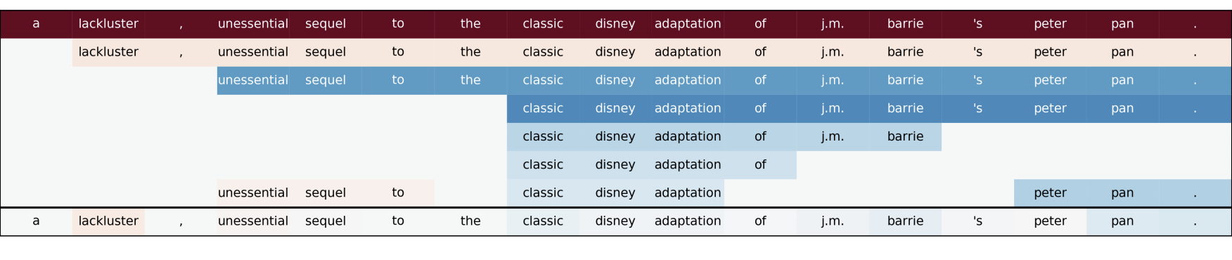

Slide 14
Conclusion/ Future Work
Can identify bias in datasets
Clear explainability as a bottom up prediction
Robustness to adversarial perturbations
Paving way for intuitive explainability

Slide 15
Plan for Sanchit
Taking a step back and reading about saliency map generations - Guided Backprop and GradCAM
Reading if Saliency methods can be applied to GraphNN

Slide 16
References
W James Murdoch, Peter J Liu, and Bin Yu. Beyond word importance: Contextual decomposition to extract interactions from lstms. arXiv preprint arXiv:1801.05453, 2018.
Sebastian Bach, Alexander Binder, Gregoire Montavon, Frederick Klauschen, Klaus-Robert Muller, ¨ and Wojciech Samek. On pixel-wise explanations for non-linear classifier decisions by layer-wise relevance propagation. PloS one, 10(7):e0130140, 2015.
W. James Murdoch, Chandan Singh, Karl Kumbier, Reza Abbasi-Asl, and Bin Yu. Interpretable machine learning: definitions, methods, and applications. arXiv preprint arXiv:1901.04592, 2019.

