Slide 1

Learning Variational Word Masks to Improve the Interpretability of Neural Text Classifier
Hanjie Chen, Yangfeng Ji
19 October 2020
Presenter: Sanchit Sinha
https://qdata.github.io/deep2Read/

Slide 2
Motivation
Interpretability is important for reaffirming - reliability and trustworthiness of models
Overcoming “black-box” nature of deep learning models
Designing a model agnostic explainability method which can be used as a small addition during training
It should be generalisable enough for all kinds of models, so only applied at the input layers
No need for human intervention in providing correct or “ground truth” explanations or annotations
Making interpretability one of the fundamental property of the network - “built into it”
Notes:
The motivation of this project

Slide 3
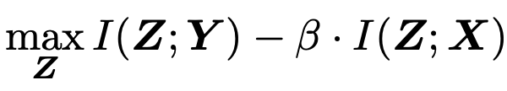
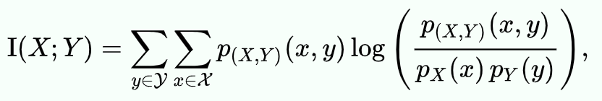
Background
Information Bottleneck framework
Mutual information/Information Gain:

Slide 4
Related Work
Information Theory based explainability methods:
Maximizing mutual information to recognize important features - Chen et al., 2018; Guan et al., 2019
Optimizing the information bottleneck to identify feature attributions - Schulz et al., 2020; Bang et al., 2019
Improving prediction using interpretability:
Post-hoc explanations to regularize models on prediction behaviors and force them to emphasize more on predefined important features - Ross et al., 2017; Ross and Doshi-Velez, 2018; Liu and Avci, 2019; Rieger et al., 2019
Trying to correspond interpretability with human explainations
Camburu et al., 2018; Du et al., 2019b; Chen and Ji, 2019; Erion et al., 2019; Plumb et al., 2019

Slide 5
Claim / Target Task
Introduce a model agnostic binary layer (mask) on top of the inputs which improves interpretability
The layer acts as a filter to control the interactions of non-important words and only allows the important words to affect the output
Layer gives better prediction and interpretability performance
Notes:
Here, we make the claim of this project.

Slide 6
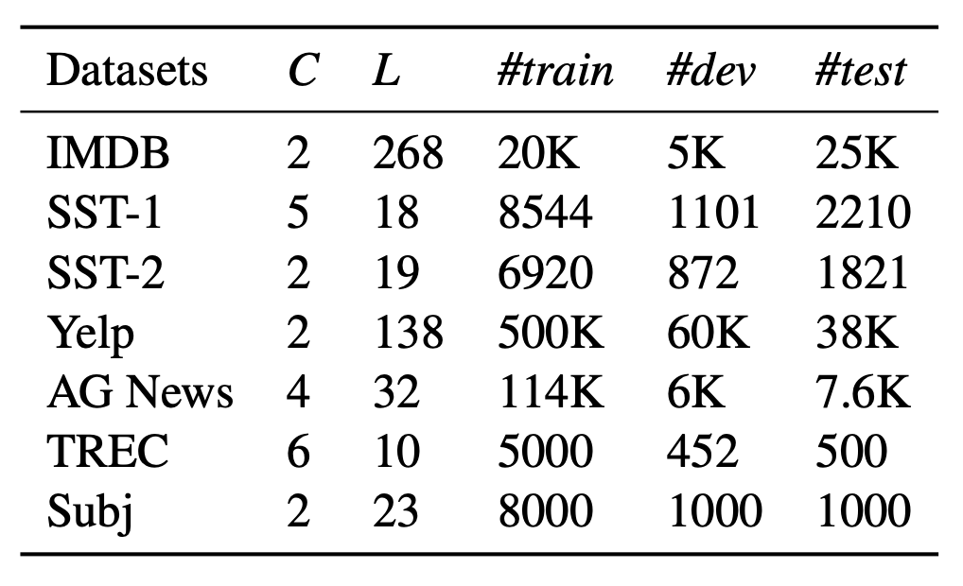
Data Summary
Notes:
In the rest of this presentation, I’m going to talk about following contents:

Slide 7
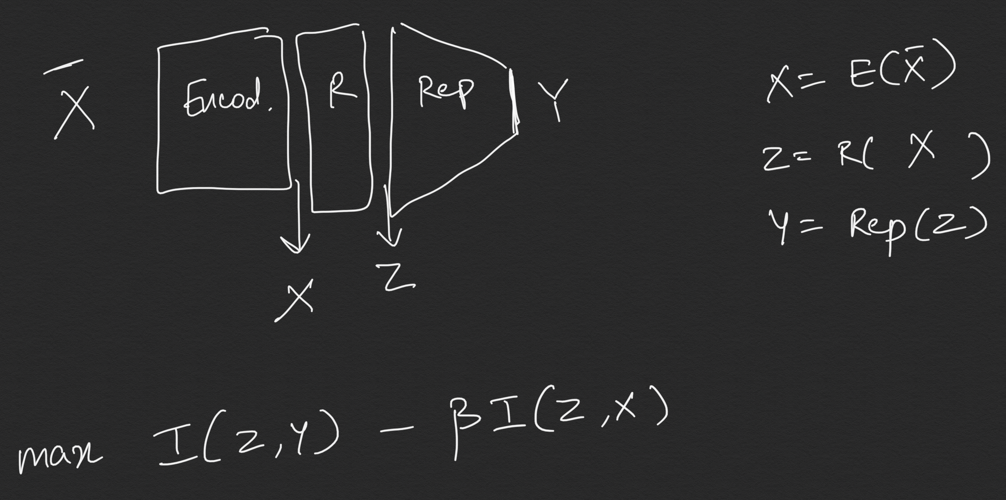
An Intuitive Figure Showing WHY Claim
Notes:
Here, we make the claim of this project.

Slide 8
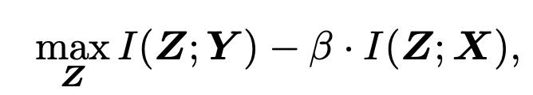
Proposed Solution
Notation :
X: Input words encoded into embeddings
R: Our custom V-Mask Layer. Every element is {0,1}
Z: Output of hadamard product of X and R
Y: The output prediction of the network (after classification)
Main optimization function:
Replacing p(x,y,z) [True distribution] with q(x,y,z) [Approximation distribution]
Notes:
Here is our proposed solution.

Slide 9
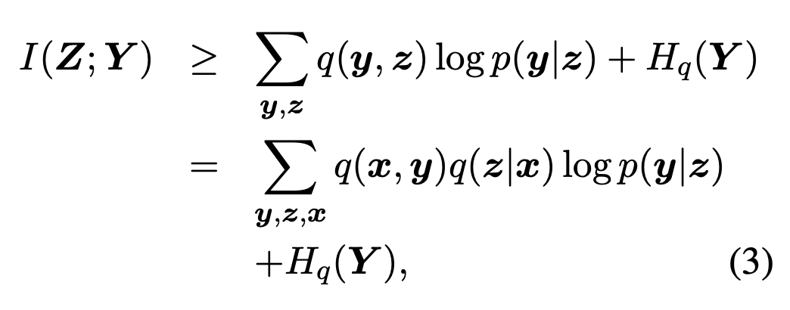
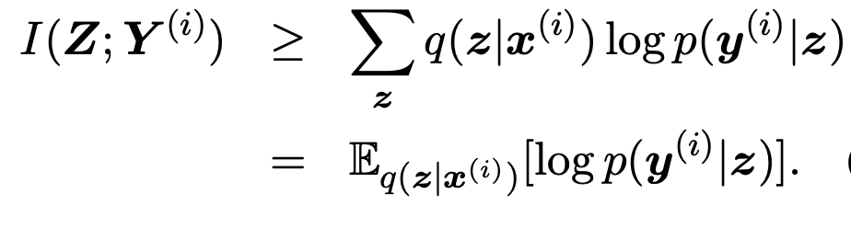
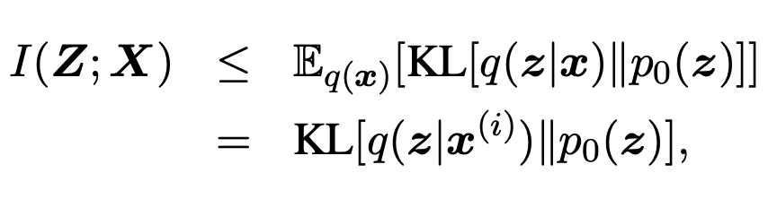
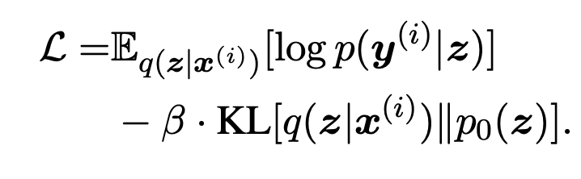
Proposed Solution
Term-1:
Term-2:
Final optimization:
Notes:
Here is our proposed solution.

Slide 10
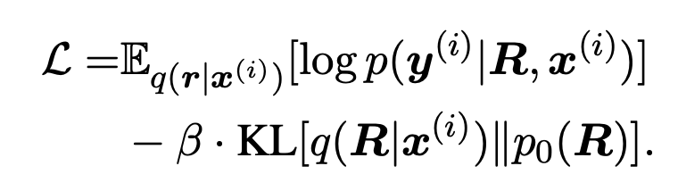
Proposed Solution
Substituting for R, we get
Tricks for optimization
Mean-field approximation (independence of rand vars)
Gumbel-softmax trick (for softmax)
KL cost annealing (posterior collapse)
Models used - same as last paper CNN, LSTM, BERT
Notes:
Here is our proposed solution.

Slide 11
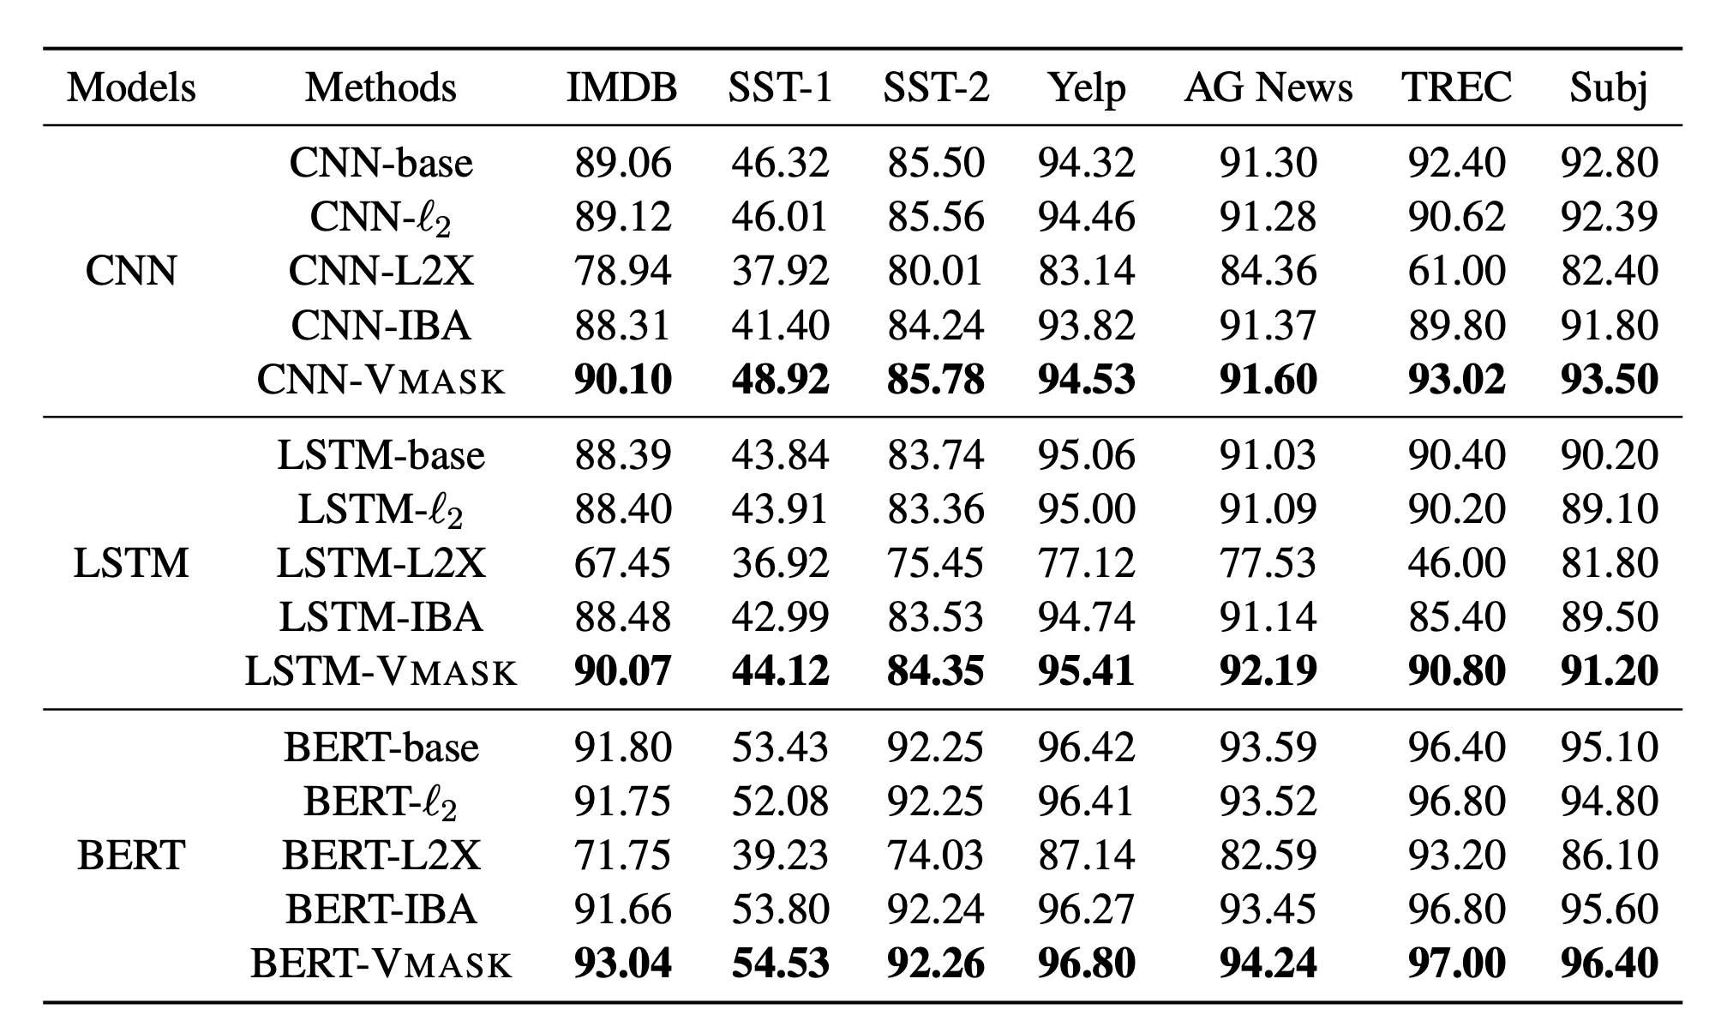
Experimental Results - Training
Notes:
In the rest of this presentation, I’m going to talk about following contents:

Slide 12
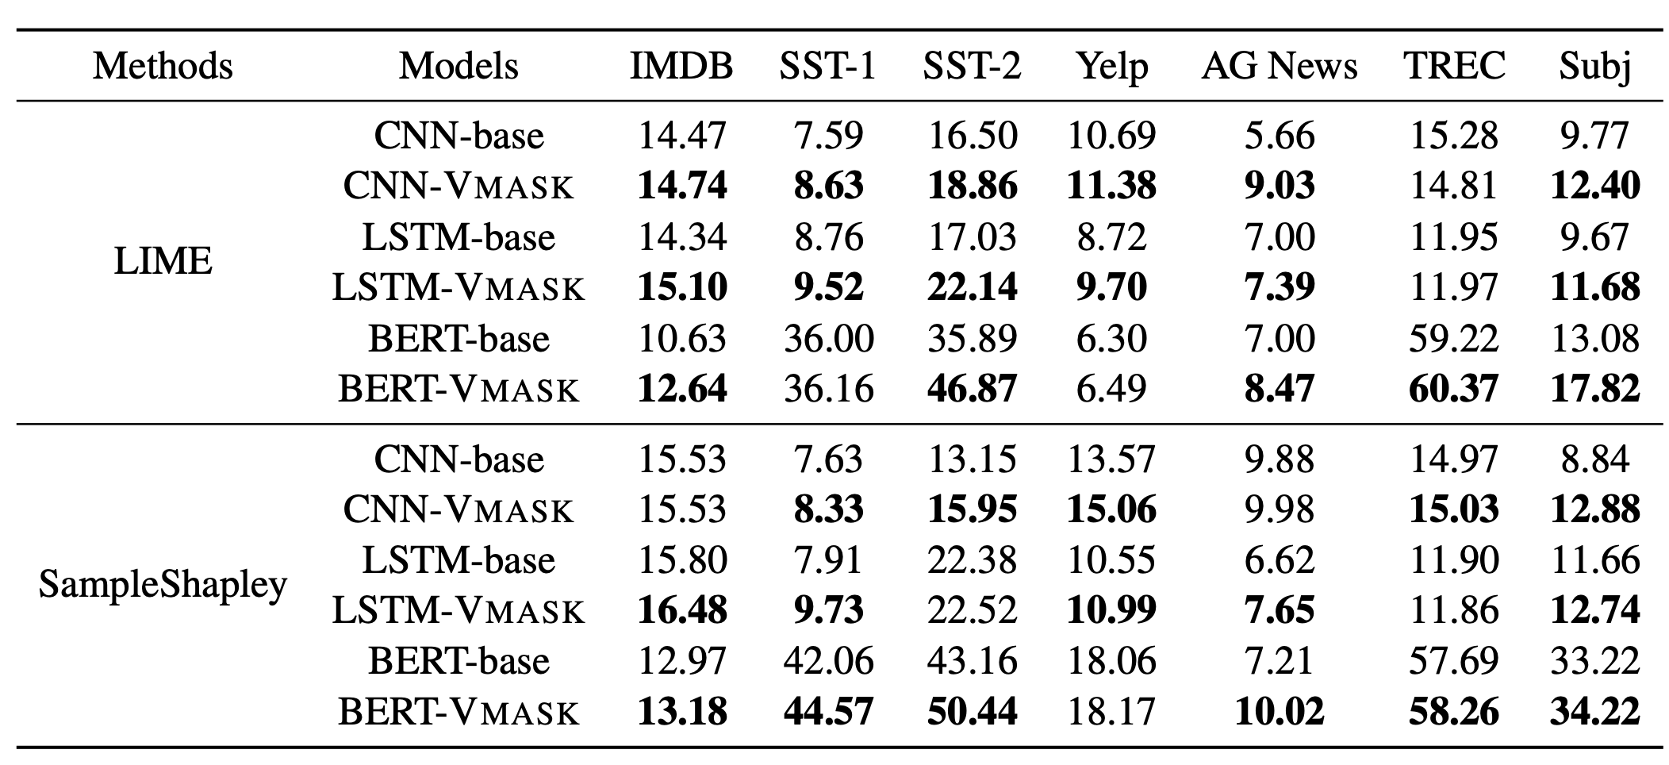
Experimental Results - AOPC
Notes:
In the rest of this presentation, I’m going to talk about following contents:

Slide 13
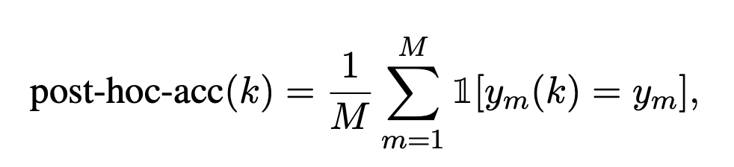
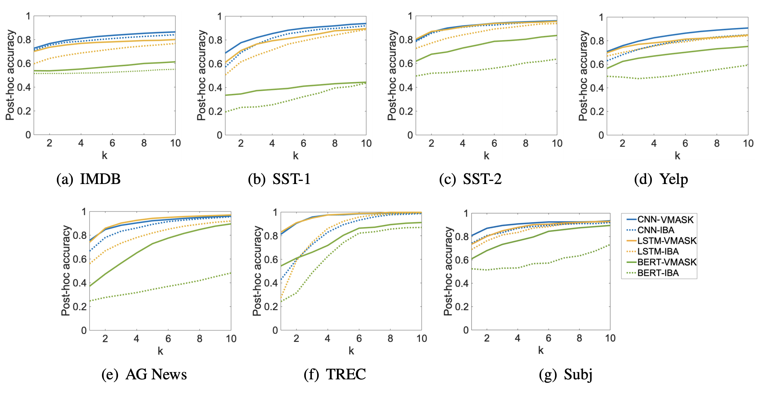
Experimental Results - Post-hoc accuracy
Influence of top k% words on the accuracy vs the whole text
Notes:
In the rest of this presentation, I’m going to talk about following contents:

Slide 14
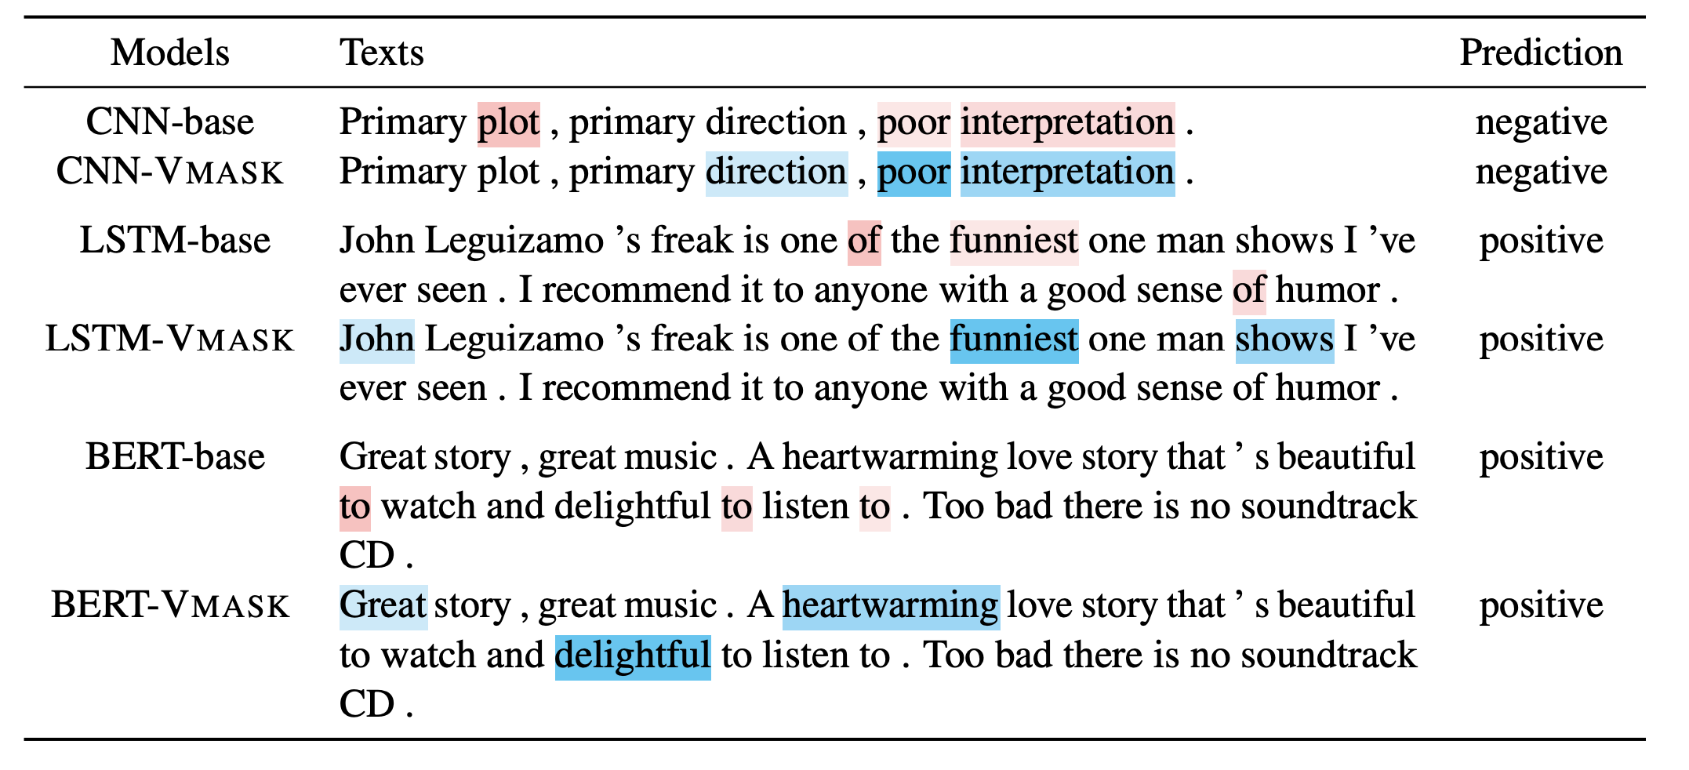
Experimental Results - Qualitative
Notes:
In the rest of this presentation, I’m going to talk about following contents:

