Slide 1

Sanity Checks for Saliency Maps
21 Jan 2020
Presenter: Sanchit Sinha
https://qdata.github.io/deep2Read/

Slide 2
Motivation
Saliency maps - to study contribution of various neurons in final outputs/predictions of DNNs
Saliency methods - used for explaining predictions made by neural nets. (Generate Saliency maps)
Several saliency methods proposed - Guided Backpropagation, Guided GradCAM, Integrated Gradients
The visual maps generated by the saliency methods tend to be evaluated visually - which is not completely correct
Comparisons to Edge maps are mere coincidence in most cases and cannot be used to justify the
Which SM to use? Which is the most explainable/robust?
Devising experiments on parameters and data to check which saliency method gives the best explanation
Notes:
The motivation of this project

Slide 3
Background
Need for Saliency methods - There is no consensus if the models produce explainable predictions
Why Explainability? - Required for debugging, remove bias, regulatory, etc.
Predictions should not be randomly done and a simple change in data/structure can make the predictions horribly wrong
Several suggested explanation methods (Saliency methods) try to predict what the model is actually learning and predicting
Need to evaluate which saliencey method is the most useful
If visual doesn’t work very well we need a different type of measures to measure the similarity between saliency maps - mere coincidence

Slide 4
Related Work
Not a lot I have read but the few I have glossed over:
Alfredo Vellido, José David Martín-Guerrero, and Paulo JG Lisboa. Making machine learning models interpretable. In ESANN, volume 12, pages 163–172. Citeseer, 2012.
Karen Simonyan, Andrea Vedaldi, and Andrew Zisserman. Deep inside convolutional networks: Visualising image classification models and saliency maps. arXiv preprint arXiv:1312.6034, 2013.
Jost Tobias Springenberg, Alexey Dosovitskiy, Thomas Brox, and Martin Riedmiller. Striving for simplicity: The all convolutional net. arXiv preprint arXiv:1412.6806, 2014

Slide 5
Claim / Target Task
Present 2 different experiments - one on model parameters and one on data labels
Randomization of model parameters
“for a saliency method to be useful for debugging a model, it ought to be sensitive to model parameters.”
Randomization of labels
“..method insensitive to randomizing labels cannot possibly explain mechanisms that depend on the relationship between instances and labels present in the data generating process”
Compare the saliency maps - visually and using some metrics
Notes:
Here, we make the claim of this project.

Slide 6
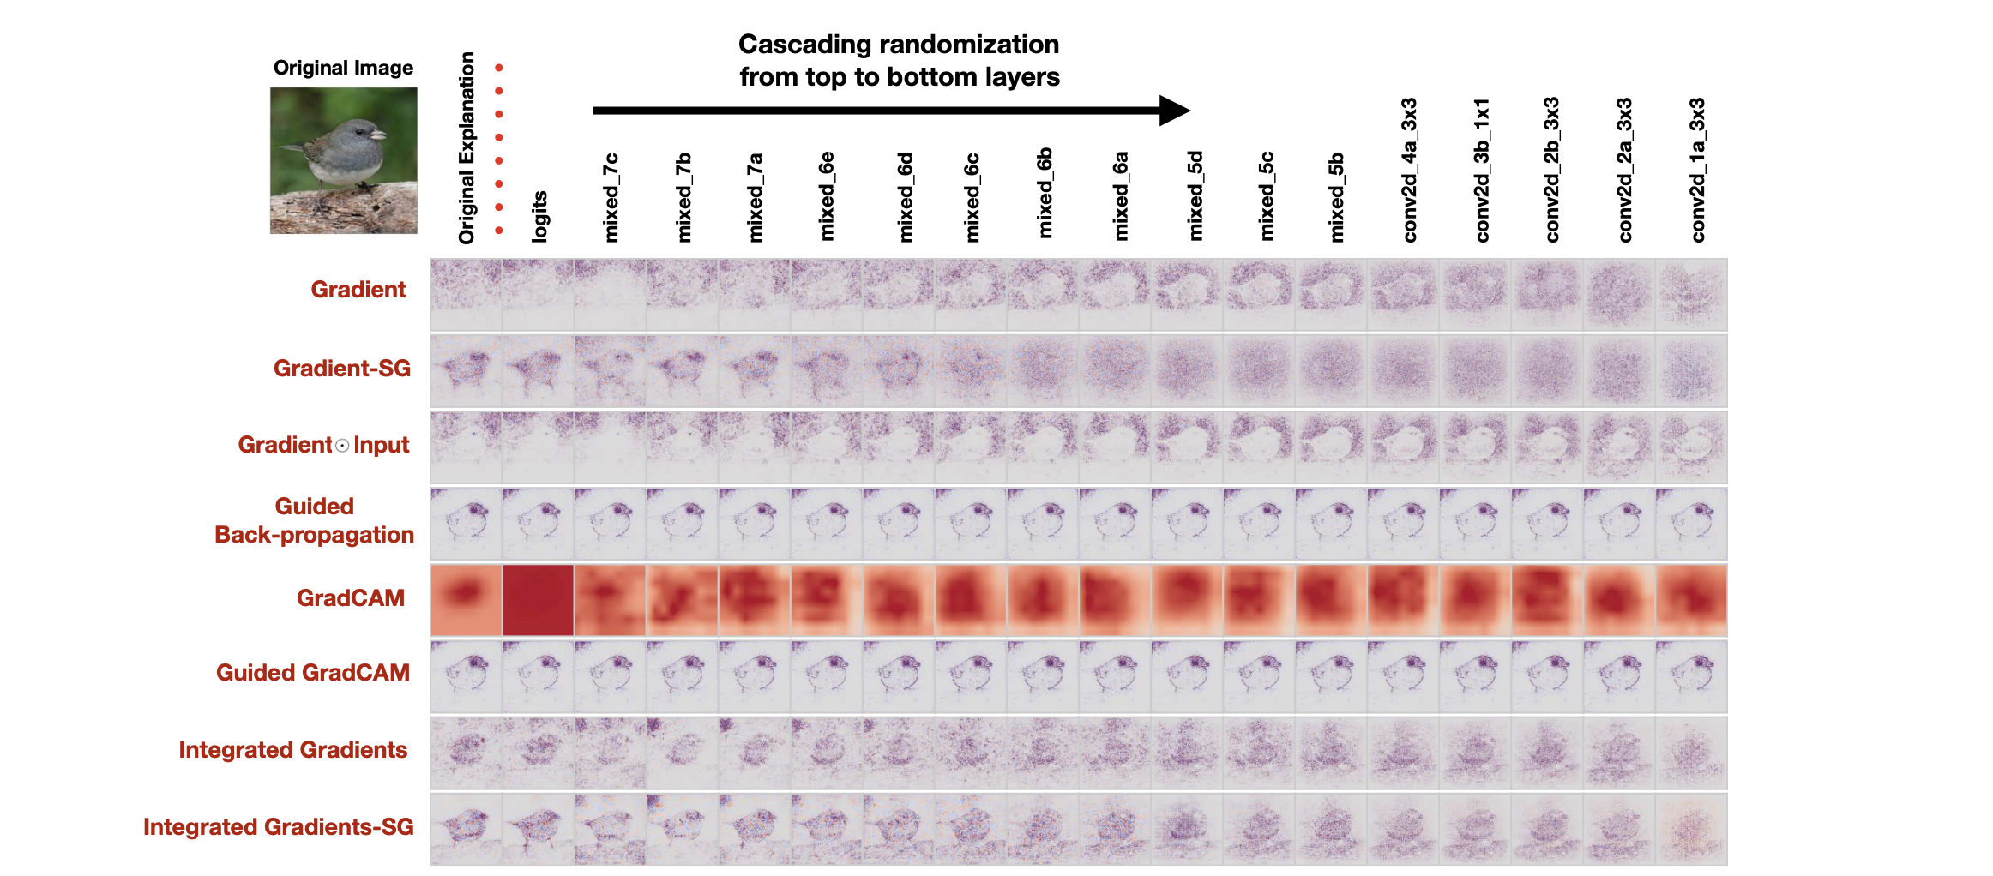
An Intuitive Figure Showing WHY Claim
Notes:
Here, we make the claim of this project.

Slide 7
Proposed Solution
Randomization of model parameters
2 experiments - cascaded randomization and independent (layer-wise)
Cascaded - top -> top+(top-1) -> … -> top+(top-1)+...1
Independent - top -> top-1 -> top-2 … -> 1
Assessed the Saliency maps using:
Visual
HOG similarity
SSIM similarity
Randomization of labels
“..method insensitive to randomizing labels cannot possibly explain mechanisms that depend on the relationship between instances and labels present in the data generating process”
Assessed using Rank Correlation
Visual
Notes:
Here is our proposed solution.

Slide 8
Implementation
Trained following models for both experiments on 3 datasets:
Imagenet - Inception v3
MNIST - MLP
Fashion MNIST - CNN
Methods tested:
Gradient
Gradient-SG
Gradient element-wise Input
Guided Backpropagation
Guided GradCAM
GradCAM
Integrated Gradients
Integrated Gradients-SG
Notes:
In the rest of this presentation, I’m going to talk about following contents:

Slide 9
Data Summary
Imagenet
MNIST
Fashion MNIST
Notes:
In the rest of this presentation, I’m going to talk about following contents:

Slide 10
Experimental Results - Param
Notes:
In the rest of this presentation, I’m going to talk about following contents:

Slide 11
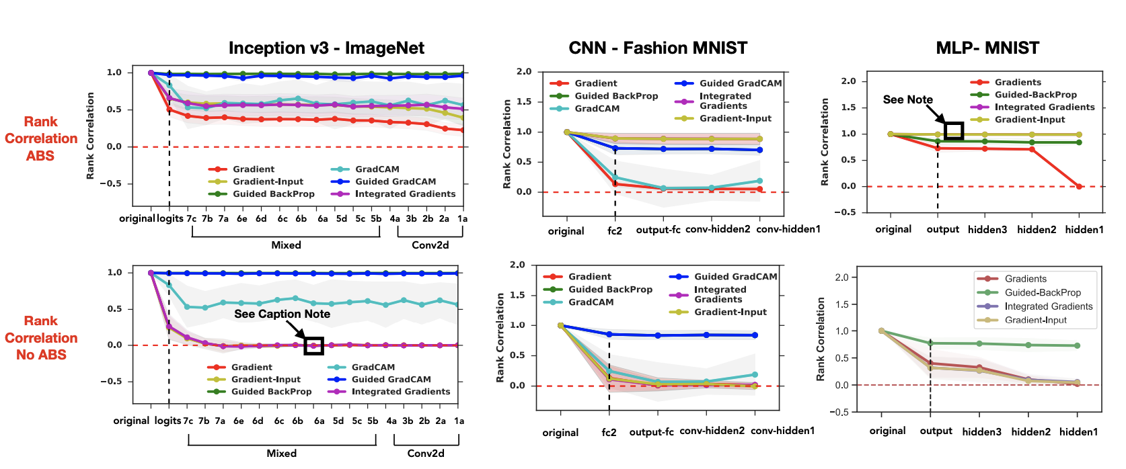
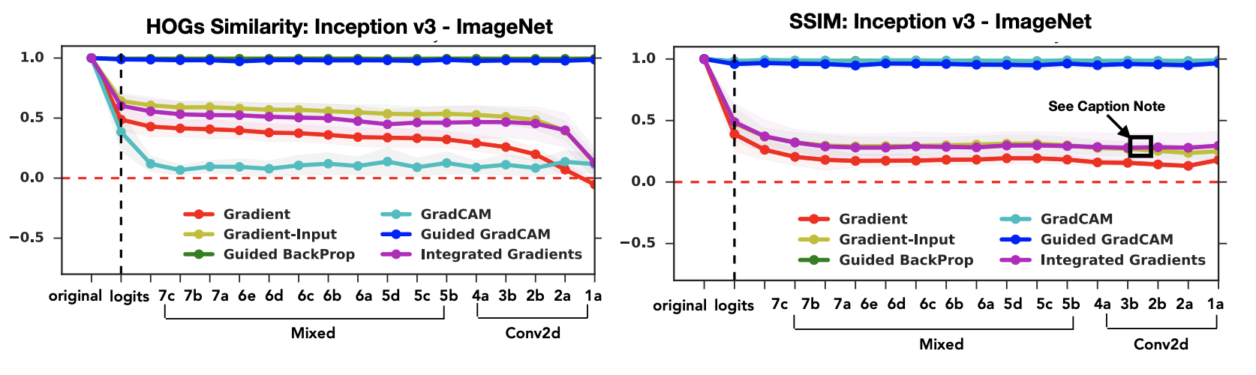

Slide 12
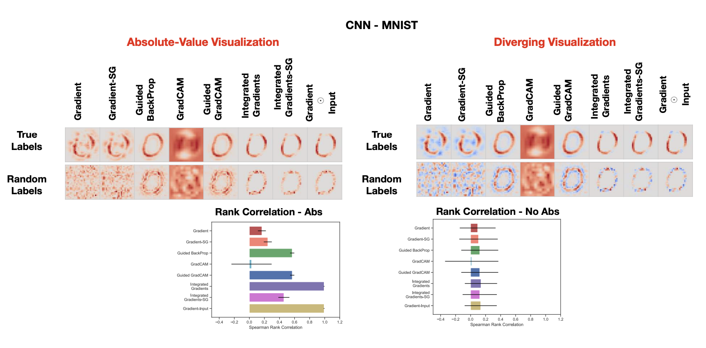
Experimental Results - Labels

Slide 13
Experimental Analysis
Compared the sensitivity among different Saliency methods:
Guided Backprop and Guided GradCAM (very famous) is broken
Gradient * Input (element wise) is the most sensitive
Guided GradCAM no better than an edge detector which is independent of the training data
There is confirmation bias in where visually equating Saliency maps gives any explanation
Notes:
In the rest of this presentation, I’m going to talk about following contents:

Slide 14
Conclusion and Future Work
Framework for better testing of explanation methods
Some saliency methods are totally useless

Slide 15
References
Alfredo Vellido, José David Martín-Guerrero, and Paulo JG Lisboa. Making machine learning models interpretable. In ESANN, volume 12, pages 163–172. Citeseer, 2012.
Karen Simonyan, Andrea Vedaldi, and Andrew Zisserman. Deep inside convolutional networks: Visualising image classification models and saliency maps. arXiv preprint arXiv:1312.6034, 2013.
Jost Tobias Springenberg, Alexey Dosovitskiy, Thomas Brox, and Martin Riedmiller. Striving for simplicity: The all convolutional net. arXiv preprint arXiv:1412.6806, 2014

