Slide 1

Survey of data generation and evaluation in Interpreting DNN pipelines
Presenter: Sanchit Sinha
https://qdata.github.io/deep2Read/
24 April 2020

Slide 2
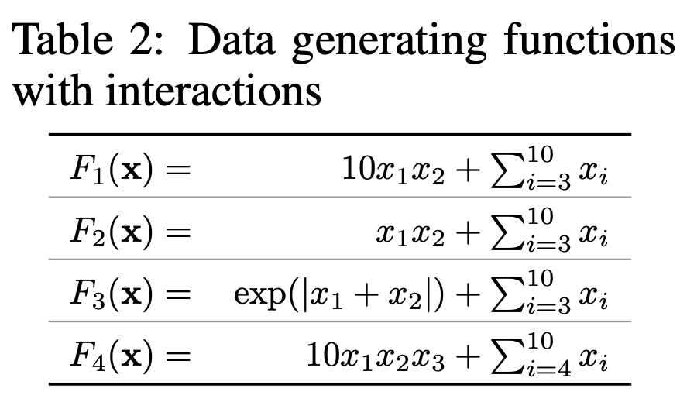
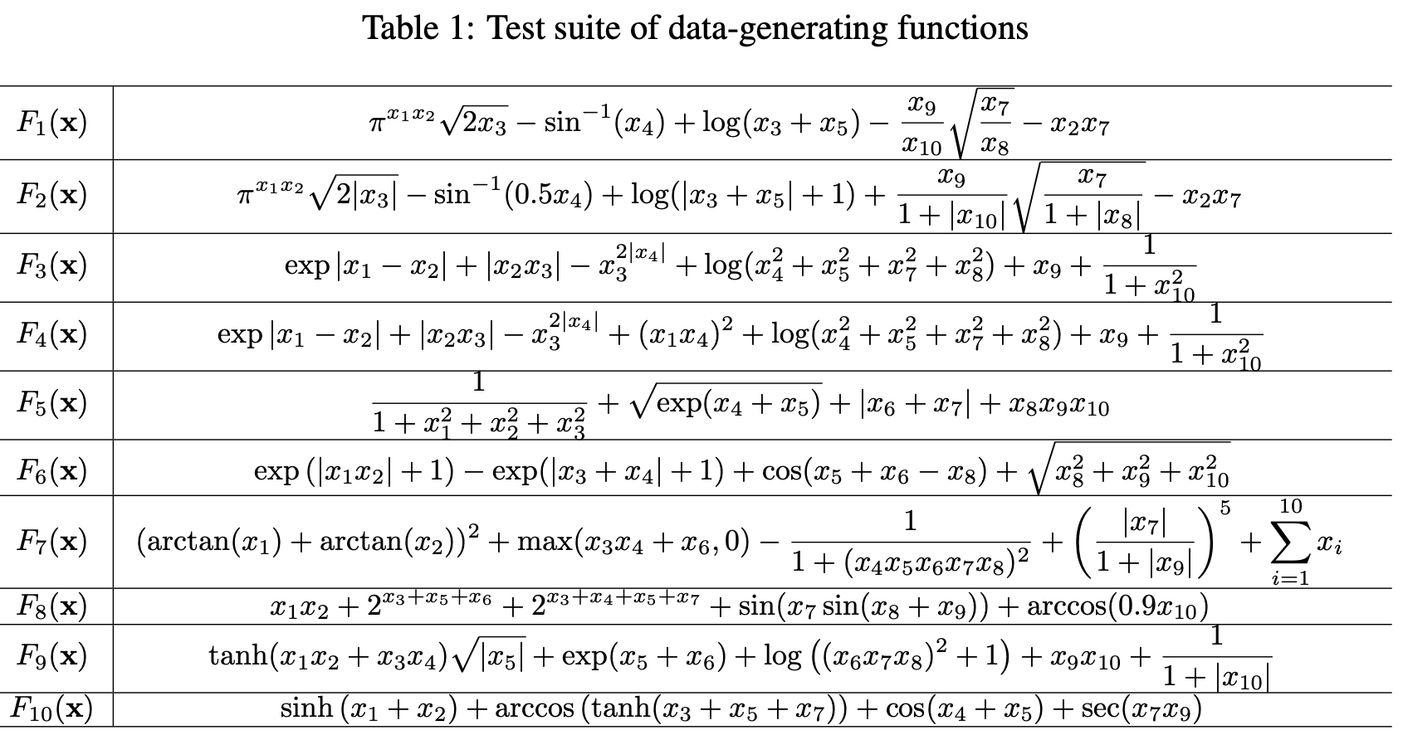
Approach-1a Generating data from probability distributions/functions
We specifically model the data to find out what exactly we want to test
“Can I trust you more? Model-agnostic Hierarchical Explanations” Tsang et al.
Objective is to study the interactions b/w the features.
Generated data from functions have interactions between the variables pre-defined in the generating functions
Sorokina et al. Used a random function generator (Hooker)
Detecting Statistical Interactions from Neural Network Weights, Tsang et al., ICLR 2018 again used functions to model interactions between features
All these methods are modelling interactions between features

Slide 3
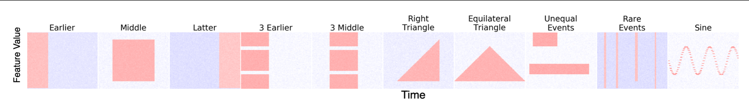
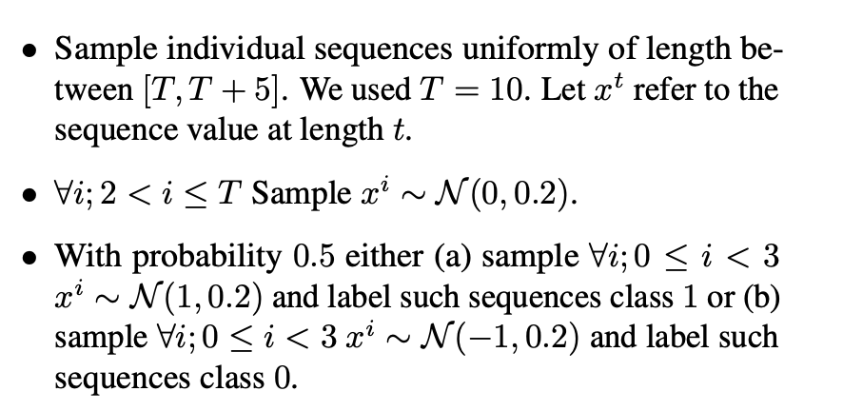
Approach-1b Manually creating data and modelling attention*
Generating data according to certain conditions which are desirable to the distribution
This method allows to visually “see” the data and manually custom-craft the data distribution and features
Used in Input-Cell Attention, Ismail et al., 2019.
Think architecture first, Manuscript
Neural Network Attributions: A Causal Perspective, Chattopadhyay et al.
Notes:
The motivation of this project

Slide 4
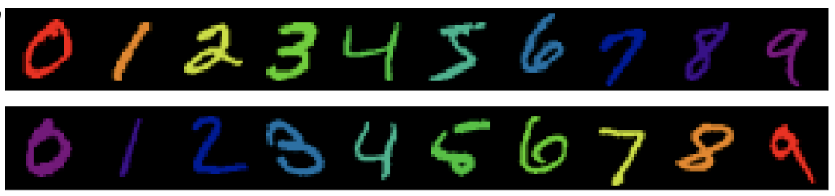
Approach 2 - Modifying real datasets
Altering real datasets
Adding color to Color MNIST - REPAIR, Li et al. and CDEP, Reiger et al. Adding color to MNIST - to learn if model looks at color or shape
DecoyMNIST - adding gray patch to the corner for images
Spurious signals (noise) in SST
Creating new features from original datasets:
As described by using SLIC superpixel in images to graphs
Using word relations to create graphs
Notes:
The motivation of this project

Slide 5
Evaluation Methods

Slide 6
Evaluation Methodologies (1)
Approach-1: Using qualitative assessments - visuals like saliency maps in images or scores of different words in NLP tasks [Might include Human experiments]
Papers using this approach:
Contextual Decomposition (CD), Murdoch et al., ICLR 2018
Picked phrases which showed ability to show negation
Hierarchical Interpretations of NN Predictions (ACD), Singh et al., ICLR 2019
Shown scores on images and sentences visually + human experiments
GradCAM, Selvaraju et al., ICCV 2017
Visual examination + error rates
Axiomatic Attribution for Deep Networks (IG), Sundararajan et al., ICML 2017
Visual examination + human perceived
“Why Should I Trust You?” Explaining the Predictions of Any Classifier, Ribeiro et al., SIGKDD, 2016
Human experiments to identify the important regions
Explaining Explanations: Axiomatic Feature Interactions for Deep Networks, Janizek et al., 2020
Qualitative experiments on samples from datasets

Slide 7
Papers with this approach
Neural Network Attributions: A Causal Perspective
Qualitative + simulated data
Can I trust you more? Model agnostic hierarchical explanations, Tsang et al, ICLR 2019
Randomly chosen phrases from the dataset, manual inspection
Interpretations are useful: penalizing explanations to align neural networks with prior knowledge, Reiger et al. ICLR 2020 (reject)
Penalizing interactions adding to loss function, training the network

Slide 8
Evaluation Methodologies (2)
Approach-2: Comparison between different methods [Usually occurs along with papers in Approach-1]
Papers using this approach:
Contextual Decomposition, Murdoch et al., ICLR 2018
Compared correlation b/w LR and CD, Gradient, LOO, Cell Decomp,IG
Sanity Checks for Saliency Maps, Adebayo et al., NIPS 2018
Correlation between various saliency methods and sanity checking their effectiveness by using experiments

Slide 9
Evaluation Methodologies (3)
Approach-3: Masking the most important attributions (the ones found with highest scores) and calculating the drop in accuracy/performance [When proposing new attribution technique]
Papers using this approach:
Data-Shapley : What is your data worth? Equitable Valuation of Data, Ghorbani et al., ICML 2019
Calculating score of a data point, removing highest, drop in accuracy calculated
L-Shapley and C-Shapley: Efficient Model Interpretation for Structured Data, Chen et al., ICLR 2019
Masking important features on text and images and calculating drop in Log odds ratio
Think Architecture First, Manuscript, 2020
Masking important features, drop in accuracy in LSTMs

Slide 10
Evaluation Methodologies (4)
Approach-4: Correlation between weights and outputs (for methods which claim a particular technique provides good explanation) or dependence
Papers which use this approach:
Attention is not Explanation, Jain et al. , ACL, 2019
Exploring correlation between attention weights and importance scores of grads/LOO showing no significant correlations

Slide 11
Evaluation Methodologies (5)
Approach-5: Robustness
Interpretation of Neural Networks is Fragile*, Ghorbani et al., AAAI 2019
?

