Slide 1

Think Architecture First:
Benchmarking Deep Learning Interpretability in Time Series Predictions
3 April 2020
Presenter: Sanchit Sinha
https://qdata.github.io/deep2Read/

Slide 2
Motivation
Saliency methods used a lot to explain and rank the most important features of a data
Conundrum: Do we focus on better saliency methods or better model architecture or somewhere in between
Understanding usefulness of saliency methods on less studied time-series data
Considering a slightly different metric - precision and recall of the features
No ground-truth to compare to, come up with a way to compare.
It is easy to SEE in visual problems
Easy to INTERPRET in NLP tasks
No way to tell in raw feature tasks
Comparison between various saliency techniques (7) over multiple models (4) and datasets (11) = 308
Notes:
The motivation of this project

Slide 3
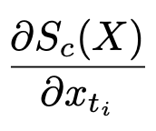
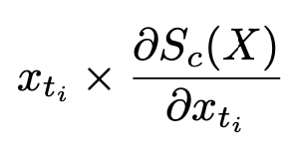
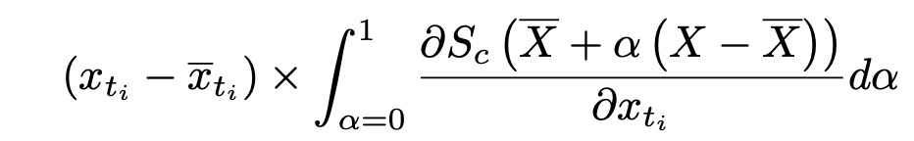
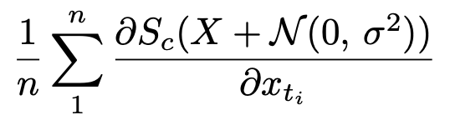
Background
Saliency methods:
Gradient (GRAD)
Input*Gradient
Integrated Gradient (IG)
SmoothGrad (SG)
DeepLift - Only x-x’
GradientSHAP - Adding Gaussian Noise to SmoothGrad
DeepSHAP - DeepLift + Shapley
Random

Slide 4
Related Work
The saliency methods mentioned before
Ismail, A. A., Gunady, M., Pessoa, L., Corrada Bravo, H., and Feizi, S. Input-cell attention reduces vanishing saliency of recurrent neural networks: On generating time series data
Transformers: Vaswani, A., Shazeer, N., Parmar, N., Uszkoreit, J., Jones, L., Gomez, A. N., Kaiser, Ł., and Polosukhin, I. Atten- tion is all you need.
Temporal Convolutional Network: (Oord et al., 2016; Lea et al., 2017; Bai et al., 2018)

Slide 5
Synthetic Data Generation
Gaussian noise with 0 mean and unit variance
Informative features highlighted by adding constant mu (=1) to positive class and subtracting mu from negative class
Dataset size is 1000 (training) and 300 (testing)
Embedding Size = 100, timesteps = 100
Types of data generated:
Earlier Boxes
Middle Boxes
Latter Boxes
Moving Box -
Right Triangle - information grows over time
Equilateral Triangle - important for the majority of the time points
Unequal Events
Rare - anomalies in time series variables
Sine - info varies widely over time.
Notes:
Here, we make the claim of this project.

Slide 6
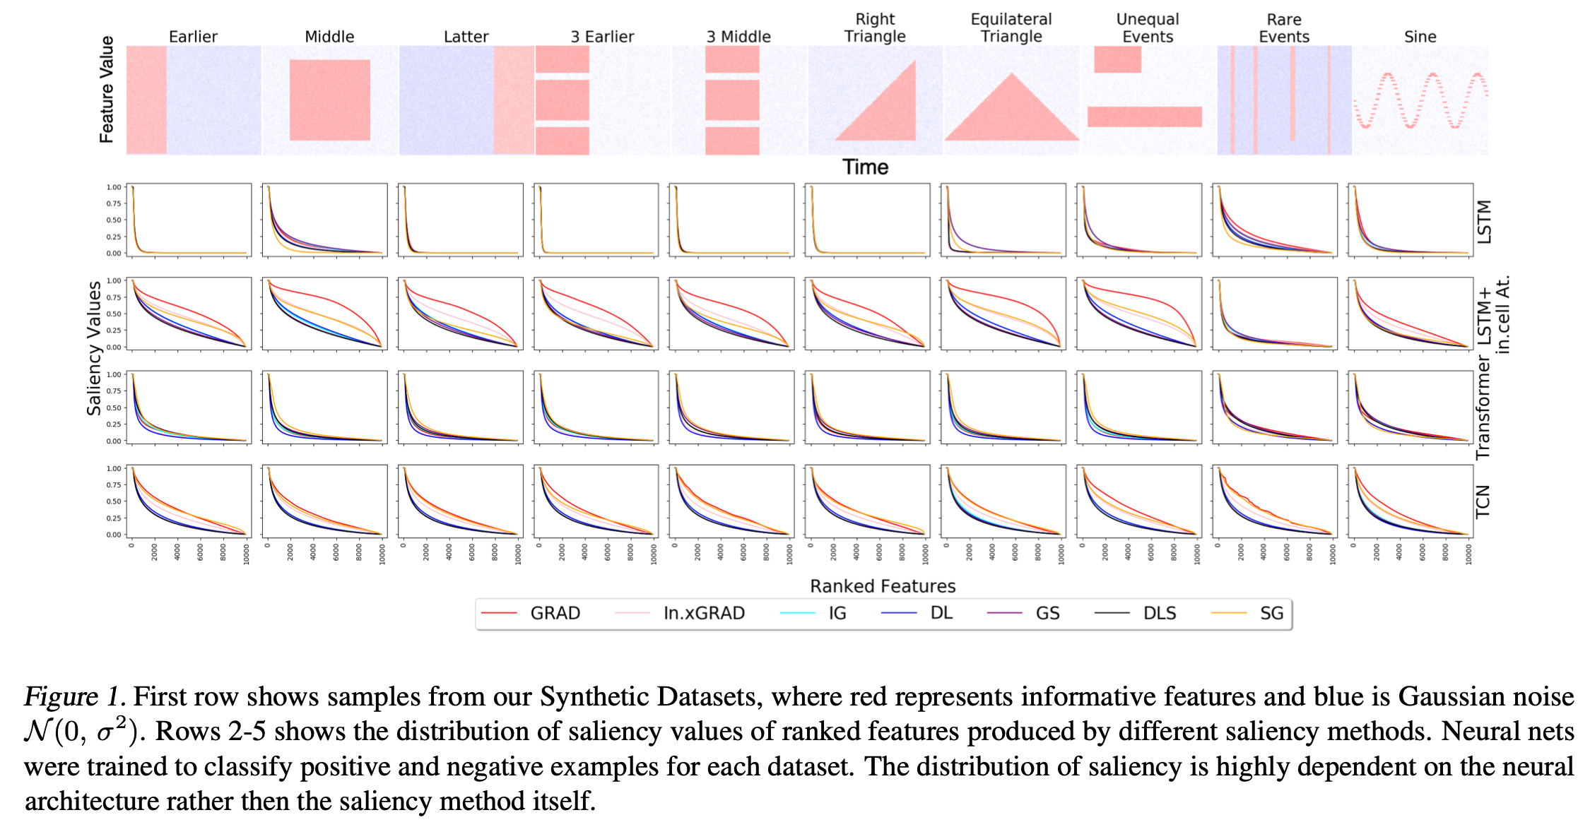
Figure for data generation
Notes:
Here, we make the claim of this project.

Slide 7
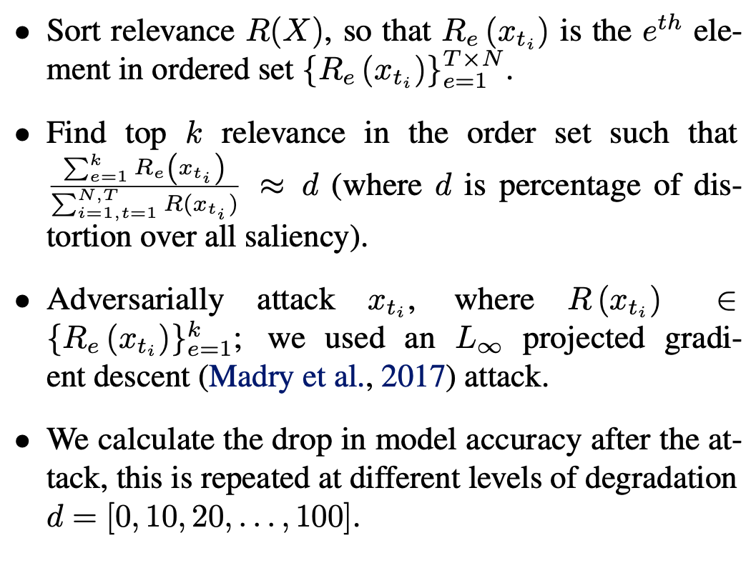
Proposed Solution
Notes:
Here is our proposed solution.

Slide 8
Proposed Solution - 2
The above process an result in:
A steep drop in accuracy, meaning that the attacked feature is necessary for a correct prediction (important feature)
Unchanged accuracy:
The saliency method incorrectly identified the feature as important (wrong method)
Removal is not sufficient for the model to behave incorrectly (ambiguous)
So solution which the authors have proposed is to use Precision and Recall

Slide 9
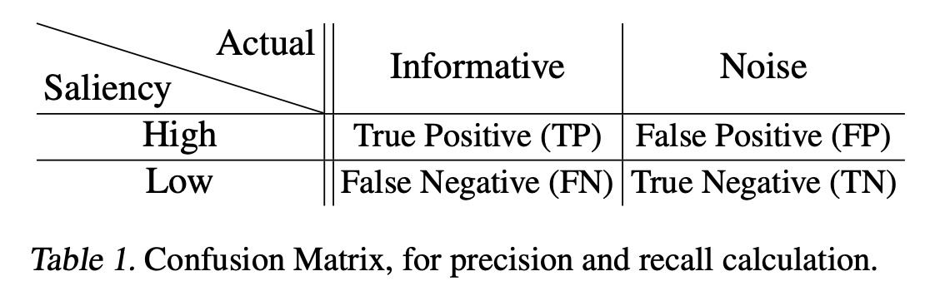
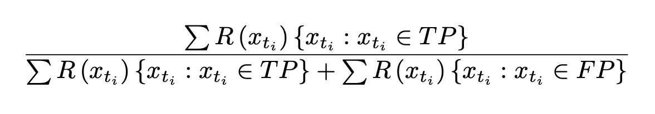
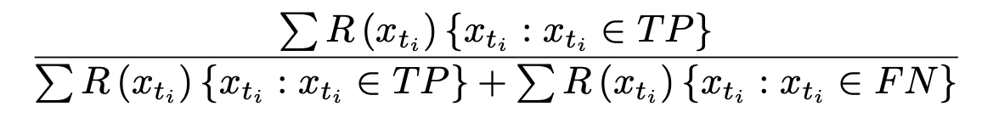
Metrics
Precision:
Recall:
Notes:
In the rest of this presentation, I’m going to talk about following contents:

Slide 10
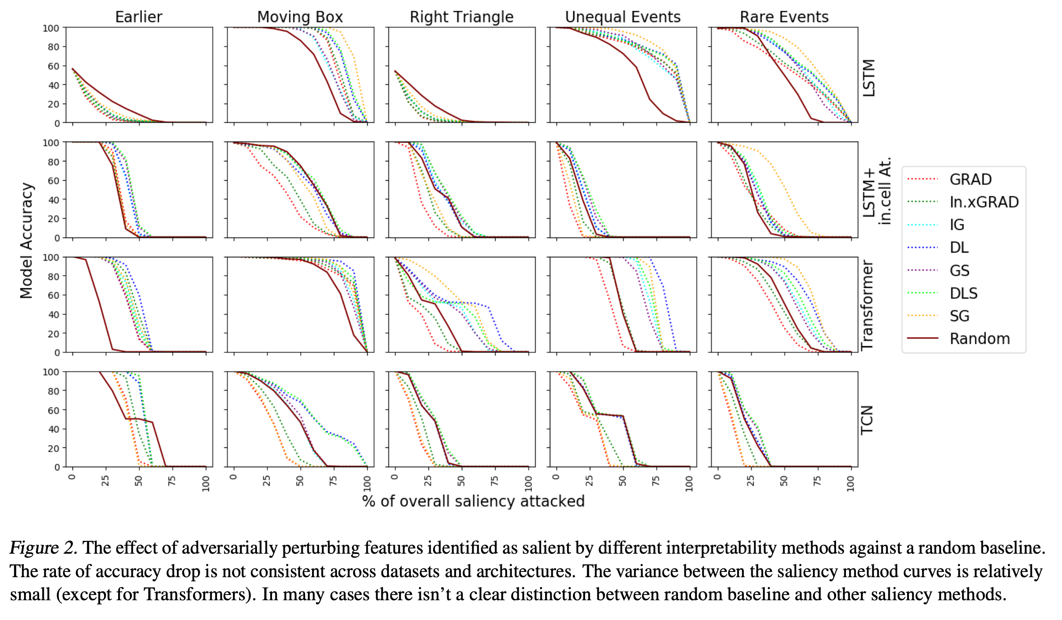
Experimental Results
Notes:
In the rest of this presentation, I’m going to talk about following contents:

Slide 11
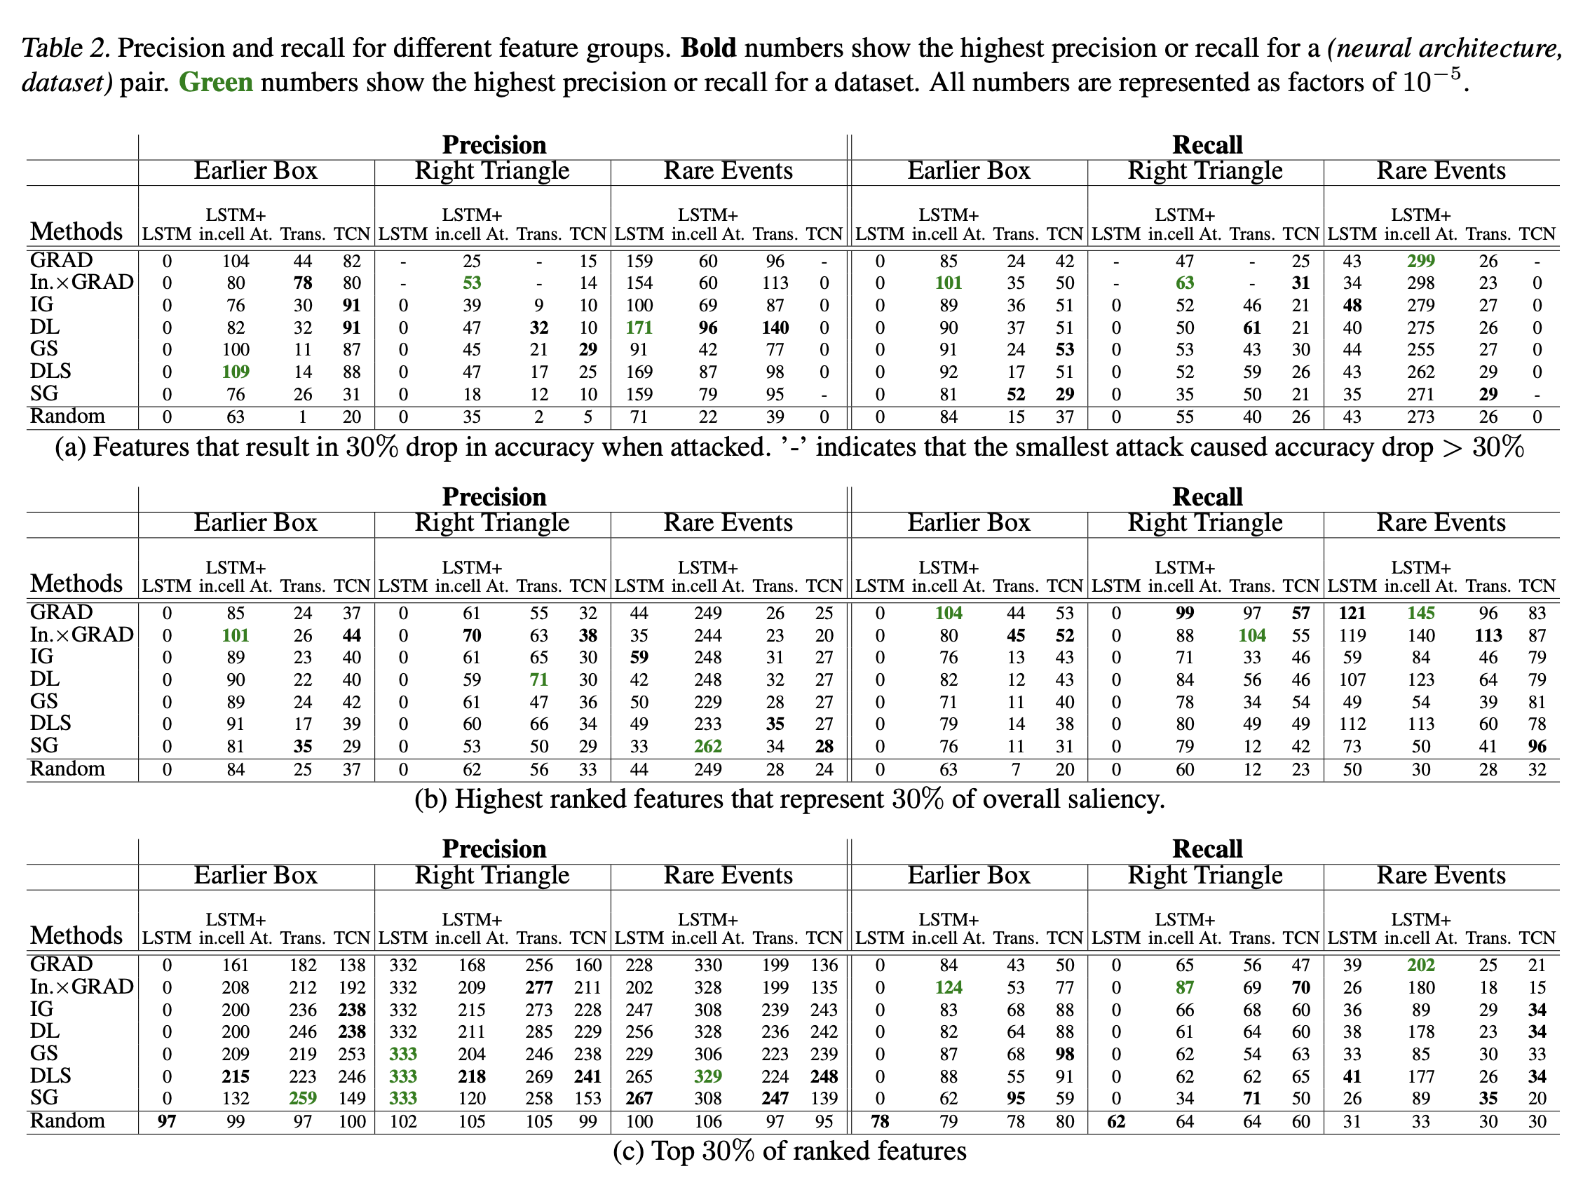
Experimental Results
Notes:
In the rest of this presentation, I’m going to talk about following contents:

Slide 12
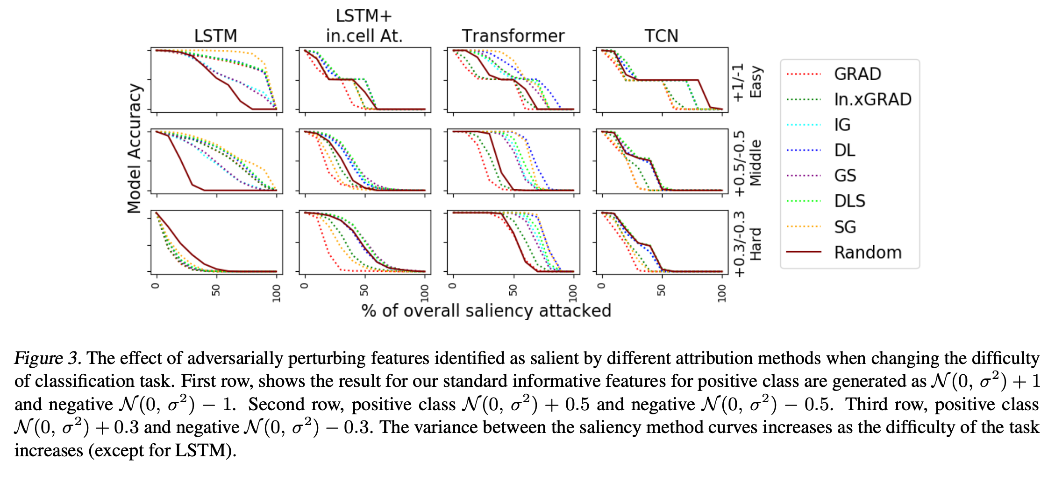
Experimental Results
Notes:
In the rest of this presentation, I’m going to talk about following contents:

Slide 13
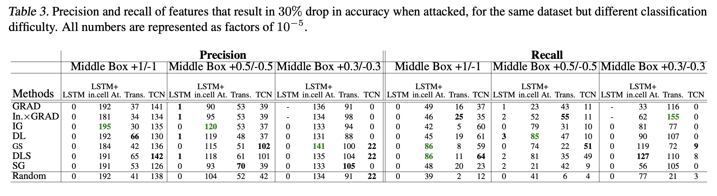
Experimental Results
Notes:
In the rest of this presentation, I’m going to talk about following contents:

