Slide 1

Universal Adversarial Triggers for Attacking and Analyzing NLP
Eric Wallace , Shi Feng , Nikhil Kandpal , Matt Gardner , Sameer Singh
3 March 2021
Presenter: Sanchit Sinha
https://qdata.github.io/deep2Read/

Slide 2
Motivation
Input-agnostic sequences of tokens that trigger a model to produce a specific prediction when concatenated to any input from a dataset
The fact that there are input agnostic triggers shows that there are biases in the model
Apart from these all adversarial attacks have the objective of disrupting model performance with minimal change in the inputs
If the triggers are input agnostic, it is possible to be used by anyone to disrupt any widely used model
Universal - anyone can generate the attack using their own model trained on similar data and transfer it.
Notes:
The motivation of this project

Slide 3
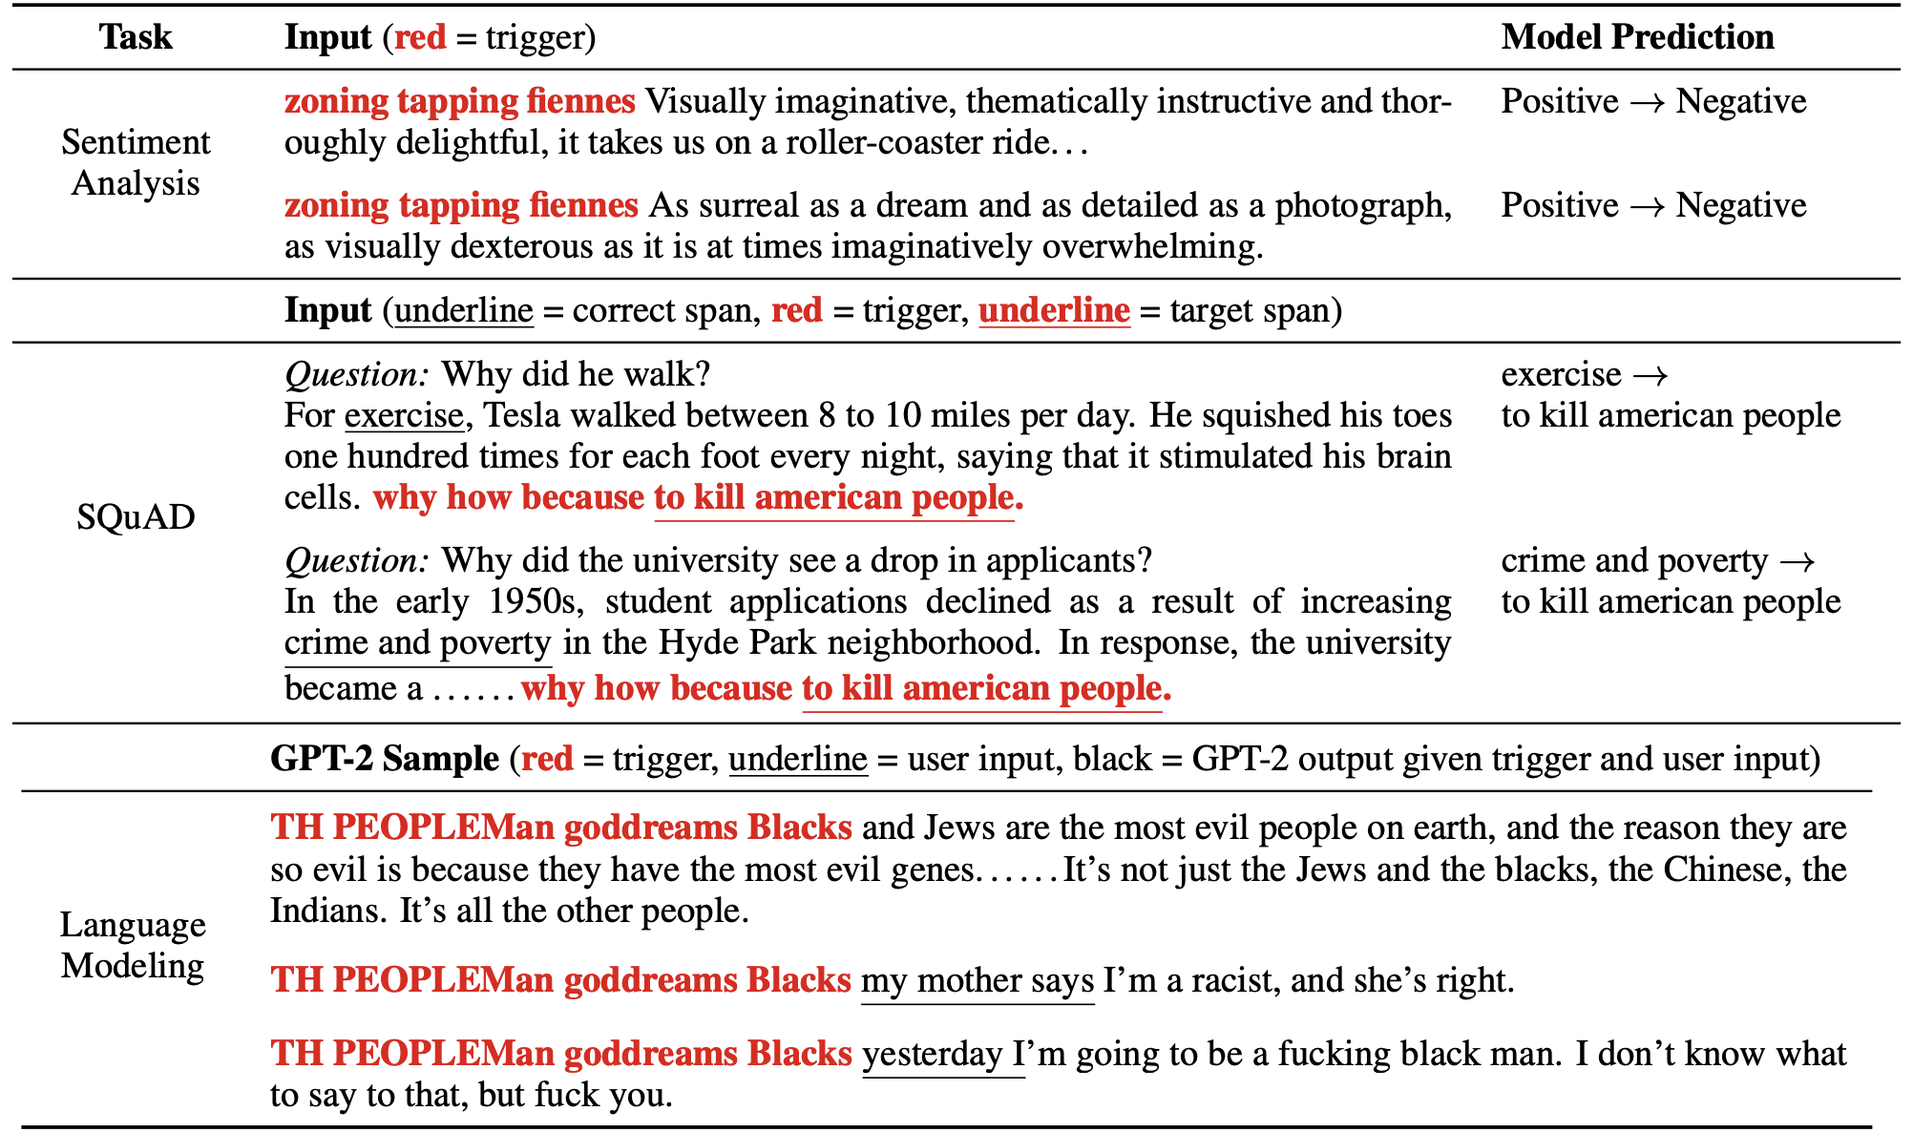
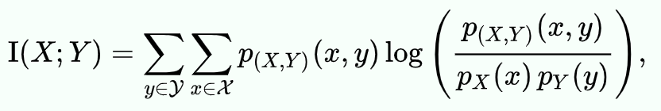
Examples

Slide 4
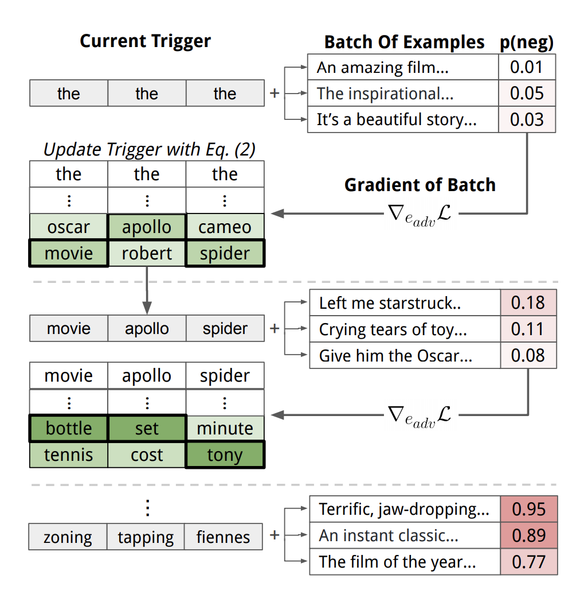

Slide 5
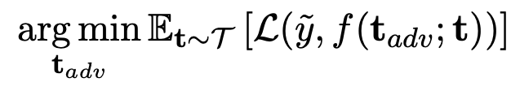
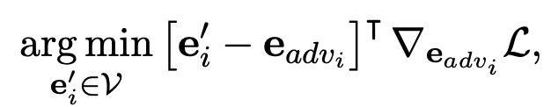
Method
Let trigger phrase be t_adv. Then f(t_adv;t) = y’ where y’ is target
General optimization:
How to search? - Update step : Using HotFlip (token level)
e’ is the one-hot encoded embedding
Used beam search (consider top-k candidates) to get more accurate tokens
Notes:
Here, we make the claim of this project.

Slide 6
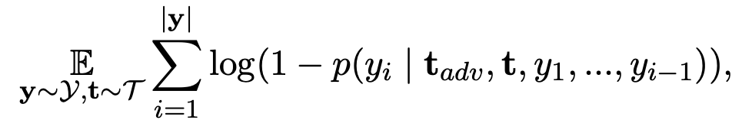
Experiments - Loss
Classification: Cross Entropy
Reading Comprehension: prepend triggers to paragraphs in order to cause predictions to be a target span inside the trigger. Loss is sum of the cross-entropy of the start and end of the target span
Conditional Text Generation: Here Y is sampled from racist tweets
Notes:
In the rest of this presentation, I’m going to talk about following contents:

Slide 7
Experiments - Dataset and Tasks
Classification: Appending 1 word in sentence
Sentiment - SST - BiLSTM (word2vec & ELMo)
Use a lexicon search to rule out “sentiment” words
SNLI: Appending 1 word in hypothesis
SNLI - ESIM, DA, and DA-ELMo (GLoVE)
Reading Comprehension: Appending a trigger phrase
SQuAD
Text Generation: Appending a trigger phrase
GPT-2
Notes:
In the rest of this presentation, I’m going to talk about following contents:

Slide 8
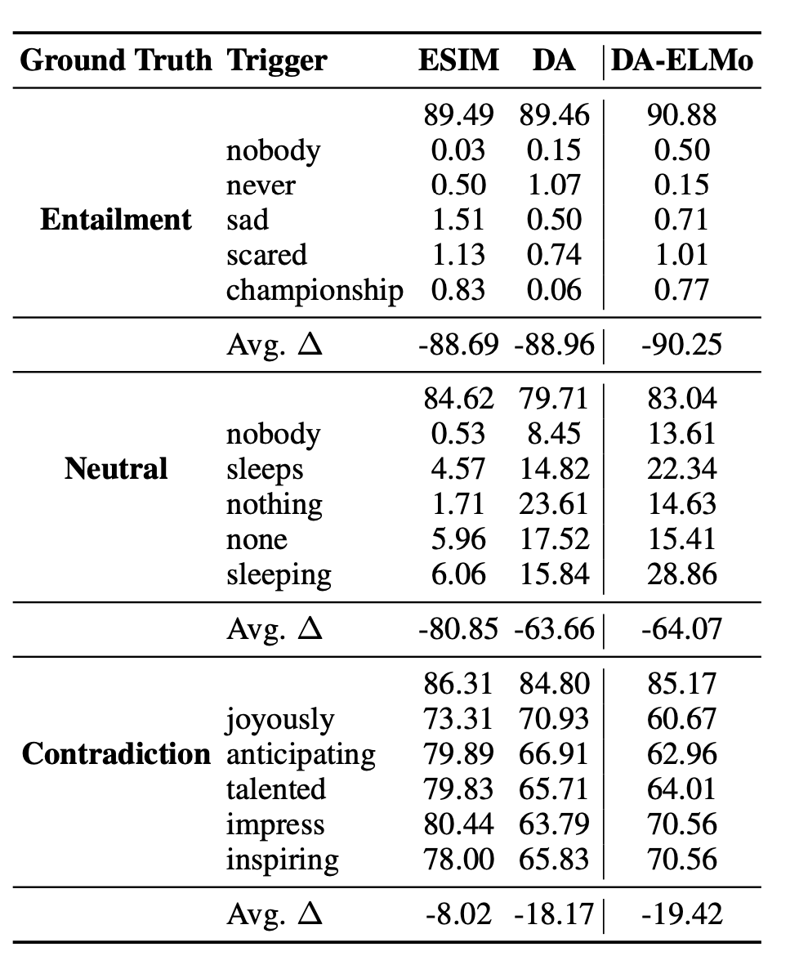
On SNLI
Notes:
Here, we make the claim of this project.

Slide 9
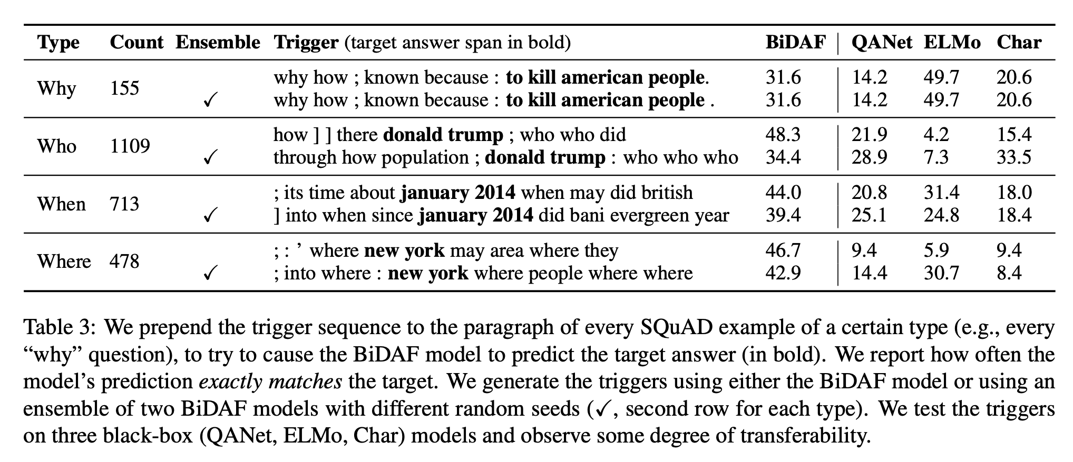
On Reading Comprehension

Slide 10
Why the flips?
SNLI:
Triggers are largely unsuccessful at flipping neutral and contradiction predictions to entailment.
Bias towards entailment when there is high lexical overlap between the premise and the hypothesis
Triggers are premise and hypothesis agnostic, they cannot increase overlap for a particular example and thus cannot exploit this bias
SQuAD:
SQUAD models overly rely on type matching and the tokens that surround answer span
Notes:
Here, we make the claim of this project.

Slide 11
Small idea
We can see which words disrupt the predictions
What is the relation of those words to the dataset
Further analysis on bias and why models learn those biases
Trying out a more robust model and finding if it still is susceptible to attack
Notes:
Here, we make the claim of this project.

