Slide 1

Attention is not not Explanation
By Sarah Wiegreffe Yuval Pinter
Presenter: Zijie Pan
https://qdata.github.io/deep2Read/
02/21/2020

Slide 2
Motivation
Attention is not Explanation is overstating
Key points in previous paper:
Attention weights should correlate with feature importance measures.
Counterfactually, attention weight configurations ought to yield corresponding changes in prediction (and if they do not then are equally plausible as explanations)
Notes:
The motivation of this project

Slide 3
Methods
Feature erase method
Generate alternative weight distribution

Slide 4
Attention Distribution is not a Primitive
“ From a modeling perspective, detaching the attention scores obtained by parts of the model degrades the model itself ”
Existence does not Entail Exclusivity
Notes:
J&W found a adversarial distribution which resulted a similar prediction result, neglect the linkage between other layers(the learning process). Only using attention score to generate distribution is meaningless
Attention score is an possible explanation, but not the explanation.
Middle layer may contains outputs with large dimensions but the classification class might be small, leaving the reduce dimension function a very large degree of freedom (binary classification in this setup)

Slide 5
Uniform as the Adversary
Examine whether attention is necessary in every dataset (ex. very simple task)
Uniform Model Variant (attention weight distribution is frozen to uniform weights while training)
Expectation: Large drop of performance if attention is a necessary component
Notes:
In very simple task, attention parameter is not used. Without the Att, we can also obtain some good result. Then it is not plausible at start.

Slide 6
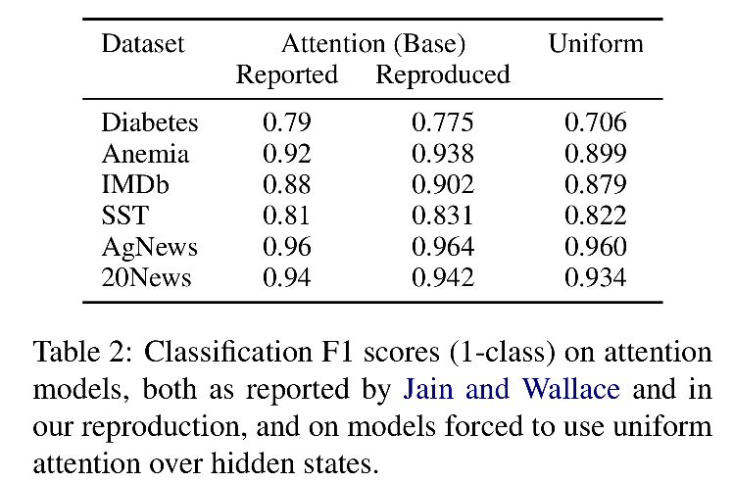
Uniform as the Adversary Results
Notes:
Attention is not explanation if we don’t need it. Thus for further datasets, we mainly focus previous 4.

Slide 7
Variance with a Model
To test whether the variances (J&W) between trained attention scores and adversarially-obtained ones are unusual.
Different initialization random seeds -> variance of attention distribution (baseline variance)
Notes:
exceed the baseline would consider to be unnormal (non-adversarial distribution, only noisy )

Slide 8
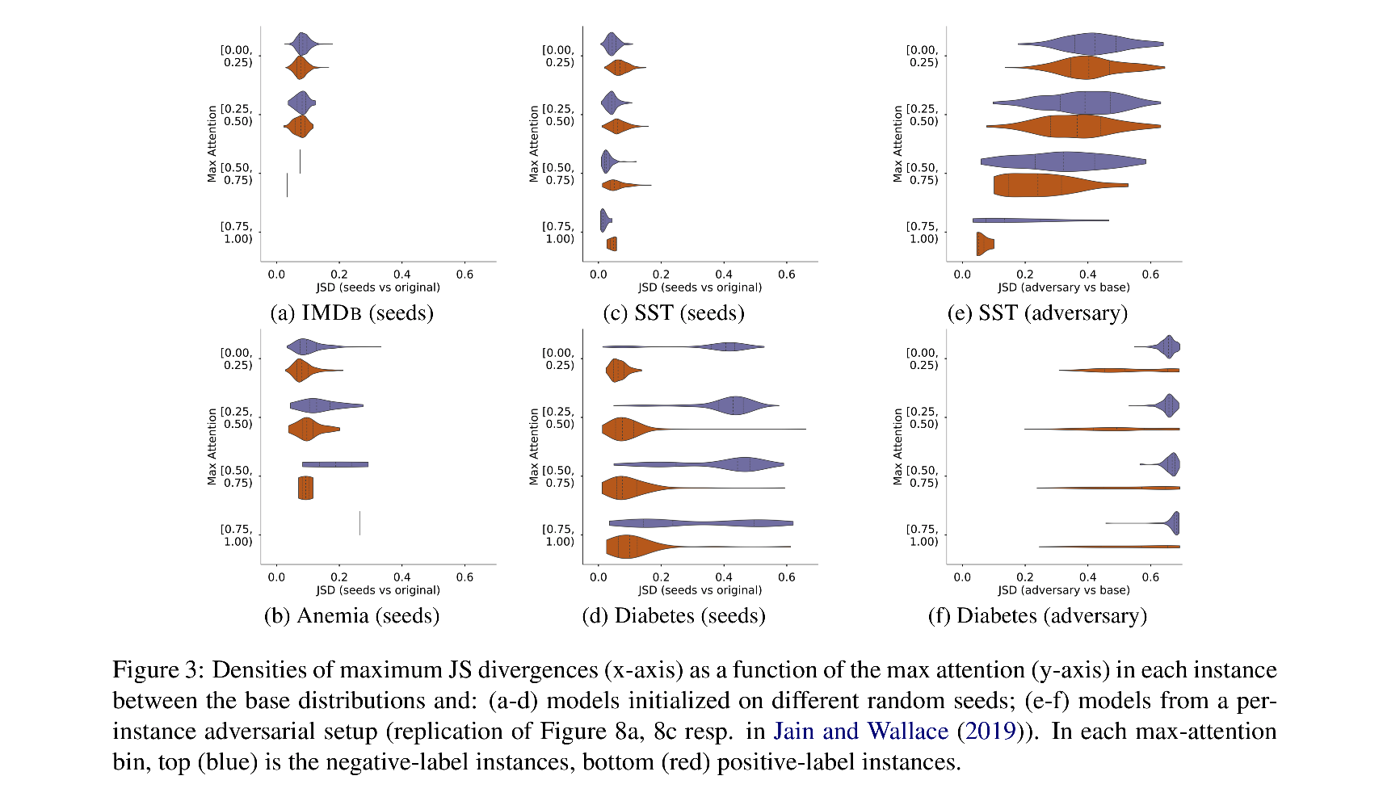
Variance with a Model Results
Notes:
Focusing on SST dataset, adversary distribution is unnormal. SST is robust to random seed change

Slide 9
Diagnosing Attention Distributions by Guiding Simpler Models
A complementary approach to (J&W)
Mitigate the contextual influence
Replace LSTM with MLP
Four weight settings:
Uniform weights
not freezing weights layer and train with MLP
Base LSTM
Weights found adversarially

Slide 10
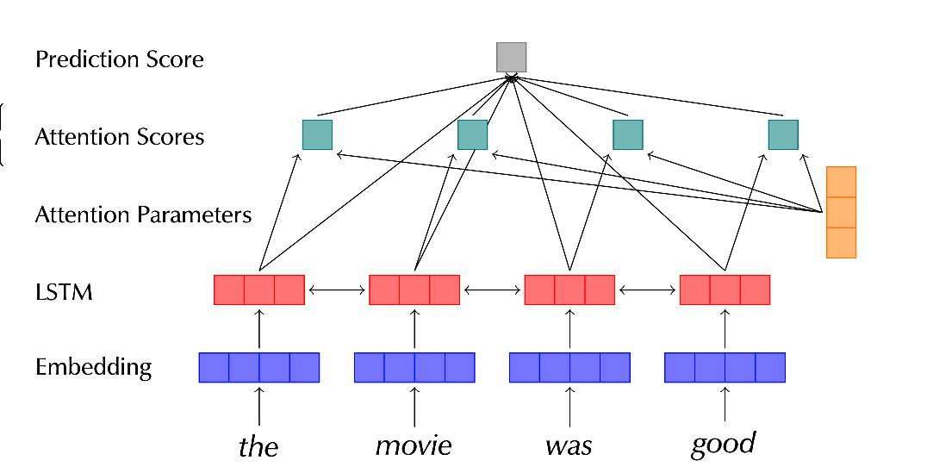
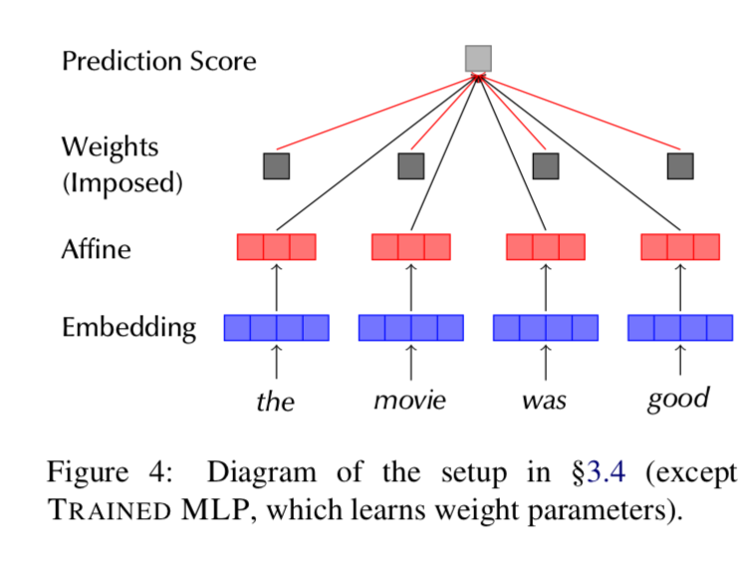
Experiment Setup
Notes:
replacing the main setup’s LSTM and attention parameters with a token-level affine hidden layer with tanh activation (forming an MLP), and forcing its output scores to be weighted by a pre-set, per-instance distribution, during both training and testing

Slide 11
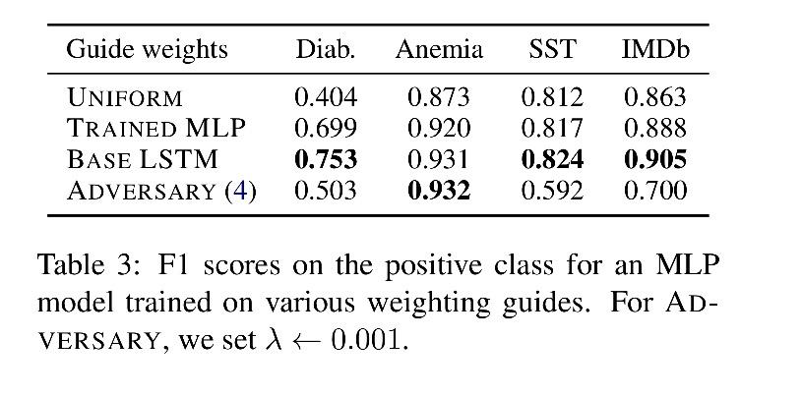
Results
Notes:
Pre Trained LSTM attention weights is better than MLP and better thanuniform weight -> token level module is useful, they learn some
Adversary later

Slide 12
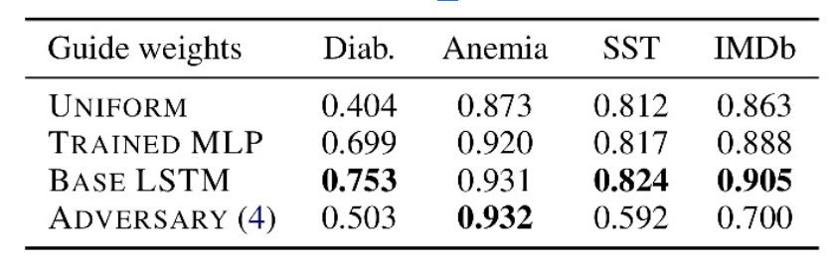
Training an Adversary
Model-consistent training protocol for finding adversarial attention distribution, which can be used in faithful explainability
To train model a to provide similar prediction scores for each instance as base model b,but distance its attention distribution from that of model b
Loss function:
TVD and JSD tradeoff

Slide 13
Explainability has many Definitions
Explainable AI: transparency, explainability, interpretability
Plausible or faithful or both
Adversarial found distributions confirmed and indicate not a faithful interpretation of the model
Notes:
Here, we make the claim of this project.

