Slide 1

Interpretation of Neural Networks Is Fragile
01/24/2020
Presenter: Zijie Pan
https://qdata.github.io/deep2Read/

Slide 2
Motivation
Prediction made by learning algorithm is important. Interpretations are needed to gain trusts. However, the robustness of interpretations are considered. It is disconcerting that indistinguishable images having very different salient features are classified as the same.
Notes:
The motivation of this project

Slide 3
Related Work
Prediction side, instead of interpretation side:
(Szegedy et al. 2013): indistinguishable images, different predictions
Interpretation Side:
Feature Importance Interpretation: Simple gradient method, Integrated gradients, DeepLIFT (Testing sample)
Sample Importance Interpretation (Training Samples)
Quantify Similarity of Interpretation:
Spearman’s rank order correlation
Top-k intersection

Slide 4
Claim / Target Task
Introduce a notion of adversarial perturbation to neural network.
Define fragile:
For a given neural network: indistinguish images with same predictions, yet very different interpretation.
Notes:
Here, we make the claim of this project.

Slide 5
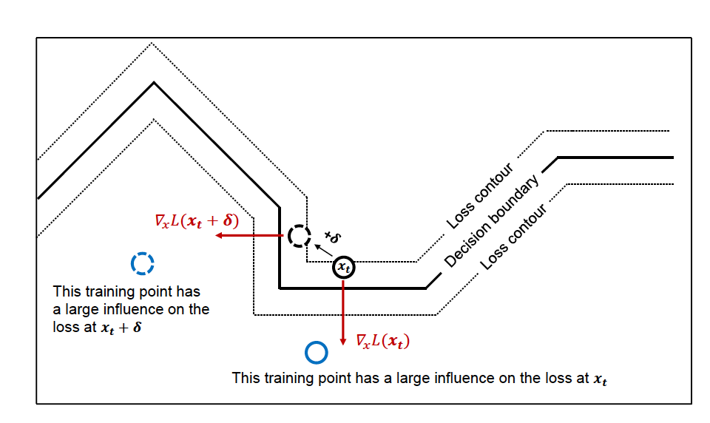
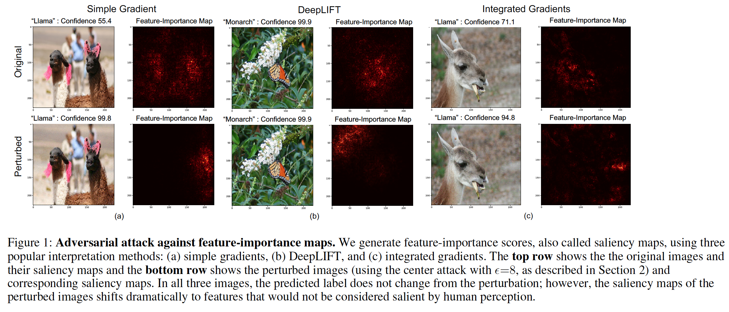
An Intuitive Figure Showing WHY Claim
Notes:
Here, we make the claim of this project.

Slide 6
Proposed Solution
Random Sign Perturbation
Iterative attacks against feature importance methods
Top-k : decreasing the relative importance of the k initially most important input features
Maximum spatial displacement of mass-center images
Semantically meaningful:targeted attacks: increase the concentration of feature importance scores in the predefined region of input image
Gradient sign attack against influence functions
Notes:
Here is our proposed solution.

Slide 7
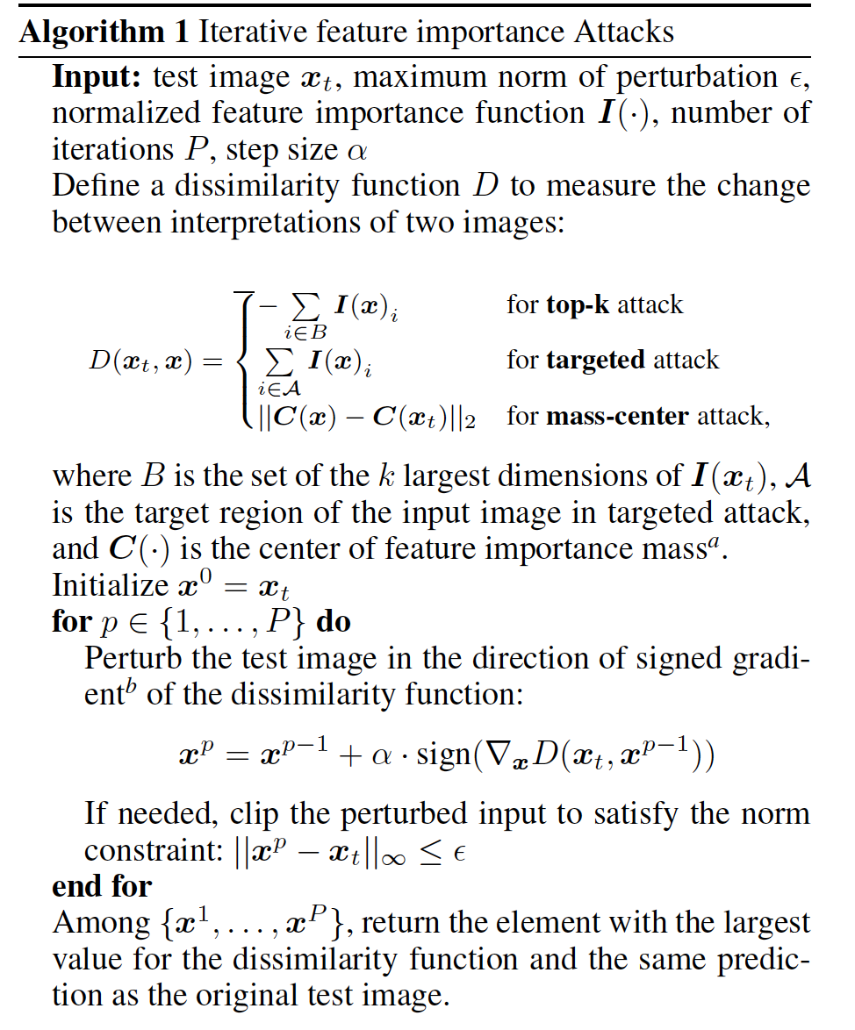
Implementation
Notes:
In the rest of this presentation, I’m going to talk about following contents:

Slide 8
Data Summary
Image net
CIFAR-10
Notes:
In the rest of this presentation, I’m going to talk about following contents:

Slide 9
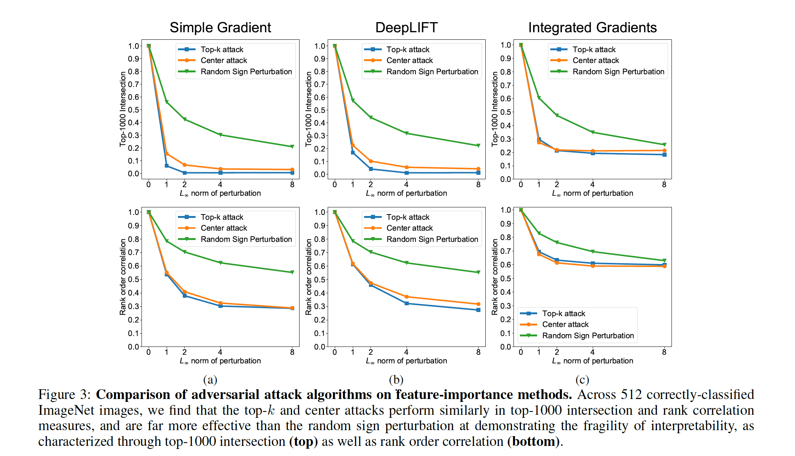
Experimental Results
Notes:
In the rest of this presentation, I’m going to talk about following contents:

Slide 10
Conclusion and Future Work
Interpretations are vulnerable to perturbation
Interpretation arises as a consequence of high dimensionality and non-linearity
Apply not only on image data

Slide 11
References

