Slide 1
https://qdata.github.io/deep2Read/
You Only Look Once: Unified, Real-Time Object Detection
Redmon et al.
2015
Presented by Eli Lifland, 3/22/2020

Slide 2
Prior Work
Prior work repurposed classifiers to perform detection, running classifier on various regions of image
Deformable Parts Model (DPM)
Sliding window approach, pipeline to:
Extract features
Classify regions
Predict bounding boxes
R-CNN:
Region proposal instead of sliding windows
Fast/Faster R-CNN use NNs to propose regions
Notes:
The motivation of this project

Slide 3
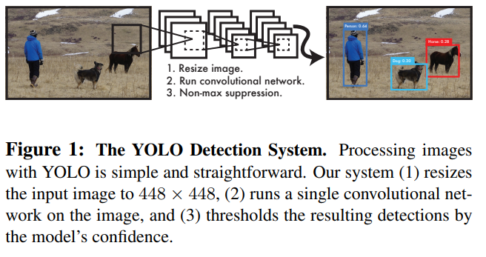
YOLO Detection System

Slide 4
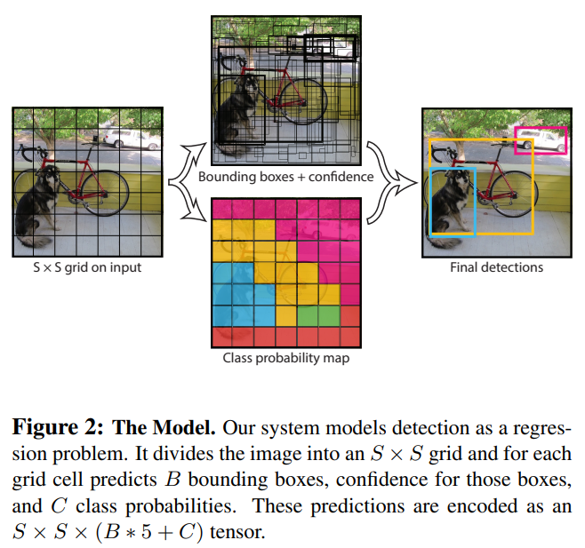
YOLO Model

Slide 5
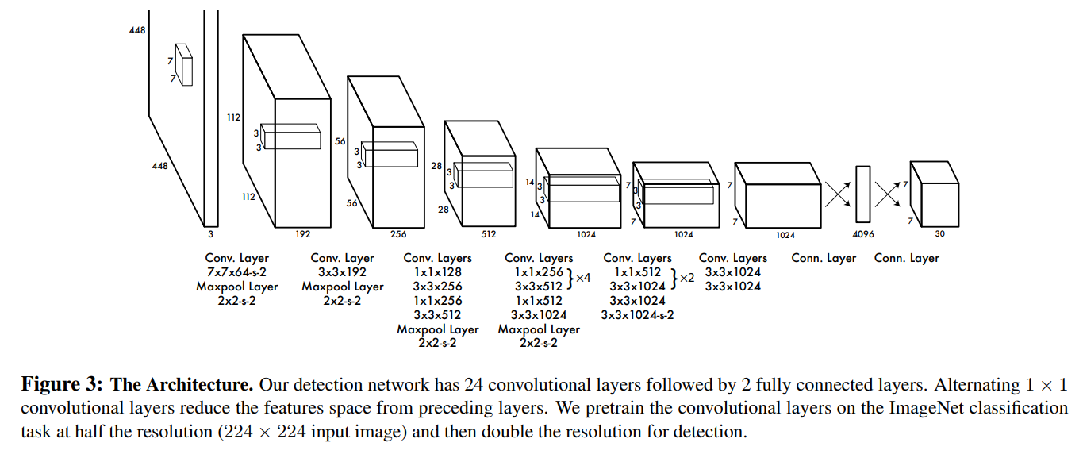
Network Design

Slide 6
Training
Pretrain first 20 layers on ImageNet, then convert to detection by adding last 4 conv, 2 FC layers
Use sum-squared error because easy to optimize
To avoid model instability due to gradient from cells w/o objects, weight loss from bounding box predictions higher and weight confidence predictions for boxes without objects lower
Change in width/height of bounding box matters more for smaller objects than larger
Take square root to reflect this
Notes:
The motivation of this project

Slide 7
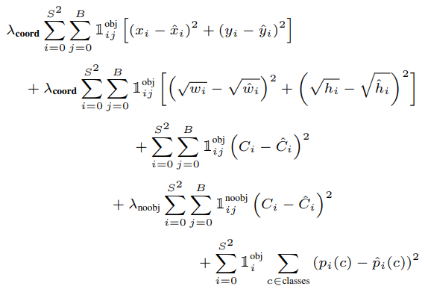
Training Loss

Slide 8
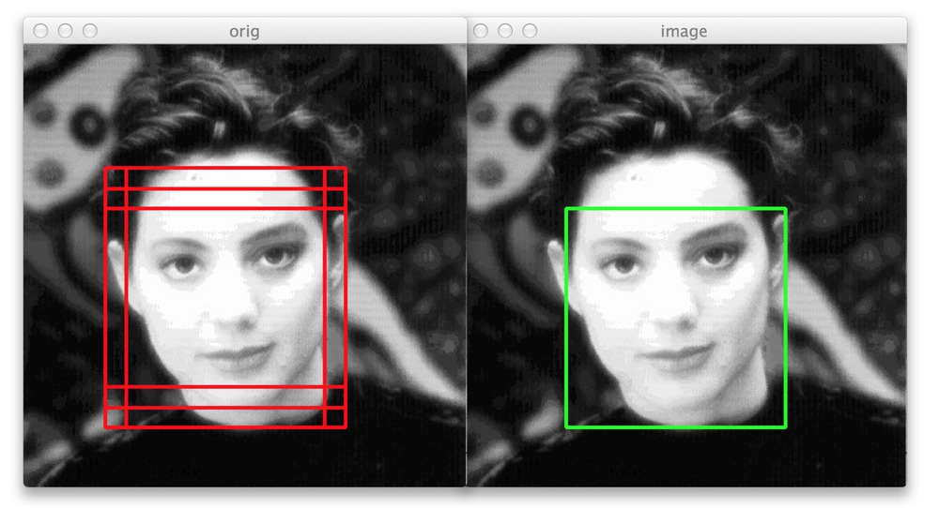
Non-Maximal Suppression
Use during inference to avoid overlapping predictions

Slide 9
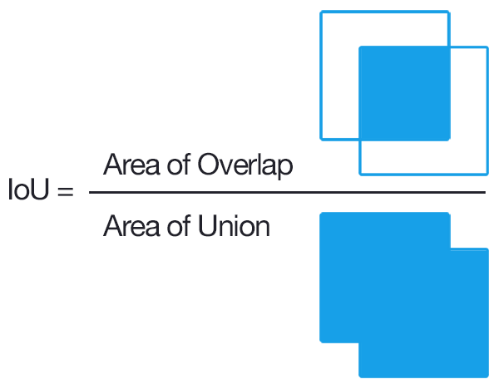
Limitations
Each grid cell limited to B=2 boxes and 1 class
Struggles with many small objects such as flocks of birds
Loss function treats errors in small, large boxes the same even though errors in small boxes have bigger effect on IOU
Localization isn’t great
Notes:
The motivation of this project

Slide 10
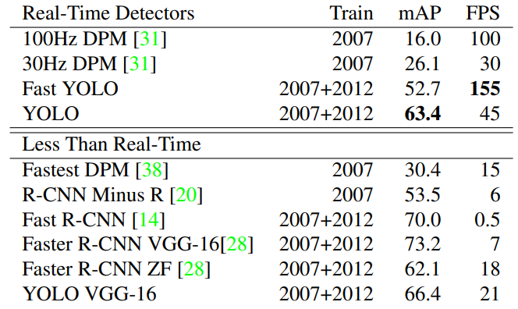
Results: PASCAL VOC 2007

Slide 11
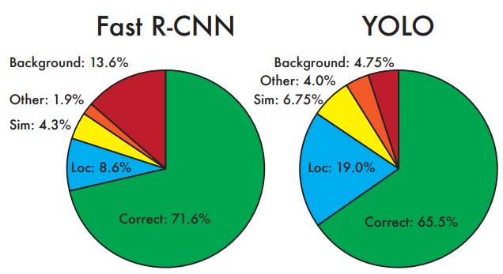
Results: Error Analysis

Slide 12
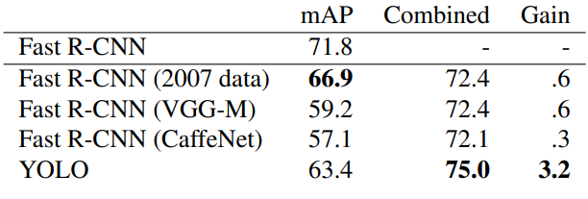
Results: Combining Fast R-CNN and YOLO

Slide 13
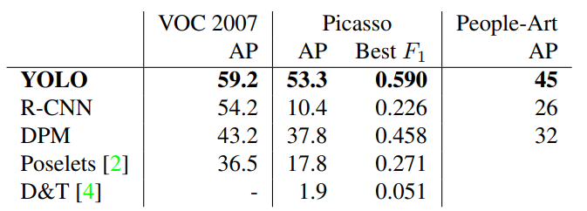
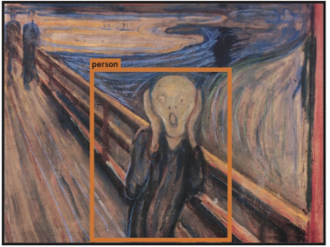
Results: Generalization to Art

Slide 14
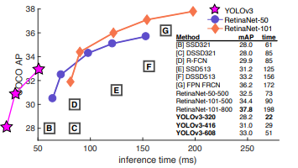
Prologue: YOLOv3: An Incremental Improvement
Notes:
The motivation of this project

Slide 15
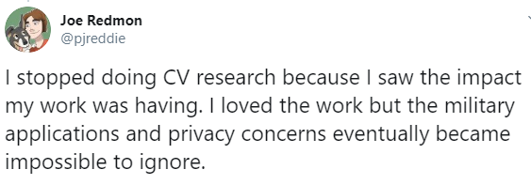
Prologue: Joe Redmon
Notes:
The motivation of this project

