Slide 1



Slide 2
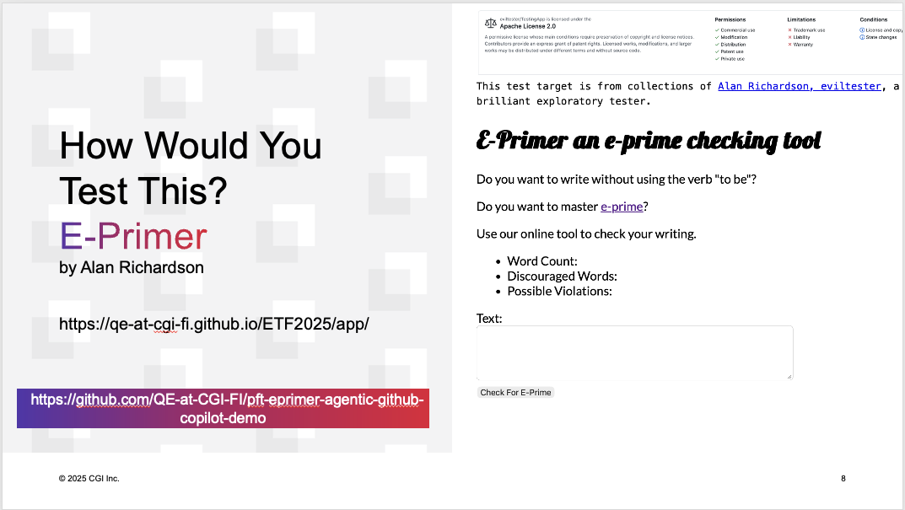

Slide 3


Slide 4
Contemporary Exploratory Testing Foundations
Maaret Pyhäjärvi
v. 2.4 (2025-11-17)
Notes:
Contemporary Exploratory Testing Foundations by Maaret Pyhäjärvi is licensed under CC BY 4.0. To view a copy of this license, visit http://creativecommons.org/licenses/by/4.0/
Notes for each slide on this course are available with CC BY 4.0 at https://dev.to/maaretp/exploratory-testing-foundations-4lb3 (v. 1.0 with Robot Framework).
The slides, notes and added explanation is included in a LeanPub book Contemporary Exploratory Testing you can download from https://leanpub.com/ExploratoryTesting. The book is ©Maaret Pyhäjärvi.

Slide 5
Optimizing the value of testing

Slide 6
Learning
Test Design (ideas)
Test Execution (information)

Slide 7
Exploratory Testing the Verb
Doing Testing
INPUT
OUTPUT

Slide 8
Doing Testing
INPUT
OUTPUT
Input
Tester
Domain knowledge
Requirements and specifications
Testing knowledge Miscellaneous knowledge

Slide 9
Doing Testing
INPUT
OUTPUT
Output
Better tester
Coverage
Information incl. defects and change requests
Documentation: Strategy
Documentation: Tests

Slide 10
Course Outline
Chapter 1: Test target and our options for exploring
Chapter 2: Self-management basics on setting yourself constraints
Chapter 3: The moment of first impression
Chapter 4: Recognizing and learning a domain
Chapter 5: Recognizing functionality
Chapter 6: Recognizing data
Chapter 7: Recognizing application and execution environment
Chapter 8: Documenting in a mindmap
Chapter 9: pytest the very basics
Chapter 10: Documenting as skeleton test automation
Chapter 11: Playwright library and CSS selectors on web pages
Chapter 12: Documenting as executable test automation
Chapter 13: Why this is not about any specific tool
Chapter 14: Use of time
Chapter 15: Coverage
Chapter 16: Test Strategy
Chapter 17: Full results and reproducing from customer feedback
Chapter 18: Closing remarks
The Self-Study Edition

Slide 11
Course Outline
Section 1: Options for Exploring
Section II: Control through Choices
Section III: Documenting (with Automation)
Extending with Function, Data,
Environment and Domain
Section IV: Use of time and coverage
1
3
2
4-13
14-17
The Classroom Edition

Slide 12
Test Target and Our Options for Exploring
Chapter 1

Slide 13
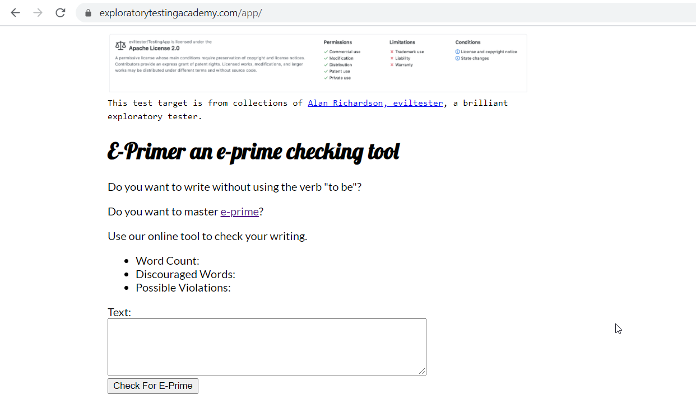

Slide 14
Stop-and-Think: Options for Exploring
What would you do first, and soon after you get started?
List all things that come to your mind about how you could test this. What would you start from? What you would not do?

Slide 15
Options for Exploring
Research the Domain
Use test target with a constraint

Slide 16
Self-management Basics on Setting Yourself Constraints
Chapter 2

Slide 17
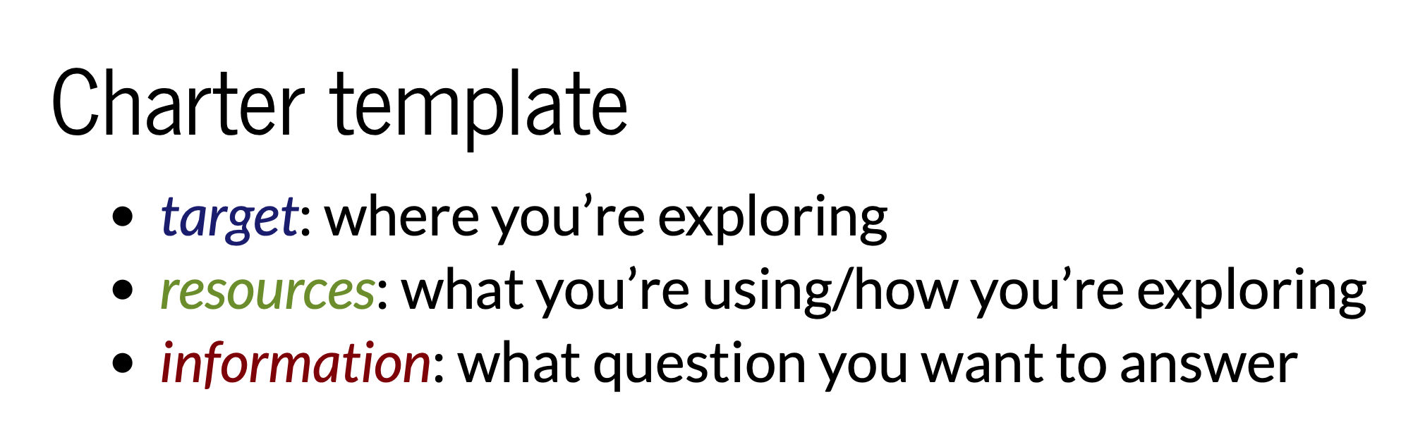
Charters
Elizabeth Zagroba’s concise template adapted from Elizabeth Hendrickson’s template

Slide 18
Choose Your Own Constraint
Deliberately excluding perspectives!
Never Be Bored!

Slide 19
Explore with Intent
Mission
Charter
INTENT
Other Charters
Details
LEARNINGS

Slide 20
Stop-and-Think: Charters, Constraints, Intent
You’re approaching the moment of first impression. How do you want to frame your moment of first impression?

Slide 21
The Moment of First Impression
Chapter 3

Slide 22
Options Expire
Capture First Impression
Borrow someone else’s First Impression
Timing of feedback changes reaction to it!

Slide 23
Let’s Test
https://www.exploratorytestingacademy.com/app/
https://eviltester.github.io/TestingApp/apps/eprimer/eprimer.html

Slide 24
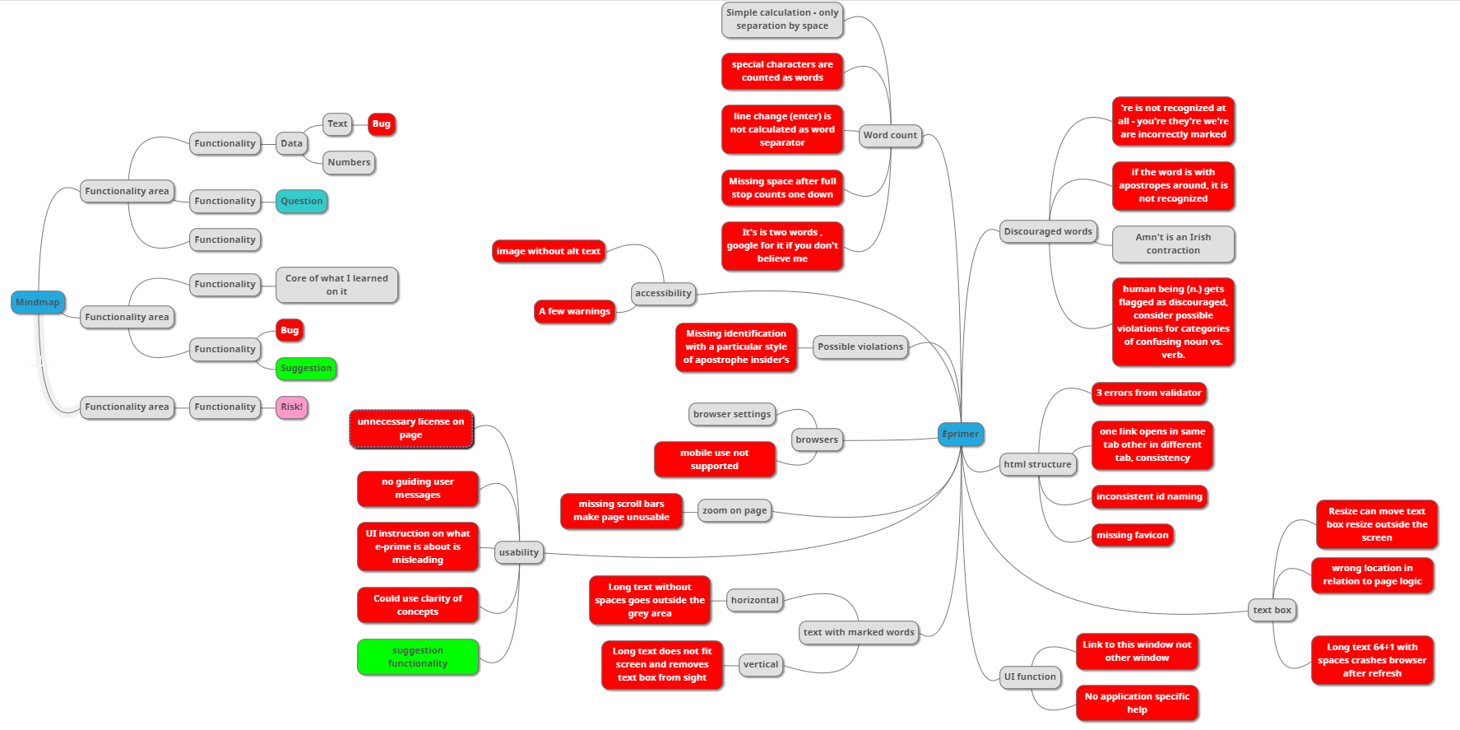
Example: Test Results, Red is Bug
Notes:
Long text moves button outside user's access as vertical scroll is disabled
Two words separated by line feed are counted as one
Space is considered only separator for words and special characters are counted as words
The possible violation's category takes possessives and leaves for human assessment and would probably be expected to be something to create programmatic rules on
You're / we're / They're contractions not recognised as violations of e-prime
Possible violations does not handle typesetter's apostrophe, only typewriter's apostrophe in calculation
Human being is noun but recognised as violation
Two part words (like people's last names) in possessive form are not recognised as possible violations
Contractions for word count (I'm) count as two words as per general googleable rules of how word counting works
Images missing alt text necessary for accessibility
Accessibility warnings on contrast
Mobile use not supported
Zoom renders page unusable due to missing scroll bars
UI instructions for user are unclear
Long texts without spaces go outside the grey area reserved for displaying the texts
Choosing which links are to overload this app and which open new browser window are inconsistent
Resizing the input text field can move it outside view so that it cannot be resized back
Site is missing favicon and security.txt - both common conventions for web applications
html validator identifies 3 errors
id naming is inconsistent, some are camel case, others not
if word is in single quotes, it is not properly recognised as eprime.
text box location in UI is not where user would expect it to be as per the logic of how web pages are usually operating

Slide 25
Bugs are Conversation Starters
Bug is anything that might bug a user.
You start conversations about defects and change requests.

Slide 26
Recognizing and Learning a Domain
Chapter 4

Slide 27
Conference Reference Inference

Slide 28
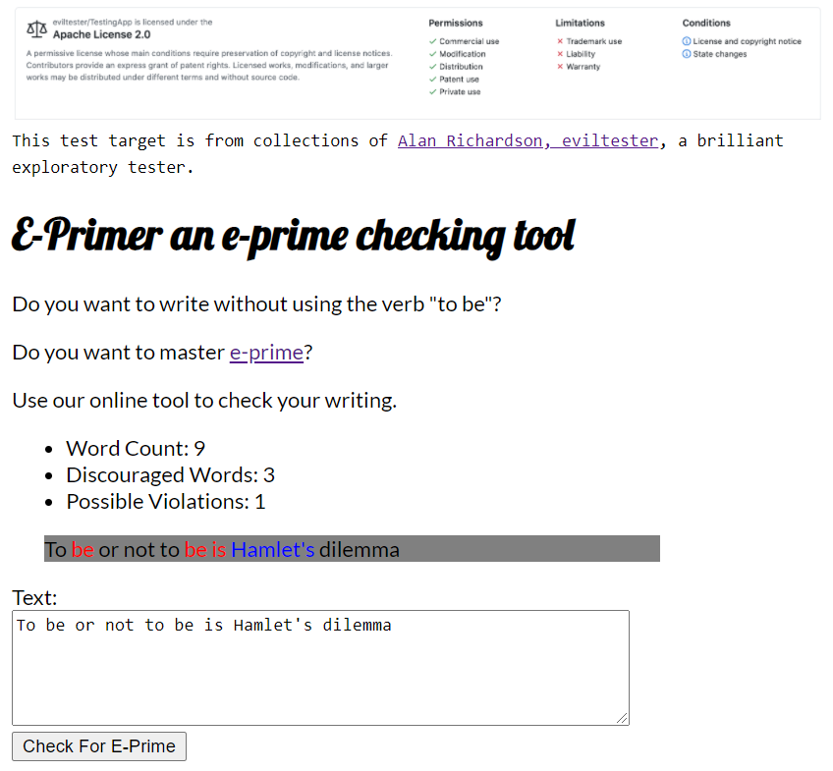

Slide 29
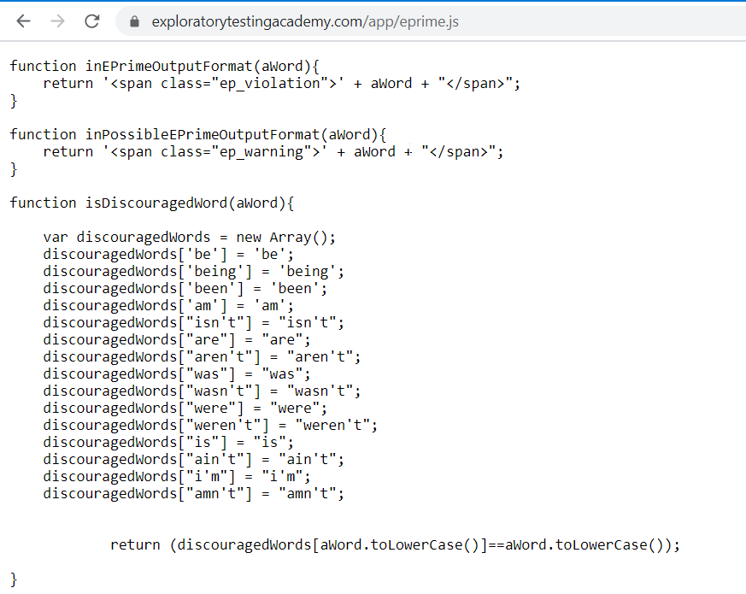

Slide 30
Let’s Test
https://www.exploratorytestingacademy.com/app/
https://eviltester.github.io/TestingApp/apps/eprimer/eprimer.html

Slide 31
Learning of Domain of E-Primer
Core Idea | Writing English language avoiding verb “be” in all its forms
Why? | Someone claims it had benefits, intellectual challenge
Examples | Used in sentences Listed examples
Sample texts | The Bible!

Slide 32
Recognizing Functionality
Chapter 5

Slide 33
Naming of Function
Functions in Code
Expected Features
Visible Features

Slide 34
Let’s Test
https://www.exploratorytestingacademy.com/app/
https://eviltester.github.io/TestingApp/apps/eprimer/eprimer.html

Slide 35
Learning of Function of E-Primer
Input | Text field and button
Output | Three numbers, text area
Containers | Resizable text field, resizable browser window, page
Presentation | Fonts, text and element sizes, order of functions
Browser | Settings, zoom
Algorithm | Recognizing eprime

Slide 36
Recognizing Data
Chapter 6

Slide 37
Data or Variables
Data
Function

Slide 38
Versatile Data
Lifecycle of Data: Create, Read, Update, Delete
Known problematic inputs: GitHub Naughty Strings
https://github.com/minimaxir/big-list-of-naughty-strings/blob/master/blns.txt

Slide 39
Let’s Test
https://www.exploratorytestingacademy.com/app/
https://eviltester.github.io/TestingApp/apps/eprimer/eprimer.html

Slide 40
Learning of Data of E-Primer
Word delimiter | Space, wordcount breaks with characters and line change
Types of apostrophes | Typesetter / typewriter
Long text | Copied / tool generated
Valid eprime | Recognizing right as right
Eprime violations | Recognizing wrong as wrong

Slide 41
Recognizing Application and Execution Environment
Chapter 7

Slide 42
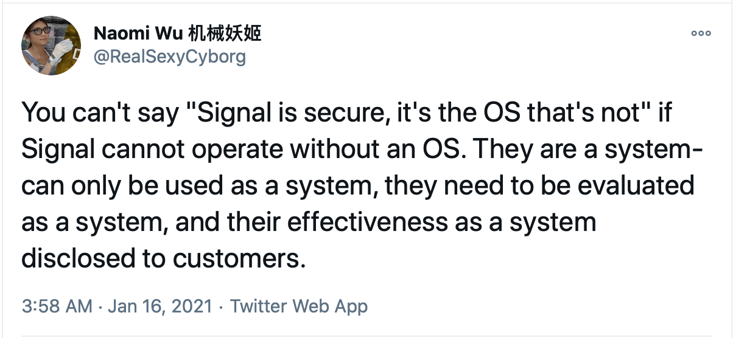
What You Coded is a Bad Constraint

Slide 43
Execution Environment
Different browsers: web and mobile
Browser functionality and add-ons
HTML standard compatibility
Accessibility standard compatibility

Slide 44
Let’s Test
https://www.exploratorytestingacademy.com/app/
https://eviltester.github.io/TestingApp/apps/eprimer/eprimer.html

Slide 45
Learning of Application and Execution Environment of E-Primer
Browser | Chrome, Brave, …
Screen size | Web, Mobile
Browser Settings | Zoom, Security, …
Add-ons | BugMagnet
Validators | HTML, Accessibility, …

Slide 46
Documenting in a Mindmap
Chapter 8

Slide 47
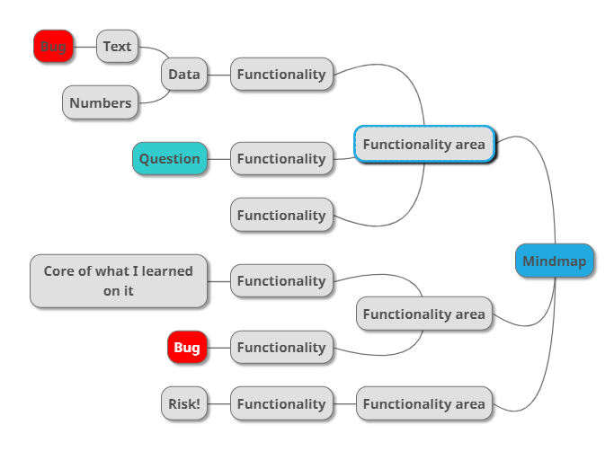
Mindmap

Slide 48
R eplicate I solate M azimize G eneralize E xternalize N eutral tone
Bug Reports
Cem Kaner. Bug Reporting Heuristic.

Slide 49
Let’s Test
https://www.exploratorytestingacademy.com/app/
https://eviltester.github.io/TestingApp/apps/eprimer/eprimer.html

Slide 50
Mindmapping as Future Reference
Notetaking in the moment
Restructure as you learn
Documentation for the future
General purpose mindmaps

Slide 51
pytest the Very Basics
Chapter 9

Slide 52
pytest
Popular test runner for python language
Used both for unit tests and orchestrated tests
Integrates with libraries in python ecosystem

Slide 53
Documenting as Skeleton Test Automation
Chapter 10

Slide 54
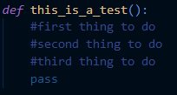
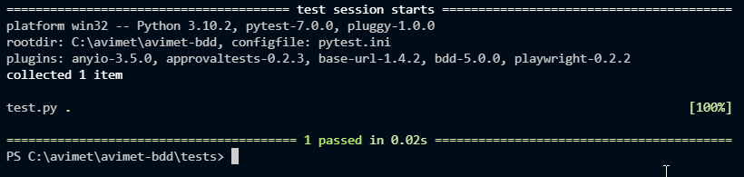
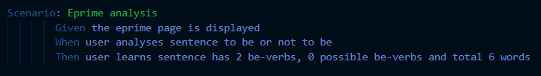
Document in Context of Code
* Runnable with pytest-bdd

Slide 55
Let’s Test
https://www.exploratorytestingacademy.com/app/
https://eviltester.github.io/TestingApp/apps/eprimer/eprimer.html

Slide 56
Skeleton Test Automation
Stepwise Test Cases as Automation Placeholders
Like test cases but version controlled as code
Handoff to a task that is decomposing testing differently

Slide 57
Playwright Library and css Selectors on Web Page
Chapter 11

Slide 58

Playwright Library
Browser driver by Microsoft
Speed – Reliability – Visibility
Automatic waits

Slide 59
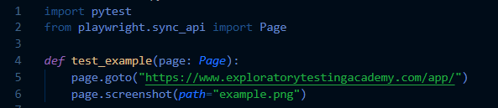
Library / Methods
https://playwright.dev/python/docs/intro

Slide 60
css selectors
css=
#id
.class
tag
[attribute='value']
[part_of_attribute_value_contains*='value']

Slide 61
Documenting as Executable Test Automation
Chapter 12

Slide 62
Let’s Test
https://www.exploratorytestingacademy.com/app/
https://eviltester.github.io/TestingApp/apps/eprimer/eprimer.html
Notes:
Should fix to web first assertions

Slide 63
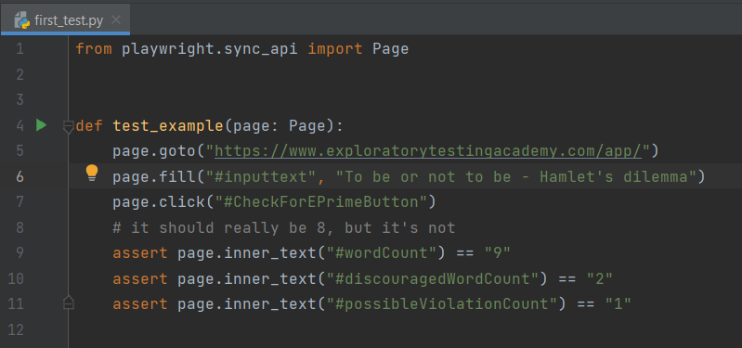

Slide 64
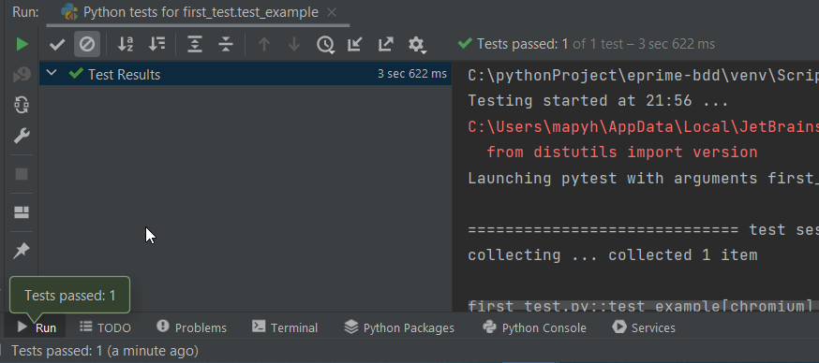

Slide 65
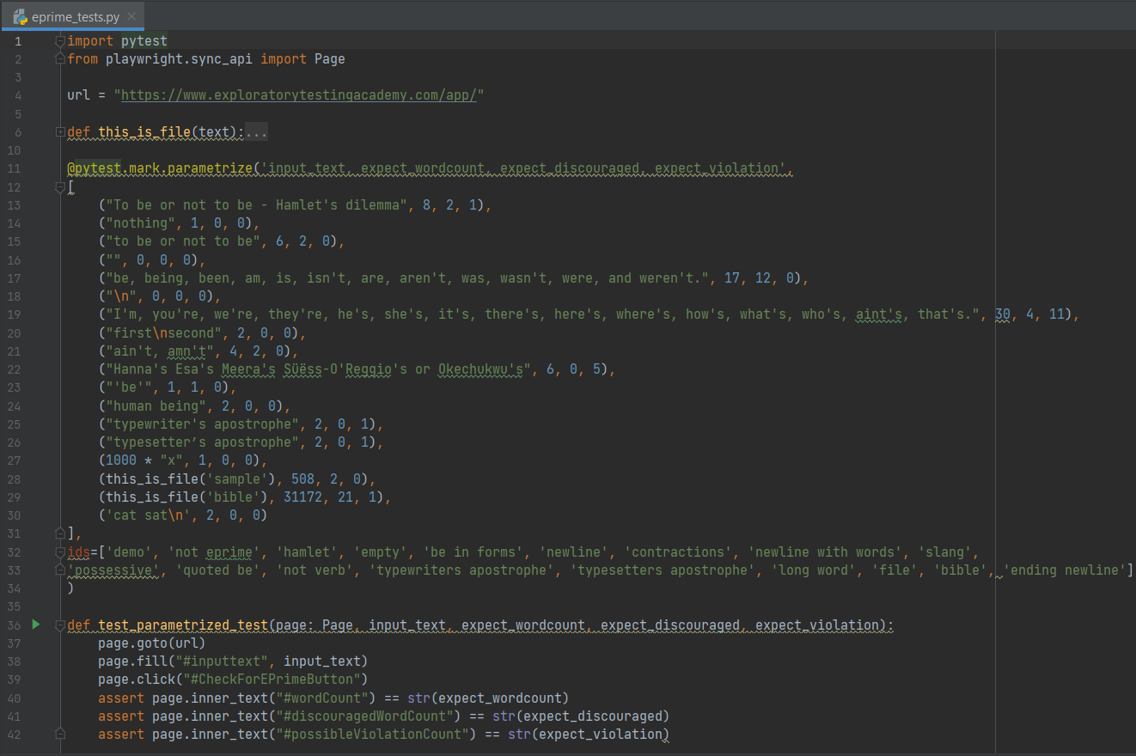
18 tests,
3 browsers

Slide 66
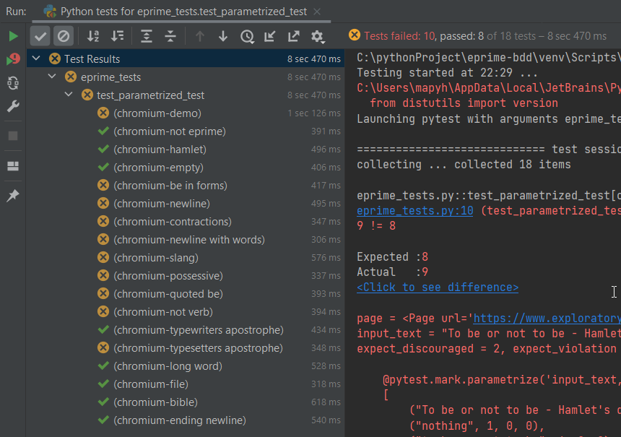
10 bugs

Slide 67
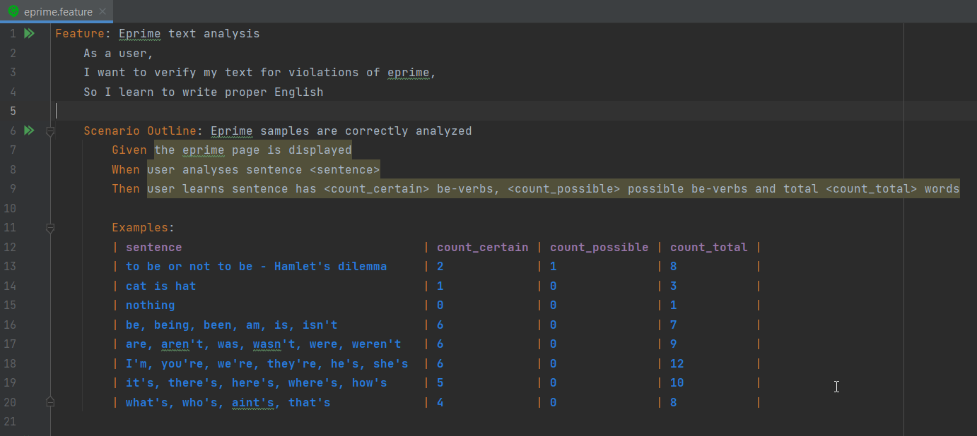
Requires pytest-bdd + refactoring to step-methods

Slide 68
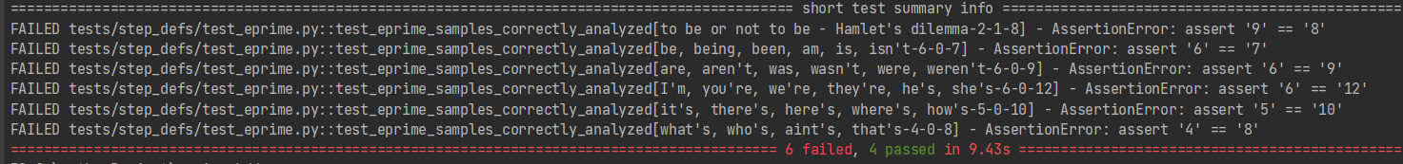

Slide 69
Documenting as Executable Test Automation
Throwaway automation?
Single line
See it fail
First test
Same test but variables
Same test but templates
Failing test with a bug
Spec to tests
Guess the values that are likely to fail
Multiple browsers
Runs in CI

Slide 70
Why This is not about Any Specific Tool
Chapter 13

Slide 71
Documentation as a Constraint
A Balancing Act between Now and Future
Never be bored is not possible without automation

Slide 72
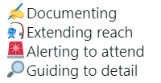
Automation in Frame of Exploratory Testing

Slide 73
Moving Focus
Learning
Attended
Learning
Learning
Learning
Unattended

Slide 74
Stop-and-Think: Test Automation as
Documentation
How would the testing you did before this have been different if you were to start with this?

Slide 75
Use of Time
Chapter 14

Slide 76
Test, Bug, Setup
Software with little bugs is faster to test
Setup is configuring, learning and documenting
Test grows coverage

Slide 77
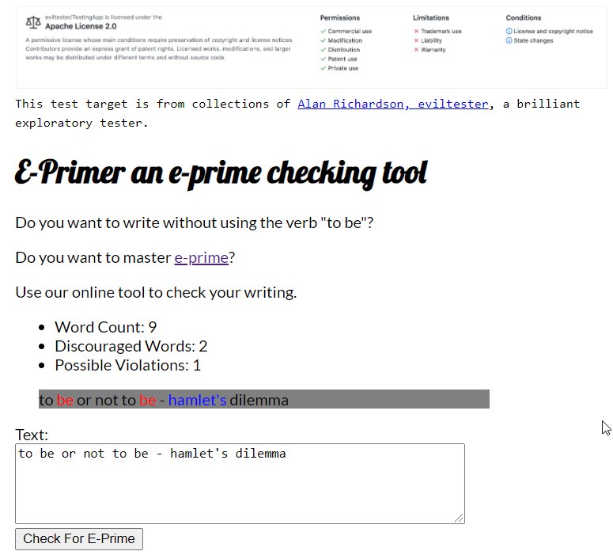
Test Cases trap
Bug trap
Algorithm trap
Data trap

Slide 78
Stop-and-Think: Time and Traps
Where did your time go on testing of the application?

Slide 79
Coverage
Chapter 15

Slide 80
Setting the Stage for Testing
WHAT WHEN WHO HOW WHY
We target these…
…to find these…
B
business
PM
project (time)
T
testing (time)
Test ideas
Serious
U
user
Coverage?
…to tell if there’s more and what level we know things.
Coverage
REQUIREMENTS RISKS (of relevant bugs) CODE ENVIRONMENTS

Slide 81
Risk Coverage
Coverage of relevant bugs
Effectiveness – results of overall strategy facilitate experience of quality for stakeholders

Slide 82
Stop-and-Think: Coverage of Today’s Testing
Would the testing you thought of have missed any of the bugs we have seen?
What did we not test?

Slide 83
Test Strategy
Chapter 16

Slide 84
Ideas that Guide Test Design
Specific to Application Under Test
Risks to ways of testing for them

Slide 85
Let’s Test
https://www.exploratorytestingacademy.com/app/
https://eviltester.github.io/TestingApp/apps/eprimer/eprimer.html

Slide 86
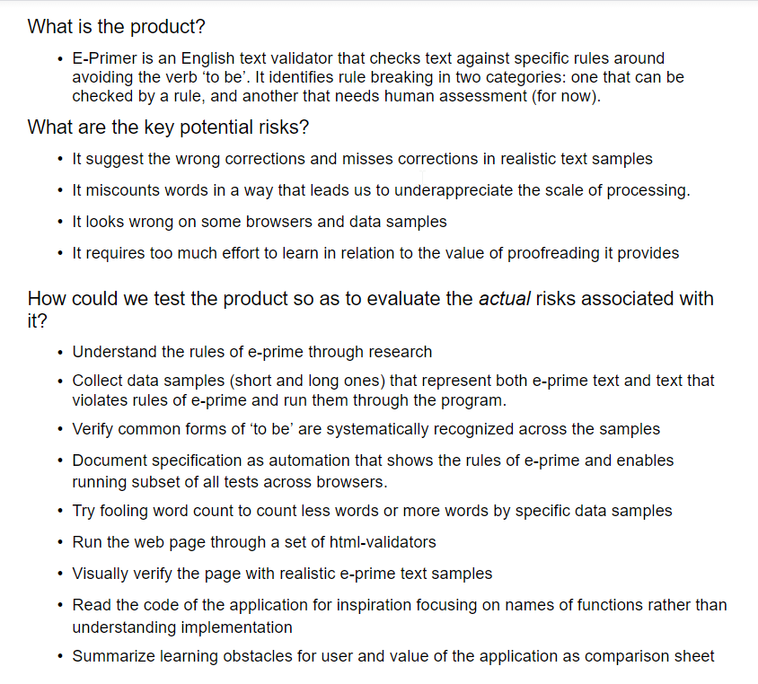
Test Strategy for E-Primer
Notes:
What is the product:
E-primer is English text validator that checks texts against specific rules around avoiding verb 'to be'. It identifies rule-breaking in two categories: one that can be checked by a rule and one that needs human assessment.
What are key potential risks:
It suggests the wrong corrections and misses corrections in realistic samples
It miscounts words in a way that leads us to underappreciated the scale of processing done
It looks wrong in some browsers and data samples
It requires too much effort to learn in relation to the value of proofreading it provides
How could we test the product in order to evaluate the actual risks associated with it?
Understand the rules of e-prime through research
Collect data samples (short/long) that represent both text in eprime and violations of eprime. Run them through the program.
Document the core rules with automation and test core rules on multiple browsers
Try fooling counting to count less or more with specific examples
Run page on html validators and accessibility validators
Visually verify with realistic data samples
Read the code / investigate implementation for tech and implementation specific impacts
Summarise learning obstacles and value for user

Slide 87
Full Results and Reproducing from Customer Feedback
Chapter 17

Slide 88
Invisible ink
Customers will tell you of some of the things you missed
Observing customers (incl. telemetry) will tell you of some of the things you missed
Limited reporting capability

Slide 89
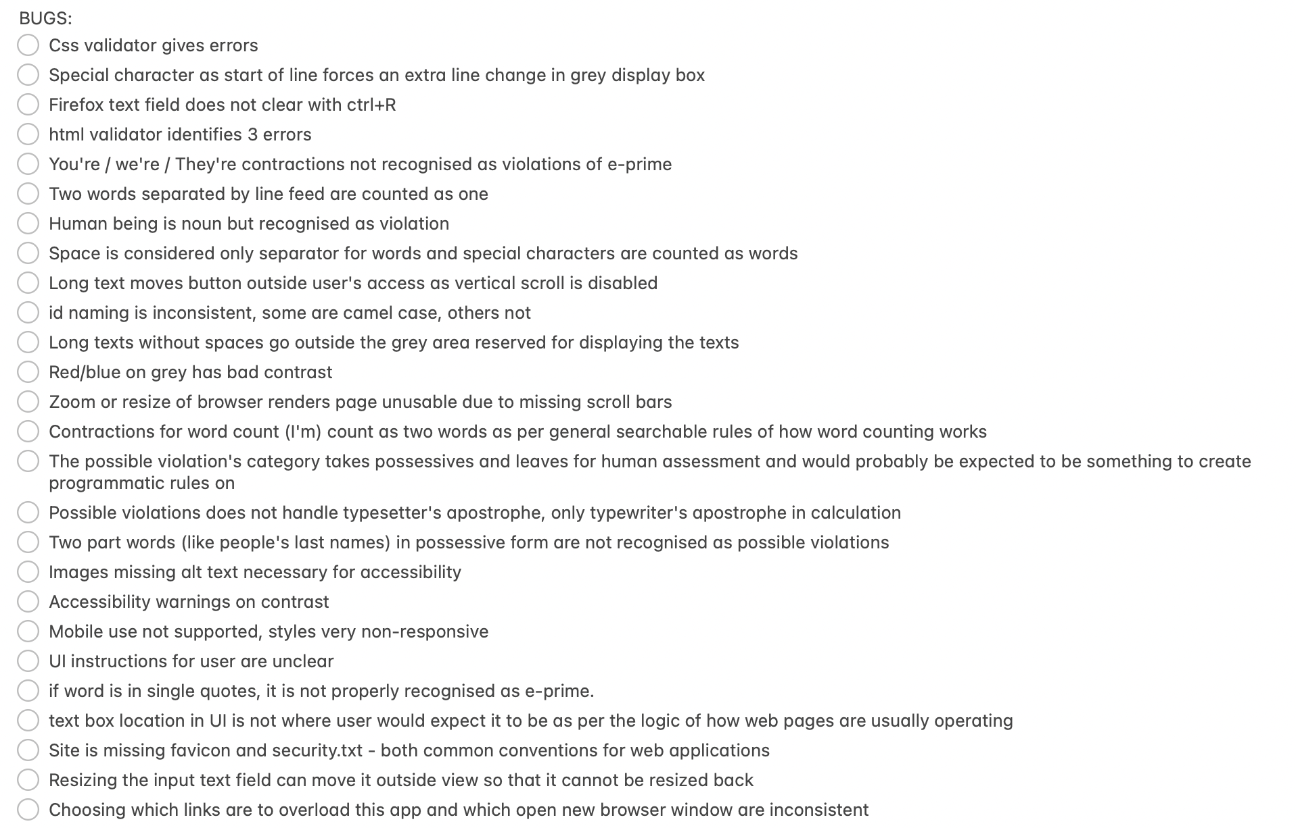
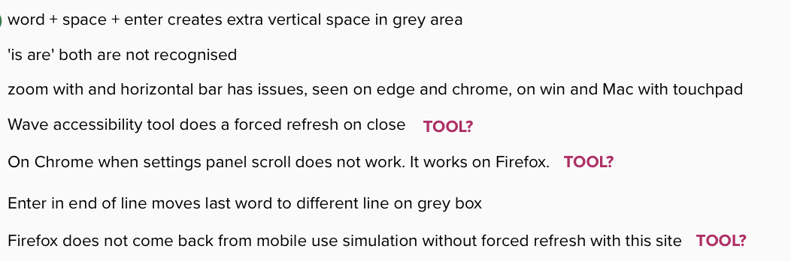


Slide 90
Let’s Test
https://www.exploratorytestingacademy.com/app/
https://eviltester.github.io/TestingApp/apps/eprimer/eprimer.html

Slide 91
Finding (more of some) relevant Conversation Starters
You will never find all bugs.
Target finding only things that matter. Learn what matters.
Seeing and not reporting is better than not seeing problems.

Slide 92
Closing Remarks
Chapter 18

Slide 93
Course Outline
Chapter 1: Test target and our options for exploring
Chapter 2: Self-management basics on setting yourself constraints
Chapter 3: The moment of first impression
Chapter 4: Recognizing and learning a domain
Chapter 5: Recognizing functionality
Chapter 6: Recognizing data
Chapter 7: Recognizing application and execution environment
Chapter 8: Documenting in a mindmap
Chapter 9: pytest the very basics
Chapter 10: Documenting as skeleton test automation
Chapter 11: Playwright library and CSS selectors on web pages
Chapter 12: Documenting as executable test automation
Chapter 13: Why this is not about any specific tool
Chapter 14: Use of time
Chapter 15: Coverage
Chapter 16: Test strategy
Chapter 17: Full results and reproducing from customer feedback
Chapter 17: Closing remarks

