Slide 1
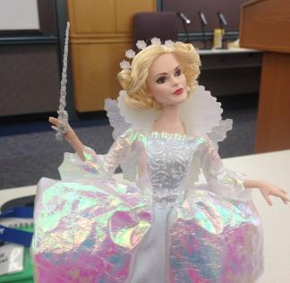

Exploring Programmatic Interfaces (APIs)
by Maaret Pyhäjärvi

Slide 2
We Learn to Test by Testing
TestThisBox Gilded Rose
Roman Numerals
ApprovalTests
E-Primer
DFEditor
Freemind
Zippopotamus
React-Weather
Odoo
Do
Reflect

Slide 3
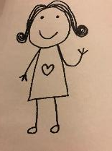
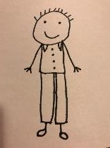

Spec => Tests + a Session to Find all Bugs
First Experience to Exploratory Testing?
Repeat list of test cases + a conference awakening
Some tests, budget of time, QA on results

Slide 4
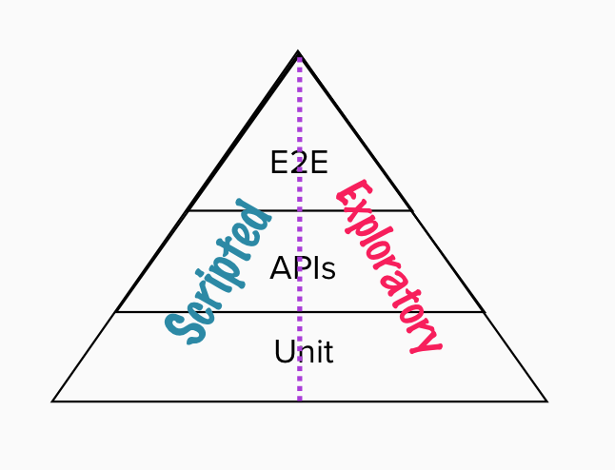
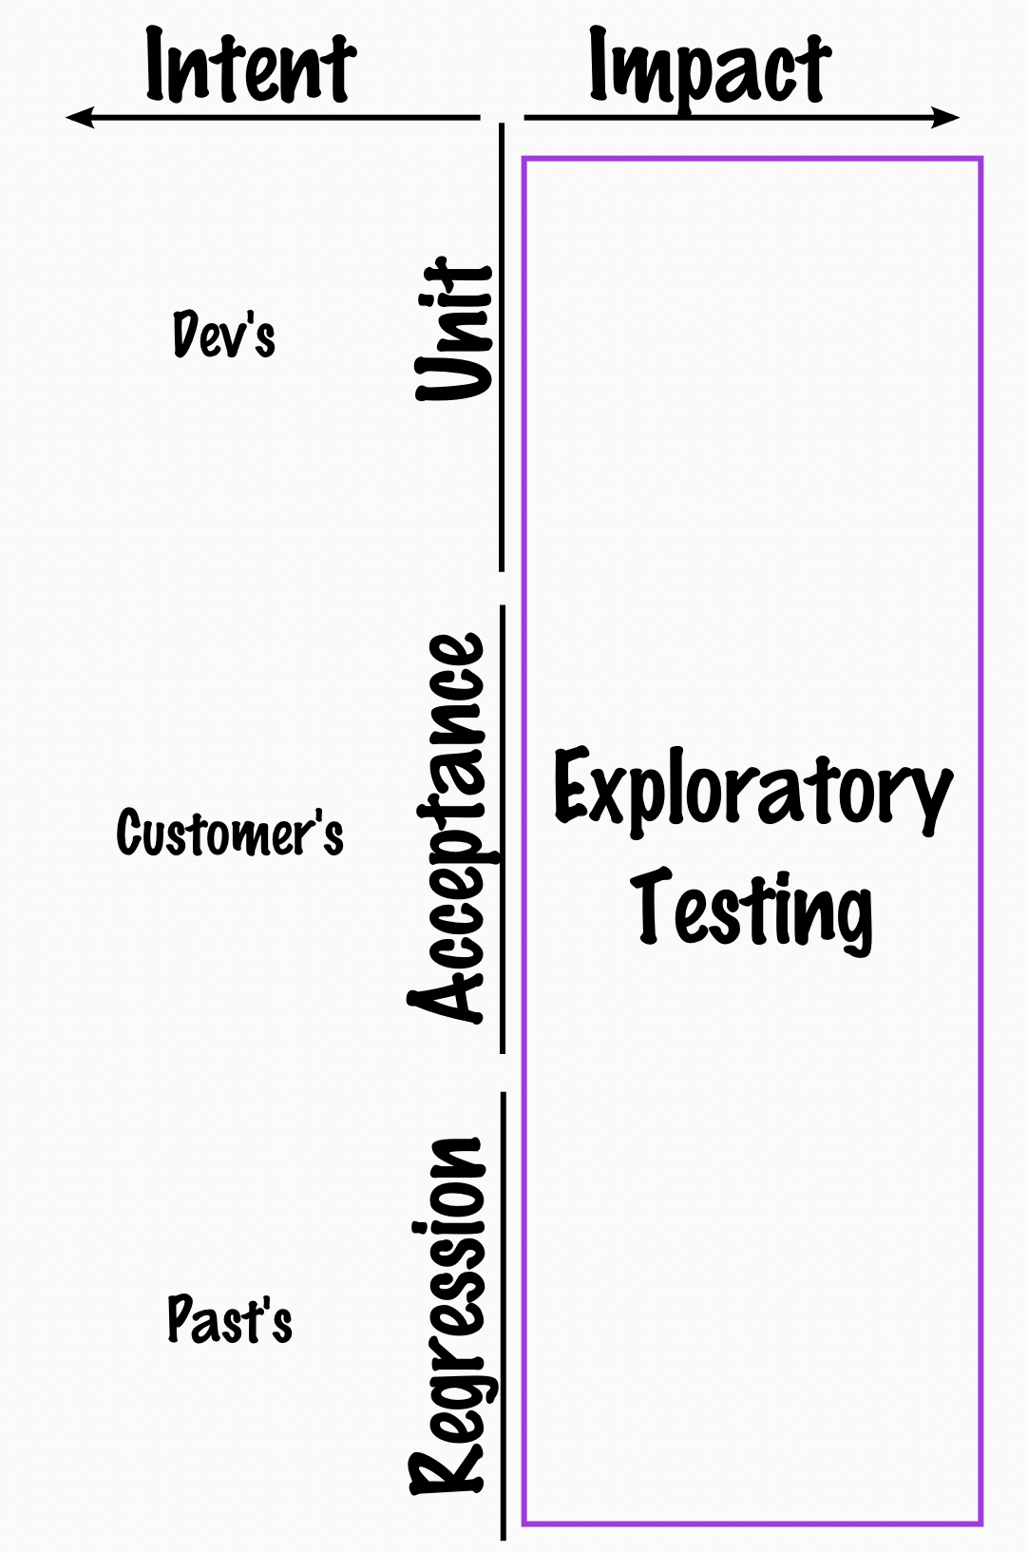
Notes:
CODE – COMPONENT – CONTAINER - CONTEXT

Slide 5
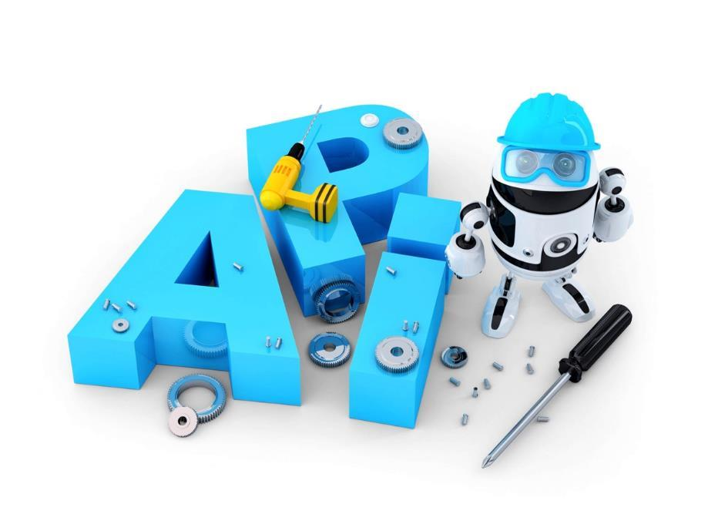
An application programming interface (API) is a set of routines, protocols, and tools for building software and applications.

Slide 6
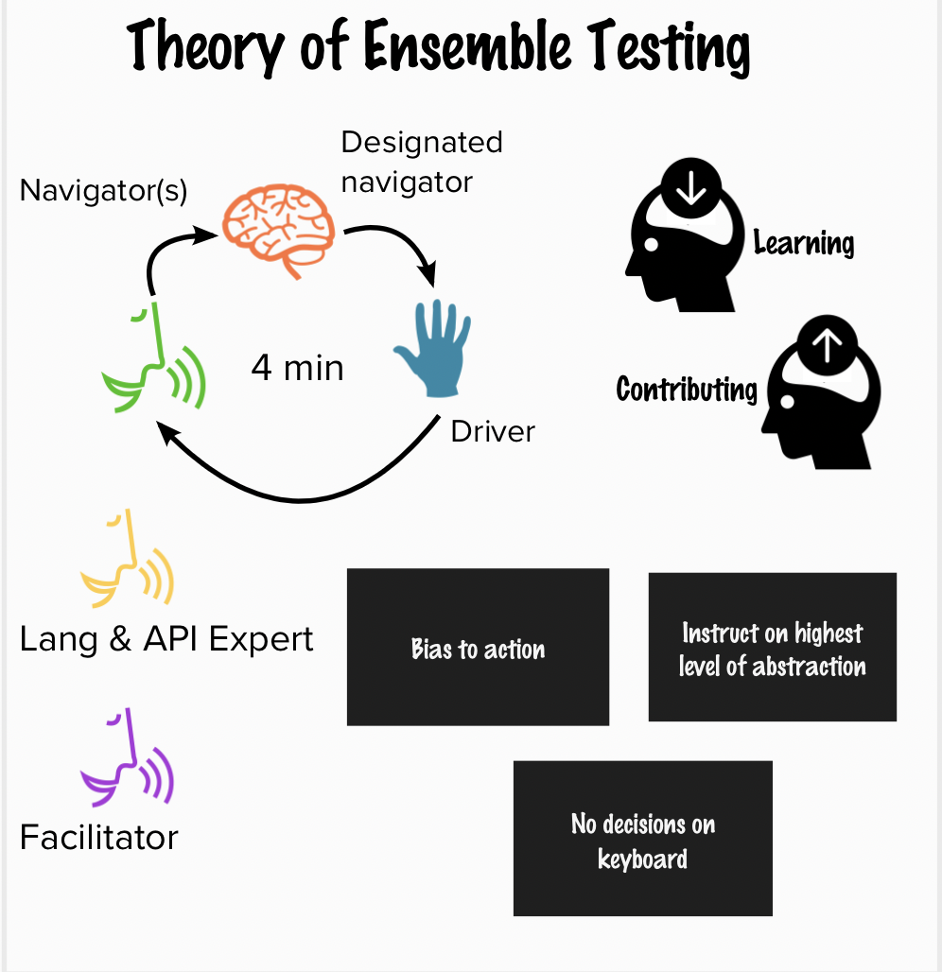

Slide 7




Maaret Pyhäjärvi (from Finland)
MIATPP Most Influential Agile Testing Professional Person
2020
2016
Email: maaret@iki.fi
Twitter: @maaretp Web: maaretp.com
Blog: visible-quality.blogspot.fi
(please connect with me through Twitter or LinkedIn)
#PayToSpeak #TechVoices #EnsembleTesting #EnsembleProgramming #StrongStylePairing #ExploratoryTesting #TestAutomation
#ModernAgile
#AwesomeTesters

Slide 8
DX
Developer Experience
Building it the First Time
Debugging and Maintaining

Slide 9
REST APIs (http(s)) Streaming APIs (ws(s))
Libraries
Frameworks
Languages
Methods
CLI
Protocols and Messages

Slide 10
Exploratory Testing: Frame of Management
Debriefing
Perception of quality and coverage
Quality Report
Coaching
Past
Results
Obstacles
Outlook
Feelings
”A day’s work”
Test Manager
Vision (“Sandbox”)
Current Charter
Metrics summary
Tester
Other Charters
Details
#
Session sheets of the past testing
?
Charter backlog of the future testing
x
#, ?, x, +
Next in importance!
Bug Reports
20:20:60
Idea of exploration
Playbooks
Coverage outlines
Out of budget

Slide 11
The Pieces in Management Framework
A disciplined tester replanning on various levels
Session with charter that provides a report
Classification of information created as metrics
Prioritizing of what test idea comes next
Supporting reporting by debriefing
Supporting skills development by coaching or pairing
Creating a combined judgement of quality by quality reporting

Slide 12
Gilded Rose
By Emily Bache (available in 32 languages…) https://github.com/emilybache/GildedRose-Refactoring-Kata

Slide 13
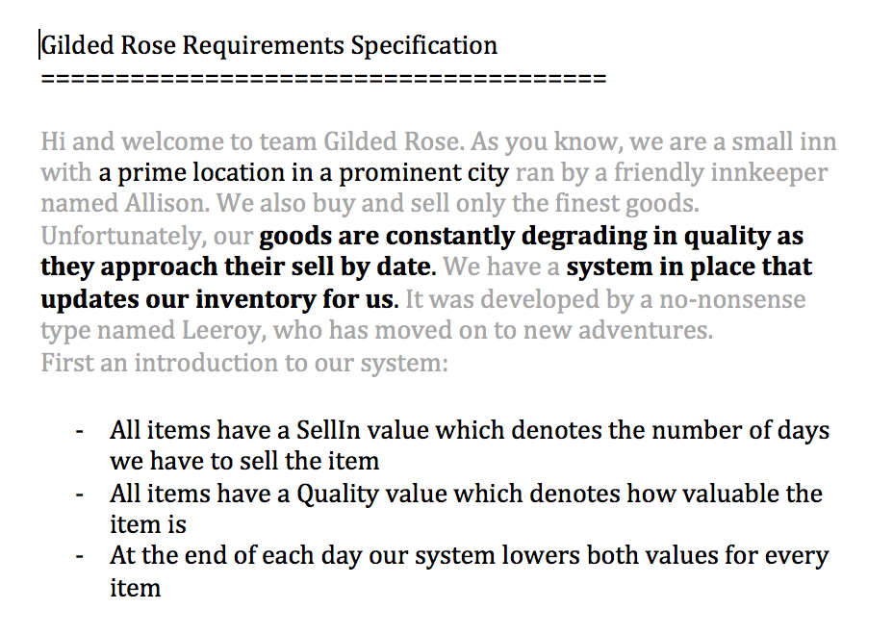

Slide 14
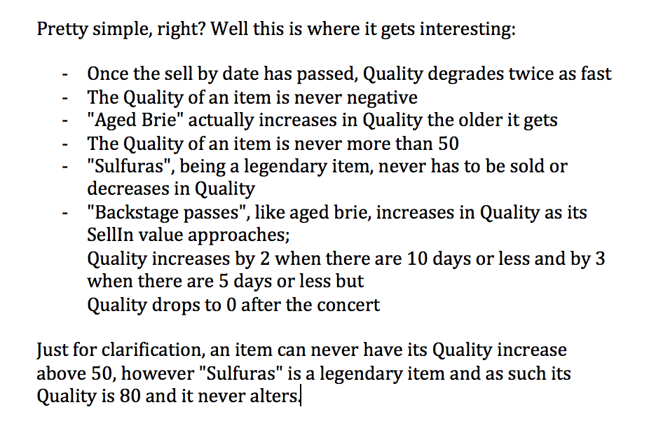

Slide 15
How to Explore
Do something with it
Find out what is the common thing to do with it
Find out what you could do with it
Reflect after anything and everything – make notes
What do we know from other connections?
What do we know from empirical evidence?
How do we turn it all into empirical evidence?

Slide 16
REST API

Slide 17
Nouns
Verbs
“CRUD”

Slide 18
Methods
HTTP GET
HTTP POST
HTTP PUT
HTTP DELETE
HTTP PATCH
Status Codes
1xx: Informational
2xx: Success
3xx: Redirection
4xx: Client Error
5xx: Server Error

Slide 19
Verbs
Authorization/authentication
Data
Errors
Responsiveness
http://qa-matters.com/2016/07/30/vader-a-rest-api-test-heuristic/

Slide 20
Patterns of Exploration for APIs
Lessons Distilled

Slide 21
Working with limited understanding: Focus!
Notes:
People freeze when facing the Unknown: non-programmers fear code; programmers fear languages they don’t work in; everyone fears unknown applications.

Slide 22
Calls and Operations. Inputs and Outputs.
Exceptions.
Notes:
Extending an API – Can you?
Find your building blocks.

Slide 23
Target of your testing vs. the environment it depends on

Slide 24
Specific user with a specific purpose
Building it the First Time
Debugging and Maintaining
Notes:
Intended use. Misuse.

Slide 25
Why would anyone use this?

Slide 26
Think lifecycle Versioning and Deprecation

Slide 27
Google for Concepts like “Conservative Overloading Strategy”

Slide 28
Fast-track your understanding: collaborate

Slide 29
Documentation Matters a Lot for APIs
Notes:
Discoverability without automation
Copy-pasteable
Just the right amount
Available in the tooling where you use the API
Names should be meaningful. Programmers are people too!
Ordering of parameters. TDD to create nicest possible signatures that make sense in english!
Consistent with language. Type of tools. Helping people using it with the memory loading.

Slide 30
Explore to create documentation
Notes:
The developer support site with copy-pasteable examples
MTFHW (hello world) and MTFWA (working application)

Slide 31
Some patterns become visible with repetition
Notes:
Artifacts as discretionary output. Search "<ns1:Koodi>" (443 hits in 169 files) in VE
Y:\ELLU\LAPA\Testaus\Kokonaiseläketurvan-ote\Ansaintatiedot-VE\HaeAnsaintatiedot-VE__ 20110307 14-22-15.xml (4 hits)
Line 1313: <ns1:Koodi>YL130I</ns1:Koodi>
Line 1317: <ns1:Koodi>LAPA_172_011</ns1:Koodi>
Line 1321: <ns1:Koodi>67</ns1:Koodi>
Line 1324: <ns1:Koodi>67</ns1:Koodi>
A lot of text cut away from here…

Slide 32
Existing automation allows for exploration reach

Slide 33
Creating automation forces exploration of details
Notes:
When a thing works, that’s when you put it to test automation. Meanwhile you’re ’scripting the case’ while getting the bug fixed.

Slide 34
Failing automation is invitation to explore

