Slide 1
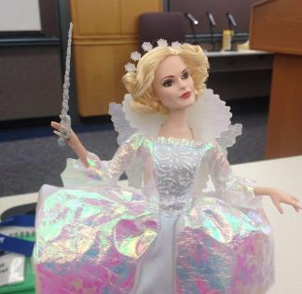

Hands-Off Exploratory Testing How to Manage at Scale
by Maaret Pyhäjärvi

Slide 2
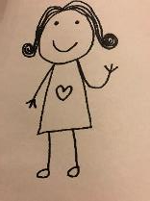
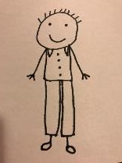

Spec => Tests + a Session to Find all Bugs
First Experience to Exploratory Testing?
Repeat list of test cases + a conference awakening
Some tests, budget of time, QA on results

Slide 3
Exploratory Testing: Frame of Management
Debriefing
Perception of quality and coverage
Quality Report
Coaching
Past
Results
Obstacles
Outlook
Feelings
”A day’s work”
Test Manager
Vision (“Sandbox”)
Current Charter
Metrics summary
Tester
Other Charters
Details
#
Session sheets of the past testing
?
Charter backlog of the future testing
x
#, ?, x, +
Next in importance!
Bug Reports
20:20:60
Idea of exploration
Playbooks
Coverage outlines
Out of budget

Slide 4
The Pieces in Management Framework
A disciplined tester replanning on various levels
Session with charter that provides a report
Classification of information created as metrics
Prioritizing of what test idea comes next
Supporting reporting by debriefing
Supporting skills development by coaching or pairing
Creating a combined judgement of quality by quality reporting

Slide 5
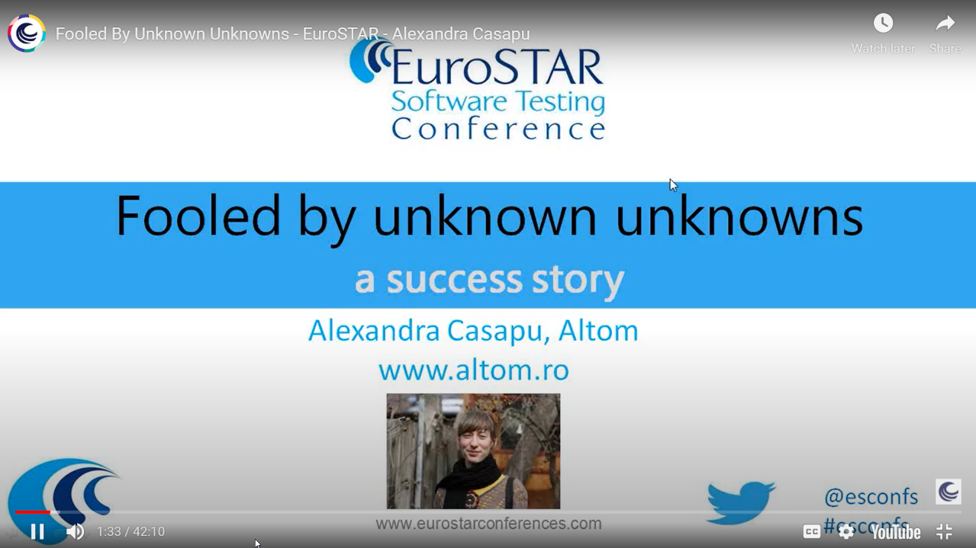
https://www.youtube.com/watch?v=KnKwB_WERtc
Feedback on Results
5 → 29 bugs found

Slide 6
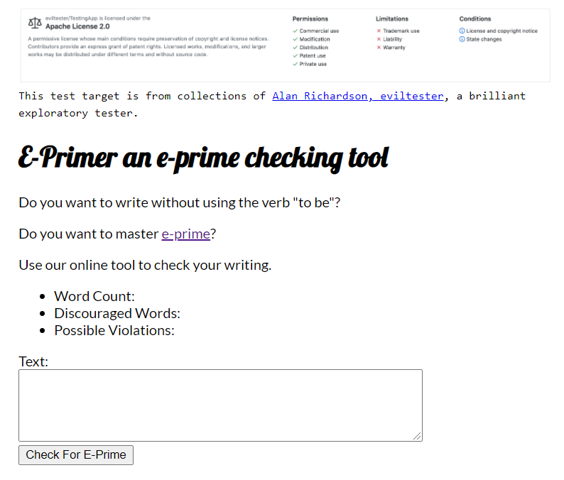
An Example
Notes:
Software Testing as game is not a game where you win your opponent, but you win on results together! The product not the programmer is the “opponent”.

Slide 7
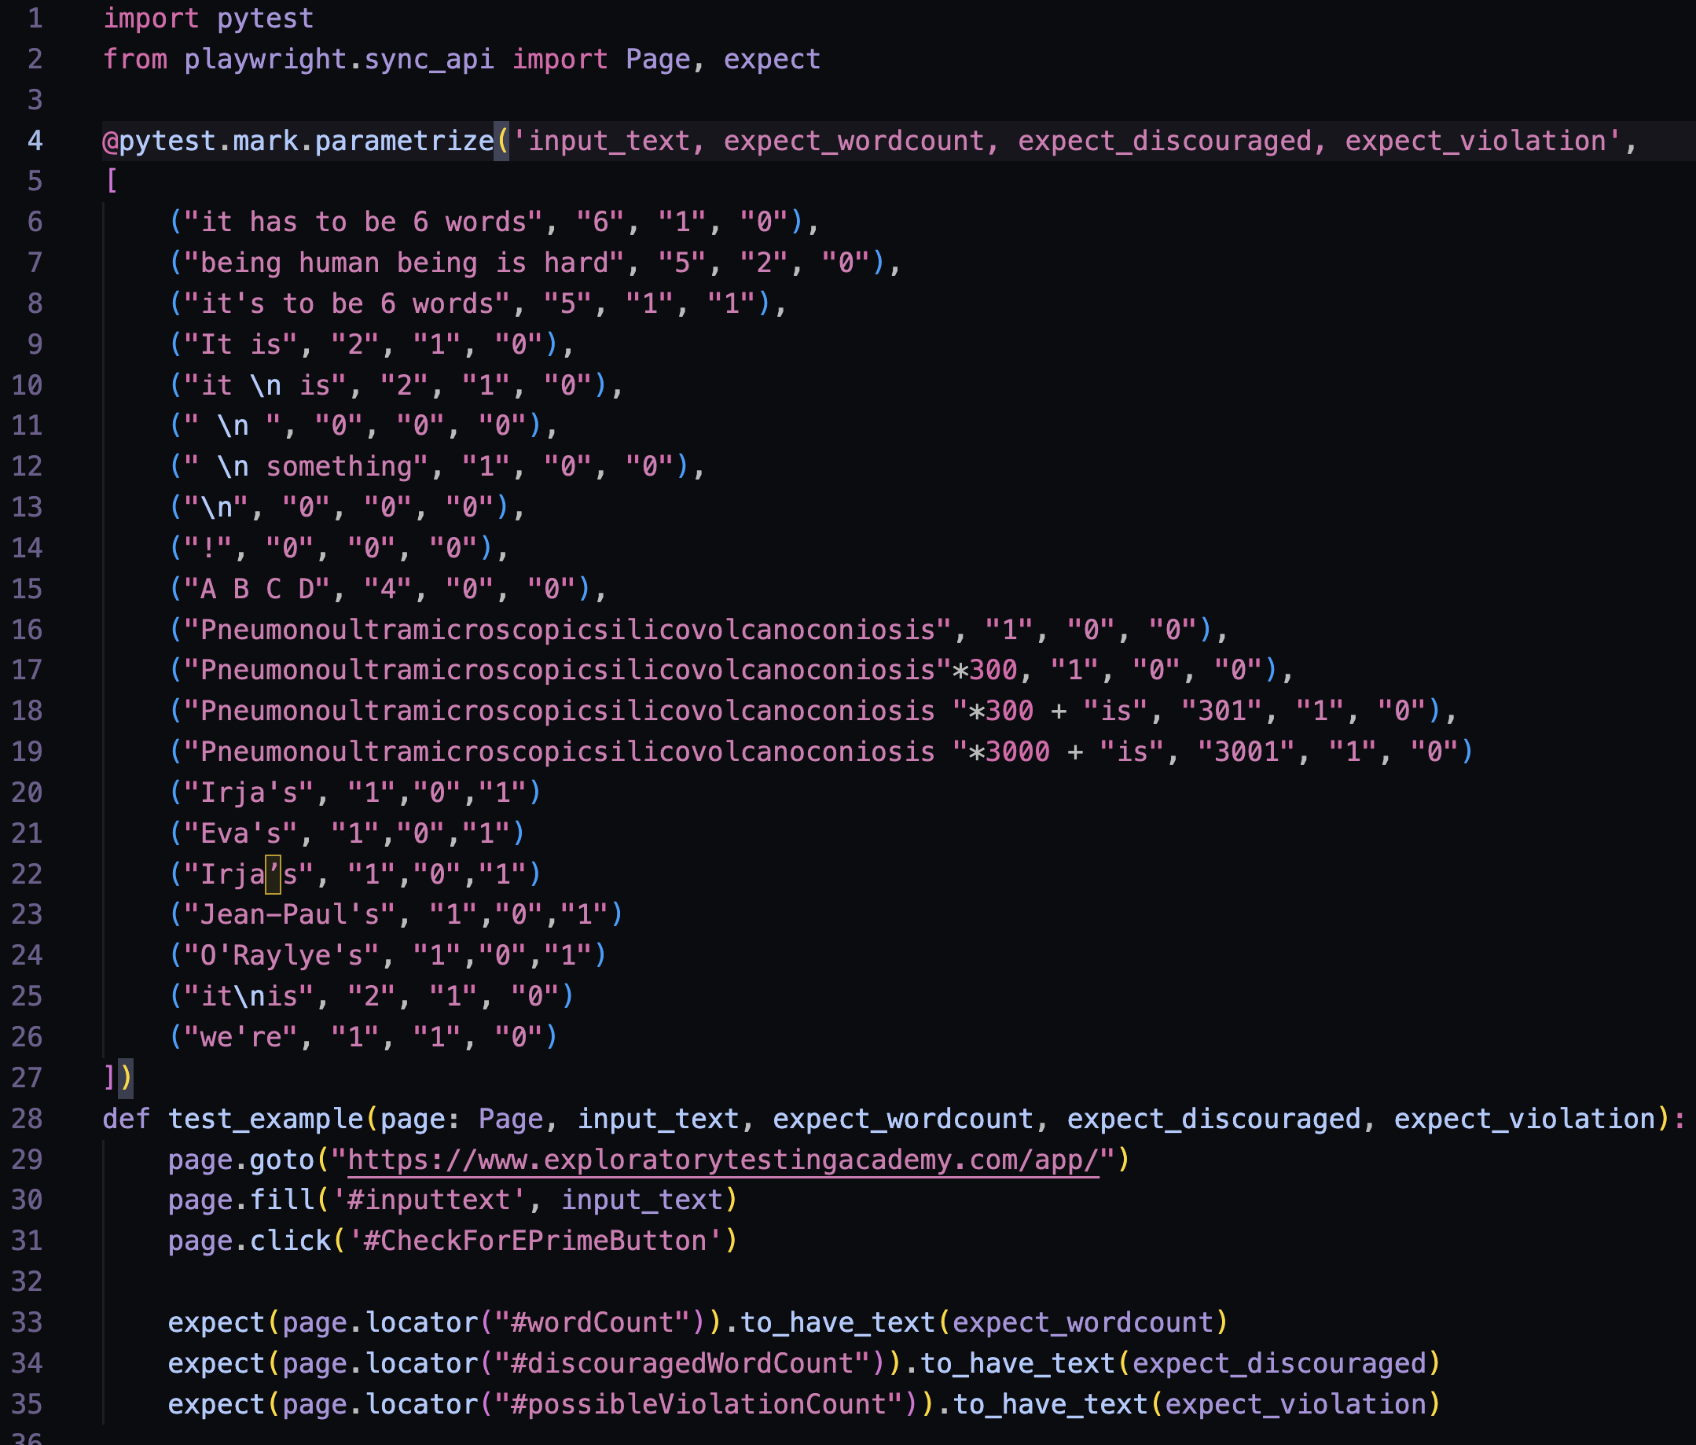
Solo
Ensemble
2/23 bugs
1-4 TA x single browser
19/23 bugs
15 bugs with TA
21 TA x 3 browsers

Slide 8
”Find (some of) What Others May Have Missed”
Stakeholders happy, even delighted
–Quality Information
Surprise!
Results Gap
Good Team’s Output
–Quality Information
Results Gap on a Team that thinks
Testers == Testing
Pick up the pizza boxes…
Less than Good Team’s Output
–Quality Information

Slide 9
Discuss: How You Manage Exploratory Testing?
Your own
Single team of testers
Single team with embedded testers
Multiple teams with embedded testers

Slide 10
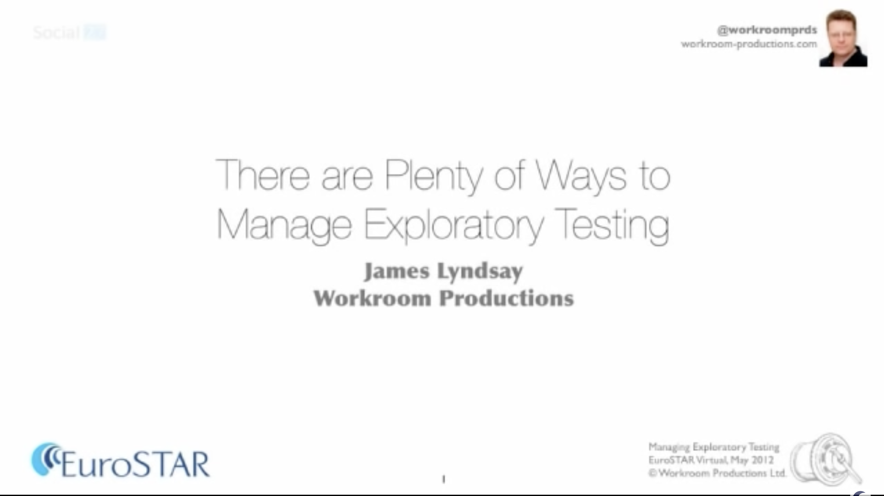
https://www.youtube.com/watch?v=WQnU2NkiIOw

Slide 11
Exploratory Testing the Verb
Doing Testing
INPUT
OUTPUT

Slide 12
Exploratory Testing the Noun
Organization’s Expectations
Doing Testing
INPUT
OUTPUT

Slide 13
Two Usual Ways To Manage
I) Exploratory Testing Team Sessions
II) Session-based Test Management

Slide 14
Optimizing the value of testing

Slide 15
Agency
power to decide with knowledge and attitude that goes with power

Slide 16
Exploratory Testing
product design
TEST DESIGN
TEST EXECUTION
M
M
A
A
LEARNING,
AGENCY
* power to decide with knowledge and attitude that goes with power
IMPACTFUL RESULTS

Slide 17
Discuss: Do You Have Agency?
What organizational expectations remove your agency?
What behaviors you have that increase your agency?

Slide 18
Lesson Distilled
Focus on results (Bugs, Test Automation)
Protect Agency
Limit scope / extend scope through network facilitation
Ideas that Guide Test Design in Scale

Slide 19
Good Neighbor Principle
No centralized E2E testing team. 21 component teams that care about being good neighbors.

Slide 20
Everything Continuous Principle

Slide 21
Sustain Agency Principle

Slide 22
Protect Agency
Continuous Releases: Shorter Increments over Session Based Test Management
Co-Design Workshops over Status Meetings
Pair/Ensemble Testing over Reviewing Test Ideas
Regular Review of Investment and Results

Slide 23
Ideas for Scale
Small Continuous Changes ‘Nothing changes if you change nothing’
Cut the timeframe of consideration with releases
Moving to releases relying on automation starts with ONE test
Ask through power, ask directly, avoid assigning tasks
Stay visible – communicate with summaries, enable access to info
Numbers as conversation starters
Grow don’t manage

Slide 24
Grow as Testers
Finding and Sharing New Information Matters
Investment Awareness
Time Dimensions: Now vs. Future
From Reactive to Just-in-Time Reactive
Learn to Learn *really well*

Slide 25
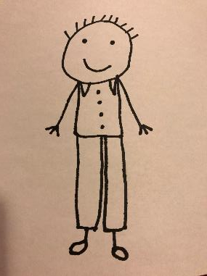
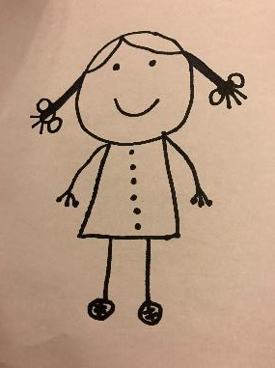
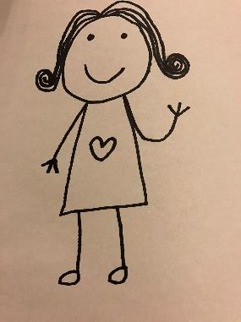
Testing is too important to be left for only testers!
(Exploratory) Tester
Test Automator / Programmer
(Application)
Programmer

Slide 26







Maaret Pyhäjärvi (from Finland)
MIATPP Most Influential Agile Testing Professional Person
https://exploratorytestingacademy.com
2020
2016
2019, 2020, 2021
Email: maaret@iki.fi
Twitter: @maaretp Web: maaretp.com
Blog: visible-quality.blogspot.fi
(please connect with me through Twitter or LinkedIn)
Ohjelmistotestaus ry
#PayToSpeak #TechVoices #EnsembleTesting #EnsembleProgramming #StrongStylePairing #ExploratoryTesting #TestAutomation
#ModernAgile
#AwesomeTesters
https://techvoices.org

