Slide 1
Vaatimukset ja hyväksymistestiohjattu kehitys
...
Erkki Pöyhönen & Maaret Pyhäjärvi
Nimeä | Attribution (Finland)
http://creativecommons.org/licenses/by/1.0/fi/
http://creativecommons.org/licenses/by/1.0/fi/deed.en

Slide 2
Harjoitus: Paripiirtäminen
Sopikaa roolit
Piirtäjä
Selittäjä
Piirtäjä sulkee silmät 30 sekunniksi
Selittäjä näkee kuvan
Selittäjä auttaa piirtäjää piirtämään kuvan

Slide 3
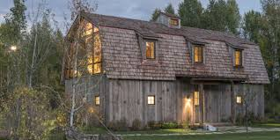

Slide 4
Working Software vs. Documentation
Agile values state working software is valued over comprehensive documentation
Often heard from testers: ”agile: doing exactly what we did except for not getting any documentation”
To replace documentation, there is tight collaboration with various parties
Externally needed documentation – ”a part of the product” – is often done in teams with tester involved due to natural interests
An essential practice: conversational test creation
Collaborate with customer and the team to find out what should and must be tested

Slide 5
Specification by Example (SBE)
Also known as
Executable specifications
Automated acceptance testing
Acceptance-test driven development
Behavior-Driven Development
SBE – Specification by Example
Not a testing method, but a specification method that just happens to equate key examples and tests that should at least be confirmed to pass

Slide 6
Feature: Sign up From Cucumber-book
Sign-up works in three stages:
1. Apply for an account via a form on the website. Applicant gets an email
2. Follow the confirmation in the email to activate the account
3. Fill out profile information. By this stage the user has an account but we try to collect more information about them.
Scenario: Apply for an account
GIVEN I do not have an account
WHEN I follow the sign up link from the homepage
AND I fill out the form with valid details and submit it
THEN I should see a confirmation message telling me to check my email
Scenario: Confirm account
GIVEN I have applied for an account
AND I have confirmed my application
WHEN I log in
THEN I should not see a message telling me to confirm my account
BUT I should see a welcome message
AND I should see a form asking me to fill out my account profile
Scenario: Fill out account profile
GIVEN I have logged in to a brand new account
WHEN I fill out my profile details
AND I log out and log in again
THEN I should not see the form asking me to fill out my account profile

Slide 7
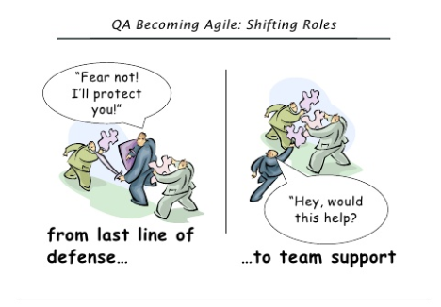
Testing is Feedback
First, make sure you understand the idea well enough to implement the right solution
Second, deliver soon and test for surprising limitations that may threaten the value.
INCREMENT
SBE
Feedback
Feedback
TDD
IDEA
€
REAL BENEFIT
solution
Willing
Unable
Able
Unwilling
Source: Elisabeth Hendrickson

Slide 8
The Testing Quadrants (Adapted from Marick, Crispin&Gregory, Hendrickson)
CONFIRM
INVESTIGATE
Business expectations
External quality risks
Customer-, user-value
BUSINESS
Internal quality risks
Predictability, efficiency
Technology expectations
TECHNOLOGY

Slide 9
The ”Beer Game”
Can I get a beer, please?
Waiter comes and pours a bucket of beer to your head. Not what you wanted, so make your order more specific.
Can I get a beer in glass on the table, please?
Waiter brings you a shot glass of beer. Still not what you wanted, so make your order more specific.
Can I get a beer in a pint glass on the table, please?
Waiter brings you a pint glass of boiling beer.
Can I get a cold beer in a pint glass on the table, please?
Waiter brings you a pint glass of frozen beer.
Can I get a 8C degree beer in a pint glass on the table, please?
Waiter brings you a pint glass of 8C degree beer, but the glass has a tennis ball inside it.
Can I get a 8C degree beer in a pint glass that does not contain any other objects on the table, please?
Goes 30 minutes and you do not get anything. So you ask from waiter what is taking so long? Waiter explains that the kitchen is building a new dust free room, and it will take some days to get your beer without any objects.
Can I get a 8C degree beer in a pint glass that does not contain any big size other objects but small particles are ok on the table, please?
Waiter brings you a pint glass of 8C degree beer. And warns you that it has some small residue of plutonium in it.
What Should We Learn from This?

Slide 10

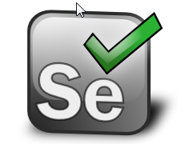
Our Environment and Toolset
Software development team of 9+1
Product management team of 4+
C# for .NET web applications
Notes:
Cucumber – Ruby
Robot Framework - Python

Slide 11
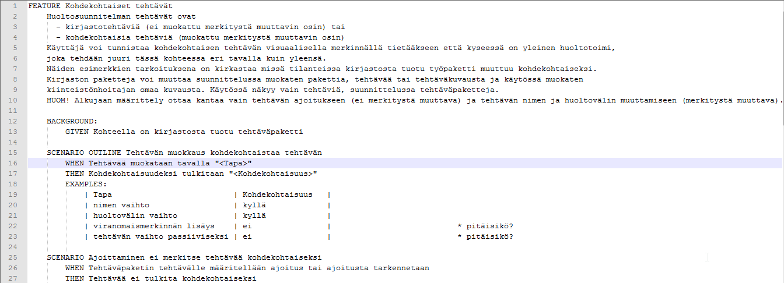
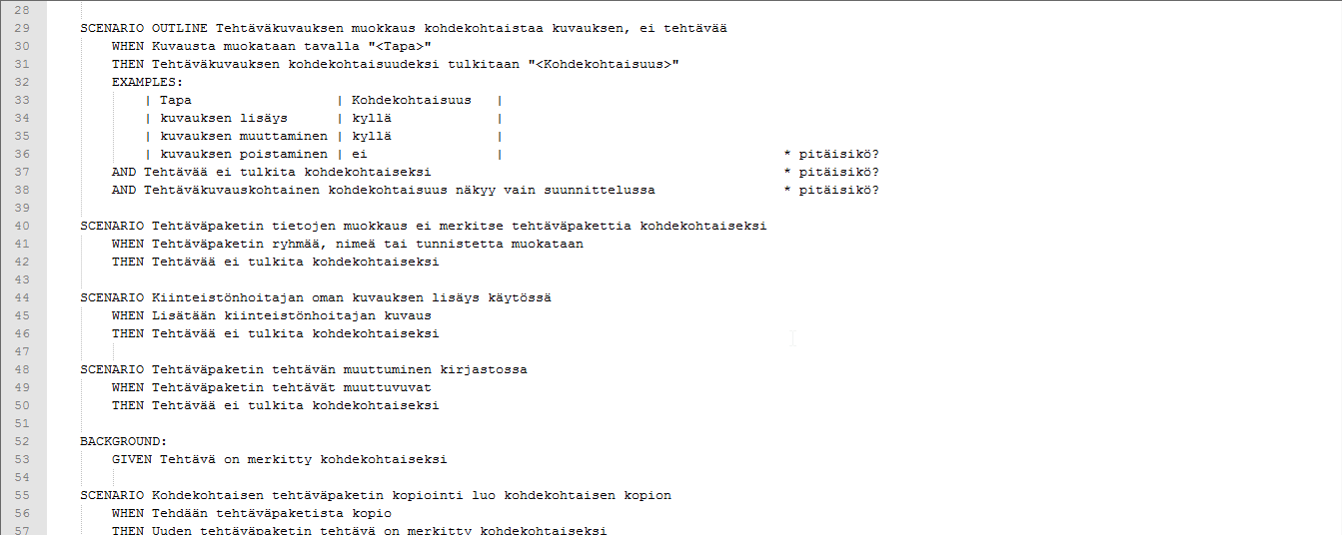

Slide 12
Trying It Out Taught Me About People
Specifying in prose allows you to pass on requirements without specifying the implications – ”not out job” –attitude
Specifying but not managing to get core understood gives a ”I told you so” –feeling
Specifying but still learning while testing changed the specifications – software talks to us who listen

Slide 13
Letting It Sink In…
Gojko’s SBE workshop: ”It’s about domain modeling – making business terms match the technical implementation”
All printed examples look bad – so much context around why we need to discuss this detail
Discussion is the key, the automation may be a nice bonus – provided you can rely on the interface you connect with

Slide 14
Agile Specification?
There is no such thing as agile specification
But, there may be a project-specific specification practice that your agile project uses
Emphasis on different forms for different needs and working software over comprehensive documentation
Requirements are often handled as conversations and workshops – with team included

Slide 15
Building Something for the Future
Instead of building in diversity, do the simplest thing that could possibly work
Build in adaptability: prepare to change, don’t fix things in stone
”I knew we’d need this later”
We’ve built a lot of things we did not need later to be right at some
Instead, focus on value.
DISCUSS and suggest, don’t assume decisions base on absolute knowledge of everything

Slide 16
Effectiveness of Communication Strategies on Agile Development Teams Source: Scott Ambler, Requirements Specifications on Agile Projects, Modern Analyst May 2009
Communication strategy | Within team | With stakeholders
Face to face | 4,25 | 4,06
Face to face at whiteboard | 4,24 | 3,46
Overview diagrams | 2,54 | 1,89
Online chat | 2,1 | 0,15
Overview documentation | 1,84 | 1,86
Teleconference calls | 1,42 | 1,51
Videoconferencing | 1,34 | 1,62
Email | 1,08 | 1,32
Detailed documentation | -0,34 | 0,16
Media Richness Theory: documentation is the worst strategy available to communicate information between people
Rated on a range of -5 (very ineffective) to +5 (very effective)

Slide 17
User Story Format
As a <role>, I want <capability> so that I can <accomplishment>
And can see that it does <example.>
Defining by epics and stories
Epic = big story, a theme
Minimum marketable feature could be several stories or even epics
Story should fit to be implemented in a sprint
Think of the smallest possible deliverable value to add at a time

Slide 18
Agile Requirements Hierarchy
VISION
Themes
Epics
User Stories
User Stories
Epics
User Stories
Tasks
Tasks
Tasks
Tasks
Acceptance criteria

Slide 19
Working with Stories: the 3*C Critical Aspects
Card
One line requirement reminder
Identification is essential, card is a token
Conversation
Exchange of thoughts, opinions and feelings
Largely verbal, supported with documents
Confirmation
The acceptance test defining criteria for Done

Slide 20
I.N.V.E.S.T. – Good Backlog Items
Independent
Value to be delivered solo
Negotiable
In solution space – implementations may vary for the value to deliver
Valuable
Should have priority – inventory is waste
Estimable
Rough size, don’t waste too much effort on estimating
Small
Early delivery, early feedback results in needed learning.
Testable
Knowing when it’s done.

Slide 21
Acceptance Test Driven Development
Each Story to implement is made tangible with Acceptance tests
Acceptance tests are defined in the early parts of the sprint
Not ready in planning day
Involve a lot of discussions – essentially whole-team test planning with examples
Role of test automation essential: high level cases transformed to implemented acceptance tests during the sprint

Slide 22
Team Takes Action in Acceptance Testing
In start of sprint
Defining requirements and commitment
Outlining acceptance tests
Conversational test creation
Working together with customer and team to find out what to test
Specification by example
Definition of scope in examples that can be executed to show completeness
During the sprint
Adding more examples into the acceptance tests to refine requirements
Implementing test automation for acceptance tests
Implementing features that will eventually pass the acceptance tests
End of sprint
Measuring done in testing against Tested Running Features – for all things implemented until this sprint, not only in this sprint
Demo
For work not done, two options:
Say the product backlog item was not done
Identify (testing) work left as quality debt if you could actually also deliver without the information with a significant risk
Acceptance Test Driven Development = Executable Requirements Approach

Slide 23
Reasons for Lack of ATDD
Can’t work in incremental fashion
Increment does not provide a new slice of business value, but more like building pieces for future business value
Can’t define acceptance criteria fast enough
Acceptance criteria for a focused change with past tests supporting might be possible, but there’s a lot of implications on changes and little time during planning day if you can’t rely on past in scales
Can’t automate enough
With incremental development, there’s more to test after every addition. If the automation does not take of the old, the old takes a lot of manual effort from the team.
Can’t automate fast enough
Transforming test ideas to test automation does not fit the sprint work, there’s no quick enough way of automating on acceptance level
Concern for skewed focus on automation over investigative testing
Too much focus on automation and you end up not including really relevant in-depth exploratory testing
A manual test is not the same as automated, but for a lot of cases it does not matter – except for people who are convinced of 100 % test automation

Slide 24
Non-functional Requirements in Agile Backlogs
Write test-stories on non-functional requirements
Non-functional features are not free and can to some extent be added later – cost varies
For maintaining status quo on non-functional requirements, include in definition of DONE and acceptance criteria of the item
System features: performance, scalability, usability, ...

Slide 25
Make Tradeoff-priorities Visible
 | Sacrifice others for this | Try to maintain | Sacrifice these for others
Flexibility in use |  |  | x
Ease of use |  | x
Stability | x
Security | x
Fancy-looking UI |  | x
Schedule |  |  | x
Performance |  |  | x

Slide 26
Why Customers Find Bad Bugs We Don’t Find?
If you rely on written requirements, you are bound to fail
Customer / user perception is different and has unpredictable aspects
Meeting real users and customers personally improves tester’s capabilities to sympathize correctly

Slide 27
Ideoita, ajatuksia, kysymyksiä?

