Slide 1
Testauksen parantaminen
Jatkuvasta oppimisesta säännölliseen muutokseen
Erkki Pöyhönen & Maaret Pyhäjärvi
Nimeä | Attribution (Finland)
http://creativecommons.org/licenses/by/1.0/fi/
http://creativecommons.org/licenses/by/1.0/fi/deed.en

Slide 2
Self-Organized Team Also Organizes for Improvement
Agile values suggest improvement done where the problem is, everyone solves their own problems - together
Using examples of what other people did in similar situations is a source of ideas
Availability of those ideas is difficult
My take
Point things to teams that seem to have improvement potential and ask for solutions
Suggest solutions for problems outside a team’s scope, volunteer to facilitate but make the changes visible, enable participation
Encourage to share good practices
Organize workshops on common issues, find solution together

Slide 3
Concept of Kaizen and Retrospectives
Small and continuous change
Inspect-and-adapt, change and see how it works
Global optimization instead of local: considering the value chain
Don’t complete the project, bring the learning for the benefit of the ongoing project
Starting from a seemingly good standard does not emphasize continuous change

Slide 4
Agile Focuses on People
A significant part of process improvement is related to
Individual’s abilities and skills
Team’s ability to work together for the goals
Learning by doing
Retrospectives as mechanism to change things for better on regular and frequent intervals
Other people’s practices are ideas, make things work for you

Slide 5
Improvement Starting Point and Organizing
As a Project – large scale
Strengths:
Isolated resourcing and scope
Gives status for the effort with a label
Gives permission to focus with resourcing
Visible to management with project follow-up mechanisms
Weaknesses:
May become distant to real life and real needs
Generalized instruction don’t work in specialized situations
As Part of Work – small scale
Strengths:
Goal of improvement bound directly to real work
Avoidance of shelf-methods
Knowing the real needs by heart
Weaknesses:
Generalization for use in other projects may be challenging
Improvement is easily a lower priority tasks and stays alive only with strong personal interests
Works when analyzing needs requires time and effort and commitment needs emphasizing.
Works if you already have idea on what should be improved and project management is committed.

Slide 6
Elements of Process Change Source: Tim Kasse, 1999. Managing complex change processes.
Process evaluation
Vision
Skills
Rewards
Resources
Prioritization
Change
Skills
Rewards
Resources
Prioritization
Confusion
Vision
Rewards
Resources
Prioritization
Anxiety
Skills
Resources
Prioritization
Slow change
Vision
Vision
Skills
Rewards
Prioritization
Frustration
Skills
Rewards
Resources
Wrong change
Vision

Slide 7
Test Process Improvement – Choosing the Right Medication
Price
”is there a coverage metric”
Remedy (correct or counteract)
Effectiveness
Benefits
Impact
Risks
Constraints
Structure / Anatomy
Problem
Symptom
”there’s no evidence of test coverage”
Functional part
Importance
Context factors
Notes:
Onko oire yleensäkään ongelma? Kuinka tärkeä ongelma? Onko oire aina oleellinen? Jos pitää jatkuvasti ikkunaa auki niin että reumatismi vaivaa, niin eikös siinä vaiheessa lääke taas olisi korjata tilannetekijöitä. Vai ovatko oireet aina seurausta tilannetekijöistä? Toisaalta, tällöin jotkin tilannetekijät olisivat sisäsyntyisiä.
Missä kuviossa tavoitteet ja keinot? Onko monenlaisia tavoitteita? Vai onko tavoite arvioinnissa aina parantaa/korjata? (sairausvertauskuva)

Slide 8
Basic Principles of Lean Development
Add nothing but value (Eliminate waste)
Center on the people who add value
Flow value on demand (Delay commitment)
Optimize across organizations

Slide 9
The Seven Wastes of Software Development
Overproduction = Extra features
Inventory = Requirements
Extra processing steps = Extra steps
Motion = Finding information
Defects = Defects not caught by tests
Waiting = Waiting, including customers
Transportation = Handoffs

Slide 10
Hints on Evolving and Improving Testing Practices
Retrospectives: Regular Process Reflection to Improve Practices
Showing the Big Picture of Improvement and Status

Slide 11
Retrospectives: Improvement from Bottom-Up
Consider: What a team can change without involving others directly?
Team retrospectives: inspect and adapt
Inspect: Look at what we were trying to do and did against values, principles, practices, goals
Adapt: Decide on changes, and have them in place for next iteration
Dig into symptoms and root causes
Understanding what really is the issue to fix is relevant
E.g. “Project manager and test manager argue” → Teams don’t get heard on their opinion on quality
Some ideas:
List of things people have said about the team’s performance and practices to analyze, 5*WHY
Go through the team practices, analyze for better return on investment
Drop or replace something that the team wanted to keep for a limited timeframe

Slide 12
Retrospectives: One Typical Formula
Identify
Keep: Things that work well and should remain
Drop: Things that don’t work well and should be changed:
Try: Things that could change state as it is now for positive
Joker: Anything outside the other categories, freeform ideas
Group
Similar ideas from many participants
Prioritize
Team voting on what is most relevant
Agree on actions
What changes will happen NOW

Slide 13
Different Retrospectives
Team Retrospective
Multi-Team Retrospective
Functional Retrospective
Most typical
Global improvement from one point of view
Often feelings of powerlessness on bigger issues
Representatives of various teams
Triggers cross-team discussion and improvement
Function could be e.g. Testing
Bring together people with common theme to exchange ideas
When you need improvement, you set up a proper audience to discuss and make things happen.

Slide 14
Multi-team Setting for Improvement
When there’s several teams, each should identify and fix things regarding the whole
In practice, separation of concerns happens and without support it is easy to turn inwards – ”our team does this, we should improve our things”
Role of a facilitator essential: help in thinking global improvement

Slide 15
Retrospective Is an In-team Mechanism
For larger projects, the cross-team or cross-organization issues don’t get easily tackled with the local in-team retrospectives
For scaling:
Team representatives retrospective
Scrum masters retrospective
Mechanisms for including larger investments into being better in the product backlog

Slide 16
Bringing Visibility to the Improvement Efforts
Invisible results of status and improvements causes problems
Decision-making stakeholders are more difficult to convince to allowing improvements
Status of testing degenerates without internal marketing of results
Two main brands of achieving this
Pseudo-measurement: scoring your skills and practices on a scale
Measurement: business bottom-line implications of saving money or making things more fluent
Usually many things change at once in real world
Avoid taking credit solely on testing side improvements, testing never succeeds without the support from others

Slide 17
Comparing Pre-Agile and Post-Agile is Larger Scale Improvement
Looking back on inaccurate scale gives confidence and ideas of improvement
Number of releases
By business relevance and effort used
Feature development
By importance to business and effort used → rough ROI calculation
Quality as seen by customers
Beta and piloting programs & Post-release support cases
(submitted / relevant / fixed / debt / not pending on R&D)

Slide 18
Test Process Improvement Model
Originates from the Netherlands, Sogeti
A means to show where you are and where you want to go with improvement
Excellent list of areas from a professional testing’s point of view
An inherently plan-driven approach of ”did you take the right medicine”
Other similar candidate
TMM – Test Maturity Model

Slide 19
Key Areas |  | Controlled |  |  |  |  | Efficient |  |  |  |  | Optimized
 | 0 | 1 | 2 | 3 | 4 | 5 | 6 | 7 | 8 | 9 | 10 | 11 | 12 | 13
Test strategy |  | A |  |  |  |  | B |  |  |  | C |  | D
Lifecycle model |  | A |  |  | B
Moment of involvement |  |  | A |  |  |  | B |  |  |  | C |  | D
Estimation and planning |  |  |  | A |  |  |  |  |  |  | B
Test specification techniques |  | A |  | B
Static test techniques |  |  |  |  | A |  | B
Metrics |  |  |  |  |  | A |  |  | B |  |  | C |  | D
Test automation |  |  |  |  | A |  |  | B |  |  |  | C
Test environment |  |  |  | A |  |  |  | B |  |  |  |  |  | C
Office environment |  |  |  | A
Commitment and motivation |  | A |  |  |  | B |  |  |  |  |  | C
Test functions and training |  |  |  | A |  |  | B |  |  |  | C
Scope of methodology |  |  |  |  | A |  |  |  |  |  | B |  |  | C
Communication |  |  | A |  | B |  |  |  |  |  |  | C
Reporting |  | A |  |  | B |  | C |  |  |  |  | D
Defect management |  | A |  |  |  | B |  | C
Testware management |  |  | A |  |  | B |  |  |  | C |  |  |  | D
Test process management |  | A |  | B |  |  |  |  |  |  |  | C
Evaluation |  |  |  |  |  |  | A |  |  | B
Low-level testing |  |  |  |  | A |  | B |  | C

Slide 20
Example: Status and Improvements as Themes
Avainalueet |  | Controlled |  |  |  |  | Efficient |  |  |  |  | Optimizing
 | 0 | 1 | 2 | 3 | 4 | 5 | 6 | 7 | 8 | 9 | 10 | 11 | 12 | 13
Test strategy |  | A |  |  |  |  | B |  |  |  | C |  | D
Lifecycle model |  | A |  |  | B
Moment of involvement |  |  | A |  |  |  | B |  |  |  | C |  | D
Test estimation and planning |  |  |  | A |  |  |  |  |  |  | B
Test specification techniques |  | A |  | B
Static test techniques |  |  |  |  | A |  | B
Metrics |  |  |  |  |  | A |  |  | B |  |  | C |  | D
Test automation |  |  |  |  | A |  |  | B |  |  |  | C
Test environment |  |  |  | A |  |  |  | B |  |  |  |  |  | C
Office environment |  |  |  | A
Commitment and motivation |  | A |  |  |  | B |  |  |  |  |  | C
Test functions and training |  |  |  | A |  |  | B |  |  |  | C
Scope of methodology |  |  |  |  | A |  |  |  |  |  | B |  |  | C
Communication |  |  | A |  | B |  |  |  |  |  |  | C
Reporting |  | A |  |  | B |  | C |  |  |  |  | D
Defect management |  | A |  |  |  | B |  | C
Testware management |  |  | A |  |  | B |  |  |  | C |  |  |  | D
Test process management |  | A |  | B |  |  |  |  |  |  |  | C
Evaluation |  |  |  |  |  |  | A |  |  | B
Low-level testing |  |  |  |  | A |  | B |  | C
Notes:
Keltainen: tavoitteiden kirkastus, dokumentointi
Oranssi: Viestintäparannus
Punainen: mittaristoon, erityisesti tuntiraportoinnin käyttöönottoon liittyvät asiat
vihreä: kehittäjän testausprosessin kehittäminen

Slide 21
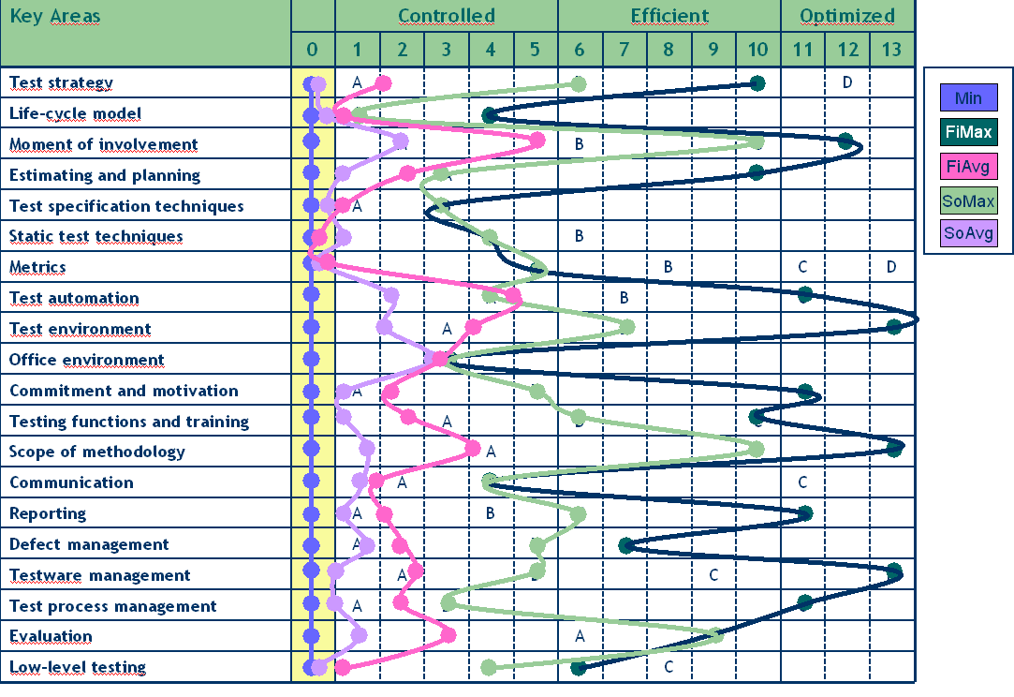
TPI-benchmark ’04 – Conformiq (fi) & Sogeti (nl)

Slide 22
Agile and TPI
We observed that when we went forward, with TPI we went backwards
The point of TPI is not to get on the right side with areas but you can choose your level
However, you would want to show progress (to positive and to negative)
We did this with school grades system of our relevant test areas of practice

Slide 23
Areas of Practices in Testing
Product-level Test Planning and Control
“Master Test Planning”
Test Automation
Area-level Test Planning and Design
“Test strategies, test specification”
Acceptance testing of external components
Test Reporting
Maintenance Testing
Build mastering
Test Execution and Logging
Development Documentation testing
“Reviews and inspections of requirements, designs, plans”
Bug reporting
Developer testing
Test Environments and Infrastructure
QE Process Improvement

Slide 24
So, What We Had at End of 2004
Grade:
7
Grade:
7
Product-level Test Planning and Control
“Master Test Planning”
Test Automation
Master test plans not written.
People working on their areas, only very few “system testers”
Full-time person to maintain GUI regression automation, API-level script-based solutions in some components
Grade:
7
Grade:
7
Area-level Test Planning and Design
“Test strategies, test specification”
Acceptance testing of external components
No strategies, detailed test cases with positive and negative tests, old priorities. Not enough non-functional aspects.
Limited number of external components, with somewhat unclear acceptance testing.
Subcontracting components undeveloped.
Grade:
8
Grade:
8
Test Reporting
Maintenance Testing
Occasionally filled weekly reports about open severe bugs, false sense of security
Maintenance managers struggling with maintenance vs. project load, specialized maintenance QEs
Grade:
7
Grade:
7
Test Execution and Logging
Development Documentation testing
“Reviews and inspections of requirements, designs, plans”
Often only priority 1 cases run, system bugs not found, bugs found late.
Logs filled in, kept negative cases on lists
Some inspections used with quite bad results.
Grade:
7
Grade:
8
Bug reporting
Developer testing
Unfocused bug reports typically with higher than appropriate severity. Centralized large-effort CCB.
Very few developers had tried, no support from QE side
Grade:
7
Grade:
6
Test Environments and Infrastructure
QE Process Improvement
Unknown/random lab services, everyone has their own env.
Slow network.
People not improving their own work. Nobody working on general testing improvements. QE Forum dead.
Grade:
5

Slide 25
So, What We Had in Beginning of 2005
Grade:
8
Grade:
8
Product-level Test Planning and Control
“Master Test Planning”
Test Automation
Master test plans written, not used
People working on their areas, difficult to find “system testers”
Full-time person to maintain GUI regression automation, API-level script-based team solutions
Grade:
8
Grade:
8
Area-level Test Planning and Design
“Test strategies, test specification”
Acceptance testing of external components
No strategies, prioritized detailed test cases with both positive and negative tests. Not enough non-functional aspects.
Limited number of external components, with somewhat unclear acceptance testing.
Subcontracting components undeveloped.
Grade:
8
Grade:
7
Test Reporting
Maintenance Testing
Occasionally filled weekly reports about open severe bugs, false sense of security
Maintenance managers struggling with maintenance vs. project load, specialized maintenance QEs
Grade:
7
Grade:
9
Test Execution and Logging
Development Documentation testing
“Reviews and inspections of requirements, designs, plans”
Priorities focused a lot of effort on regression testing, bugs found late.
Logs filled in, kept negative cases on lists
Progressive inspection concept developed, tried, but limited in applicability due to applying skills
Grade:
8
Grade:
8
Bug reporting
Developer testing
Unfocused bug reports typically with higher than appropriate severity. Centralized large-effort CCB.
Some developers had tried, no support from QE side
Grade:
8
Grade:
7
Test Environments and Infrastructure
QE Process Improvement
Shared lab services a bare minimum, everyone has their own env.
Slow network.
People not improving their own work, waiting for intervention. QE forum just launched.
Grade:
8

Slide 26
Where were we (WinCore) (Spring 2007)
Grade:
8
Grade:
7
Product-level Test Planning and Control
“Master Test Planning”
Test Automation
Monthly QE resourcing to teams with implicit planning. QE Weekly not self-organized. Risks on quality not escalated.
Developer automation, more technical as direction. System smoke automation missing. Nice little tools, no consistency.
Grade:
7
Grade:
7
Area-level Test Planning and Design
“Test strategies, test specification”
Acceptance testing of external components
Strategies implicit and based too much on individuals in team. Various forms of test specs. Loc test and CI-goals unclear.
Avoiding change, not embracing it. Unclear practices. Go with risk of team. Acquisition expectations changed.
Grade:
8
Grade:
8
Test Reporting
Maintenance Testing
Qualitative report, not scheduled, role unclear: internal vs. external. Done items review weekly. Too little quantification.
Specialized maintenance QE, tried recycling. Maintenance cases fixed in new releases. Fuzzy resourcing for teams.
Grade:
8
Grade:
8
Test Execution and Logging
Development Documentation testing
“Reviews and inspections of requirements, designs, plans”
Exploratory testing with too little explaining what is done. Last week formal log missing. Some private logs.
Workshops to define goals, requirements. No official reviews nor documents. Role of documentation under dispute.
Grade:
9
Grade:
8
Bug reporting
Developer testing
Per-team CCB drives quality. Big picture not summarized. Unsystematic follow-up. Tooling under consideration.
More developers have tried, QE support halted, interest in developer side exists.
Grade:
8
Grade:
8
Test Environments and Infrastructure
QE Process Improvement
Basic services, image library. New hardware acquired as needed. Trainings for consistency missing.
QE weekly and QE forum exist. Workshops on pressing issues. Teams independent. Peer feedback.
Grade:
9
Build mastering
Fast builds, basic practices good. View to changes difficult.
Grade:
9

Slide 27
Other Groups of Teams Are Different
Product-level Test Planning and Control
“Master Test Planning”
Test Automation
+
Area-level Test Planning and Design
“Test strategies, test specification”
Acceptance testing of external components
+
Test Reporting
Maintenance Testing
-
Build mastering
Test Execution and Logging
Development Documentation testing
“Reviews and inspections of requirements, designs, plans”
+
Bug reporting
Developer testing
+
Test Environments and Infrastructure
-
QE Process Improvement
+

Slide 28
What Changes to Expect in 2007?
Grade:
9
Grade:
9
Product-level Test Planning and Control
“Master Test Planning”
Test Automation
Implicit planning made more explicit with workshops. Responsibilities communicated. Routes to discuss risk.
API-automation driven forward with teams. Visibility of automation improved.
Grade:
8
Grade:
9
Area-level Test Planning and Design
“Test strategies, test specification”
Acceptance testing of external components
Test strategies outlined with investment levels: rules of thumb of minimal time before delivery. Test specs back.
Minimal time-boxes and goals for 3rd party component changes.
Grade:
8
Grade:
9
Test Reporting
Maintenance Testing
Add quantitative data to qualitative. Find proper audiences to remove waste.
Redefining organizing for maintenance. More power to the teams in deciding, role of maintenance manager changing.
Grade:
8
Grade:
9
Test Execution and Logging
Development Documentation testing
“Reviews and inspections of requirements, designs, plans”
Exploratory testing, explaining more to peers what and why has been tested. ISP test documentation served.
Refine need of documents, not assuming certain documents must be in. Continue workshops.
Grade:
9
Grade:
9
Bug reporting
Developer testing
Bug-based quality summary, change PVCS and restructure.
Developer testing on areas where it is still missing.
Grade:
9
Grade:
9
Test Environments and Infrastructure
QE Process Improvement
Training on handling malware. Training on shared services.
QE weekly & QE forum continues, everyone more proactive in improvement.
Grade:
9
Build mastering
Quality of change logs from teams improved. Comparison between builds.
Grade:
9

Slide 29
Make Your Own Concepts Visible
The essential is to focus on communicating improvement and lack-of-thereof with your organization’s terminology
Start with honesty in representation and enable learning
Standard to compare against is supposed to go forward as you learn

Slide 30
HOW Agile Are We?
Erkki Pöyhönen & Maaret Pyhäjärvi
Nimeä | Attribution (Finland)
http://creativecommons.org/licenses/by/1.0/fi/
http://creativecommons.org/licenses/by/1.0/fi/deed.en

Slide 31
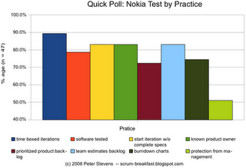
Agility Test: ”The Nokia Test”
Are iterations time-boxed to less than four weeks?
Is the software tested and working at the end of an iteration?
Do iterations start before specifications are complete?
Does the team know who the product owner is?
Is there a product backlog prioritized by business value?
Does the product backlog have estimates created by the team?
Does the team generate its burndown charts and knows its velocity?
Is the team protected from project managers (or other people) disrupting its work?

Slide 32
Seven Pillars of a Good Agile Team Source: Brian Marick´s blog, www.exampler.com
Product Sense
Business Value
Self-improvement
Collaboration
Technical Excellence
Confidence
Supportive Culture

Slide 33
Exercise: What Your Testing Knowledge Can Give an Agile Team
Consider the Seven Pillars of a Good Agile Team
Identify what could you bring with your testing knowledge to an agile team
Are some axes more heavily testing-related?
Discuss in groups
Product Sense
Business Value
Self-improvement
Collaboration
Technical Excellence
Confidence
Supportive Culture

Slide 34
Ideoita, ajatuksia, kysymyksiä?

