Slide 1
Agile methods – More stuff
Ketterä testaus
v.13 (2011-04)
The variance in agile methods – agile is not one
Erkki Pöyhönen & Maaret Pyhäjärvi
Nimeä | Attribution (Finland)
http://creativecommons.org/licenses/by/1.0/fi/
http://creativecommons.org/licenses/by/1.0/fi/deed.en

Slide 2
Software Development Source: Alistair Cockburn
It is a cooperative game of invention, experimentation and communication with limited resources.
People solving a problem that keeps changing and they don’t yet understand
People creating a solution that keeps changing and they don’t really understand
People expressing ideas that keep changing in restricted languages they don’t really understand
Resources are limited and every choice has economic consequences

Slide 3
Typical vs. truly iterative&incremental
Implementation
Fixing old bugs
TRADITIONAL
Everything worked at simultaneously
Throughput dependent on weakest area and as long as the project
Extra features added while waiting for slowest
Fixing new bugs
Testing of an unstable system
System testing as intended
Real knowledge about quality
Perception about quality
Fixing old bugs
Implementation of partial functionality
Implementation of partial functionality
Implementation of partial functionality
ITERATIVE & INCREMENTAL
Minimize the size of things under work and intermediate storage
Maximize throughput
Minimize waste
Fixing new bugs
System testing with regression emphasis
Real knowledge about quality
Perception about quality

Slide 4
Winston Royce introduced the Waterfall model in 1970 paper.

Slide 5

What Winston Royce said about single pass waterfall process

Slide 6
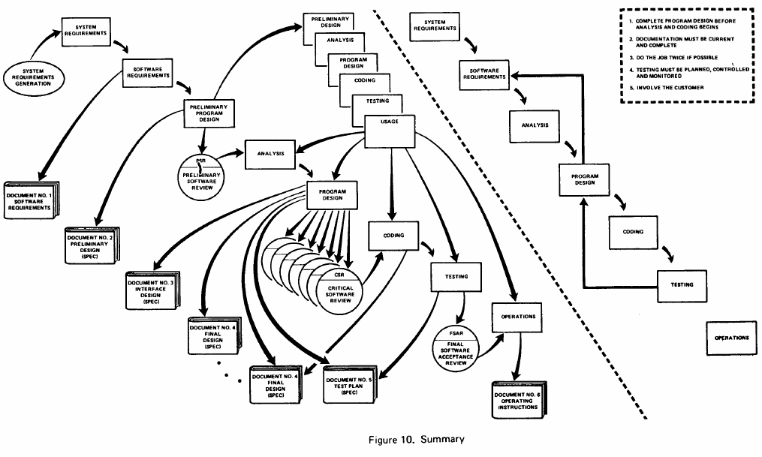
What did Royce actually suggest?

Slide 7
What is Agile Development
Self-organized and People-focused
Collaboration, communication
Iterative and Incremental
Growing the system gradually
Changing direction on regular reflection points
Adaptive
Changed goals will change development direction
Delivering most value first

Slide 8
Agile Values
AGILE
PLAN-DRIVEN
Agile is first and foremost derived from the Values
Although we value things on left more, the things on the right are not completely avoided
Think of a tradeoff: what if you can’t have it all, what you rather want
Belief in people, people’s happiness and opportunities as a central message
Individuals and Interactions
Processes and Tools
Working Software
Comprehensive Documentation
Customer Collaboration
Contract Negotiation
Responding to Change
Following a Plan

Slide 9
Agile Principles
Frequent added value for customer, measured by working software
Expect the changes, look at what is needed now in regular checkpoints
Doing things together: daily collaboration with business and technical perspectives to understand and achieve a common goal
Presence, trust and continuous communication, face-to-face
Building a motivated team with ability to deliver continuously, no overtime
Simplest possible solution done in a technically excellent level: No designs for future needs before they are here
Self-organized team finds appropriate architecture, learns to understand requirements in-depth, and finds best technical solutions that can be adapted as needs change
Continuous improvement in small parts, reflecting from near-term happenings
All activities from requirements to testing and delivery within one increment

Slide 10
Agile: Working Together
Closing the gap between naturally distinct points of views with cross-functional teams
Development
Customer
In larget organization silos are bound to happen with need of several teams – need means to work for a common goal for multi-team setting.
Team
Team
Team
Team
Team
Team

Slide 11
Agile as Being Adaptive
Discipline with a Different Emphasis!
Adaptive processes focus on the uncertainty of future, and build ways of working to optimize investment under uncertainty
Realities we must live with change continuously so we need to make change easier and cheaper
Knowing what happens in short-term but leaving future intentionally vague
Not putting effort to trying to predict something, without dismissing the signals we get about future
can tell mission statement or statement of expected value vs. cost
Inability to describe exactly “what will be done in next September”: no plan of that beforehand
Detailed information what is to about to be done within ongoing iteration
There is a plan for short-term and vision for long-term in Agile
Notes:
Plan-driven vs. agile OR lightweight just don’t tell the essential point.

Slide 12
Disciplined Teams, Not Chaos!
WHAT AGILE IS
MISCONCEIVED AGILE
Avoiding technical debt:
Make adaptable designs, maintainable code
If you take debt, you pay the interest.
Hack together the feature as soon as possible, fix later other aspects than what was now focus.
Making good-enough quality, but considering various aspects: business value as well as team happiness.
Quality is working features and fixing all problems before declaring anything done.
Flexibility of features to include, ease of development work and accuracy of estimation
Team developing something, then changing direction, without considerations of what this means for the longer-term expectations

Slide 13
Plan-Driven vs. Agile Methods
Plan-driven
Well-understood, repeatable processes
Plan as the center of the project
Plan is made to achieve goals (requirements)
Follow-up on:
Progress
Deviations from planned
Corrective actions bring one back to the planned state
Agile
Complex and unanticipated processes
Results as the center of the project
Changes can’t and shouldn’t be avoided.
Nature of software development includes continuous learning.
Learning changes the plan
Often compared heavy vs. light and formal vs. informal – these miss the main difference!
Notes:
well-understood and repeatable wouldn’t include people...

Slide 14
Suitability of Agile
Organizational abilities to implement the agile values:
Culture, People, Communication
Key success factors:
The culture of the organization must be supportive of negotiation
People must be trusted
Rather invest in fewer staff, with higher levels of competency
Organizations must live with the decisions developers make
Organizations need to have an environment that facilitates rapid communication between team members
It could be just a way of organizing differently inside the project
Focus on incremental delivery that can be really shown
Most customer value first – avoiding late risks can be value for customer
Feature exists when it has been implemented. If schedule is critical, do that first.
Even though agile promises a lot, it does not promise that with same amount of people you can all of a sudden do things you can’t without it
It just shows in increments what is realistic to expect from the development
Agile requires reinventing many of things you always assumed no-brainers. It makes some of the pain more visible and thus more difficult to tolerate. Fix early, fix often.

Slide 15
Is My Agile Skin-Deep or Real?
Saying “we use agile practices” does not make the you agile
Consider, why you want to be agile: is it some particular benefit you associate with it, or do you just want to belong to the club?
Being agile is about choosing practices that fit the agile values and guarding the values, not the practices
Think:
Can you really, as cost-effectively as possible, change direction without feeling the need of complaining about redoing your plans? Can you really deliver what you had done until this point?

Slide 16
Scope of Aiming for Agile
Within whole organization
Within whole R&D organization
Within a Development team with system testers
Within a Traditional Development team
Within a Traditional Testing team
Need to set expectations based on aimed scope
Asking everyone to jump on right away would seem unrealistic expectation.

Slide 17
Management Framework of Agile
Vision and direction where the system under development should be heading
Tangible valuable pieces to deliver incrementally
Risk-taking in priority: only delivered exists for complete delivery
Incremental Delivery
Multi-team aspects
Long-term planning
Scaling teams together for a system delivery
Minimizing handoffs but keeping team concise
Setting the effort boxes for the teams
Self-organized teams
Regular feedback cycles
Different team compositions and goals
Notes:
Development / Release teams
Willing / able

Slide 18
Ideas from Lean Development
Stop-and-Fix
Fixing problems has highest priority
Visual Management
War room – collocated team
Information radiator
Bug budget
Build status
Planned | Ongoing | Done
Mon | Tue | Wed | Thu | Fri

Slide 19
Weak Point of Scrum?
This is only my perception...
I believe scrum/agile is applicable in many kinds of organizations and projects
I believe scrum/agile increases productivity with better focus on value
I believe scrum/agile is great setting for the team to do productive work
But...
The requirements on good scrum master and product owner are huge!
The inspect-and-adapt process focuses on the team, where do you get the business analysis skills and the facilitations skills?
My feeling is that scrum is set up from a techie point of view that assumes there are answers that must come from elsewhere...
And... A concern I still have...
Are people really happy being team members without a traditional career path?

Slide 20
Business Value of Agile
Additional Materials

Slide 21
What Being Agile Promises (1/4)
Value item / Targeted benefit
Features shown can be released for added customer value Feature shown in demo can be shortly after demo released to customers to provide the added value, and are not mere prototypes of work in progress. Value is delivered incrementally so that at any point the value can be judged enough for releasing, not delivering according to planned schedule but early.
Trust in R&D from stakeholders through visibility Progress, status and plans in R&D are visible to non-R&D stakeholders, who can thus trust R&D to deliver what is promised and not promise something that cannot be done. Overall relationship is handled in open collaboration, with shared goal to make the company succeed.
Being able to estimate when done when target scope is fixed Being able to continuously evaluate schedules and improve the accuracy of knowing when the release would be ready to go out.

Slide 22
What Being Agile Promises (2/4)
Value item / Targeted benefit
Shorter time-to-market for features From an emerging need to including the implementation into deliverables is short and can be adjusted to changing priorities so that relevant features can be included in short timeframe to be released.
Added productivity with shorter time to ROI Value for business is delivered continuously and with better focus, same investment results in more return. Features worked on are prepared for be releases as soon as possible for the benefit of our customers to start investment payback. While content-wise we may not deliver more for various segments, what ever is delivered pays back sooner.
Adaptability of plans As business environment and our understanding of what is needed changes, the current direction can be changed with change of priorities without throwing away significant parts of work done before the change.

Slide 23
What Being Agile Promises (3/4)
Value item / Targeted benefit
Focus on continuous delivery readiness and quality Features completed are good enough for releasing externally and quality of the old features is maintained on level that enables ability to release.
Knowledge of risks in timely fashion As the plan vs. reality is assessed incrementally, risk to schedule and scope can be controlled through choosing the high-priority items first thus lowering risk related to them, and plans continuously updated to match the status instead of imaginary planned status.
Customer collaboration improves deliveries Showing features to real users early and often results in better features at time of release through adapting the plan of what the feature should be like to better match the needs.
Teams focus on short-term commitment Only next upcoming month is planned and committed in detail. Planning for longer time includes unknowns and is done inaccurately, adding accuracy to plans through delivering increments towards the overall goal, avoiding wasted effort on trying to accurately plan further into future.

Slide 24
What Being Agile Promises (4/4)
Value item / Targeted benefit
ROI manager focuses on long-term reliability of the expectations Whoever is assigned responsible for prioritizing items for ROI, uses the team delivery capability as means to assess reliability of expectations in long-term plans over the increment timeframe.
Wellbeing in R&D People working in R&D are happy and motivated, guide their own work to match priorities of the business. Working practices fit the people adding motivation through removal of waste and continuous inspection and adaptation of practices. People have possibility to learn new things that they need for performing their work continuously better.
Product and process innovations in R&D Providing more value requires continuous adaptation and innovative solutions, both for the products and the ways the products are built.
Doing the most valuable thing next How much or how fast a feature is delivered is not the issue, but the target is to always delivery best return for investment for us as company.

Slide 25
What Being Product Line Promises (1/2)
Value item / Targeted benefit
Minimized overall cost of feature in R&D for all market segments Product line is a mechanism of having same features available to all market segments through configuring them for respective use of the segment. Developing a feature for all segments as one is presumed cheaper for overall cost, while it may be slower for delivery.
Time-wise simultaneous delivery of feature to all segments Different market segments with their different products get a new feature timing-wise simultaneously, as it is continuously developed for all markets. If not simultaneous, at least very quickly after the other in different products.
Ability to plan inclusion of feature for other products in short timeframe Features available in one product can be with small investment and short timeframe be planned to be available in other products. When a feature is seen once in a product, the timeframe for next product with the feature is couple of months.

Slide 26
What Being Product Line Promises (2/2)
Value item / Targeted benefit
Ability to add new releases to roadmap by packaging existing modules as releases When a new release for a segment is found necessary, e.g. as a maintenance release, this can be delivered cost-effectively and fast from already available modules with the changes included.
Improved quality through reuse of modules As a problem is fixed in a module available in several products, the overall quality experience improves for all products simultaneously.
Added productivity More output for the same input: same amount of resources is able to provide more value (releases, features, hotfixes, quality) over several segments, where previously the value was added per segment.

Slide 27
IDEAS, Thoughts, Questions?

