Slide 1
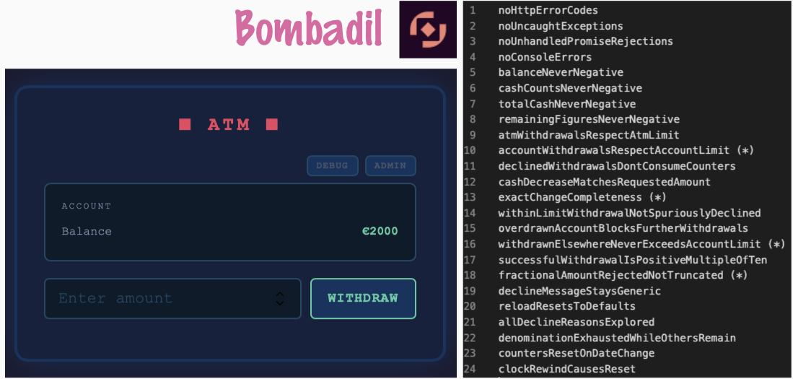
Property-based testing a web UI with Bombadil
(and Playwright)
One flow, start to finish: what the tool is, what a property is, and five short demos on an ATM app I was fixing this week.
Each demo shows the prompt that built it and the command that runs it.

Slide 2
1
New tool in the house: Bombadil
Property-based testing for web UIs.
IT RUNS IN A LOOP
Extract the current state from the browser.
1
Instead of scripting test cases, you state what must always be true, and the tool explores the app on its own: it clicks, types, scrolls and reloads, and checks every property in every state it reaches.
Check all properties against that state.
2
Pick the next action and perform it.
3
Wait for the page to settle, then start over.
4
antithesishq.github.io/bombadil

Slide 3
2
What is a property?
A statement about the system that should hold in general, not for one example.
Example-based
Property
“Withdraw €50 from €2000, balance shows €1950.”
“The balance is never negative.”
“A declined withdrawal changes nothing.”
“The account never withdraws more than its daily limit.”

Slide 4
2
How testers reason about them
Three things are worth keeping apart:
Authoring
Execution
Oracles
Always AI!
Generated vs. handcrafted.
Always-true statements vs. specific checks.
Authoring with AI, but not running agentic testing. These are deterministic generated tests. Fewer tokens harmed by knowing the difference.
This manual automation demo belongs in a frame of true automation with pipelines.

Slide 5
3
The app under test: before and after
The ATM simulator is a single HTML page: balance, amount field, WITHDRAW, plus DEBUG and ADMIN panels for limits, cash and clock. I fixed bugs in it on Tuesday, so there are two versions side by side.
PROMPT
I have a project here called atm that I was fixing on Tuesday this week. I want a Monday's version of that html app brought to this project, into folder Monday. And today's version of that html app brought to this project, into folder Thursday. Would you be able to do that for me?
Monday/
Thursday/
Before the fixes.
Today's version.

Slide 6
4
Demo: default properties
Bombadil ships with four properties that fit any web app.
PROMPT
Use playwright-cli to look at Monday and Thursday apps, and build basic property-based testing with default properties for each, into folders Monday-test and Thursday-test. I want to use Bombadil for property-based testing https://antithesishq.github.io/bombadil/index.html
I want to be able to run Monday-test saying 'demo Monday' and Thursday-test by saying 'demo Thursday' on command line. Make my wish come true, like magic!
No HTTP error codes
No uncaught exceptions
No unhandled promise rejections
No console errors

Slide 7
4
Both versions pass. That is the point.
$ demo Monday
$ demo Thursday
Crashes, not broken ATM rules
The Monday version has real bugs, and the default properties do not see them. They catch crashes, not broken ATM rules.
60 s
New tool, so…
Both run for a minute and both pass.
The default typing action entered the letter “d” into number fields instead of digits, and runs sometimes stalled. The specs in Monday-test and Thursday-test work around both.

Slide 8
5
Demo: teaching the spec the domain
To test the rules of the ATM, the specification needs to know the domain. Four kinds of building blocks in Full-test/bombadil/specification.ts
Helpers
State extractors
Turn rendered text like “€1950” into numbers.
Read balance, limits, bill counts and transaction history from the page in every state.
Properties
Action generators
The always-true statements, written over those extractors.
Put real, boundary-hitting numbers into the fields (zero, one over the limit, fractional, negative), so the interesting rules are actually reached.

Slide 9
6
Demo: more properties
20
PROMPT
There's also project here called exploring-bombadil, with full set of tests. Bring those here under Full-test folder. Now, I want to say 'magic Monday' to run this test for 60 seconds on Monday version, and 'magic Thursday' on the Monday version.
more properties on top of the four defaults
Produced by running the antithesis research skill on the app's source code.
The list: Full-test/properties.txt
The reasoning: Full-test/scratchbook/
$ magic Monday
$ magic Thursday

Slide 10
6
Monday stops in seconds, Thursday holds
magic Monday
magic Thursday
Stops within a second or two. Typing more into “Withdrawn at other ATMs” than the account's daily limit allows violates:
accountWithdrawalsRespectAccountLimit
withdrawnElsewhereNeverExceedsAccountLimit
Runs the full 60 seconds with no violations.
To look at what happened, state by state:
$ cd Full-test
$ npm run inspect:monday

Slide 11
7
Demo: properties on Playwright
Properties mix with old tools too! The same property names, checked by one Playwright test that takes a seeded random walk through the app and checks the properties after every step.
PROMPT
Monday fails after five steps
Just for the show of it, create me one playwright tests that uses the properties like I specified for Full-test. Let me run it with 'magic playwright Monday' or 'magic playwright Tuesday'. Run it headful. Make it use webkit as browser.
On accountWithdrawalsRespectAccountLimit: the same bug Bombadil finds.
Thursday passes all 300 steps
$ magic playwright Monday
$ magic playwright Thursday
Covers 13 of the properties (the state invariants and the withdrawal step properties), runs in WebKit with a visible window, and replays the same walk for the same seed.

Slide 12
8
Driver protocols
Should we talk driver protocols?
CDP in Bombadil
vs.
CDP in Playwright
vs.
WebDriver BiDi
That all matters more now with AI.

Slide 13
9
Beyond the ATM
New tool, so I also tested two more systems with it.
Prestashop
NEXT PRACTICE
PR to fix the tool so that it works with D365 FO.
Report / fix the three problems + the hundreds of API problems this found on Prestashop, for common good?
D365FO

Slide 14
What I would also want to show you…
Local LLM use for notetaking and summarizing
2nd brain aka. LLM Wiki, and how that is different from RAG
Maybe go Caveman?
YOUR TURN TO SHARE?

