Slide 1

Pizza On a Student’s Income: Team 6
Joe Grosso, Kyle Singer,
Benjamin Beggs

Slide 2
Introduction
The goals of our website (in the order we wanted to accomplish them):
Take in the user’s address, preferred search range, and their preferred type pizza as input
Identify pizza places in the user’s area
Scrape the menus of the pizza places from the web
Output the cheapest pizza options in the area for the customer

Slide 3
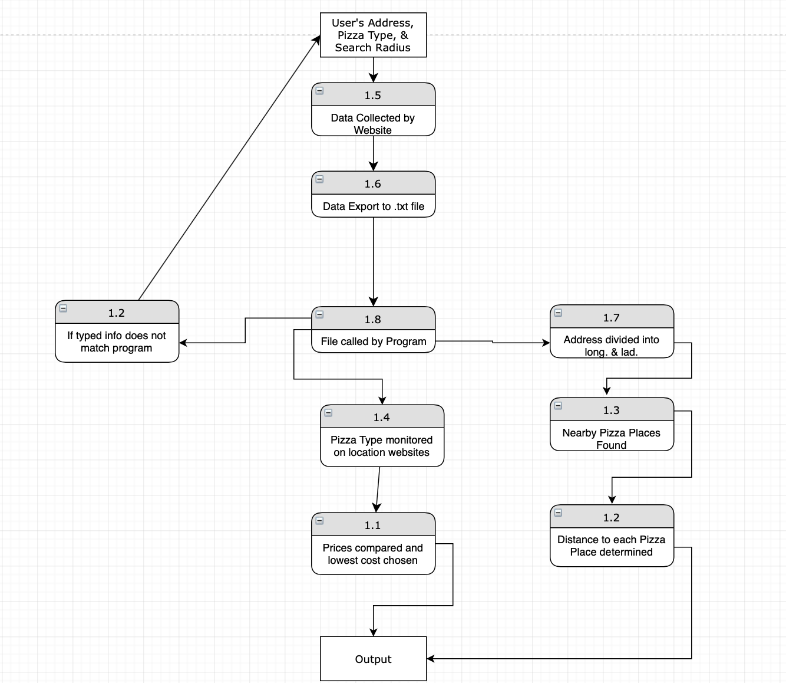

Slide 4

Geographic Proximity Web Scraper

Slide 5
Functionality
Asks the user to input a geographic location.
The script prompts the Google Maps geographic services to determine its latitude and longitude.
Gathers a list of nearby restaurants in a 5km radius from this position from Google’s servers.
Parses the relevant data from Google into an array.

Slide 6
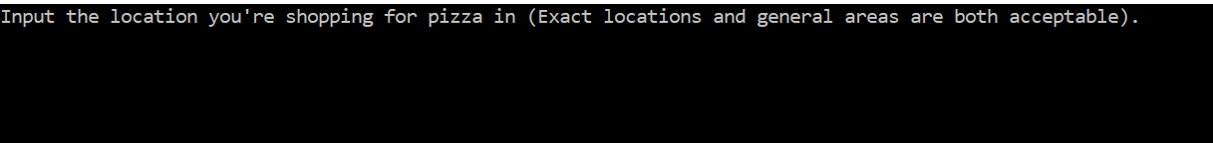
Example:
Prompt user input:

Slide 7
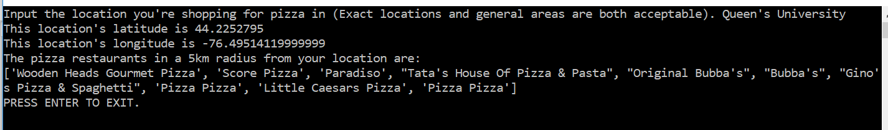
Example return:

Slide 8
Price Database Web Scraping

Slide 9
Website Front End

Slide 10
Improvements for the Future:
Fix lack of menu availability for smaller restaurants
Website functionality
Integration of the individual parts of the project
Flow of data from user to backend and vice versa
Speed improvements using DS & A, make project scalable

