Slide 1
Fermi Surface Plots
\mu tensors for CaC6 and MgB2.
Matrix elements superimposed on Fermi surfaces.

Slide 2
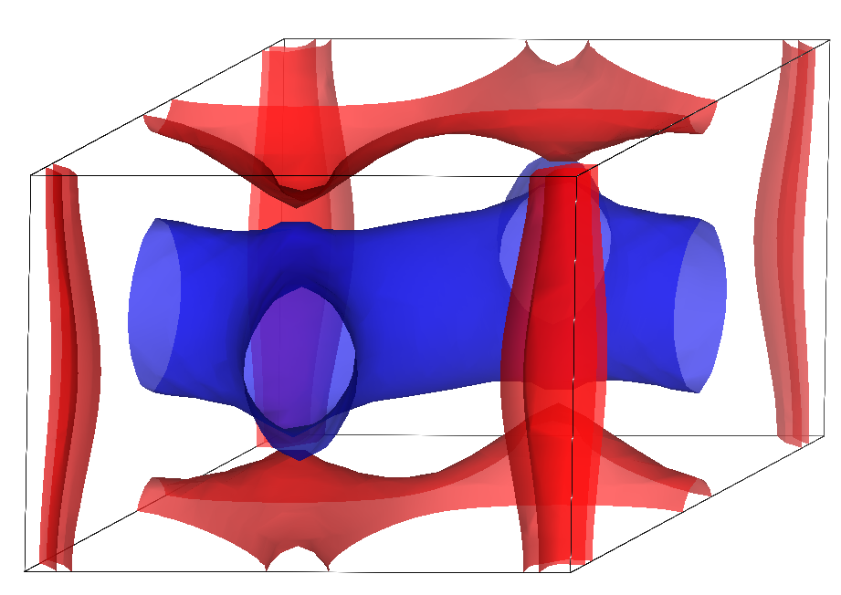
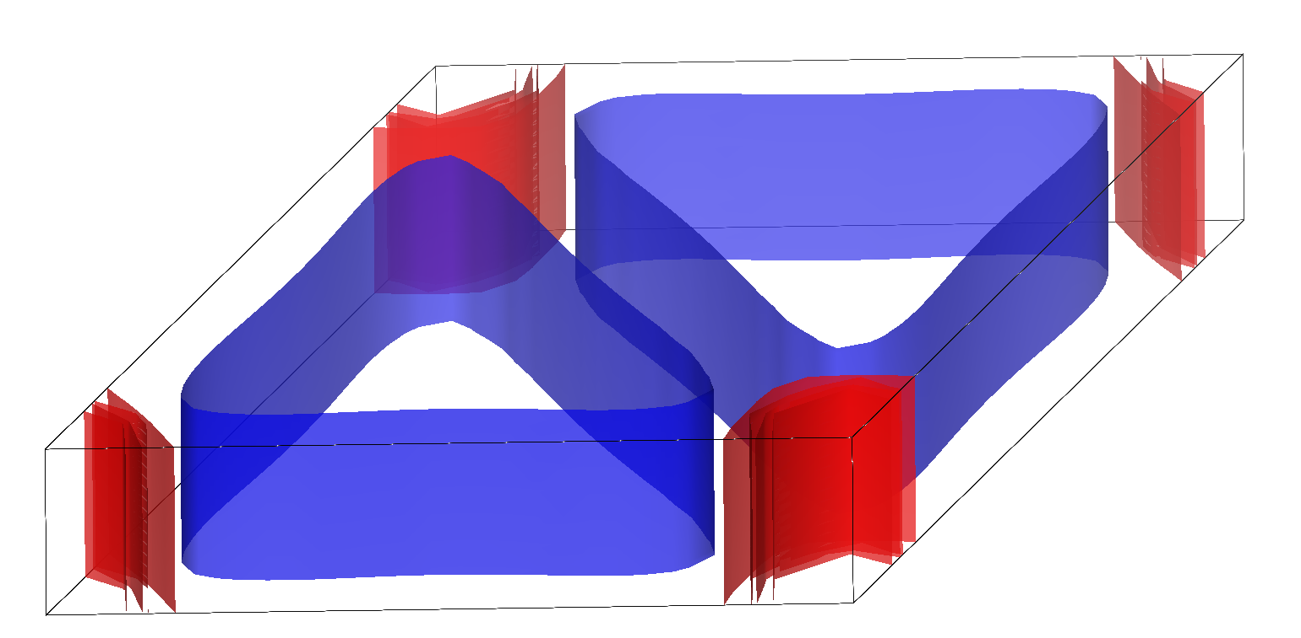
Fermi Surfaces
MgB2
CaC6

Slide 3
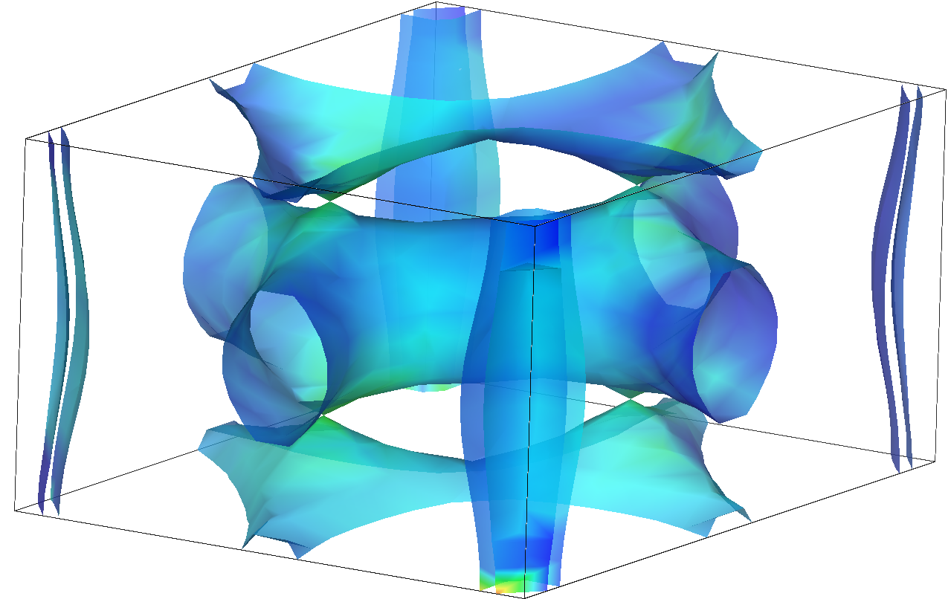
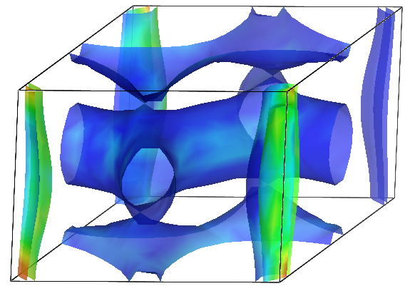
MgB2
Diagonal Screening Lindhard:
Full Dielectric Screening:

Slide 4
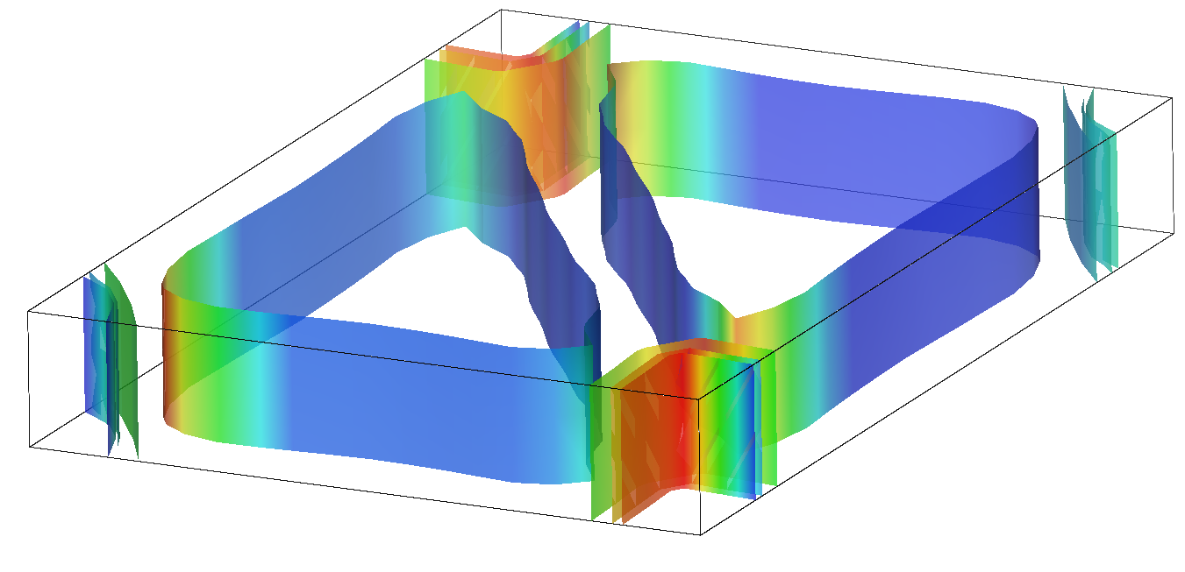
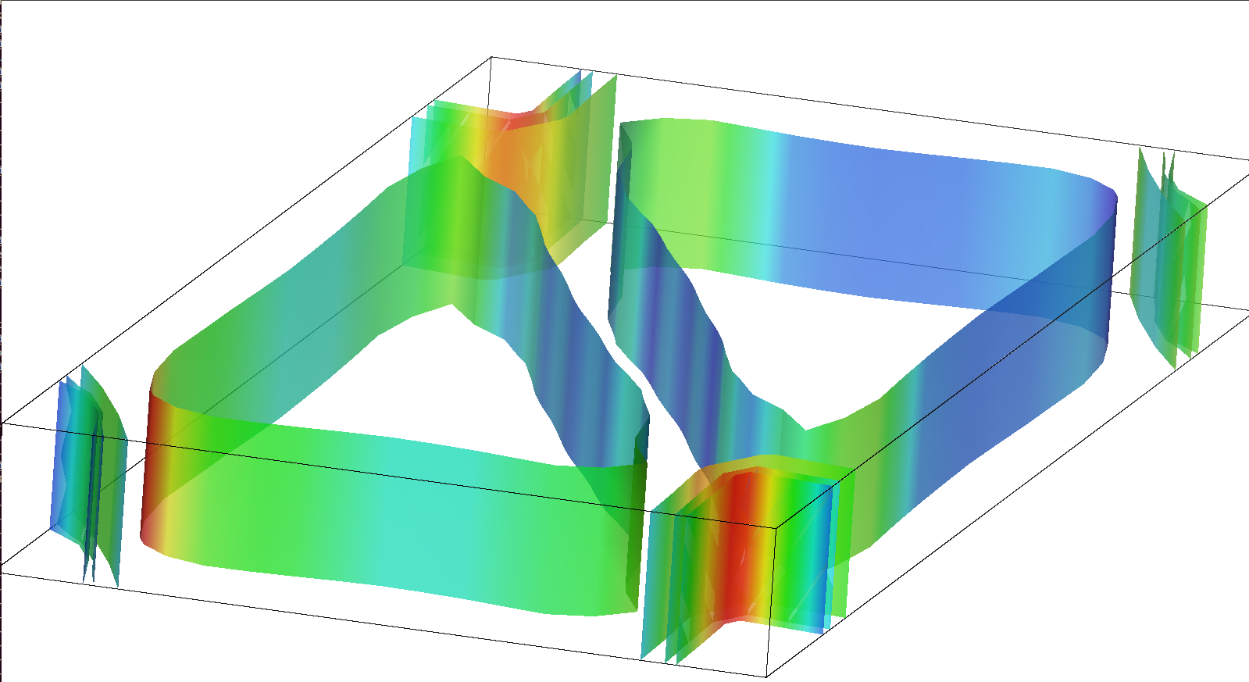
Bi-layer Calcium-Graphene
Diagonal Screening Lindhard:
Full Dielectric Screening:

