Slide 1
Quantitative Trading: The Basics
September 28th, 2021

Slide 2

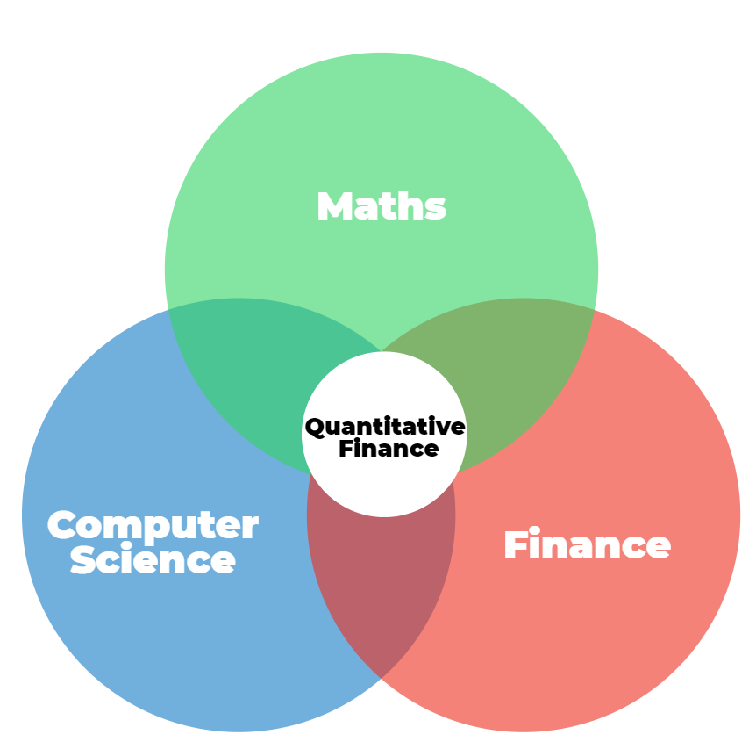


Quantitative Finance, what is it?
“Quantitative finance is the use of mathematical models and extremely large datasets to analyze financial markets and securities.”
–CFI (Corporate Finance Institute)
Classic Fundamentals
Mathematic Models
Finance Models
Computer Models
Base trades and make money off purely quantitative decisions, remove all qualitative inputs- almost impossible to achieve.

Slide 3
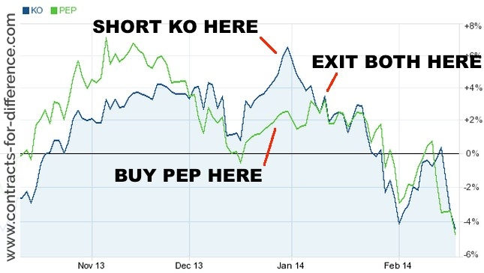
Last Semesters Project: Pairs Trading
Based on historical correlations between two securities.
When two securities deviate, take an alternate position in each.
Long underperforming, short outperforming.
Expect mean reversion– profits come from convergence of prices.
How would you employ this strategy?
Manually
Automation (Coding)

Slide 4

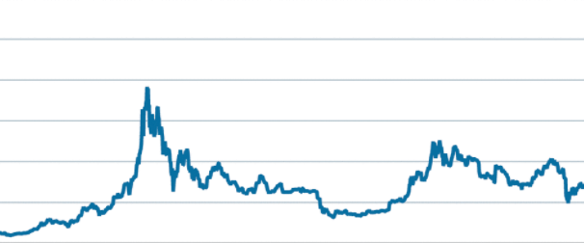
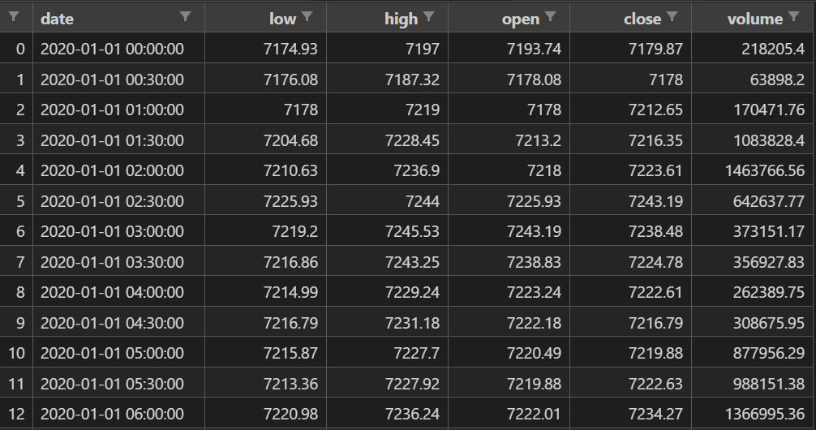

Todays Session: Coding in Python
Pandas is a software library written for the Python programming language for data manipulation and analysis.
Pandas Dataframes contain all the information we need to make trades.
Perfect for Quantitative needs
Example is BTC (Bitcoin)

Slide 5
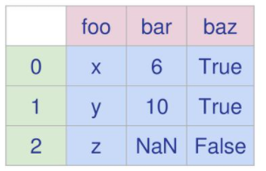
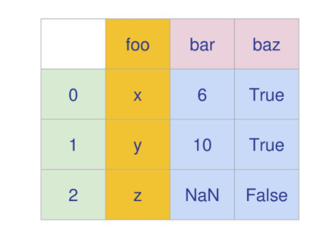
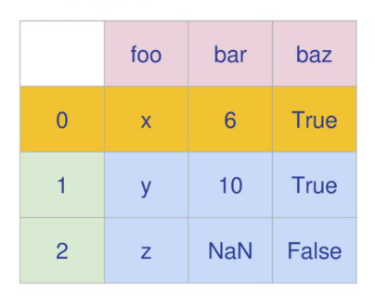


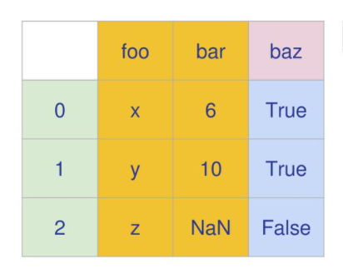
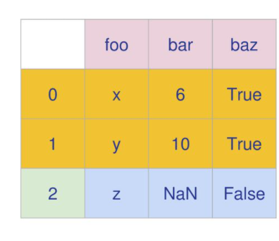


Selecting Subsets of Data
Selecting Columns df[“row”]
Selecting Rows df.loc[number]
Df =

Slide 6
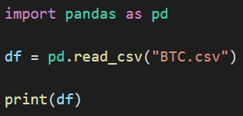
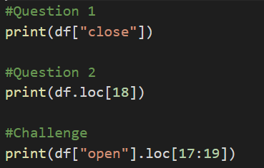
Let's get started!
Create a new folder
Copy the data (“BTC.csv”) into this folder
Data is typically sourced directly from an exchange
For simplicity today we will be using the data provided
Create a python file called “quant.py”
Import the data into Pandas.
Open the python file and import pandas
Read the data into a variable called “df”
Print the contents of this “df” variable.
Solution
Practice!
Select and print just the “close” column of the data frame.
Select and print the 18th row of the data frame.
Challenge:
Select and print just the 17th,18th and 19th rows of just the “open” column.

Slide 7
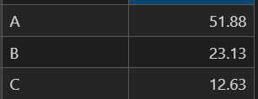
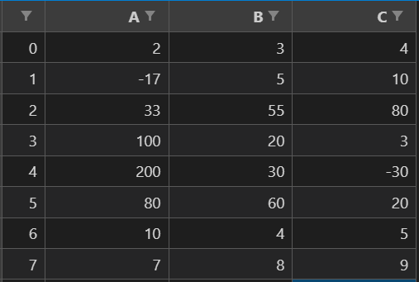
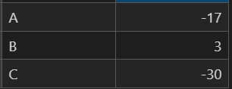
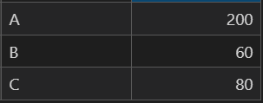
Data Analysis
Mean: df.mean()
Mean of A: df[“A”].mean() = 51.875
Df =
Min: df.min()
Min of B: df[“B”].min() = 3
Max: df.max()
Max of C: df[“C”].max() = 80

Slide 8
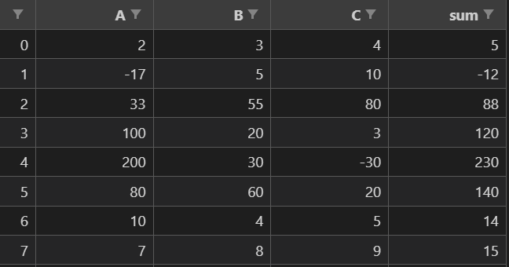

Data Manipulation
Creating new columns:
Referencing columns that don’t exist makes new ones!
EXAMPLE: Sum all the values AB and put them into a fourth column called “sum”.
Create a new column: df[“sum”]
Make it equal to column A + column B: df["A"] + df["B"]

Slide 9
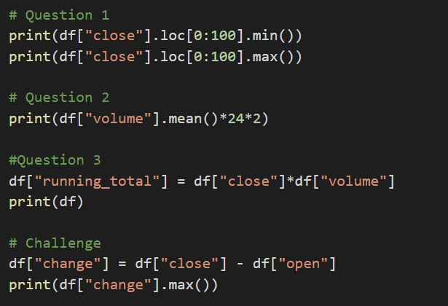
Practice Questions
Solutions:
Find the maximum and minimum “close” price in the first 100 rows.
What is the average volume moved of BTC moved per day? (remember each line of the data is a 30-minute interval).
Create a column that is the total $ amount of BTC sold for that time period called “dollar_amount” (assume every coin was traded at “close” price).
Challenge
What is the largest increase between the open and close prices in a single row?

Slide 10
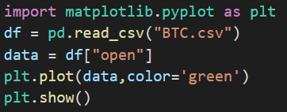
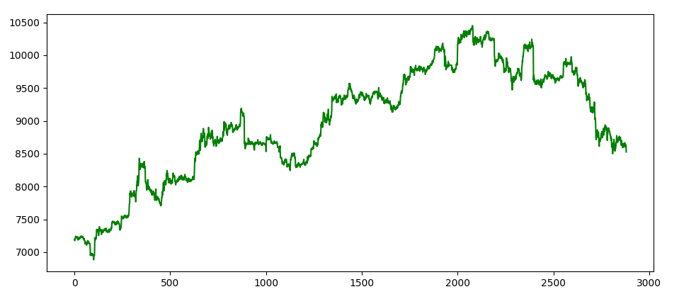
Matplotlib Graphing Module
Import matplotlib.pyplot as plt (import the module)
Set the data
Plot the data and give it a colour
Display the plot

Slide 11
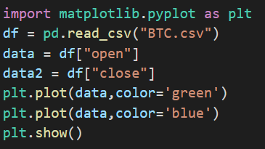
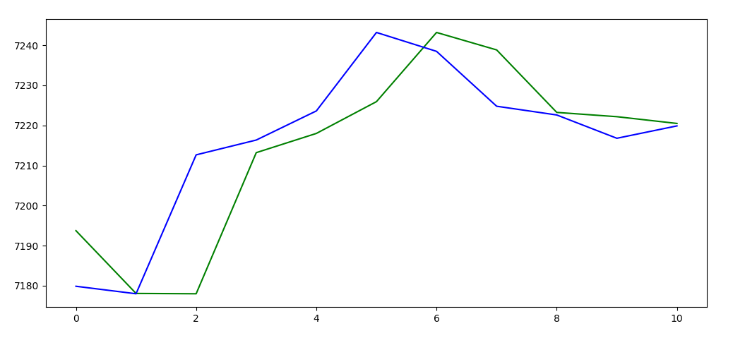
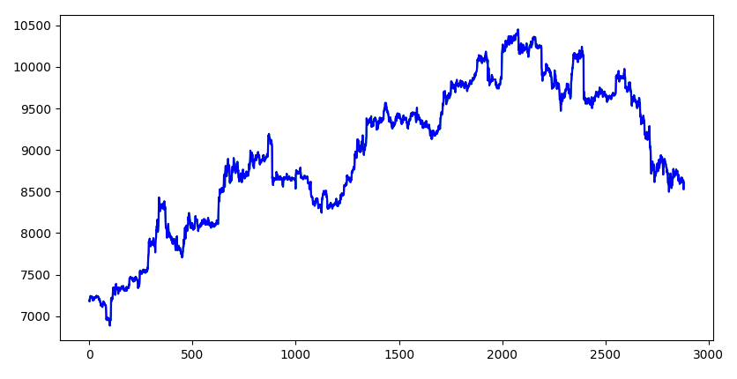
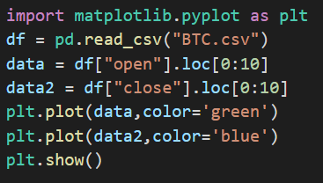
Graphing Multiple Datasets

Slide 12
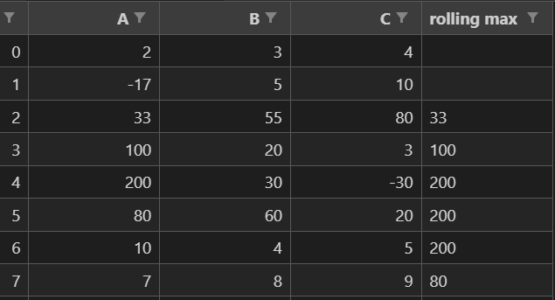
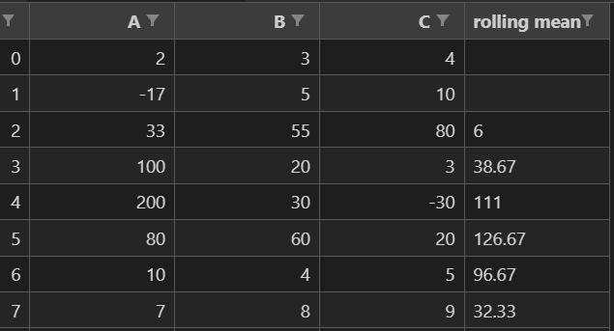
Rolling Window
With trading we don’t usually want averages over all the data, just over a specified period (maybe last 3 days or 3 months ect).
Pandas rolling() function is built for this!

Slide 13
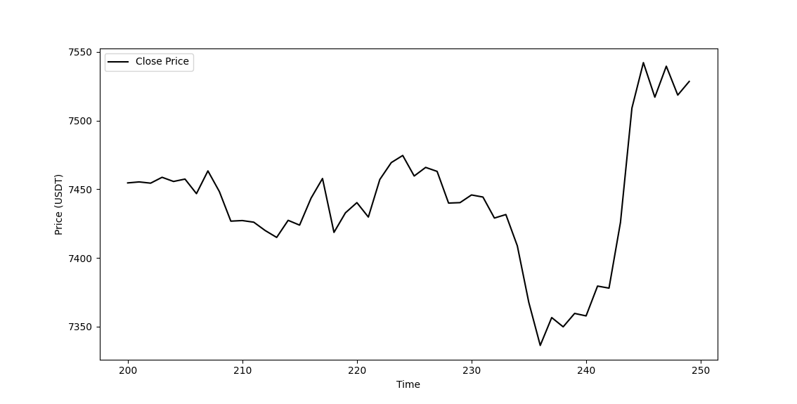
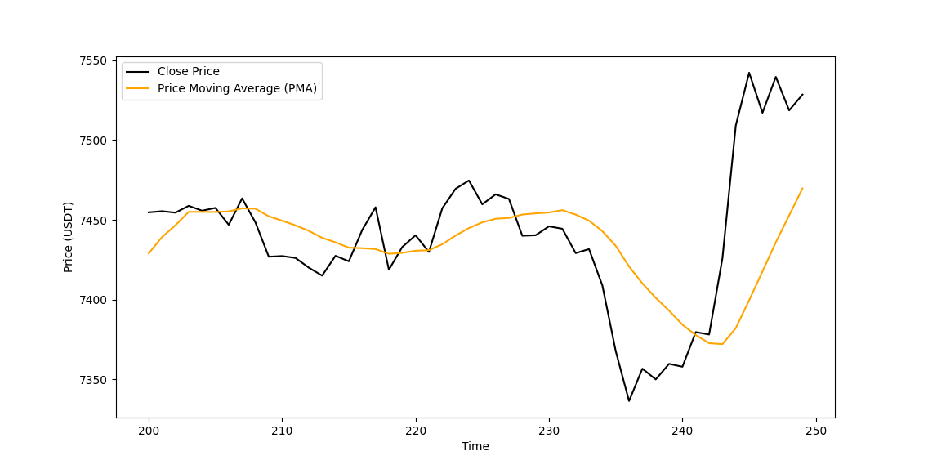
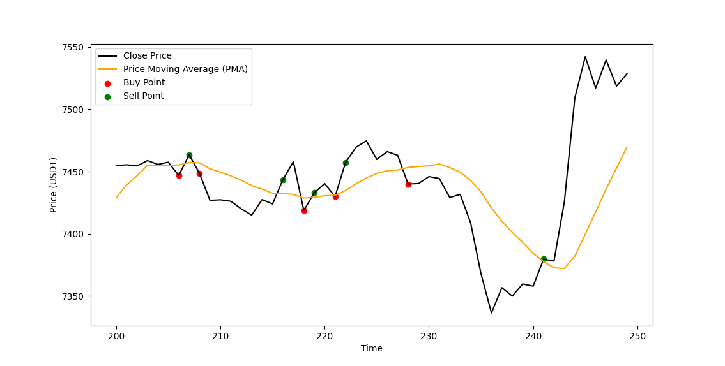
Rolling Averages Applied

Slide 14
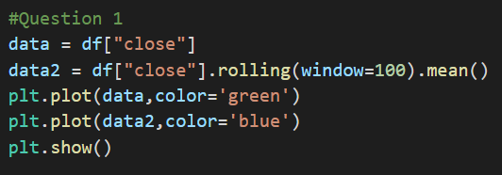
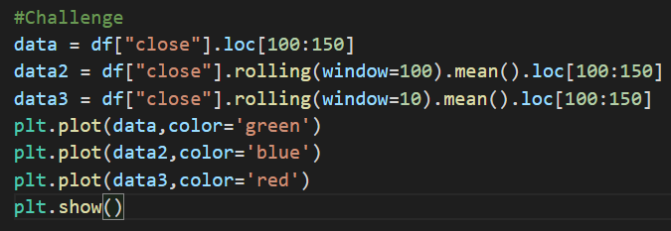
Final Set: Practice Questions
Plot the “close” price against a 100-interval rolling average.
Challenge
Plot the “close” price against a 100-interval rolling average and a 10-interval rolling average (select timeframe .loc[100:150]).

Slide 15
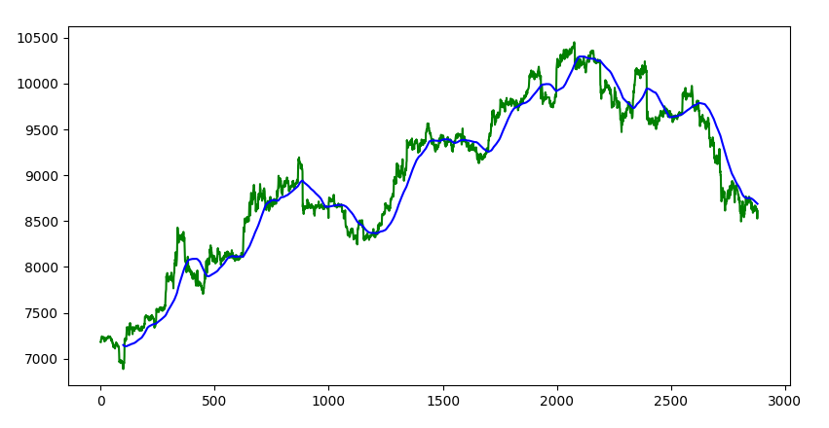
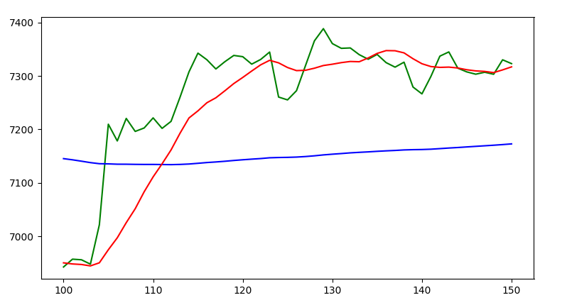
Results

Slide 16
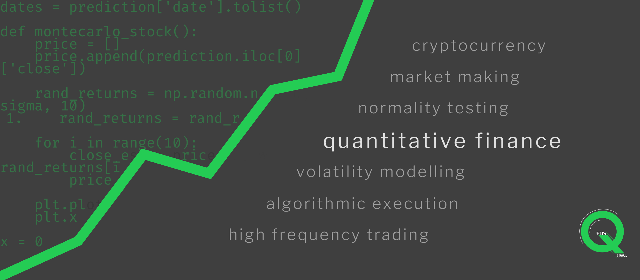
Thank you for coming!
Next Session:
5/10 2:00 PM (Same time next week)
Using pandas to create actual trading strategies.

