Slide 1
Team 4 Trading Algorithm
May 10, 2021
9/05/2022

Slide 2
Overview
Mean reversion trading algorithm based on 30 minute intervals
A hybrid strategy based on a number of indicators
Slow stochastics oscillator
RSI
MACD
Has multistage requirements to enter the market, so often our mean reversion triggers are inactive
During this time we chose to fallback on buy and hold, though this was just for illustrative purposes
This could be replaced with other fallback strategies

Slide 3
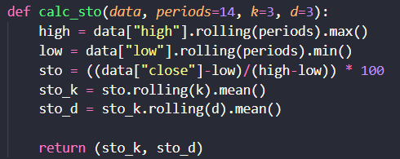
Stochastics Oscillator
Using a slow stochastic oscillator with a 14-day period and 3-day smoothing
Rolling average used was flat weighted main rather than an exponentially weighted average

Slide 4
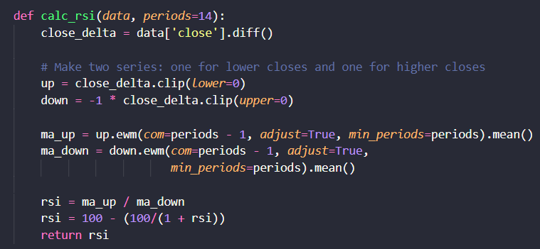
RSI
RSI was based on a 14-day period
Used exponential weighted averages rather than flat mean as this gave us more favourable results

Slide 5
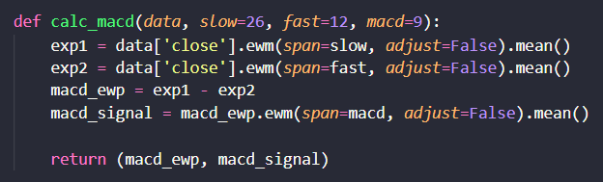
MACD
MACD was set to a 26-day slow window, 12-day fast window, and a 9-day signal line
This indicator also used exponential moving averages for the same reasons

Slide 6
Two-Stage Buy Trigger
Both long and short positions have two stages to be triggered
The first stage detects a mean reversion
The second stage detects the momentum of the mean reversion changing favourably
Second stage must occur after first stage has been identified
All market entries occur with full account value

Slide 7
Long Position
Long positions are made redundant by our pairing with buy and hold
If paired with another fallback strategy, long position trigger would be
Stage 1
Stochastic K% < 20
Stochastic D% < 20
RSI > 50
Used as a momentum indicator not a mean diversion indicator
Last interval close must be above a 100-day exponential weighted average
Stage 2
MACD crossing signal line
If either stochastic indicator reaches 80, stage 1 is reset

Slide 8
Short Position
Stage 1
Stochastic K% > 80
Stochastic D% > 80
RSI < 50
Used as a momentum indicator not a mean diversion indicator
Last interval close must be lower than 100-day exponential moving average
Stage 2
MACD crossing signal line
If either stochastic indicator reaches 20, stage 1 is reset

Slide 9
Exiting Positions
For long positions (redundant with buy and hold fallback)
RSI < 40 (indicating mean reversion) or if the MACD crosses the signal line again
stoploss = price*(1-0.0025)
Stoploss for short positions
RSI > 60 (indicating mean reversion) or if the MACD crosses the signal line again
stoploss = price*(1+0.0025)

Slide 10
Strength of Mean Reversion
Statistical Tests
Augmented Dickey Fuller :
Statistical check if time series is mean reverting or not.
P-value above 5%= mean reverting
TSLA : p-value: 0.60263, AAPL : p-value: 0.26726 ,GOOG : p-value: 0.56530
Hurst Exponent :
Statistical Measure which classify time series to: mean reverting, random walk or trending.
GOOG: random walk, AAPL and TSLA mean reverting with TSLA higher rate
Exact values in the report

Slide 11
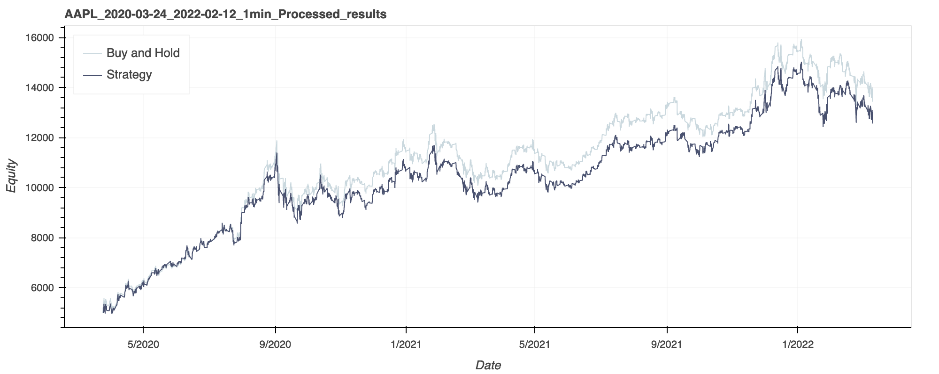
Results: AAPL
Buy and Hold : 168.75%
Net Profit : 8437.4
Strategy : 151.4%
Net Profit : 7570.11
Longs : 28
Sells : 27
Shorts : 26
Covers : 26
--------------------
Total Trades : 107

Slide 12
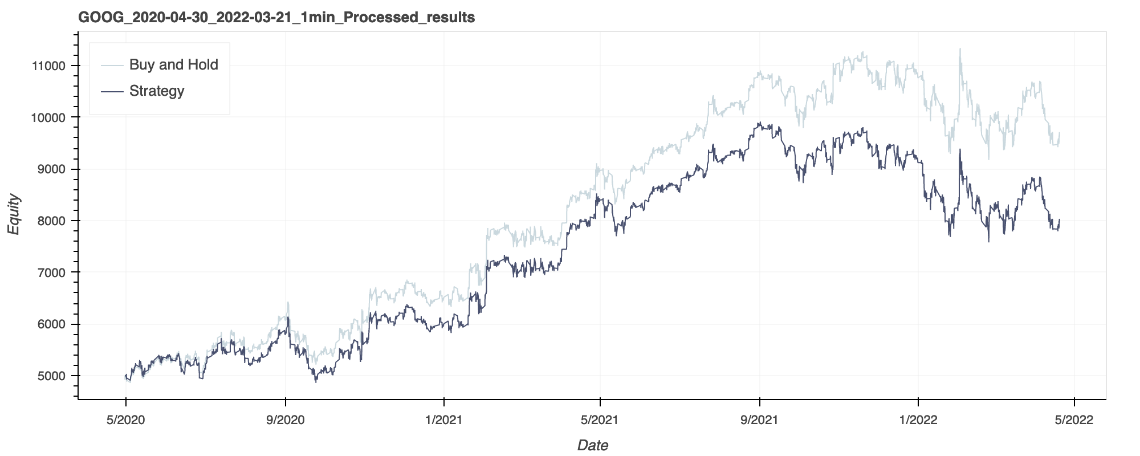
Results: GOOG
Buy and Hold : 92.95%
Net Profit : 4647.56
Strategy : 59.58%
Net Profit : 2978.85
Longs : 19
Sells : 18
Shorts : 18
Covers : 18
--------------------
Total Trades : 73

Slide 13
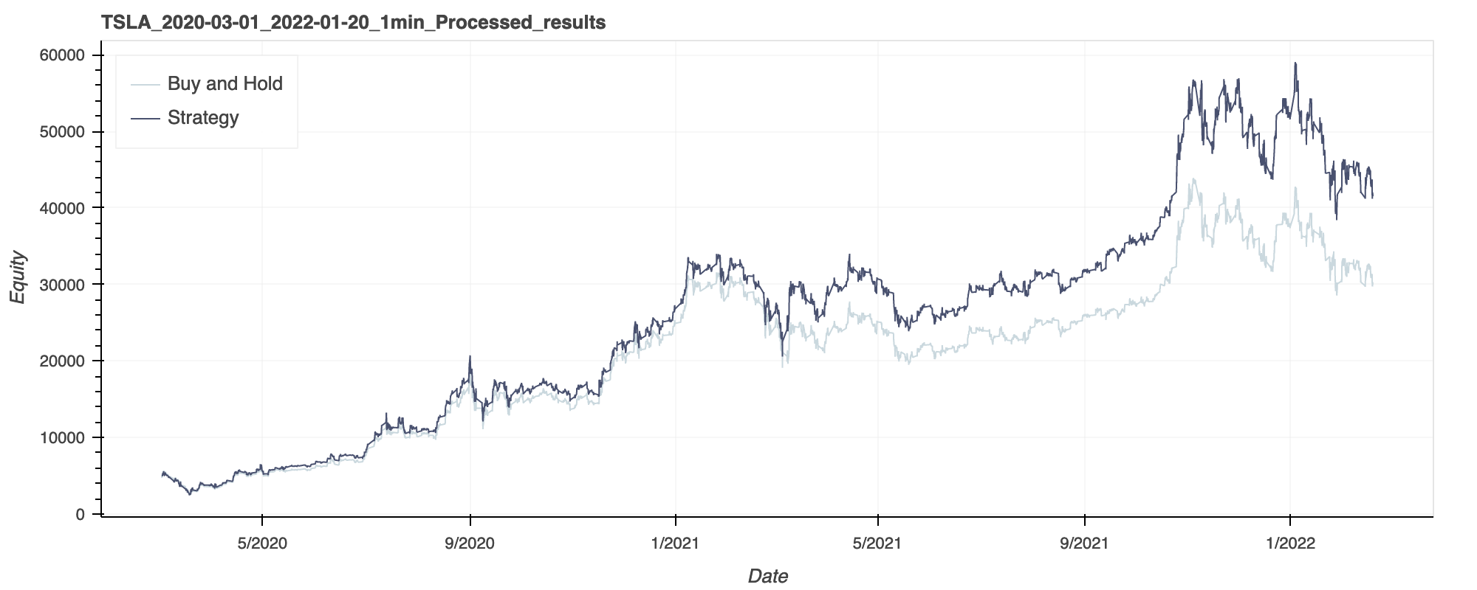
Results: TSLA
Buy and Hold : 502.32%
Net Profit : 25116.22
Strategy : 734.82%
Net Profit : 36740.77
Longs : 23
Sells : 22
Shorts : 22
Covers : 22
--------------------
Total Trades : 89

