Slide 1
Trading Team 2 Project
SEM 2 - 2022
16/03/2022

Slide 2
Summary
Initial step
Set up and familiarise git hub
Mid-term
Try to explore different range trading strategy (Bollinger band, average true range... Etc)
Try to visualise the range trading strategy and apply them
learn other basic trading knowledge (e.g. risk management, terminology…etc)
Start learning machine learning
Final step
Apply machine learning into our algorithm

Slide 3
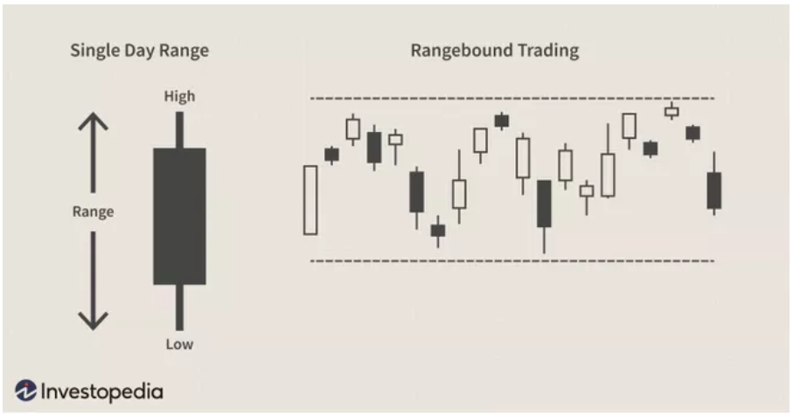
What is Range Trading?
‘A trading range occurs when a security trades between consistent high and low prices for a period of time.’
- Investopedia

Slide 4
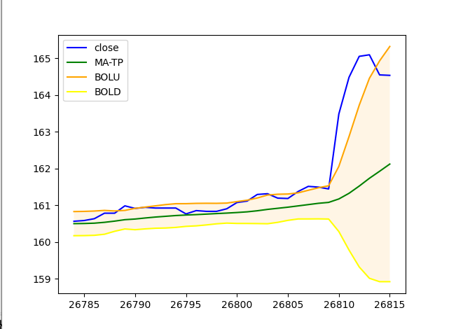
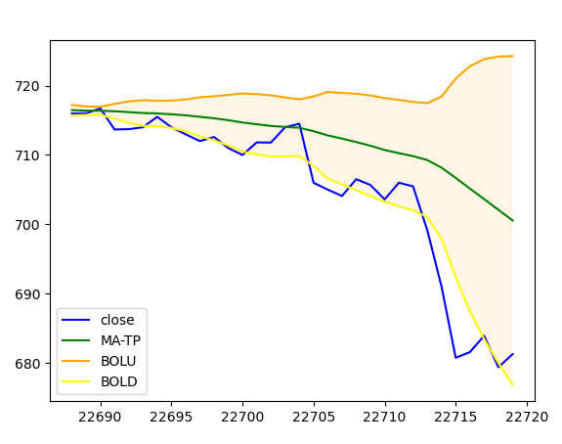
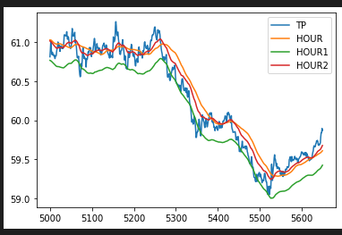
Range Trading- Indicators
We tried to plot out different Indicators in different periods using matplotlib just to visualise and get familiar to the indicators and experiment with them.
Bollinger band
Average True Range

Slide 5
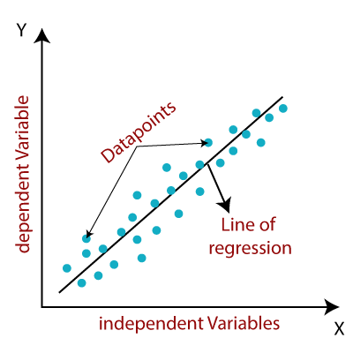
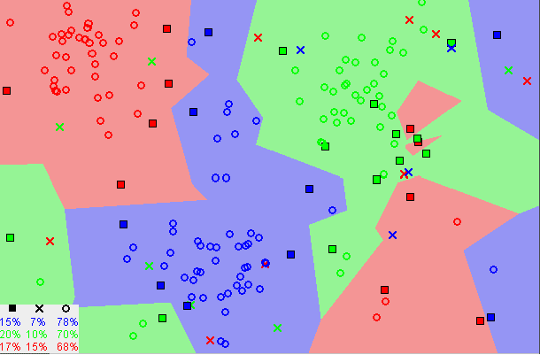
Machine learning
After trying out the indicators, we realised they are not enough to build a reliable algorithm so we decided to co-op machine learning in the algorithm. We decide to explore linear regression and KNN.
Linear Regression
Linear Regression is the supervised Machine Learning model in which the model finds the best fit linear line between the independent and dependent variable.
KNN
The number of nearest neighbors to a new unknown variable that has to be predicted or classified is denoted by the symbol 'K’. It assumes that similar things exist in close proximity.

Slide 6
Data Processing(Feature engineering)
The aim of feature engineering is to prepare an input data set that best fits the machine learning algorithm as well as to enhance the performance of machine learning models.
In order to reduce overfitting as well as trying to capture range trading opportunities, we decided to use the factors we would use to:
- ATR15Min_wav
- ATRHour_wav
- 5Candle
- 50Candle
From these, we used XGBRegressor to try to predict the return from each close to the close 5 days later.

Slide 7
Trading strategy
Once we had generated an expected return (EV) we bought and sold based of this return.
BUY when EV is larger than 0.025 (or 2.5%) and it has been at least 90 periods since last sold
SELL when EV is smaller than 0 and it has been at least 180 periods since last bought.
We had to add the 90 and 180 period condition due to long periods of constant buy signals – simulating buy and hold and leaving us overly exposed.

Slide 8
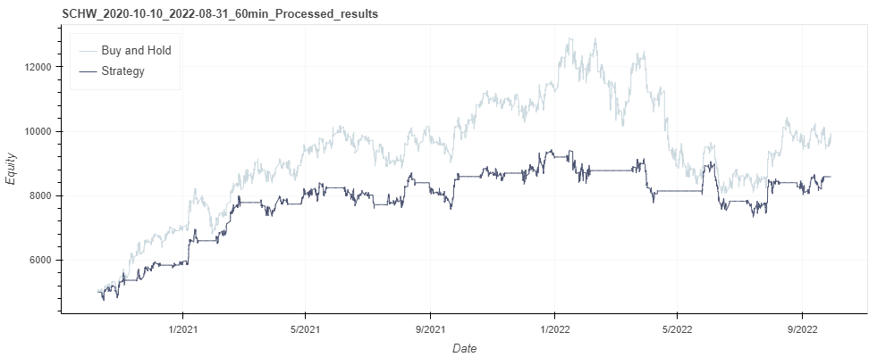
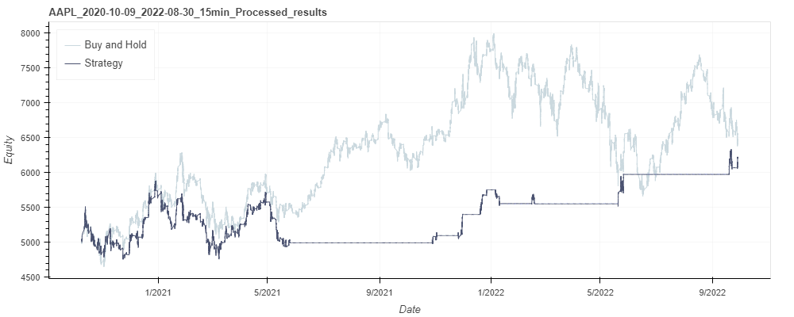
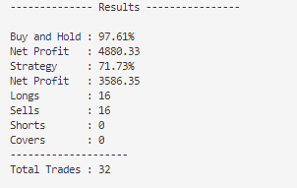
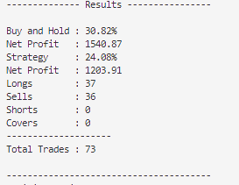
Back-testing
SCHW 60 minutes interval
AAPL 15 minutes interval

Slide 9
Challenge
Learning machine learning within a very limited time and applying it as our algorithm
Keeping on track with the group
Very limited financial background/knowledge to begin

Slide 10
Conclusion
What went well?
We are trying new method and willing to learn new things
What didn’t go so well?
Lack of communication and commitment
What can be improved?
Better scheduling for our team
Consider safety measures for our trading

