Slide 1
Trading Team 3 Presentation
30th September 2022
Isaac Bergl, Lucas Siciliano, Henry Miao

Slide 2
Introduction
What is Range Trading?
Range trading is an active trading strategy that identifies a range at which the investor buys and sells at over a short period. Range trading is best utilised in sideways markets, when prices oscillate between an upper and lower boundary. Conversely, a trending market represents a risk as it would negate the value of a range trading strategy. When market conditions change, a range trading strategy can either adapt or pause trading until the conditions are favourable.
Our Goal
Develop an automated range trading strategy, that minimises risk and maximises return while trading securities.
Our Strategy
Identifying a sideways trending market (ADX)
Defining our dynamic range (Bollinger bands and ADX)
Utilising this range to make trades (RSI)
Holding a position during directional trending market (+DI/-DI)

Slide 3
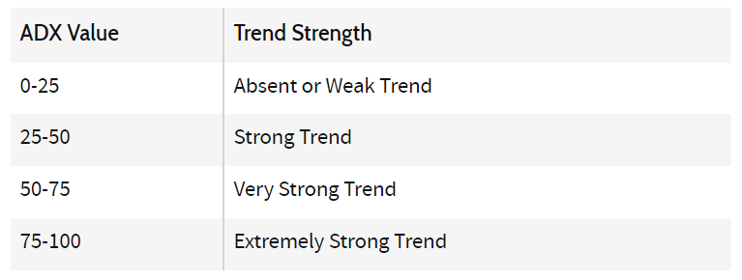
Our Strategy
Identifying a sideways trending market:
Markets only trend about 30% of the time
The other 70% of the time we want to be implementing our range trading strategy, taking advantage of a share that is moving ‘horizontally’
We identify a trending market using the Average Directional Index (ADX)
We won’t trade if ADX > 25
Adjust our range based on the ADX
(More on this later)
Credit – Investopedia

Slide 4
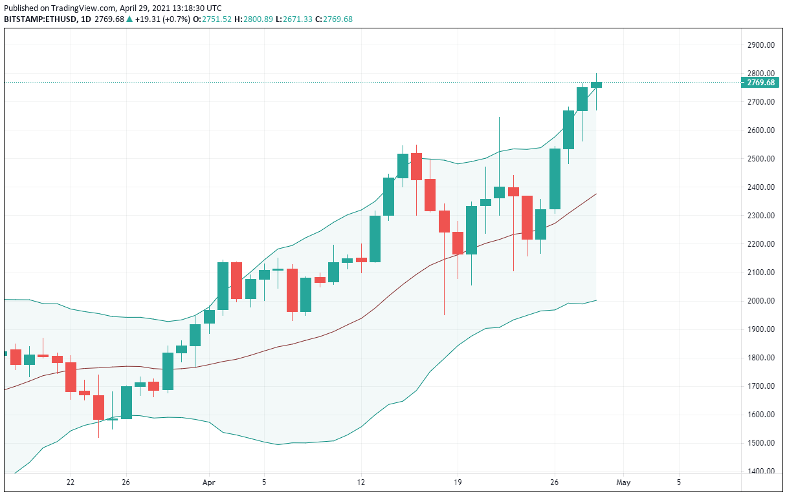
Our Strategy
Defining our dynamic range:
To create our range our team utilised Bollinger Bands
Bollinger Bands create an upper and lower bound that we want to trade within, based on a number of standard deviations from the mean price
We used 3.5 standard deviations as our standard range from the mean price and adjust based on the ADX
The idea being when ADX is lower, the market has little to no trend, and thus we can tighten our Bollinger bands, as we are more confident the price will stay within this range

Slide 5
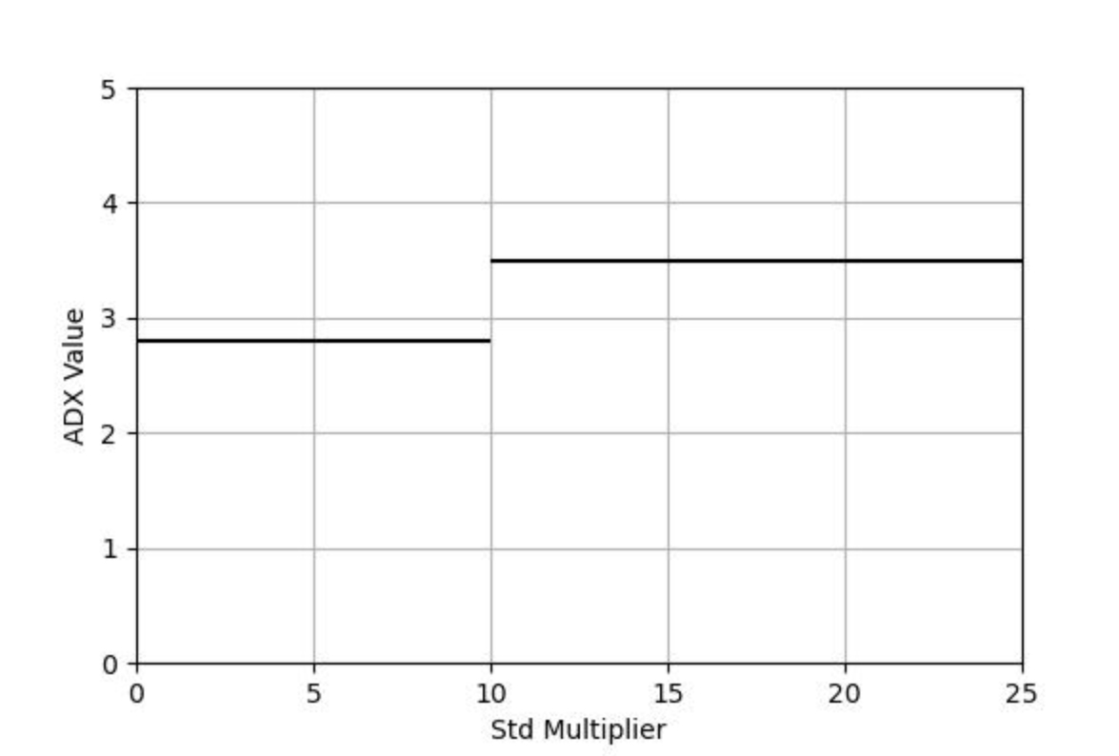

ADX Variation of Standard Deviations
Defining our dynamic range:
IF ADX > 25:
IF 10<ADX<25:
IF 0<ADX<10:
DON’T TRADE
Use standard dev of 3.5 for boll bands
Use standard dev of 2.8 for boll bands

Slide 6
Our Strategy
Trading within our range
The crux of our strategy is quite simple:
Enter a long position when price goes below the lower Bollinger Band
Enter a short position when price goes above the upper Bollinger Band
Based on the idea we think the price will revert back to its mean in a sideways market
However there are other things to consider:
Is the market trending when price crosses the Boll Band?
What about fees?
We use RSI and BOLL bands to narrow down trades:
We only enter a long position when price falls below lower Boll Band AND RSI is < 30 (undervalued)
This is to ensure the quality of our trades and to reduce fees from over-trading
Also we close all positions when ADX>25 and price moves out of range

Slide 7
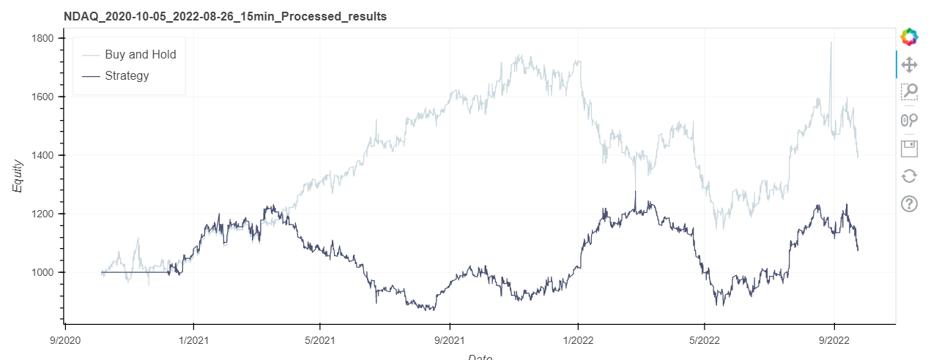
RESULTS: NDAQ
Preliminary Strategy (halt trading when market trends)

Slide 8
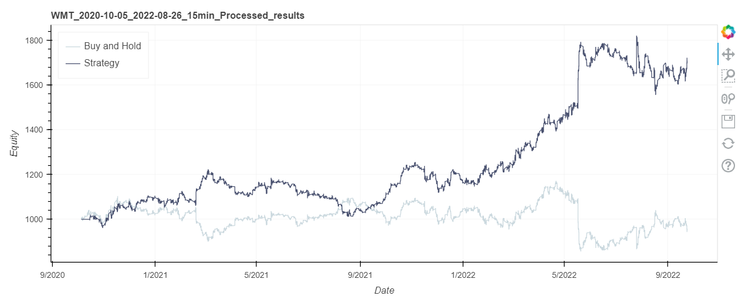
RESULTS: WMT
Preliminary Strategy (halt trading when market trends)

Slide 9
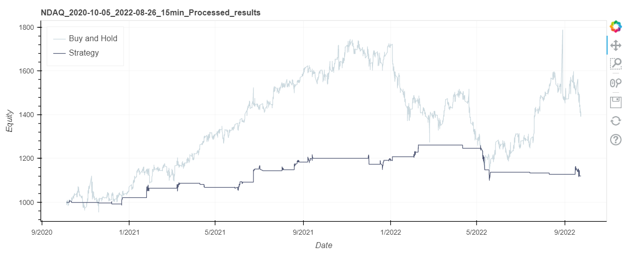
RESULTS: NDAQ
Intermediate Strategy (close all positions when market trends)

Slide 10
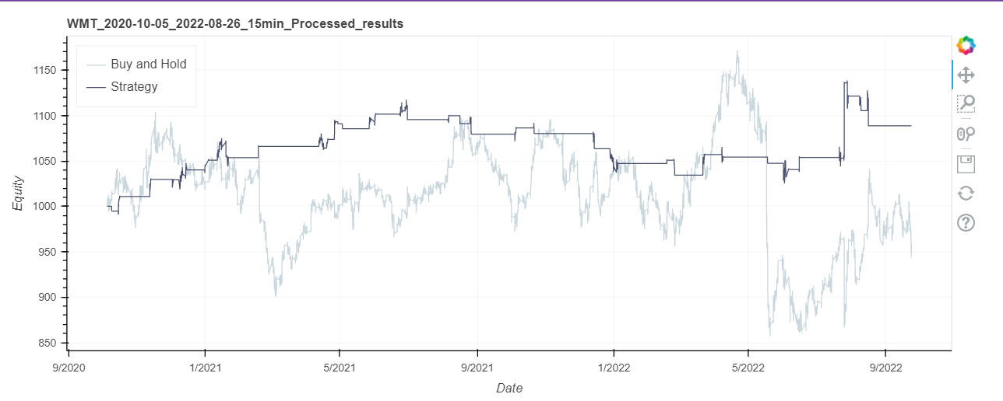
RESULTS: WMT
Intermediate Strategy (close all positions when market trends)

Slide 11
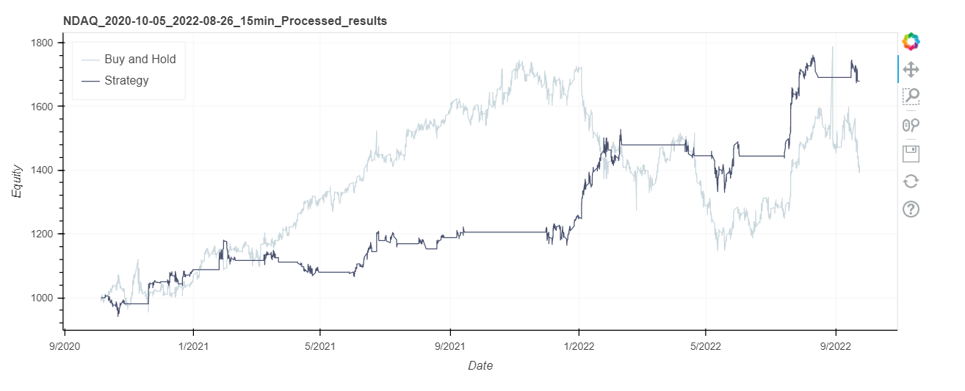
RESULTS: NDAQ
Final Strategy (close positions as per market trend direction)

Slide 12
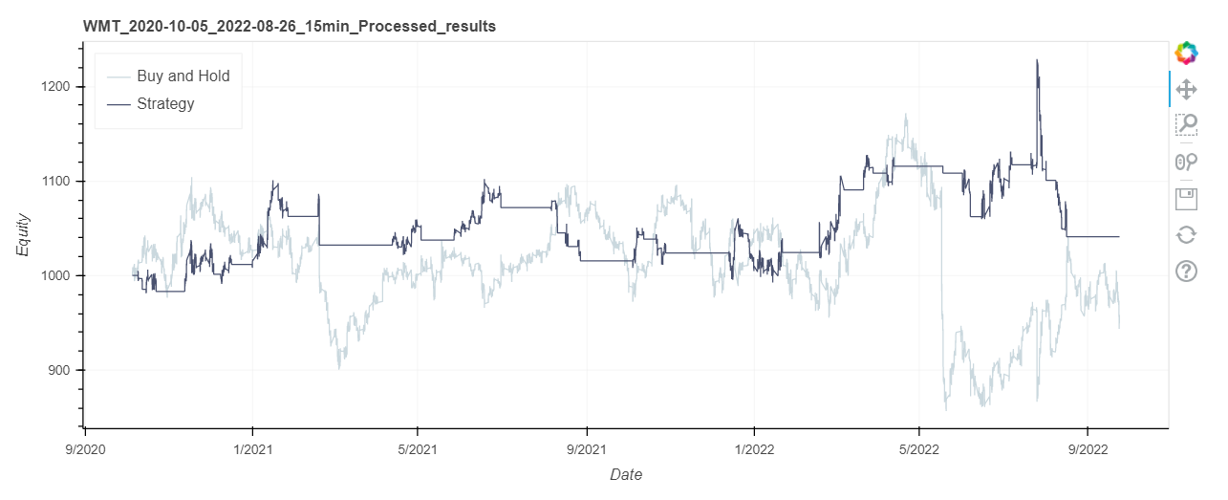
RESULTS: WMT
Final Strategy (close positions as per market trend direction)

Slide 13
Discussion
Improvements:
Greater lookback window for ADX
A more robust way to identify the direction of trends and deal with breakouts
Boll Bands not being symmetrical
Ie: If we expect price to trend upwards, push the upper bol band up more
Test buying power:
We used an ‘all or nothing’ strategy, where we put as much money we have into each of our positions

