Slide 1
Where to live in Stuttgart?
A capstone project

Slide 2

Introduction
Stuttgart is the capital and largest city of the German state of Baden-Württemberg
Its urban area has a population of 634,830, making it the sixth largest city in Germany
People used to live happy in this city

Slide 3

Introduction
Severe acute respiratory syndrome coronavirus 2 (SARS-CoV-2) is the virus strain that causes coronavirus disease 2019 (COVID-19), a respiratory illness
It is colloquially known as the coronavirus. It is contagious in humans
The World Health Organization (WHO) has designated the ongoing pandemic of COVID-19 a Public Health Emergency of International Concern

Slide 4
Introduction
Now because of the virus, the restaurants or other recreation places are closed; the workplaces are empty because people are doing home office
We will answer the question:
“Where it is the best place to live in Stuttgart?”

Slide 5
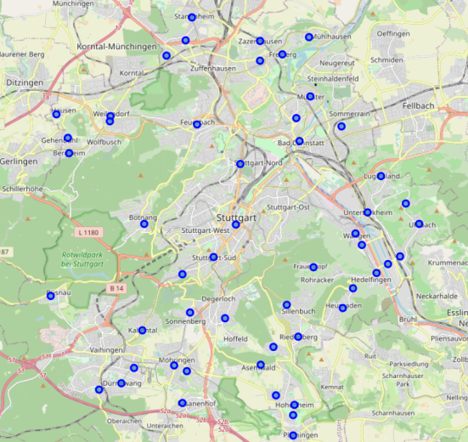
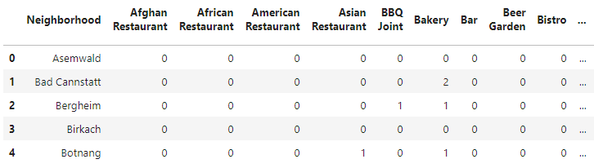
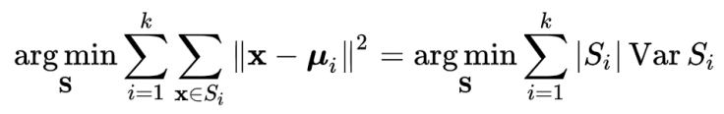
Methodology
? ? ?
? ?
?
? ? ?
Data
Results
K-mean

Slide 6
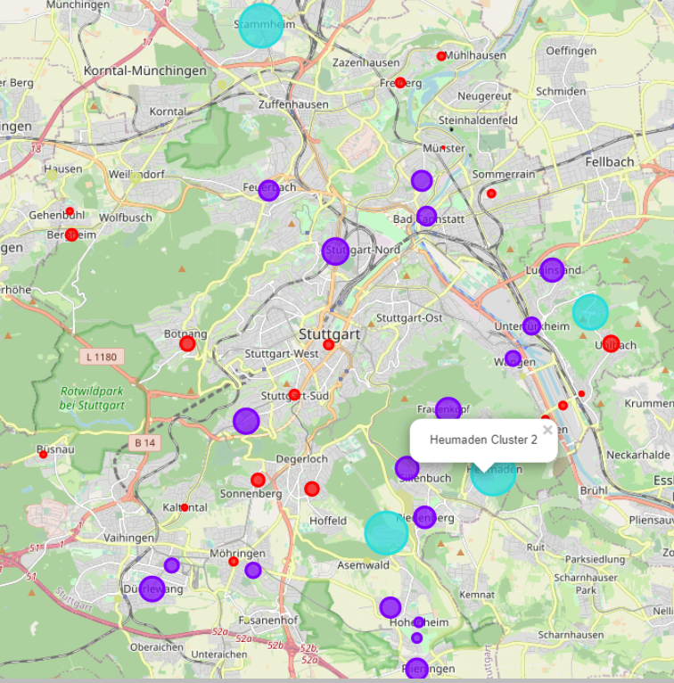
Results
Best place
Risky but nice
Healty but empty
Avoid

Slide 7
Thank you for your attention

