Slide 1
Introduction to Reinforcement Learning
强化学习
姜玥旭

Slide 2
Goal of the lecture
Basic understand and application of reinforcement learning
Approach
Examples, math formula
Application
Interactive

Slide 3
Coverage
Background
Define the problem
Term clarification

Slide 4
References
Reinforcement Learning (an introduction) [Sutton & Barto]
Silver:https://www.youtube.com/playlist?list=PLzuuYNsE1EZAXYR4FJ75jcJseBmo4KQ9-
李宏毅: https://www.youtube.com/watch?v=2-JNBzCq77c
周莫烦: https://www.youtube.com/watch?v=YY7-VKXybjc&list=PLXO45tsB95cIFm8Y8vMkNNPPXAtYXwKin

Slide 5
RL Key Players
Richard S. Sutton is Professor at the University of Alberta, one of the founding fathers of modern reinforcement learning. Contributions: temporal difference learning, policy gradient methods, the Dyna architecture
Andrew G. Barto (born c. 1948) was a professor of computer science at University of Massachusetts Amherst.
David Silver (1976-) leads the reinforcement learning research group at DeepMind and was lead researcher on AlphaGo. Professor at University College London.

Slide 6
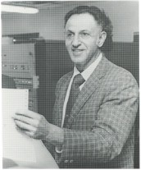
RL Foundation
History: Richard Bellman (1920-1984)
Principal of Optimality
"For every stage and every decision that starts an optimal plan from this stage, the optimal plan consists of the given decision followed by the plan which is optimal with respect to the succeeding stage".
Dynamic programming
Bellman Equations
Hamilton–Jacobi–Bellman equation
Curse of dimensionality
Bellman–Ford algorithm

Slide 7
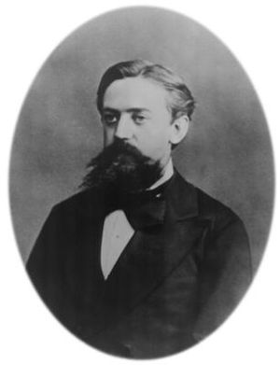
RL Foundation
“Markov chain”
Russian mathematician best known for his work on stochastic processes.
A primary subject of his research later became known as Markov chains and Markov processes.
Andrey Markov
(Андрей Андреевич Марков)
1856 – 1922

Slide 8
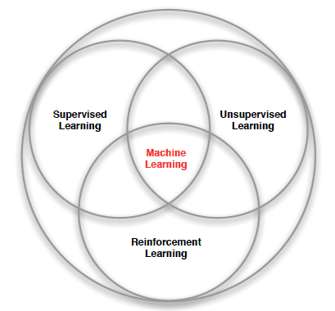
Branches of Machine Learning

Slide 9





Connection with other fields
Computer Science
Engineering
Machine Learning
Neuroscience
Optimal Control
Reward System
Reinforcement Learning
Operations Research
Classical/Operant Conditioning
Mathematics
Bounded Rationality
Psychology
Economics

Slide 10
Application examples
Alpha Go
Auto Driving
https://www.youtube.com/watch?v=AG0EqPTjgVE
Video Games
https://www.youtube.com/watch?v=nakohvx-k5U&list=PLduGZax9wmiHg-XPFSgqGg8PEAV51q1FT&index=2

Slide 11
What is Reinforcement Learning
No supervisor, agent interact with environment to get reward signal (Exploration and Exploitation)
Reward signal could be delayed (discount)
Time really matters (sequential, non i.i.d data, Markov decision process)
Agent’s action affect the states and the subsequent data it receives

Slide 12
Examples of Reinforcement Learning
Atari games
https://www.youtube.com/watch?time_continue=122&v=YOW8m2YGtRg&feature=emb_logo
Make a humanoid robot walk
E.g..

Slide 13
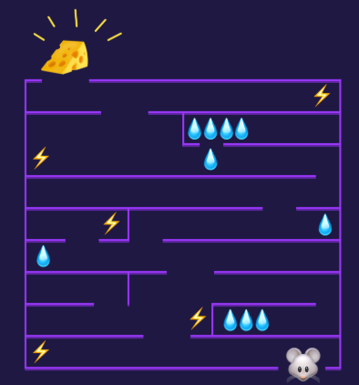
Agent and environment
Agent: mouse
State: mouse’s location
Reward: water, cheese, shock
Actions: move directions

Slide 14




Observation
Action
Agent
Don’t do that
Reward
Environment

Slide 15
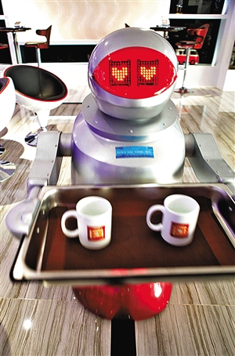
Agent learns to take actions to maximize expected reward.
Observation
Action
Agent
Thank you.
Reward
Environment

Slide 16

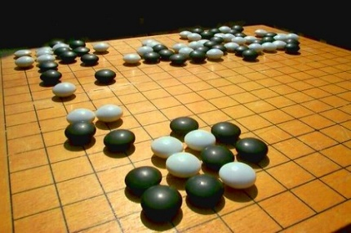
Agent learns to take actions to maximize expected reward.
Observation
Action
Reward
Next Move
If win, reward = 1
If loss, reward = -1
Otherwise, reward = 0
Environment

Slide 17
Reward
A reward Rt is a scalar feedback signal
Indicates how well agent is doing at step t
The agent’s job is to maximize cumulative reward

Slide 18
Examples of Rewards
Play Ping-Pong
Mange investments
Train a robot to collect trash

Slide 19
Major Components of an RL agnet
An RL agent may include one or more of these components:
Policy: agent’s behavior function
Value function: how good is each state and/or action
Model: agent’s representation of the environment

Slide 20
Policy
A policy is the agent’s behavior
It is a map from state to action, e.g.
Deterministic policy: a = π(s)
Stochastic policy: π(a|s) = P[At = a|St = s]

Slide 21

Value Function
Value function is a prediction of future reward
Used to evaluate the goodness/badness of states
And therefore to select between actions, e.g.

Slide 22

Model
A model predicts what the environment will do next
P predicts the next state
R predicts the next (immediate) reward, e.g.

Slide 23
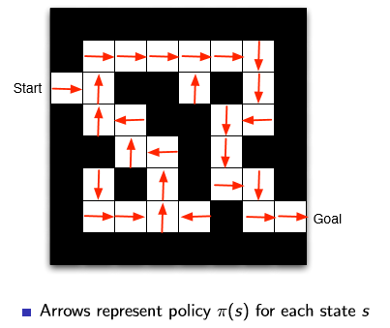
Maze Example: Policy

Slide 24
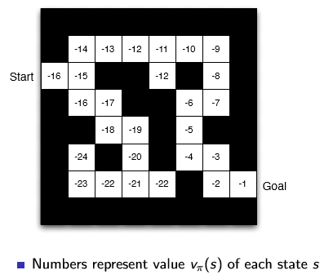
Maze Example: Value Function

Slide 25
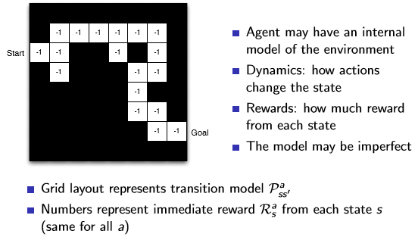
Maze Example: Model

Slide 26
Categorizing RL agents (1)
Value Based
No Policy (Implicit)
Value Function
Policy Based
Policy
No Value Function
Actor Critic
Policy
Value Function

Slide 27
Categorizing RL agents (2)
Model Free
Policy and/or Value Function
No Model
Model Based
Policy and/or Value Function
Model

Slide 28
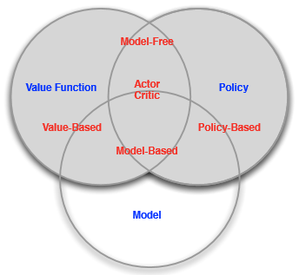
RL Agent Taxonomy

Slide 29
Learning and Planning
Two fundamental problems in sequential decision making
Reinforcement Learning:
The environment is initially unknown
The agent interacts with the environment
The agent improves its policy
Planning:
A model of the environment is known
The agent performs computations with its model (without any external interaction)
The agent improves its policy
a.k.a. deliberation, reasoning, introspection, pondering, thought, search

Slide 30
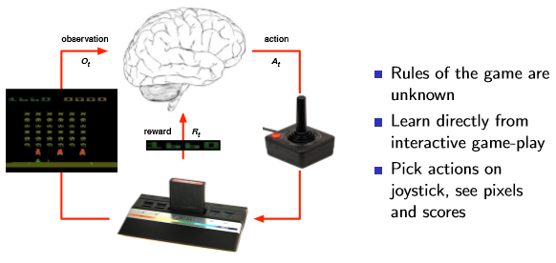
Atari Example: Reinforcement Learning

Slide 31
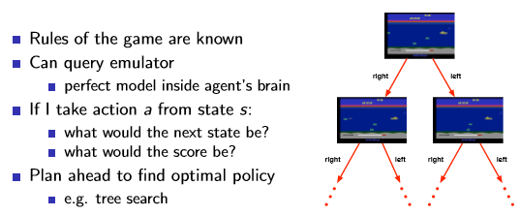
Atari Example: Planning

Slide 32
Exploration and Exploitation
Exploration finds more information about the environment
Exploitation exploits known information to maximize reward

Slide 33
Exploration and Exploitation
Restaurant Selection
Exploitation Go to your favorite restaurant
Exploration Try a new restaurant
Oil Drilling
Exploitation Drill at the best known location
Exploration Drill at a new location
Game Playing
Exploitation Play the move you believe is best
Exploration Play an experimental move
E.g…

Slide 34

Environment state
Fully Observable Environments
Agent directly observes environment state
Environment state = Agent state (Markov decision process)
Partially Observable Environments
E.g.
A robot with camera
Poker

Slide 35
Message to take home
Name to remember
Branches of machine learning
What is RL?
Terms definition
Agent
Policy
Value
Model
Reward
Environment state
Exploitation and exploration

Slide 36
Markov Decision Processes
当前的状态与过往无关
未来与过去无关,只和现在有关
假定强化学习的过程是一个马尔可夫的过程
马尔可夫决策过程
姜玥旭
几阶就看前几个状态
多个状态放在一起，就变成马尔可夫过程
马尔可夫过程是研究离散事件动态系统状态空间的重要方法，它的数学基础是随机过程理论。

Slide 37
Coverage
Markov Processes
Markov Reward Processes
Markov Decision Processes
马尔可夫过程
马尔科夫奖励过程
马尔科夫决策过程

Slide 38
Introduction to MDPs
Markov decision processes formally describe an environment for reinforcement learning
Where the environment is fully observable
i.e. The current state completely characterises the process
Almost all RL problems can be formalised as MDPs, e.g.
Optimal control primarily deals with continuous MDPs
Partially observable problems can be converted into MDPs
Bandits are MDPs with one state
马尔可夫决策过程形式化地描述了强化学习的环境
环境是完全可见的
•也就是说，当前状态完全表征了整个过程
几乎所有的RL问题都可以形式化地表示为MDPs，例如：
最优控制主要涉及连续的MDPs
部分可观测问题可以转化为MDPs
强盗是只有一个状态的mdp

Slide 39
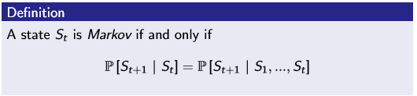
Markov Property
“The future is independent of the past given the present”
The state captures all relevant information from the history
Once the state is known, the history may be thrown away
i.e. The state is a suﬃcient statistic of the future
E.g. (location of plane)

Slide 40
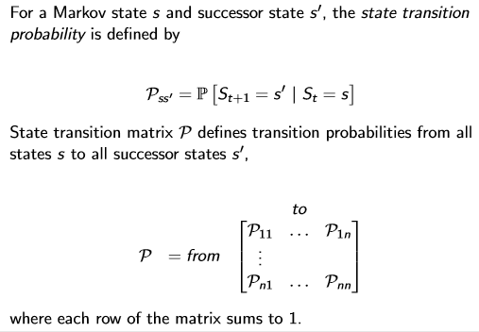
State Transition Matrix

Slide 41
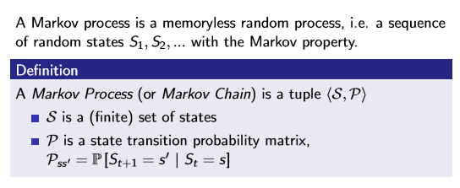
Mardov Process

Slide 42
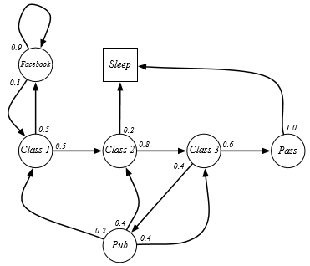
Example: Student Markov Chain

Slide 43
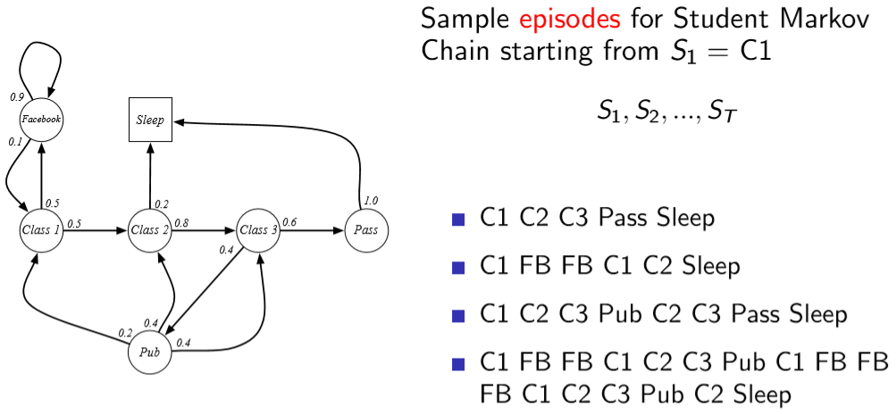
Example: Student Markov Chain Episodes

Slide 44
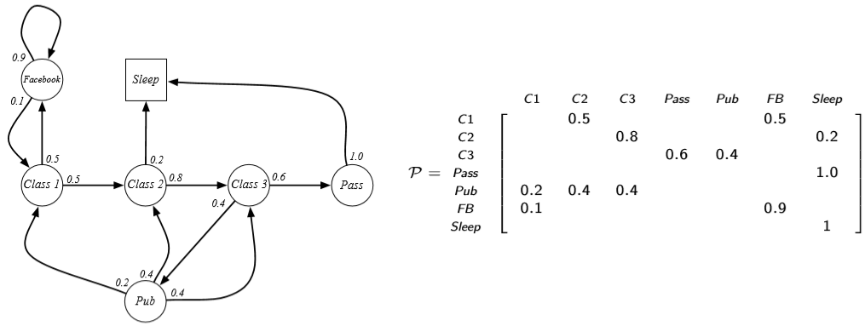
Example: Student Markov Chain Transition Matrix

Slide 45
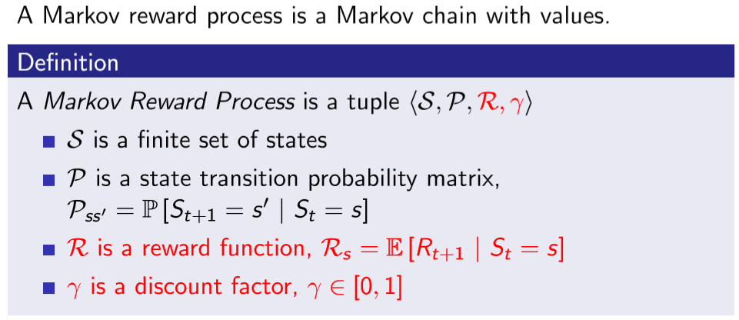
Markov Reward Process

Slide 46
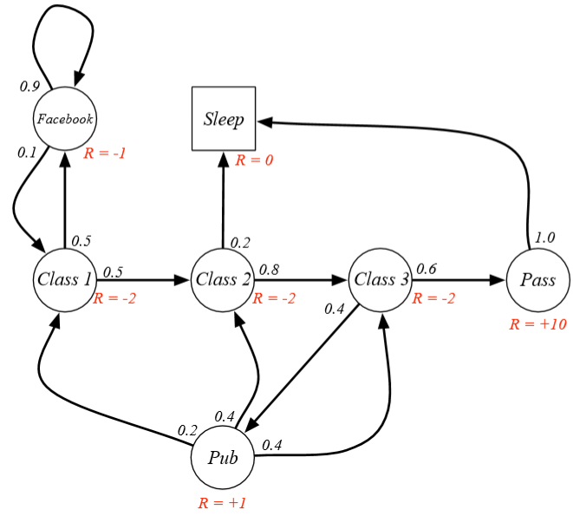
Example: Student MRP

Slide 47
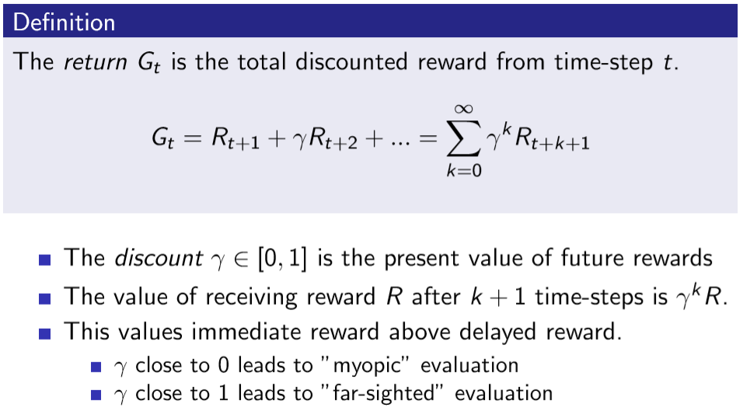
Value (Return)

Slide 48
Why discount
Most Markov reward and decision processes are discounted. Why?
Avoids inﬁnite returns in cyclic Markov processes
Uncertainty about the future may not be fully represented
If the reward is ﬁnancial, immediate rewards may earn more interest than delayed rewards
Animal/human behaviour shows preference for immediate reward
It is sometimes possible to use undiscounted Markov reward processes (i.e. γ = 1), e.g. if all sequences terminate.

Slide 49
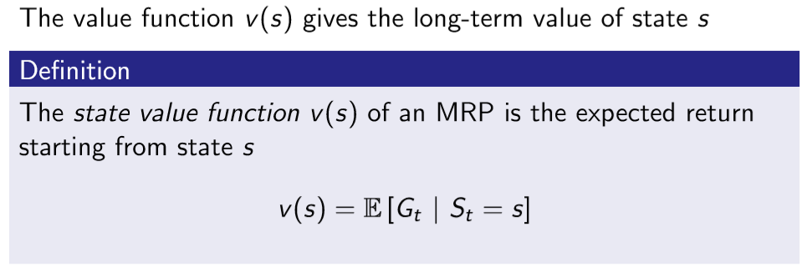
Value Function

Slide 50
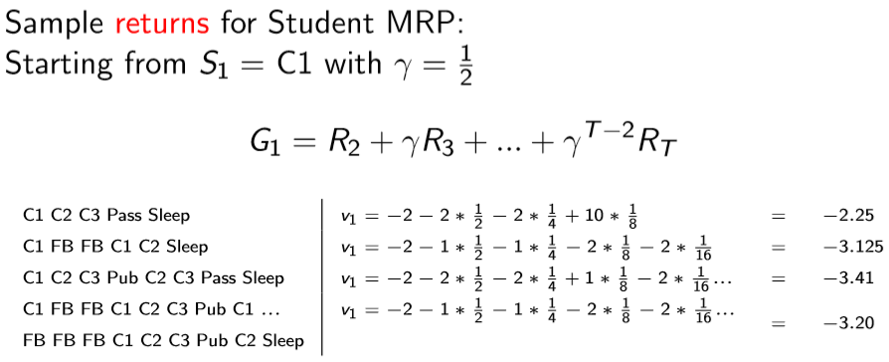
Example: Student MRP Returns

Slide 51
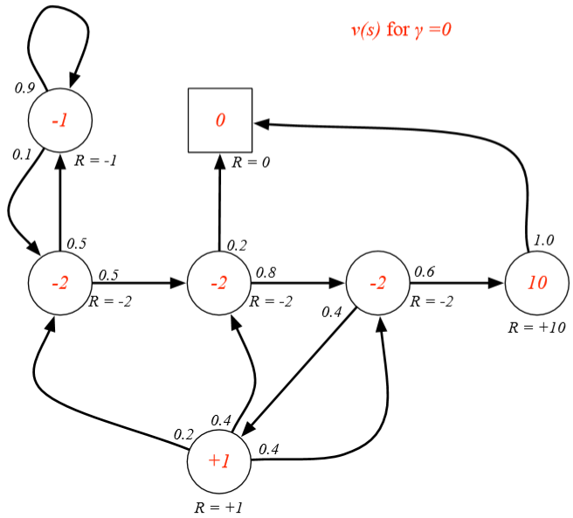
Example: State-Value Function for Student MRP (1)
数学期望

Slide 52
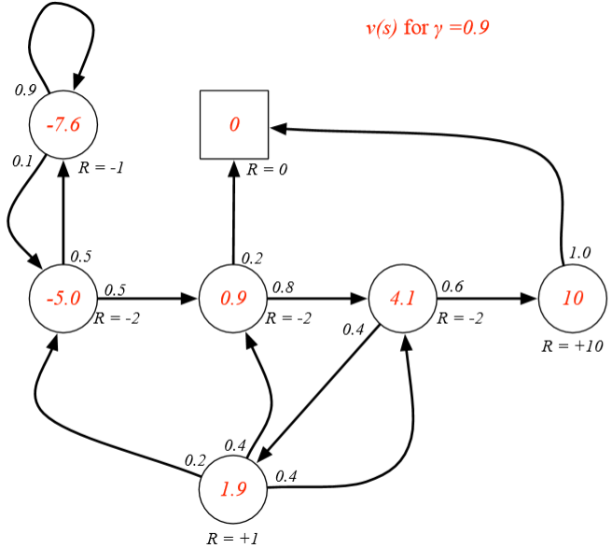
Example: State-Value Function for Student MRP (2)

Slide 53

Example: State-Value Function for Student MRP (3)

Slide 54
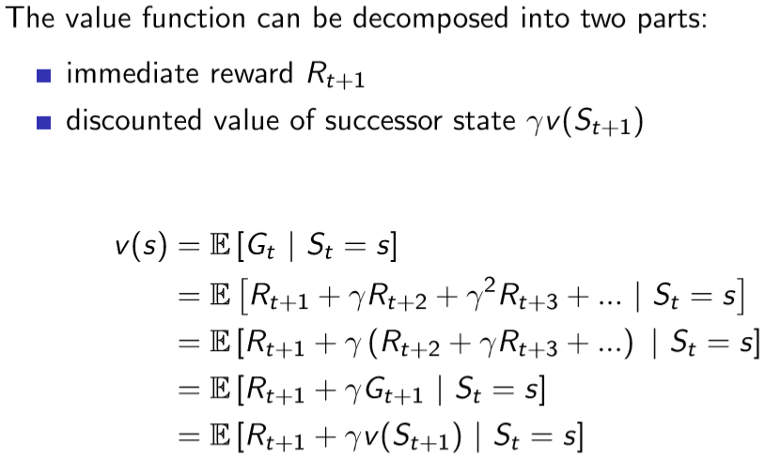
Bellman Equation for MRPs
贝尔曼方程

Slide 55
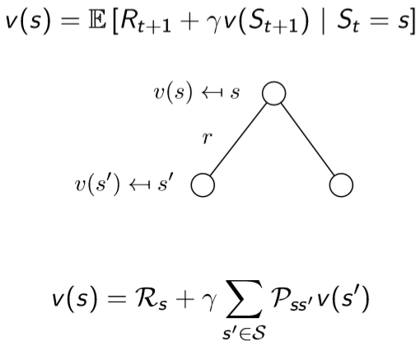
Bellman Equation for MRPs (2)

Slide 56
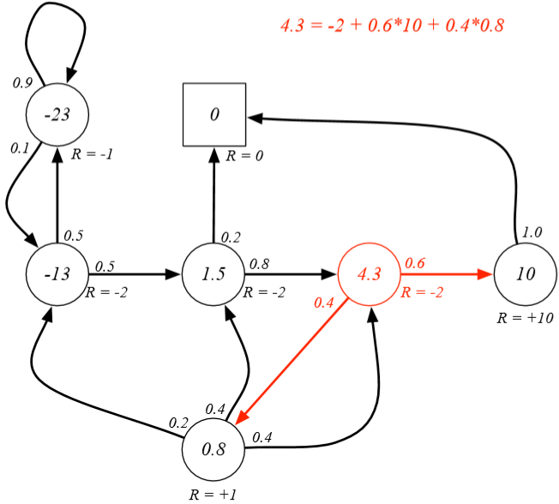
Example: Bellman Equation for Student MRP

Slide 57
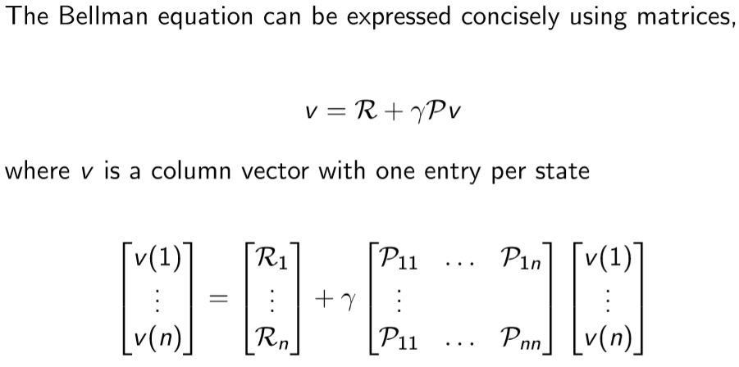
Bellman Equation in Matrix For

Slide 58
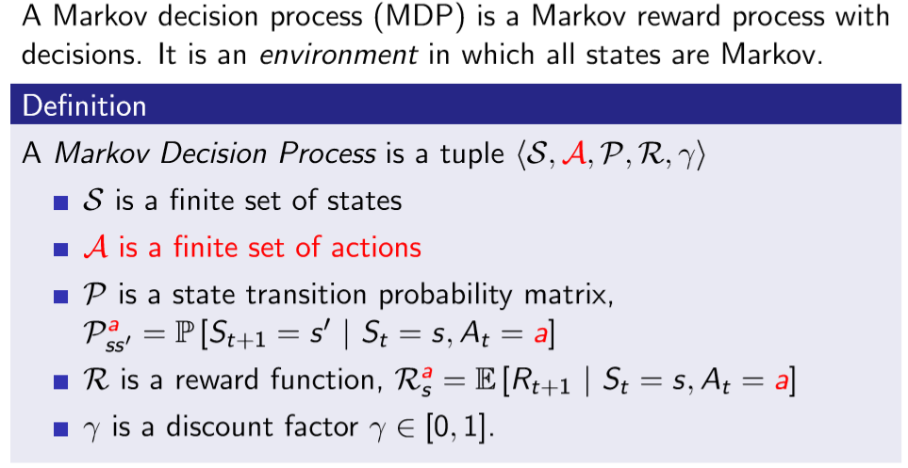
Markov Decision Process

Slide 59
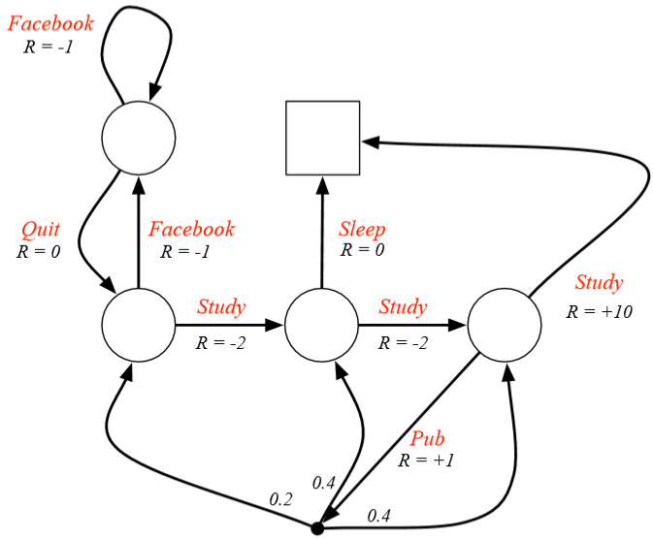
Example: Student MDP

Slide 60
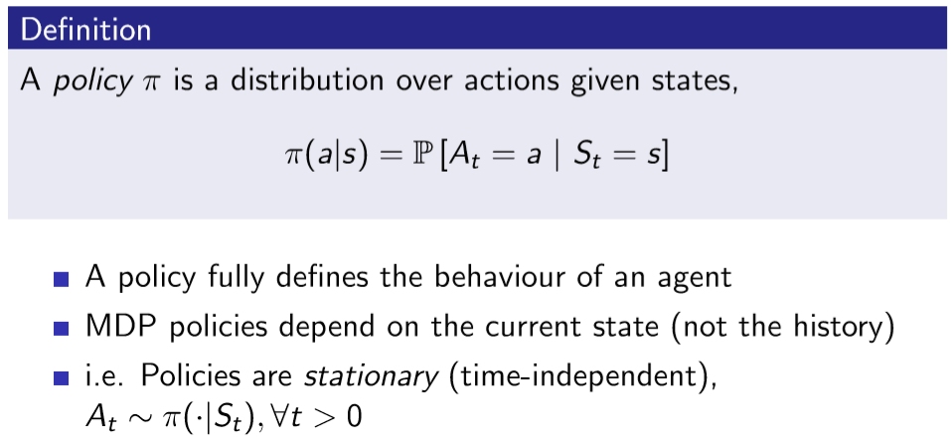
Policies (1)
p is a state transition probability matrix中p是什么
P就是状态转移矩阵。已知的 给定的。

Slide 61
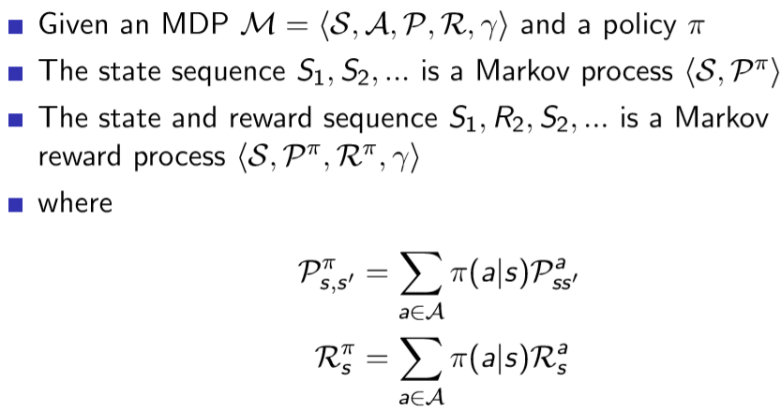
Policies (2)

Slide 62
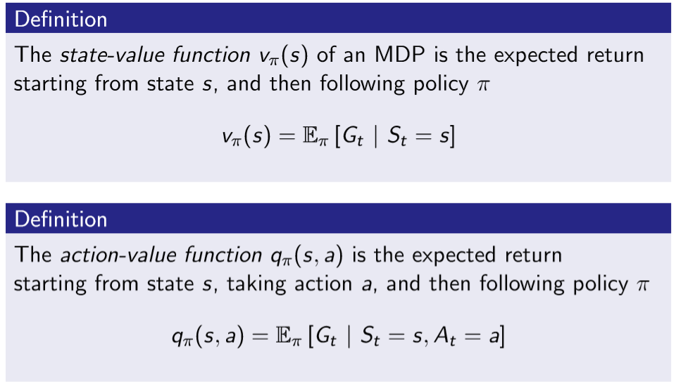
Value Function

Slide 63
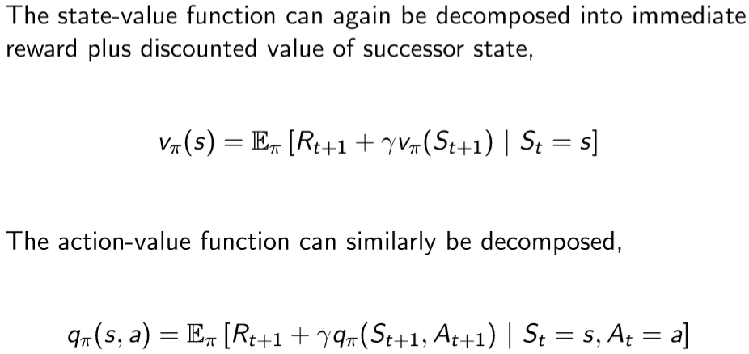
Bellman Expectation Equation

Slide 64
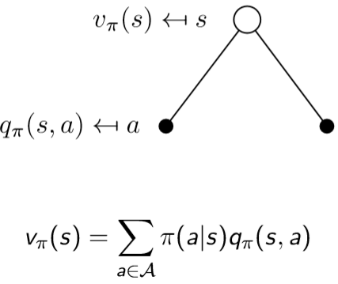
Bellman Expectation Equation for Vπ

Slide 65
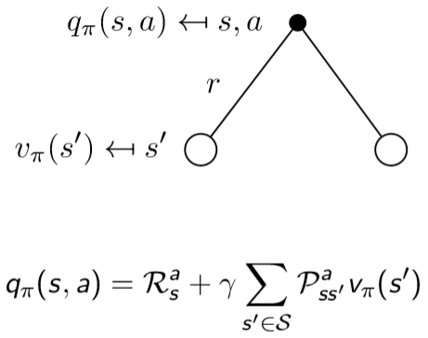
Bellman Expectation Equation for qπ

Slide 66
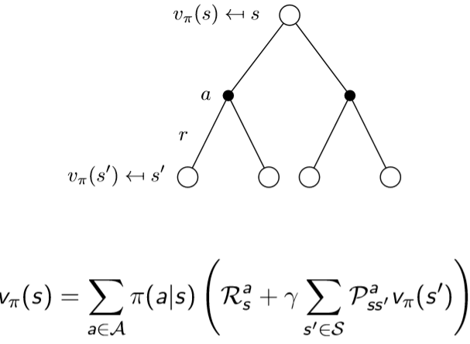
Bellman Expectation Equation for vπ (2)
贝尔曼方程二阶
便于代码实现
递归的实现
这里的各种形式，就是各种action 都考虑一遍。
立即回报 将来回报

Slide 67
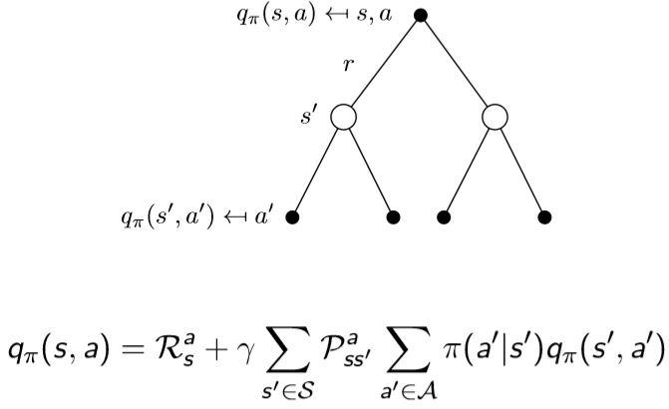
Bellman Expectation Equation for qπ (2)

Slide 68
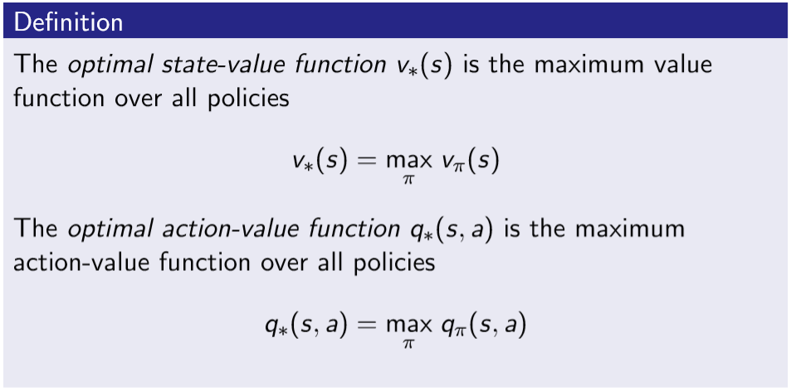
Optimal Value Function
最终是为了解马尔可夫过程方程
最优的状态函数
最优的q函数
The optimal value function specifies the best possible performance in the MDP
An MDP is “solved” when we know the optimal value q*

Slide 69
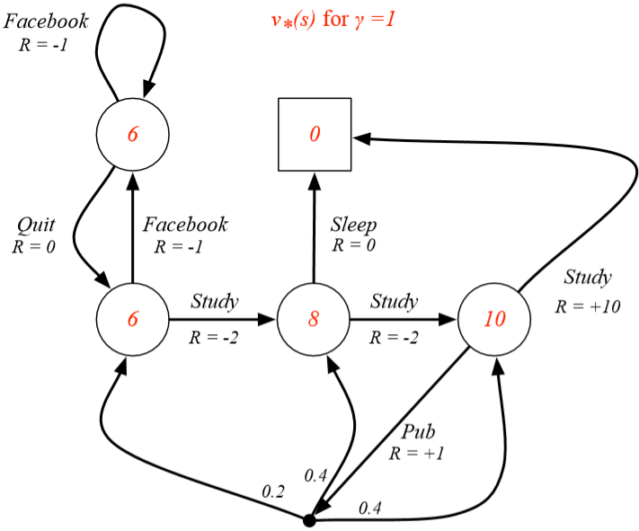
Example: Optimal Value Function for Student MDP
立即回报-2

Slide 70
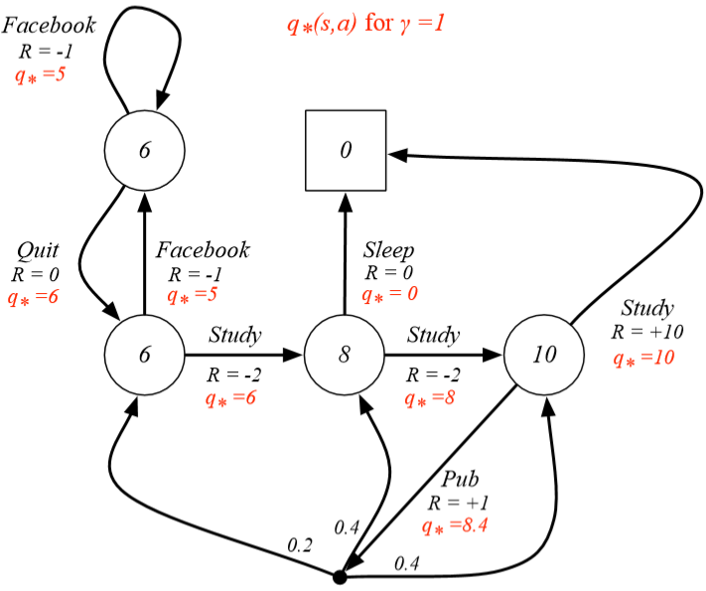
Example: Optimal Action-Value Function for Student MDP

Slide 71
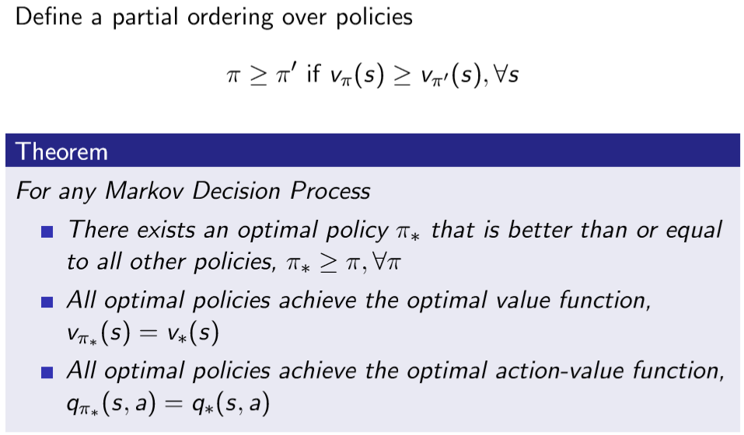
Optimal Policy

Slide 72
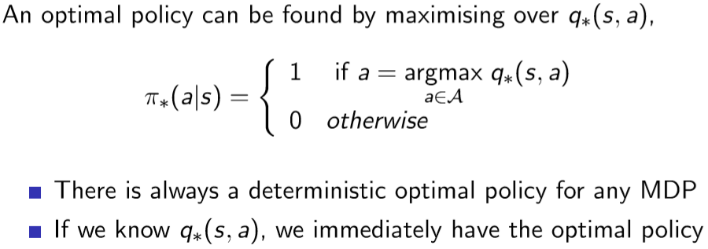
Finding an Optimal Policy

Slide 73
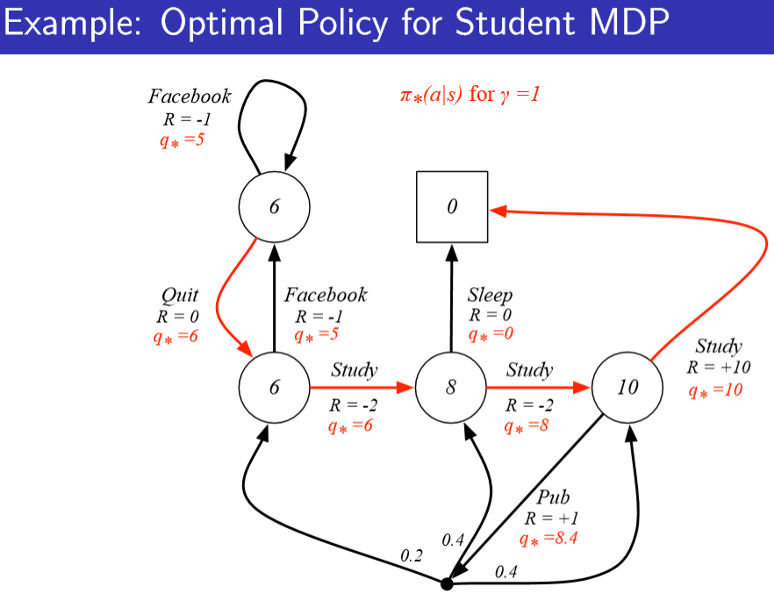
Example: Optimal Policy for Student MDP

Slide 74
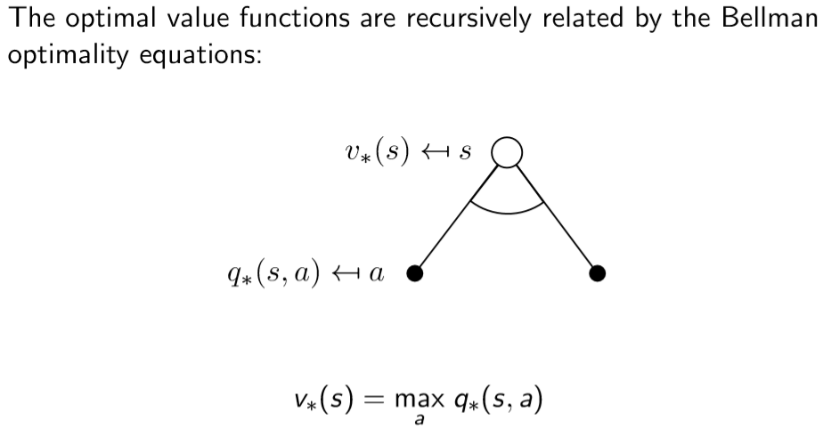
Bellman Optimality Equation for v∗
这里的各种形式，就是各种action 都考虑一遍
q是一个action 确定的，v是所有action都看
一个action
多个 状态
左边和右边各一个 state。 都是由一个action来的。
看求V*
遍历所有action
从白点到两个黑点
要比较这两个黑点的值大小，如：
左边黑点为max q*（s, a1）
右边黑点为max q*（s, a2）
然后比较a1 , a2。（意思为选择最优）

Slide 75

Bellman Optimality Equation for Q∗

Slide 76
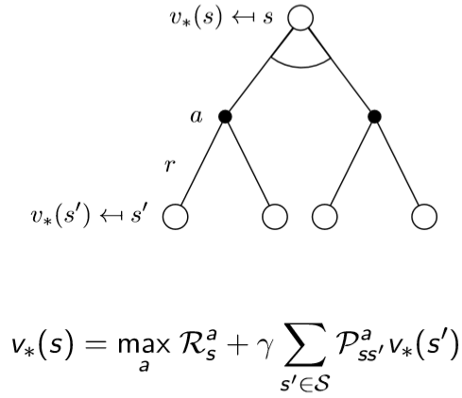
Bellman Optimality Equation for V∗ (2)

Slide 77
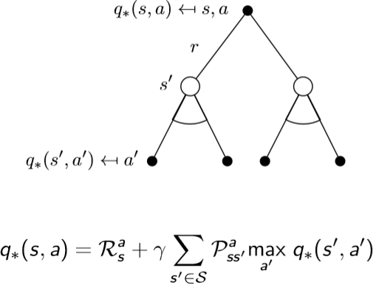
Bellman Optimality Equation for Q∗ (2)

Slide 78
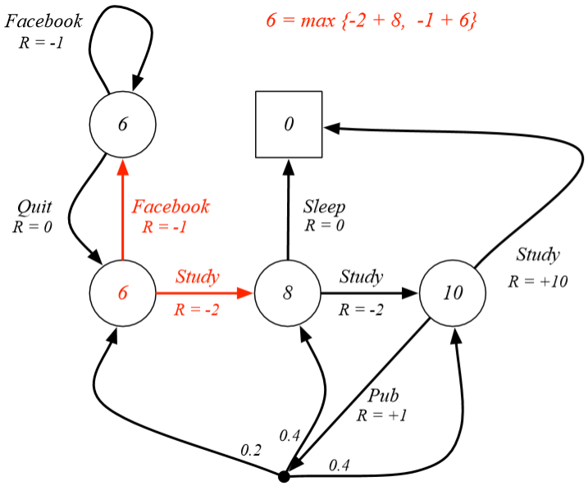
Example: Bellman Optimality Equation in Student MDP

Slide 79
Solving the Bellman Optimality Equation
Bellman Optimality Equation is non-linear
No closed form solution (in general)
Many iterative solution methods
Value Iteration
Policy Iteration
Q-learning
Sarsa

