Slide 1
Planning by Dynamic Programming
姜玥旭

Slide 2
Outline
Introduction
Policy Evaluation
Policy Iteration
Value Iteration

Slide 3
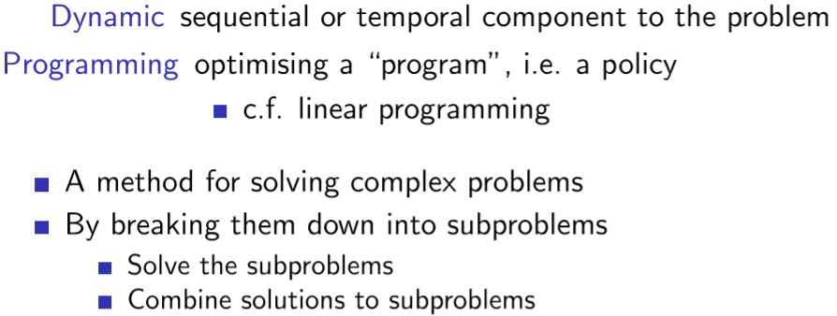
What is Dynamic Programming?
什么是动态规划?
问题的顺序或时间部分

Slide 4
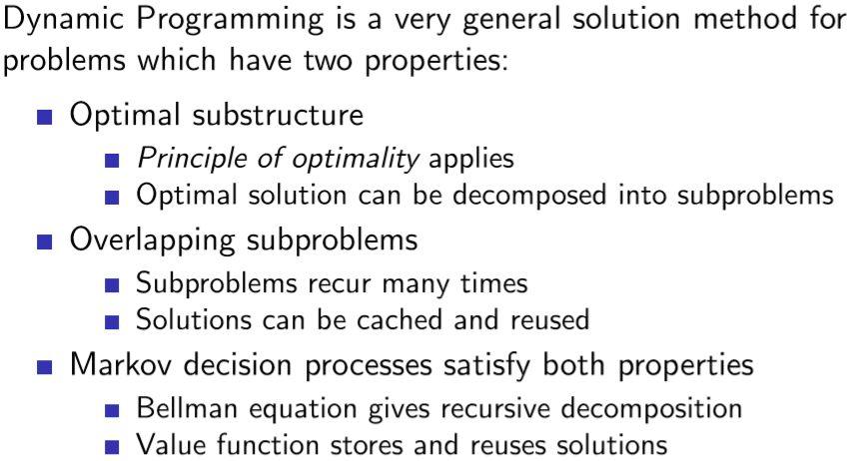
Requirements for Dynamic Programming
已知起点到中间点的位置
动态规划要求
把点分解
怎么得到最好值就行

Slide 5
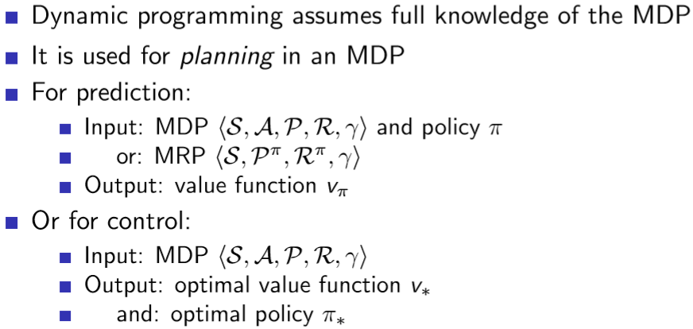
Planning by Dynamic Programming

Slide 6
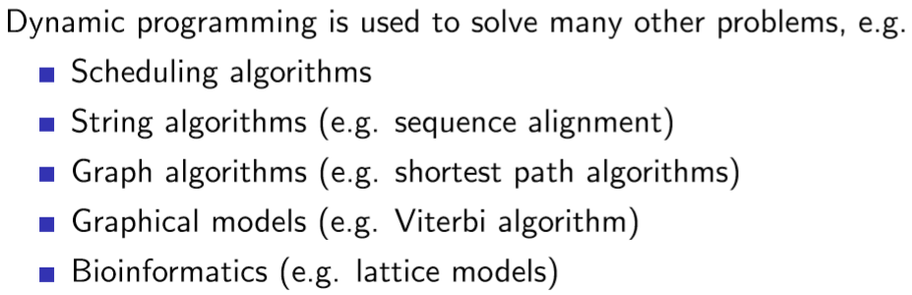
Other Applications of Dynamic Programming

Slide 7
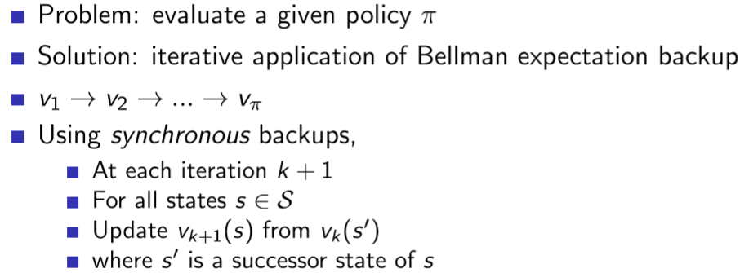
Iterative Policy Evaluation
迭代的政策评估
使用贝尔曼期望
更新方法
由上一次迭代的来计算这一次迭代的

Slide 8
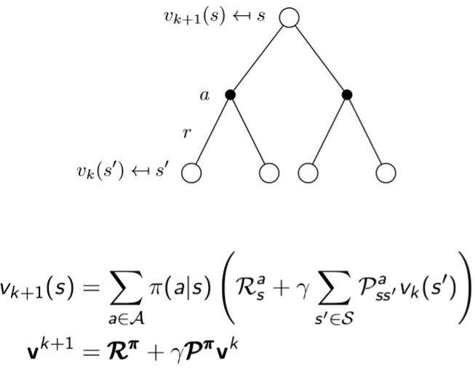
Iterative Policy Evaluation (2)

Slide 9
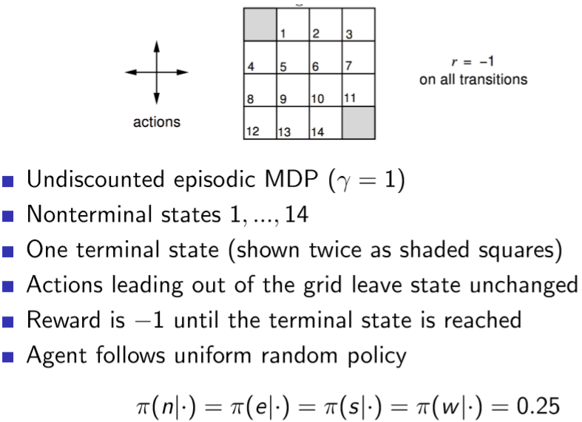
Evaluating a Random Policy in the Small Gridworld
随机的policy

Slide 10
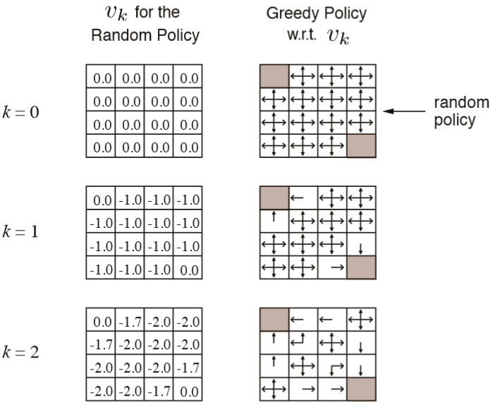
Iterative Policy Evaluation in Small Gridworld
通过不断训练，最终会得到最优的方法/走法
-2x0.25+-2x0.25+-1x0.25+-1x0.25=-1.7

Slide 11
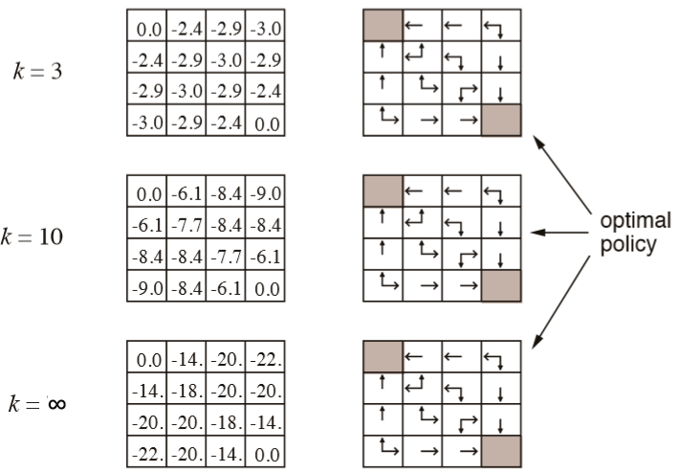
Iterative Policy Evaluation in Small Gridworld (2)

Slide 12
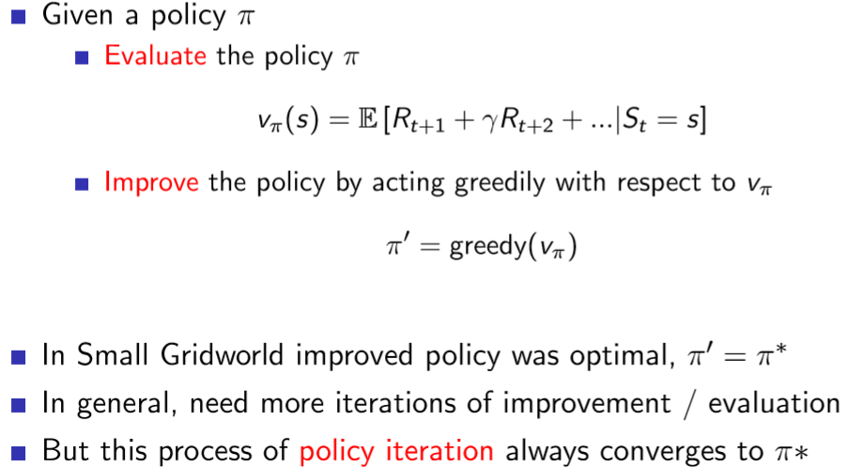
How to Improve a Policy

Slide 13
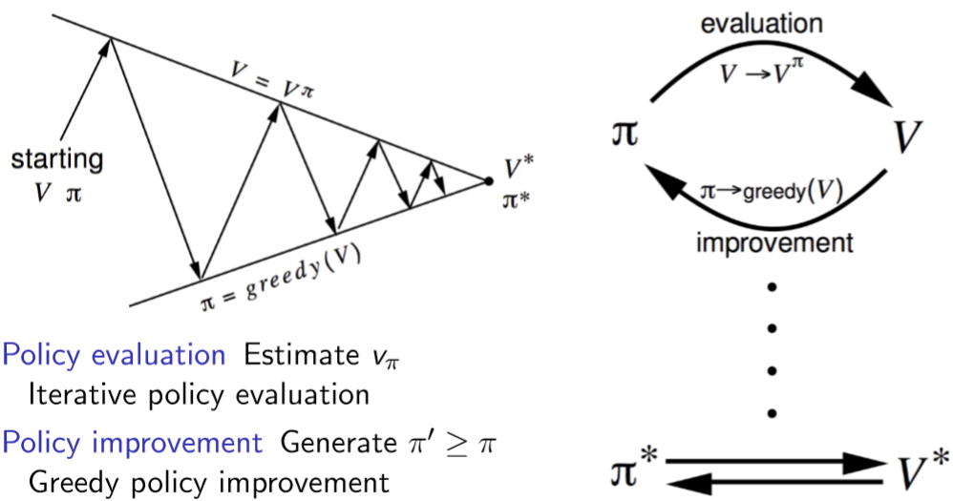
Policy Iteration

Slide 14
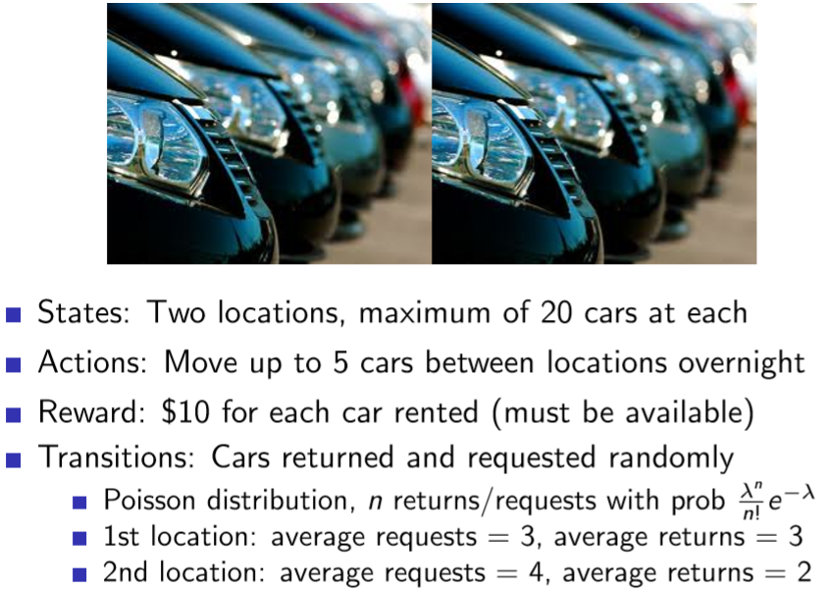
Jack’s Car Rental

Slide 15
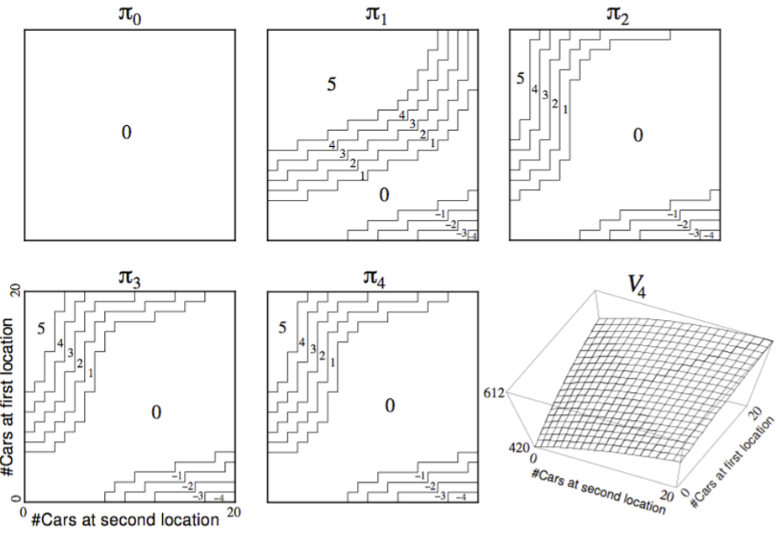
Policy Iteration in Jack’s Car Rental

Slide 16
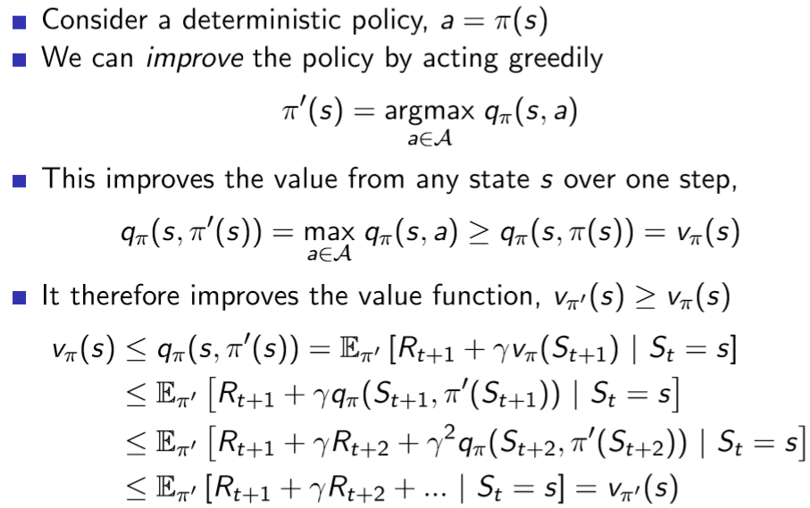
Policy Improvement

Slide 17
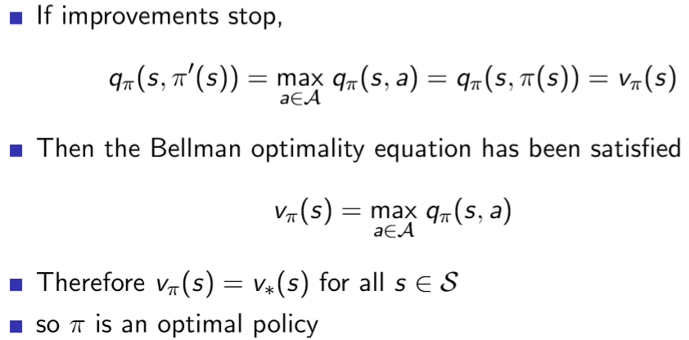
Policy Improvement (2)

Slide 18
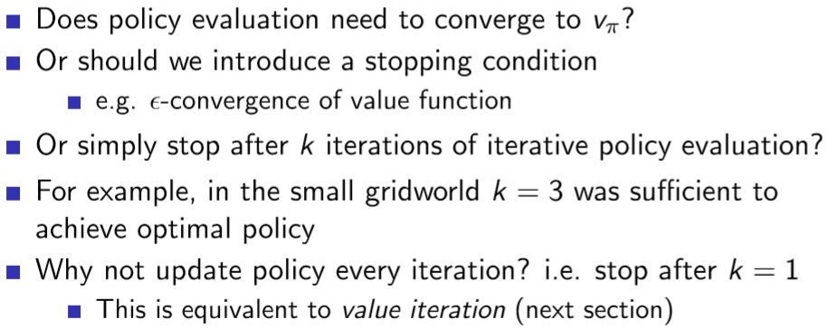
Modiﬁed Policy Iteration

Slide 19
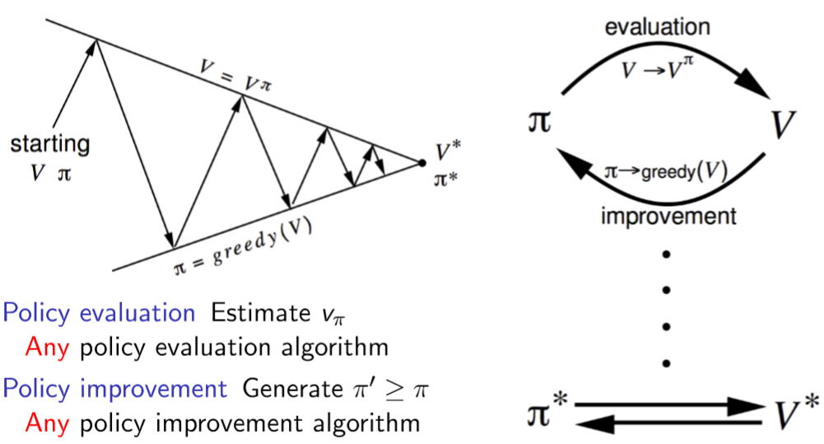
Generalised Policy Iteration

Slide 20
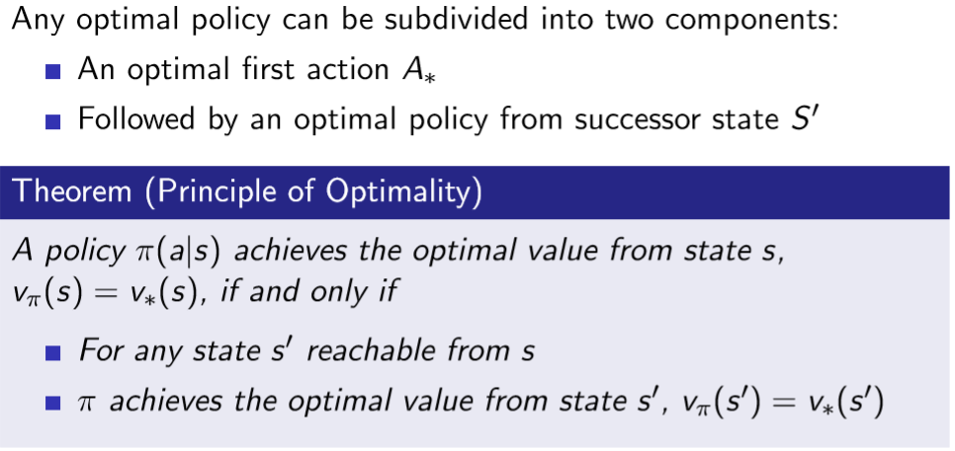
Principle of Optimality

Slide 21
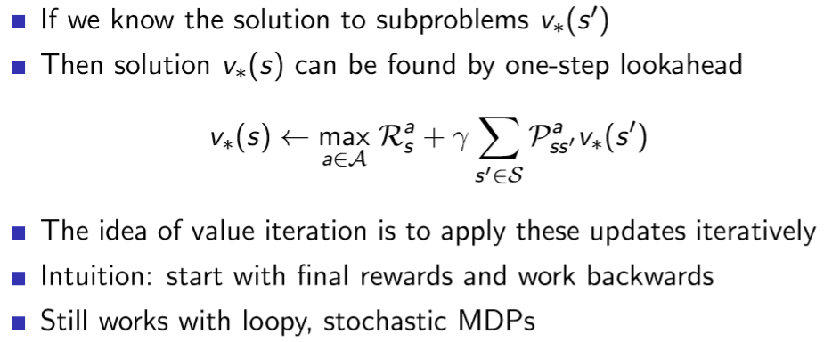
Deterministic Value Iteration

Slide 22
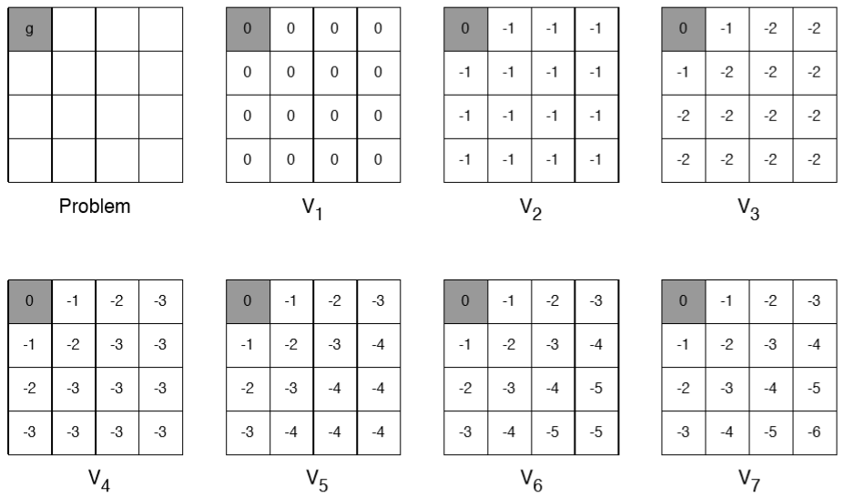
Example: Shortest Path

Slide 23
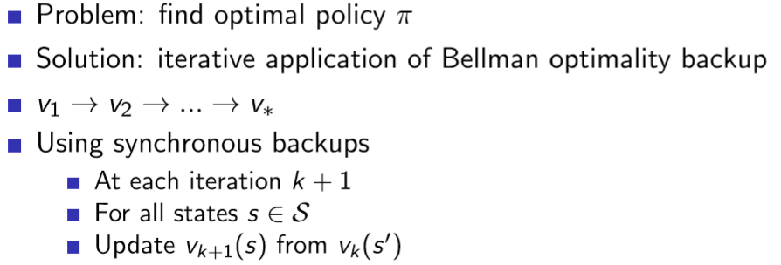
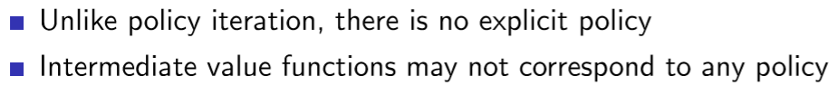
Value Iteration

Slide 24
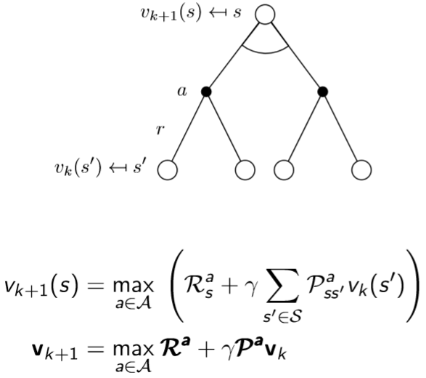
Value Iteration (2)

Slide 25
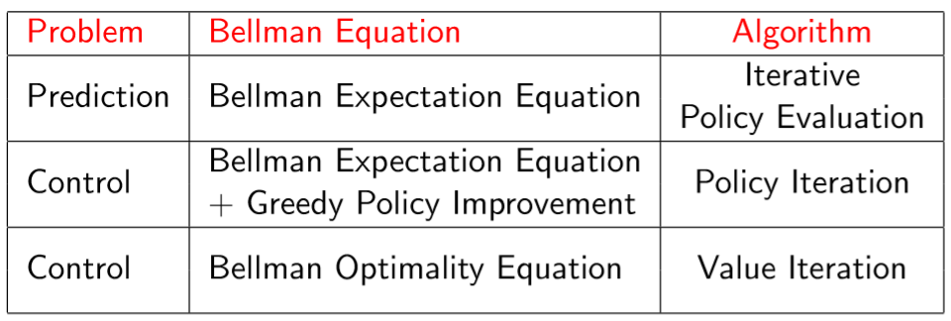
Synchronous Dynamic Programming Algorithms

