Slide 1

Maps and Tools for Insurance Adjusters

Slide 2
Motivation
Insurance adjusters need a simple layout to save time reviewing valuation and impact photographs
Staff needs to quickly search for and respond to customer correspondence
Staff needs to save notes regarding prior customer claim requests

Slide 3
Currently implemented
Map page with confidence level and damage filter
Building information detail in sidebar
Toggle for before and after image
99% accurate damage model
Building shapes according to geo-coordinates from satellite data

Slide 4
Major Tools Used
MapLibre GL JS: the interactive map, with building polygons colored by damage level and a click-through detail sidebar.
xBD satellite dataset: the before and after imagery and building labels for the Joplin tornado tile, with 276 building footprints.
GeoJSON: the single static file, buildings.geojson, that carries every building’s damage, confidence, address and images to the map.
Python pipeline (shapely, Pillow): scripts that extract footprints, crop before and after thumbnails, and merge everything into that file.
LocationIQ and OpenStreetMap: LocationIQ gives approximate street addresses, and OpenStreetMap provides the basemap and an experimental building-type lookup.

Slide 5
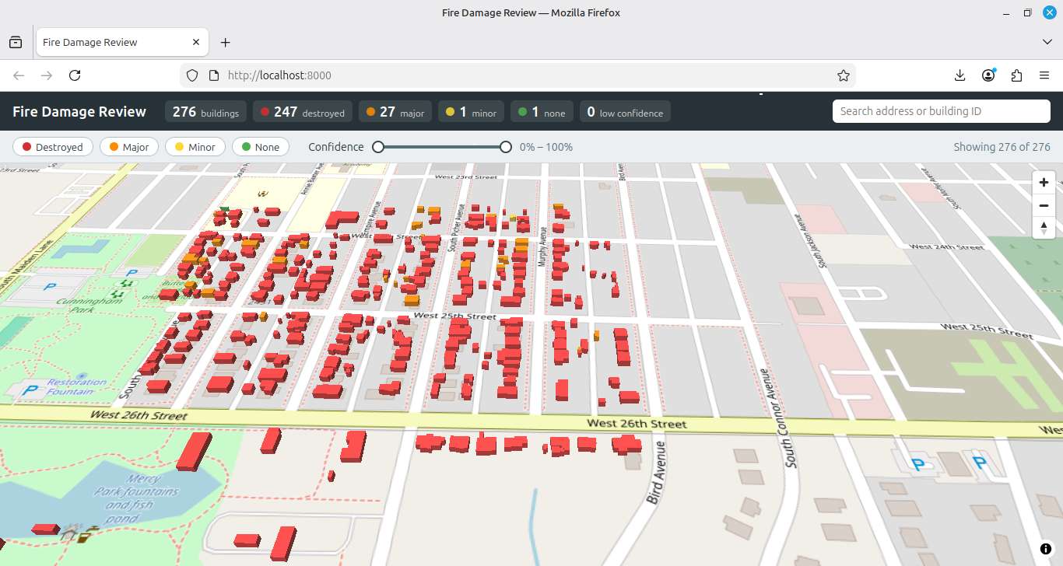
Screenshots

Slide 6
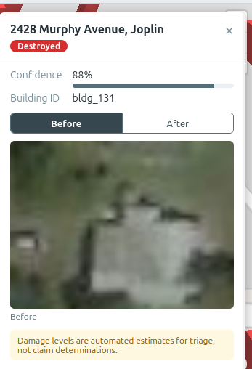
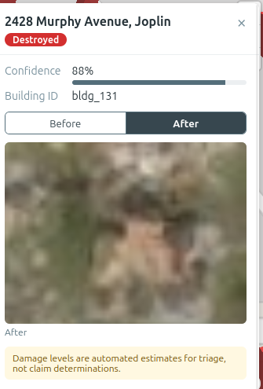
Screenshots (Continued)

