Slide 1

分析家族健康資料
報 告 人 ： 邱郁涵 (A6409001)
指 導 老 師 ： 鄭美龍 老師
2019.06.11

Slide 2
目錄
I
III
資料清洗
檢討改進
資料蒐集
II
資料圖像
IV

Slide 3

I
資料蒐集

Slide 4
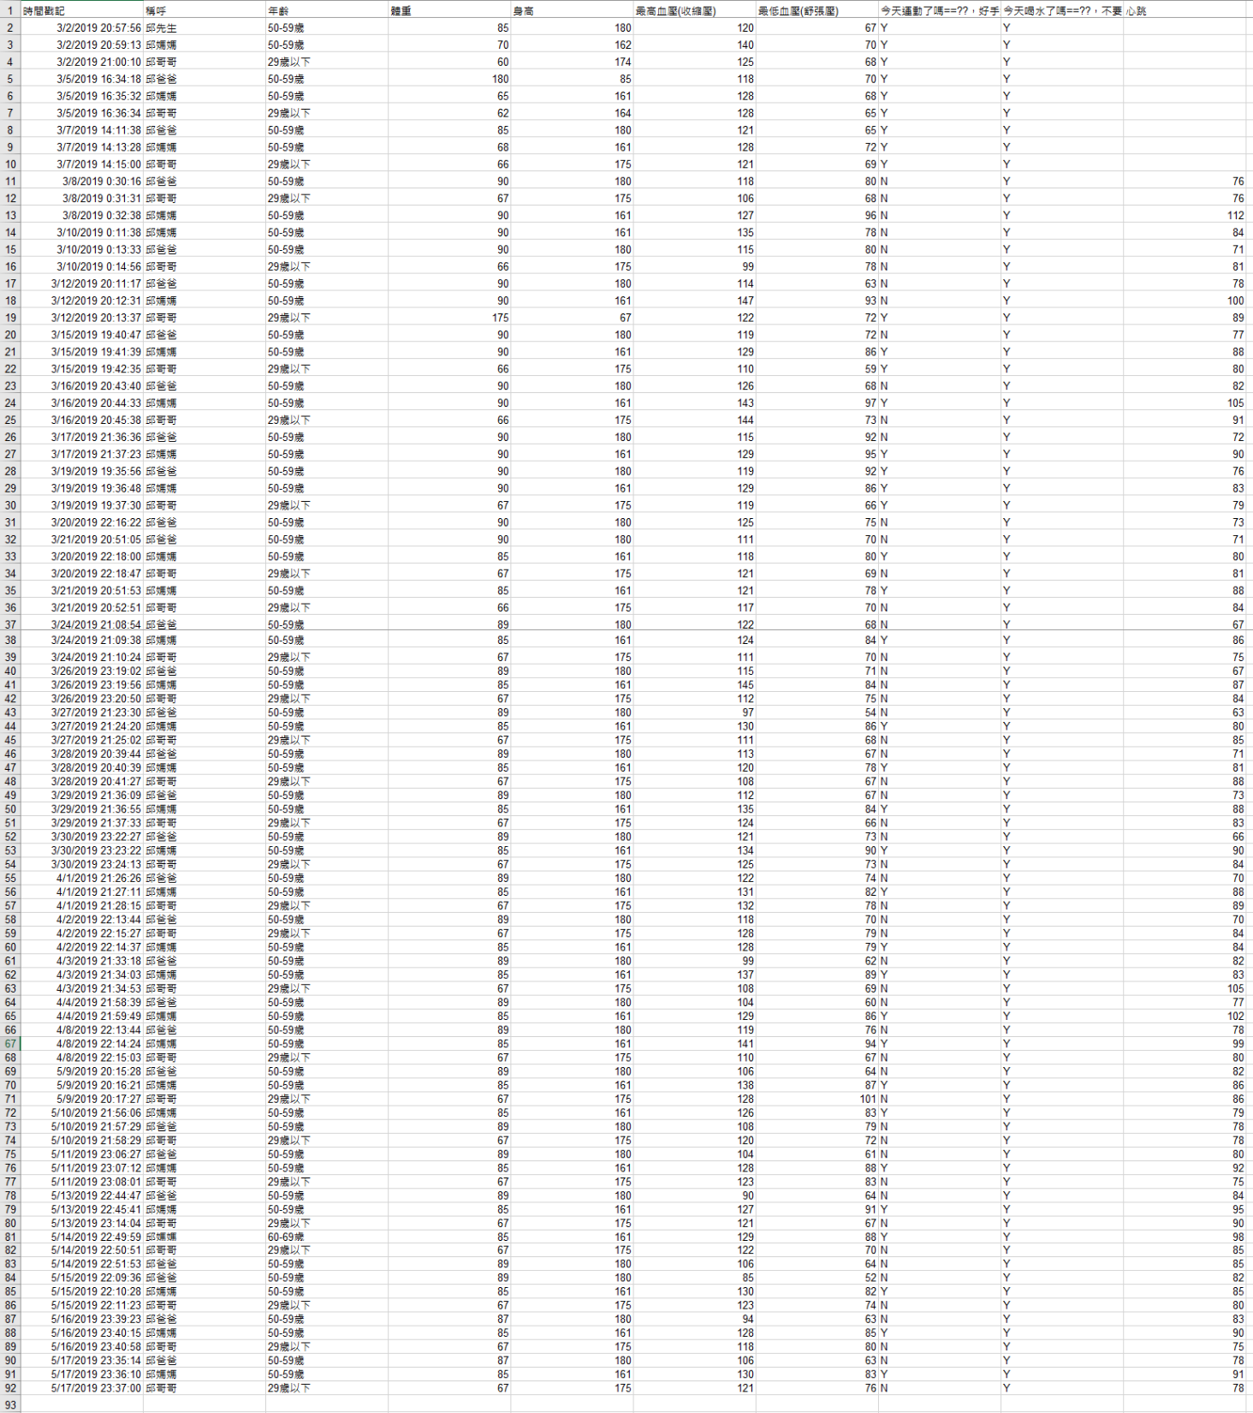
I
資料蒐集
資料蒐集
紀錄範圍：108年3-5月
紀錄平台：Google表單
蒐集項目：身高、體重
血壓、心跳
參與人員：爸媽、哥哥

Slide 5
II
資料清洗

Slide 6
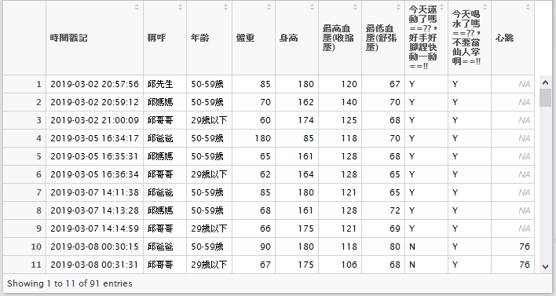

II
資料清洗
LIFE
Click here to add words Click here to add words Click here to add words Click here to add words
Click here to add words Click here to add words Click here to add words Click here to add words

Slide 7
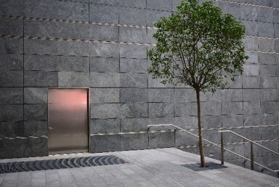
PART ONE
words Click here to add words Click here to add words
Click here to add words Click here to add words Click here to add words Click here to add words
Click here to add words Click here to add words Click here to add words Click here to add words
LIFE

Slide 8
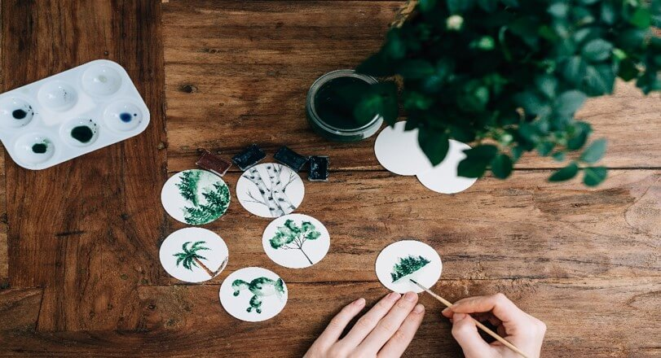

PART TWO
words Click here to add words Click here to add words
LIFE
Click here to add words Click here to add words Click here to add words Click here to add words

Slide 9
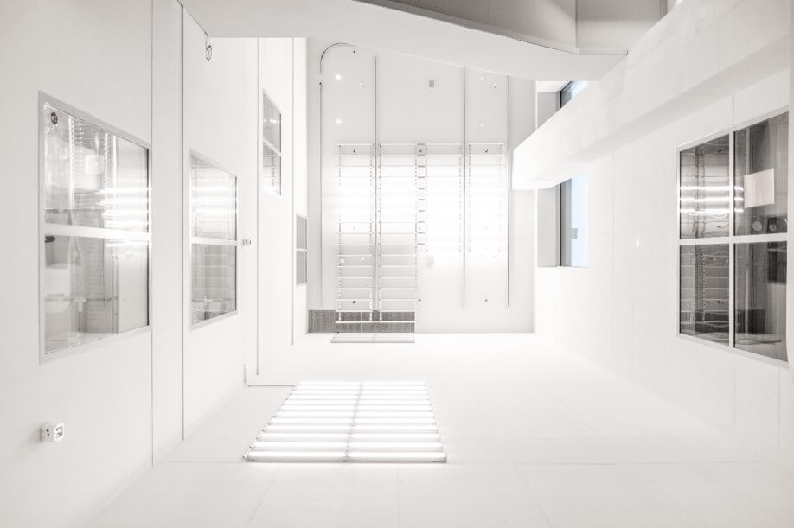
PART TWO
words Click here to add words Click here to add words
Click here to add words Click here to add words Click here to add words Click here to add words
LIFE

Slide 10
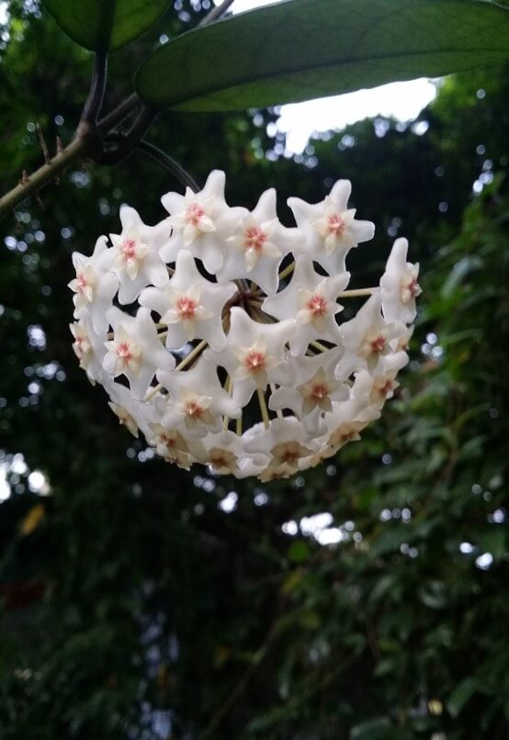
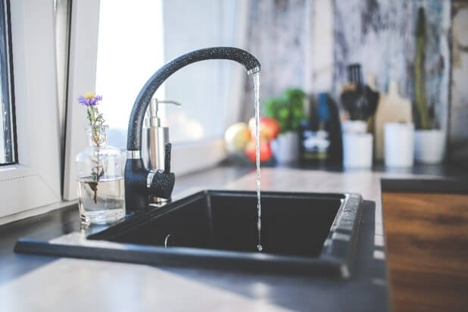
PART TWO
words Click here to add words Click here to add words
Click here to add words Click here to add words Click here to add words Click here to add words
LIFE

Slide 11
PART TWO
words Click here to add words Click here to add words
Click here to add words Click here to add words Click here to add words Click here to add words
LIFE

Slide 12
PART THREE
words Click here to add words Click here to add words

Slide 13

PART THREE
words Click here to add words Click here to add words
MY LIFE
LIFE
Click here to add words Click here to add words Click here to add words Click here to add words

Slide 14

PART THREE
words Click here to add words Click here to add words
Hello
Click here to add words Click here to add words Click here to add words Click here to add words

Slide 15
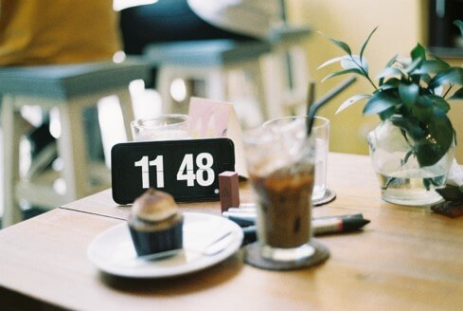
PART THREE
words Click here to add words Click here to add words
Click here to add words Click here to add words Click here to add words Click here to add words

Slide 16
PART FOUR
words Click here to add words Click here to add words

Slide 17


PART FOUR
words Click here to add words Click here to add words
Click here to add words Click here to add words Click here to add words Click here to add words
LIFE
LIFE
Click here to add words Click here to add words Click here to add words Click here to add words

Slide 18

PART FOUR
words Click here to add words Click here to add words
LIFE
Hello
Click here to add words Click here to add words Click here to add words Click here to add words

Slide 19

PART FOUR
words Click here to add words Click here to add words
LIFE
Click here to add words Click here to add words Click here to add words Click here to add words

Slide 20
Bye
Click here to add words Click here to add words Click here to add words Click here to add words
2019.03.31

