Slide 1
PART IV
資料預處理
(Data Pre-processing)
編撰者：許志華
文化大學應用數學系
115/11/07

Slide 2
Data Preprocessing的意義
Real-world databases are highly susceptible
  Noise: errors, outlier values that deviate from expected
  Missing
  Incomplete: lacking attribute values or certain attributes of interest
  Inconsistent
Data Preprocessing的目的
  To help improve the quality of the data
  精確定義可以量化的數據以減少錯誤的判斷發生
115/11/07

Slide 3
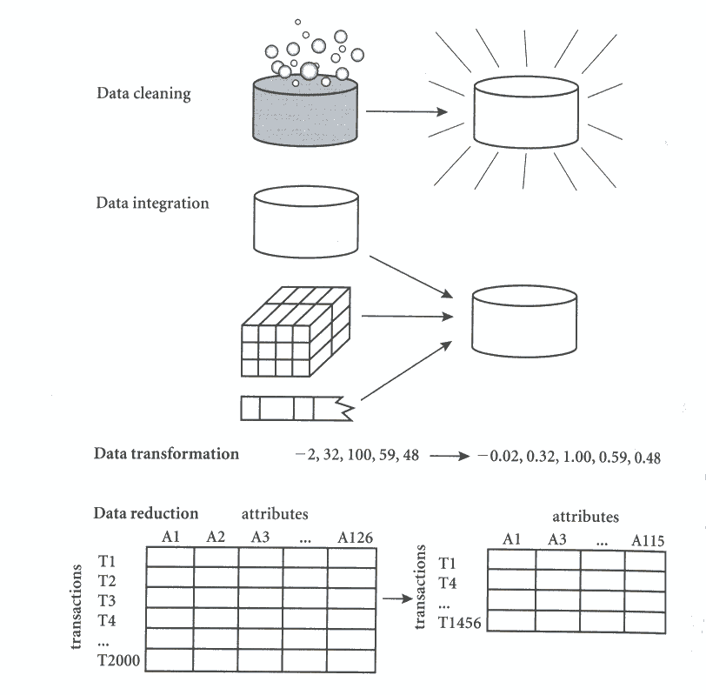
Data Preprocessing的型式
115/11/07

Slide 4
Data Preprocessing的型式
Data Cleaning
Data integration
Data transformation
Data reduction
115/11/07

Slide 5
Data Cleaning
Data Cleaning的意義
  Attempt to fill in missing values, smooth out noise while identifying outliers, and correct inconsistencies in the data.
Data cleaning 的方法
  Missing values
  Noisy data
    Noise is a random error or variance in a measured variable.
115/11/07

Slide 6
處理 Missing values 的方法
Ignore the tuple
Using a global constant to fill in the missing value
  Such as a label like “Unknown”
Use the attribute mean to fill in the missing value
Use the attribute mean for all samples belonging to the same class as the given tuple
Use the most probable value to fill in the missing value
115/11/07

Slide 7
Example
No. | A | B | C | D | E
1 | 0.3 | 1 | 0.3 | 5 | T
2 | 0.4 | 2 | 0.7 |  | F
3 | 0.1 |  | 0.8 | 3 | T
4 | 0.4 | 2 | 1.1 | 3 | T
5 | 0.2 | 3 | 1.2 | 4 | F
115/11/07

Slide 8
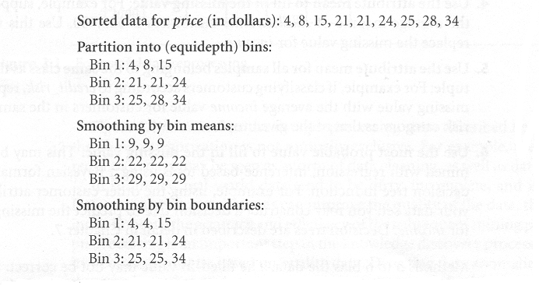
處理 Noisy data的方法
Binning
Clustering
  Outliers may be detected by clustering, where similar values are organized into groups, or clusters.
Combined computer and human inspection
Regression
115/11/07

Slide 9
Data integration
Data integration的意義
  Combines data from multiple sources to form a coherent data store.
Data integration的方法
  Correlation analysis
  Data conflict detection
115/11/07

Slide 10
Data transformation
Data transformation的意義
  Convert the data into appropriate forms for mining.
Data transformation的方法
  Smoothing: remove the noise from data
  Aggregation: summary or aggregation operations are applied to the data
  Normalization: where the attribute data are scaled so as to fall within a small specified range, such as -1.0 to 1.0, or 0.0 to 1.0.
  Attribute construction: new attributes are constructed and added from the given set of attributes to help the mining process
115/11/07

Slide 11
Data reduction
Data reduction
  to obtain a reduced representation of the data set that is much smaller in volume, yet closely maintains the integrity of the original data.
  Mining on reduced data set should be more efficient yet produce the same analytical results.
115/11/07

Slide 12
Methods of data reduction
Data cube aggregation
Dimension reduction
Data compression
115/11/07

Slide 13
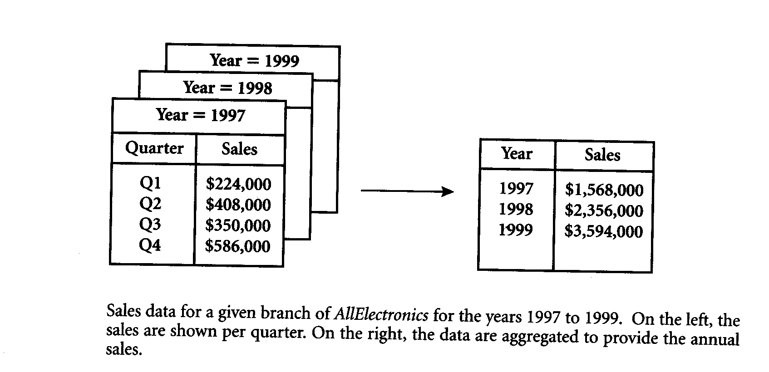
Data cube aggregation
115/11/07

Slide 14
Dimension reduction
Irrelevant, weakly relevant, or redundant attributes or dimensions may be deleted and removed
Heuristic methods of attribute subset selection
  Stepwise forward selection
  Stepwise backward selection
  Decision tree induction
115/11/07

Slide 15
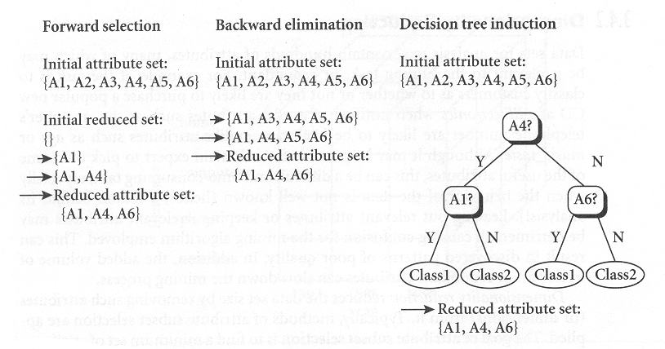
Dimension reduction的方法
115/11/07

Slide 16
Data compression
Encoding mechanisms are used to reduce the data set size
Data compression的方法
  Wavelet transforms
  Principal components analysis
115/11/07

