Slide 1
Tutorial Week 6
ACID --- Isolation
Nest transactions
Flat transactions

Slide 2
Question 1

Slide 3
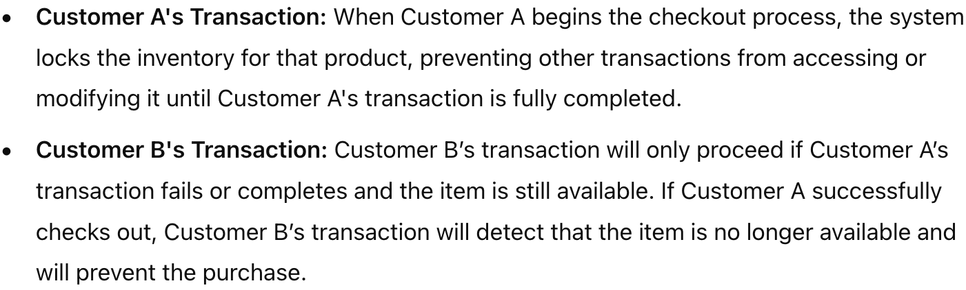
Question 1
Online shopping platform
Example: Customer A and B add the item to their cart and proceed to checkout closely.
Problem: When A is checking out, B still sees the item as available, which may lead to overselling.
Add isolation (All-or-Nothing Visibility / preventing overselling):

Slide 4
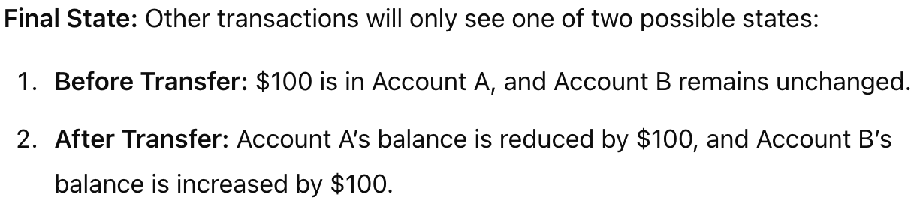
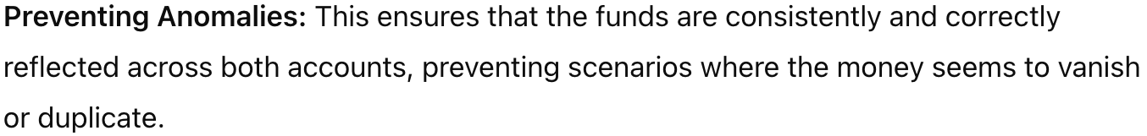
Question 1
Online banking system
Add isolation:
Benefits:

Slide 5
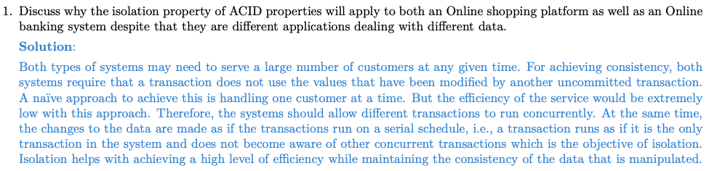
Question 1

Slide 6
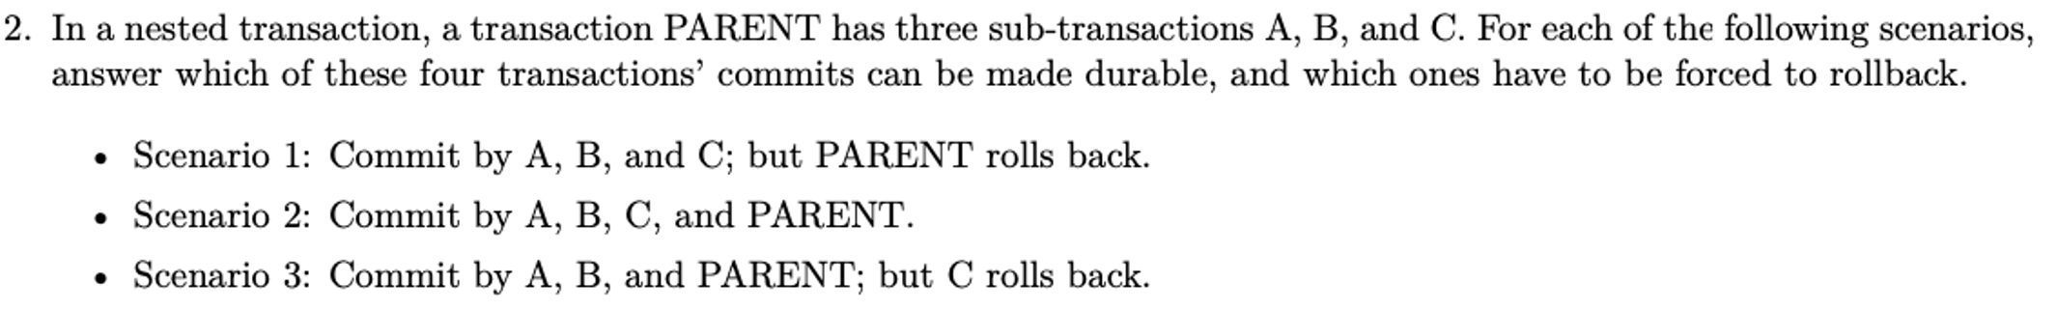
Question 2

Slide 7
Nested transaction
rules
commit cannot take place unless the parent itself commits
Sub-transactions have A, C, and I properties but not D property unless all their ancestors commit
Commit of a sub-transaction makes its results available only to its parents
Parents should not modify objects while children are accessing them

Slide 8
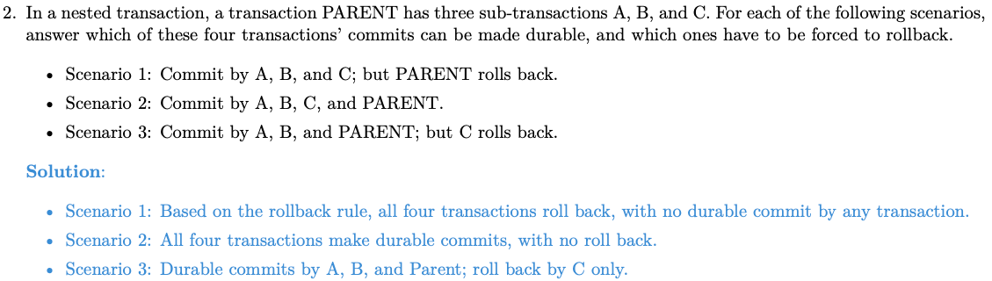
Question 2

Slide 9
Question 3

Slide 10
Transaction Processing Monitor
TPMs manage the transfer of data between clients and servers
breaks down applications or code into transactions and ensures that all databases are updated properly
It also takes appropriate actions (roll back / notification) if any error occurs

Slide 11
Question 3
An error in a single process can affect all transactions being processed, leading to system disruptions. This could lead to poor performance as well as monitors of different transactions cannot be distributed either.
To address this risk, it's essential to use redundancy, distributed architectures, and robust error-handling mechanisms to ensure system reliability and minimize the impact of errors.

Slide 12
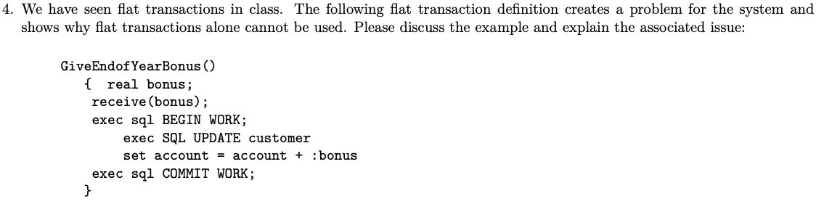
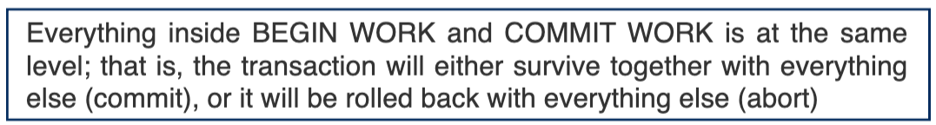
Question 4
Flat transaction =

Slide 13
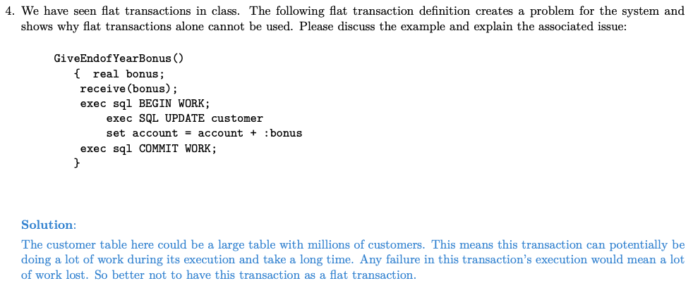
Question 4

Slide 14
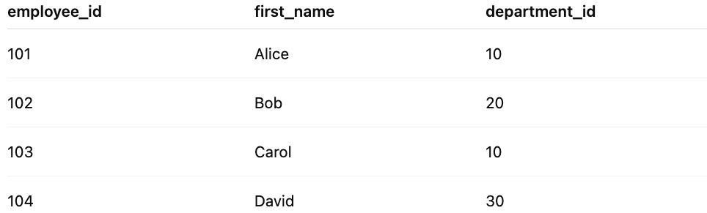
Question 5
singleton select: use department_id
Only one row is returned
Fast and simple
Safe for single-row operations
cursor: use department_id
Handle multiple rows, one at a time
Can loop through all matching rows
Memory efficiency for large database

Slide 15
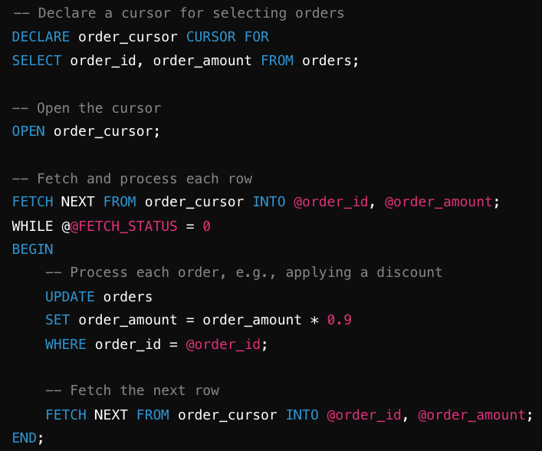
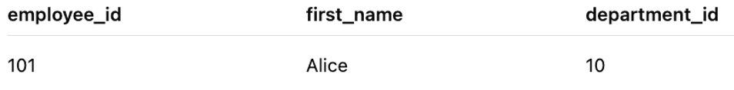
Question 5

Slide 16
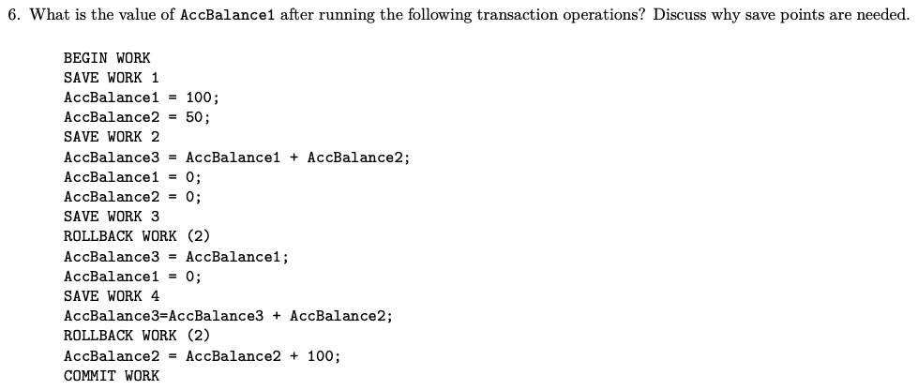
Question 6

Slide 17
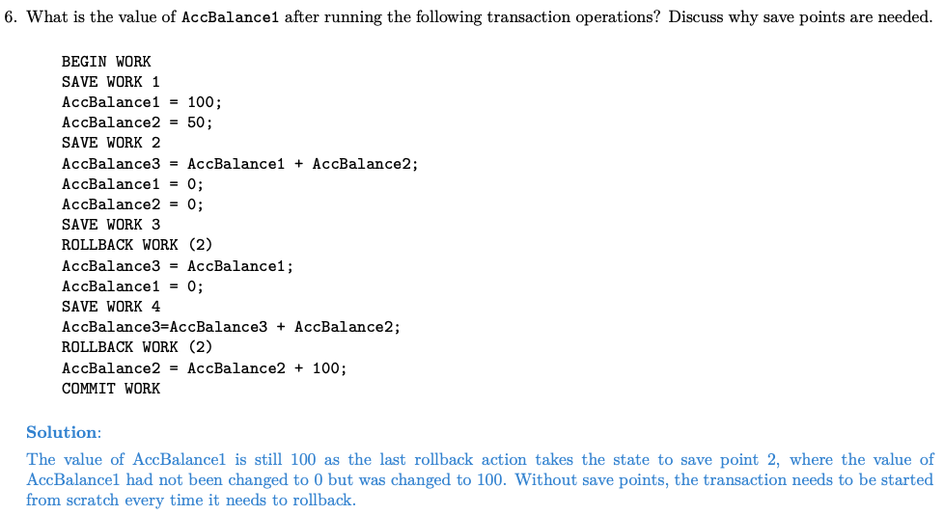
Question 6

Slide 18
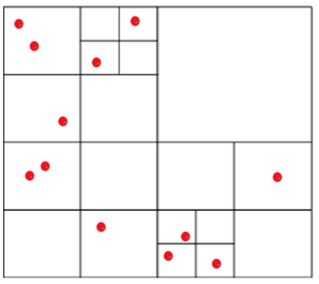
Question 7

Slide 19
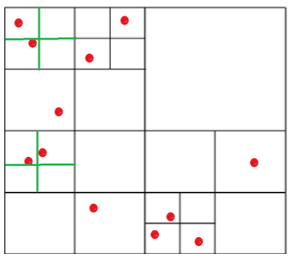
Question 7

