Slide 1
Tutorial Week 7
Isolation
Deadlock

Slide 2
Question 1

Slide 3
Question 1
we are not benefiting from the potential use of resources
even under single CPU situations, concurrency can speed up things (use the CPU waiting time to do other tasks)
if there is a long-running transaction in the system, holding up every other transaction till that long one finish
(not efficient)

Slide 4
Question 2

Slide 5
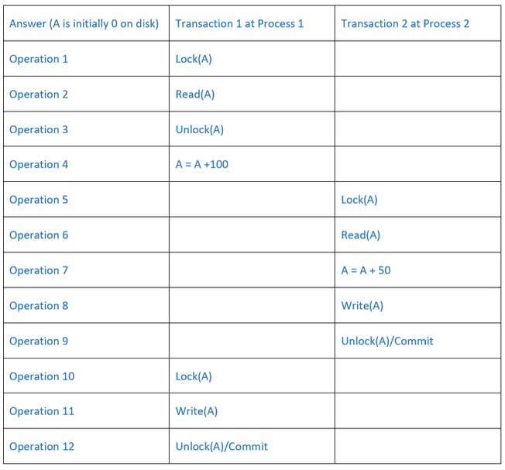
Question 2
Does not obey the Isolation property. Thus, we need something more for proper concurrency control in DBMSs.
How to solve it:
Use a higher isolation level (serializable): making transactions appear as if they are executed one after the other, rather than concurrently
Strict two-phase locking: a transaction holds all its exclusive (write) locks until it commits or aborts

Slide 6
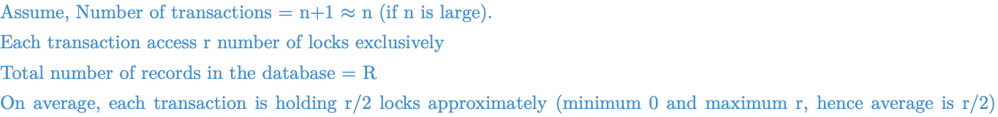
Question 3

Slide 7
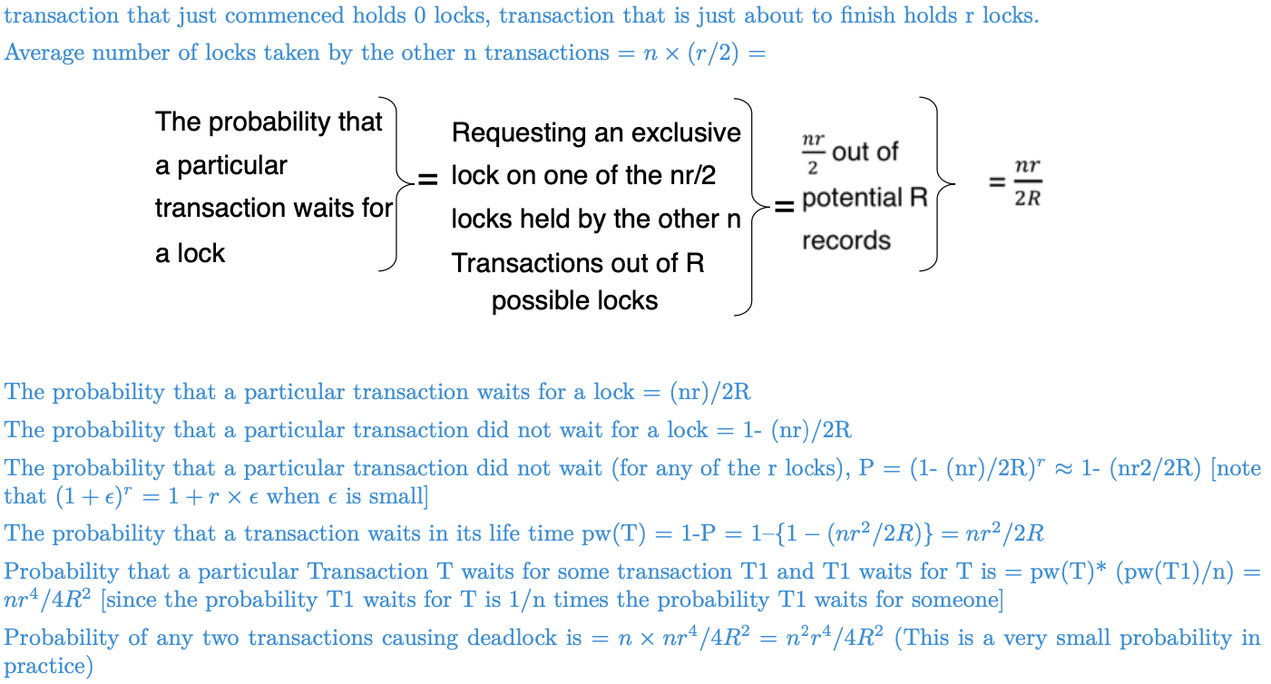
Question 3

Slide 8
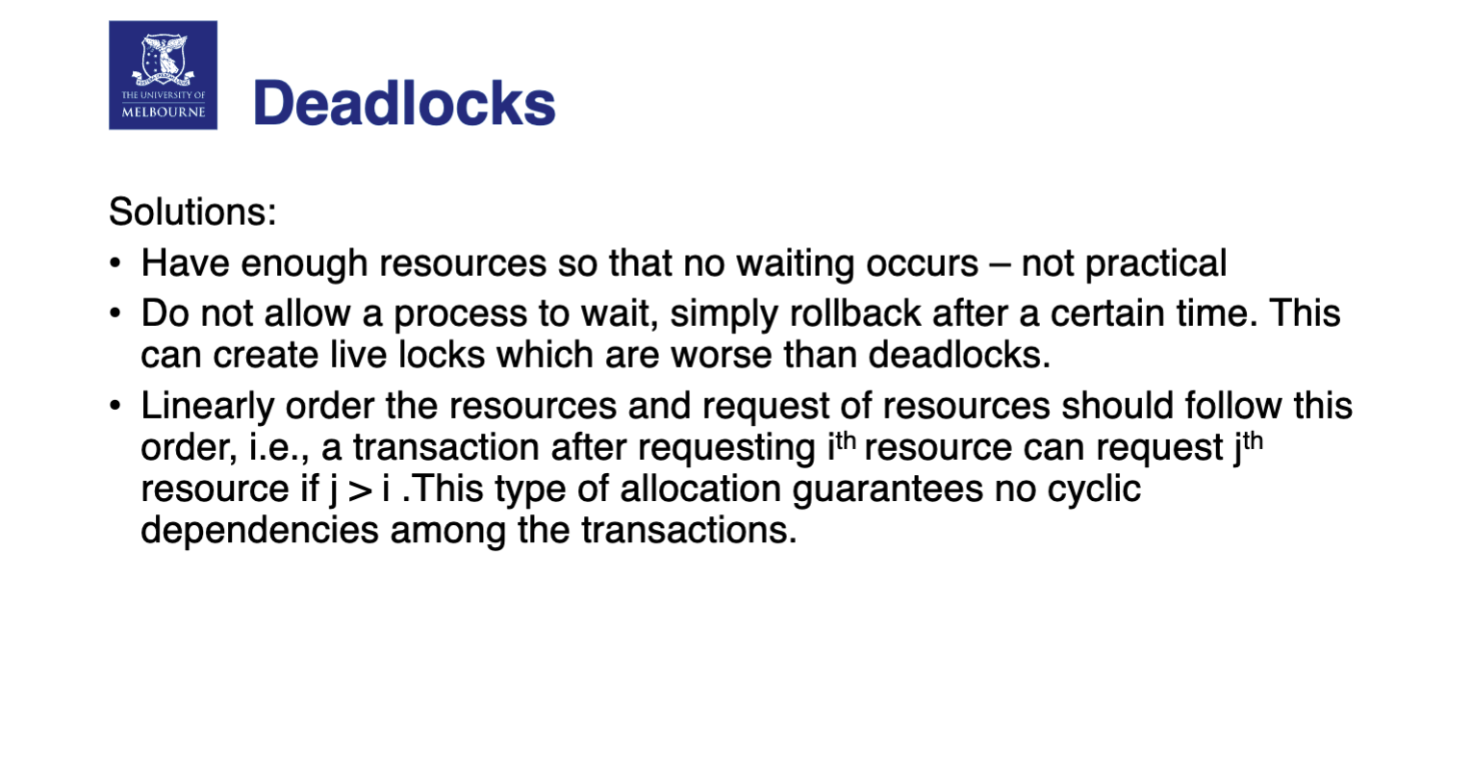
Question 3

Slide 9
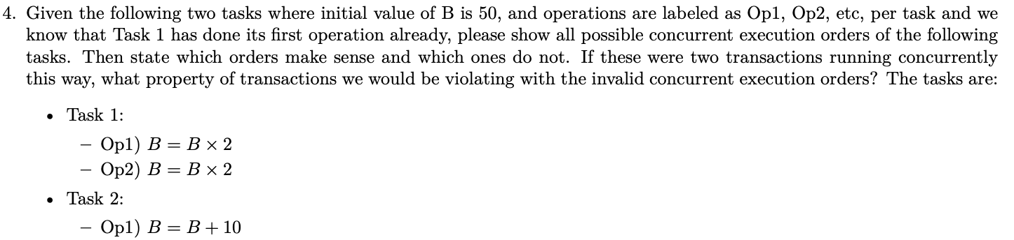
Question 4

Slide 10
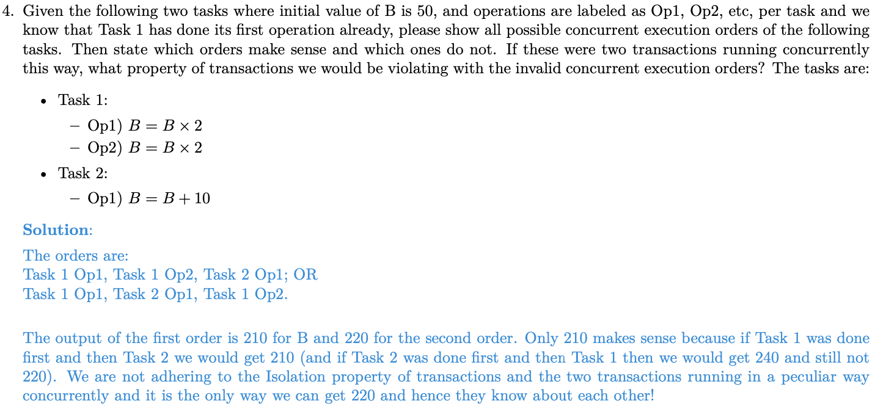
Question 4

Slide 11
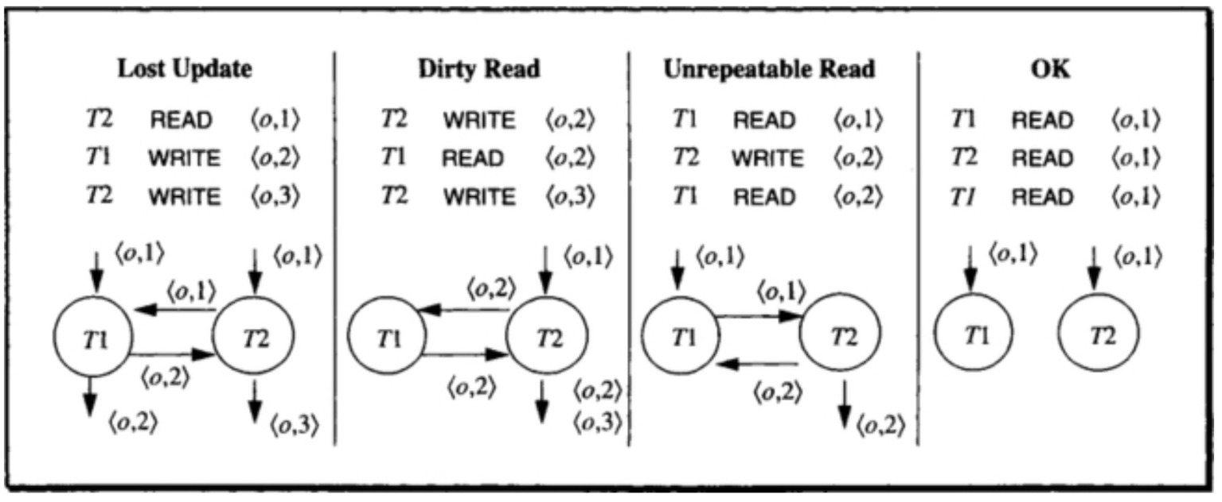
Question 4
Possible dependencies

