Slide 1
Week 3 tutorial
Exercise 2 (query optimization plan / nested loop join)
https://github.com/QINGTANS/ADB_tutorial_slides_2026_S1

Slide 2
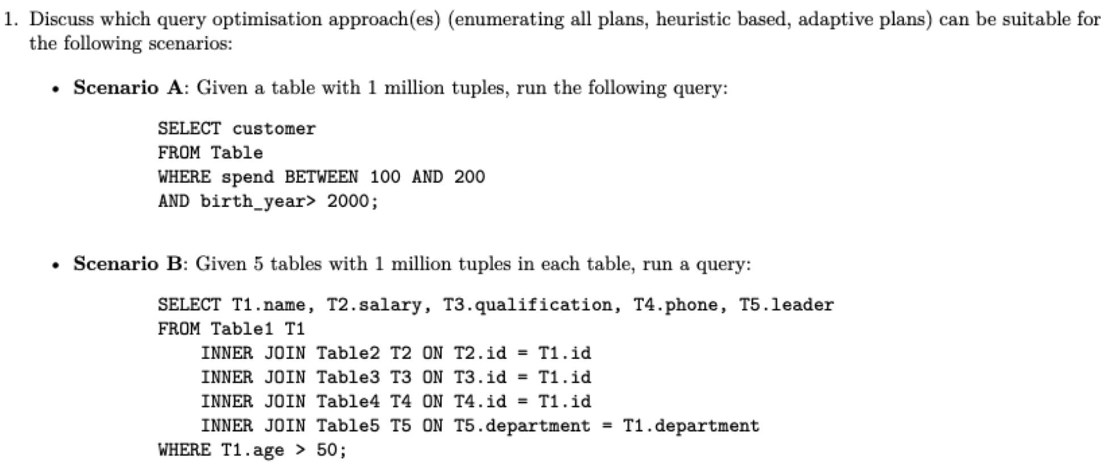
Question 1

Slide 3
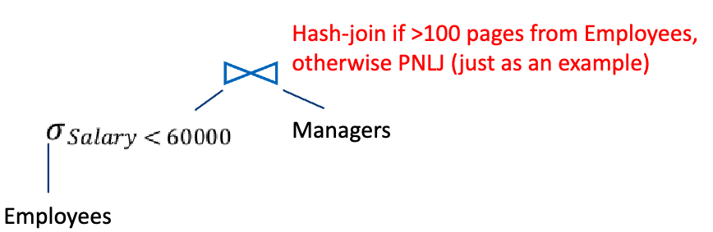
Question 1
Query optimization approaches: heuristic based / enumerating all plans / adaptive plans
heuristic based: Heuristic optimization transforms the query-tree by using a set of rules that typically (but not in all cases) improve execution performance
enumerating all plans: get all query plans, evaluate the cost of each plan, choose the cheapest one
adaptive plans: Wait for one/some parts of a plan to execute first, then choose the next best alternative (re-evaluate the cost of other parts)

Slide 4
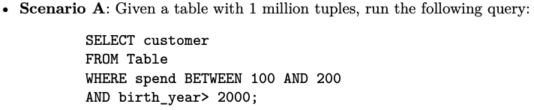
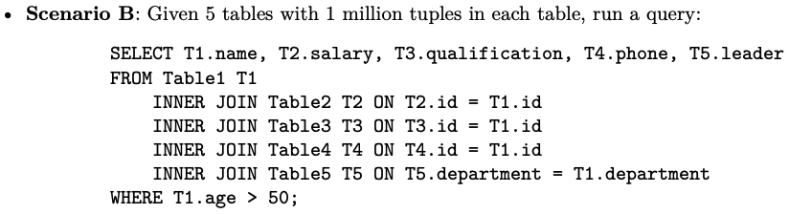
Question 1
heuristic based / enumerating all plans / adaptive plans

Slide 5
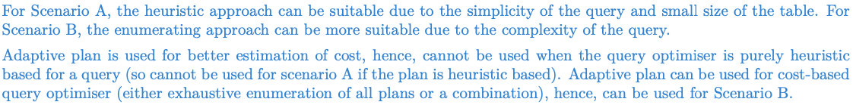
Question 1
Methods | Suitable conditions
heuristic based | Useful for simpler cases / indexes
enumerating approach | Useful for complex queries or large tables where various strategies need to be considered
adaptive plan | Useful when data distribution is uncertain, and dynamic adjustments can optimize performance

Slide 6
Question 2

Slide 7
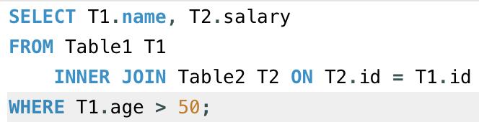
Question 2
After insertions and deletions, the statistics of a table may not be updated instantly.
T1.name | T1.age
A | 20
B | 30
C | 51
T1.name | T1.age
D | 53
E | 55
C | 49

Slide 8
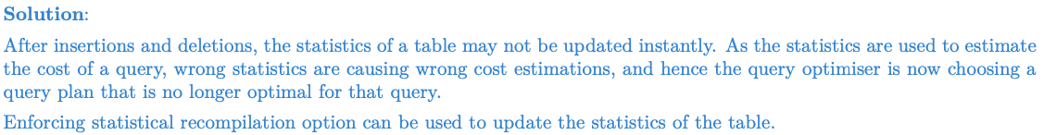
Question 2
Question: After insertion and deletions, will the heuristic-based plan change?

Slide 9
Question 3

Slide 10
Question 3

Slide 11
Question 4

Slide 12
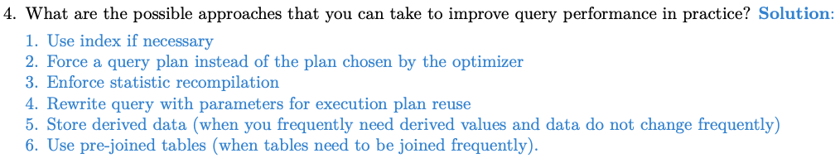
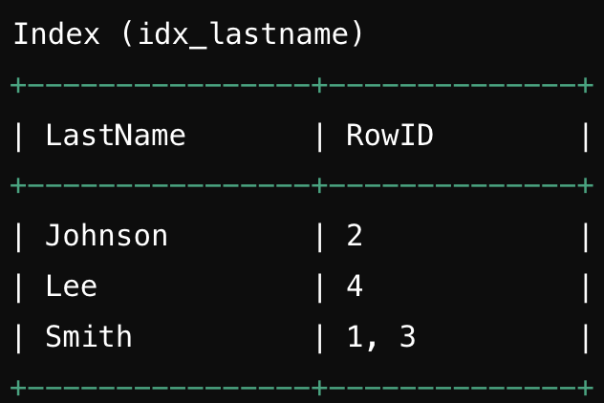
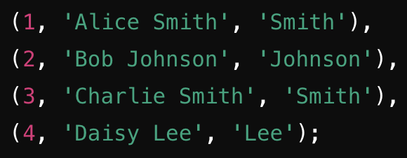
Question 4
1. Use index
Example

Slide 13
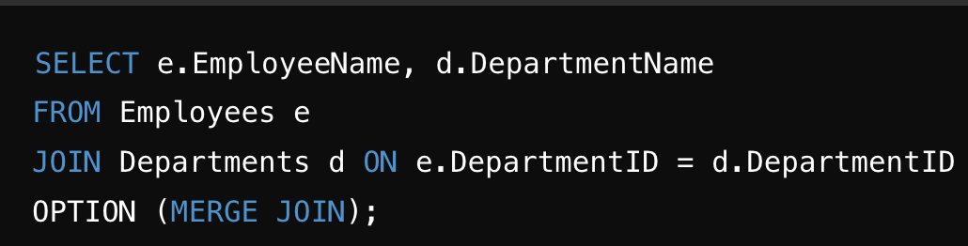
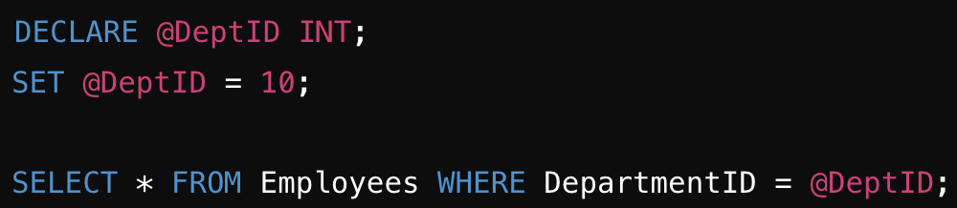
Question 4
2. Force a query plan instead of chosen by the optimizer
3. Enforce statistic recompilation: discussed in Q2
4. Rewrite query with parameters for execution plan reuse
Using parameters allows SQL Server to reuse execution plans, reducing overhead and improving performance.

Slide 14

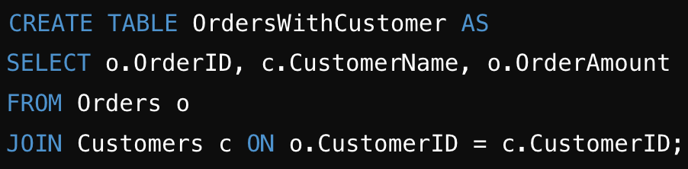
Question 4
5. Store derived data
Reduces the need to perform aggregation calculations, improving query performance.
6. Use pre-joined tables
Reduces the need to repeatedly perform joins, speeding up queries that require this information.

Slide 15
Question 5

Slide 16
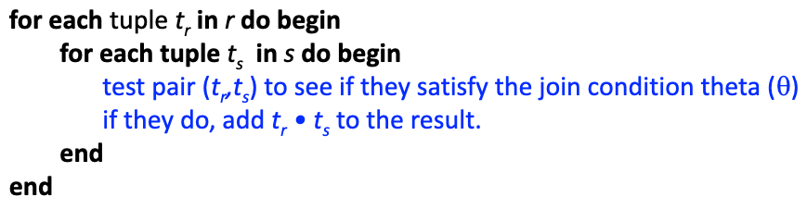

Question 5
A Simple Nested-Loop Join
r is called the outer relation and s is the inner relation of the join.
Page access:
Seek time: br + nr

Slide 17
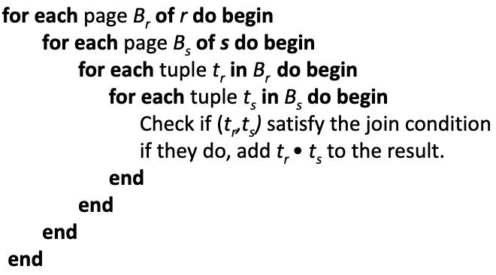

Question 5
Page-Oriented Nested-Loop Join
Page access:
Seek time: 2*br

