Slide 1
Tutorial Week 2
Briefly introduce myself
Workshop questions
Group project (if we still have time)

Slide 2
about me
Qingtan
Ph.D. in School of Computing and Information Systems
Email: qingtan.shen1@unimelb.edu.au

Slide 3
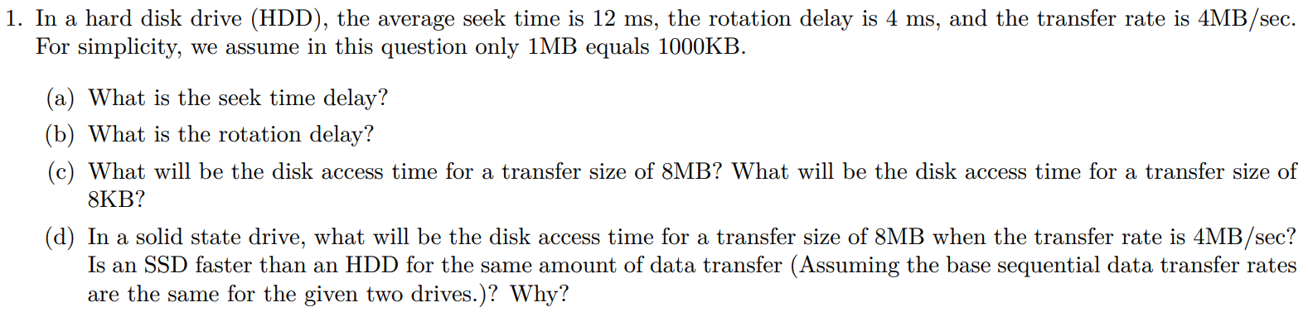
Question 1

Slide 4
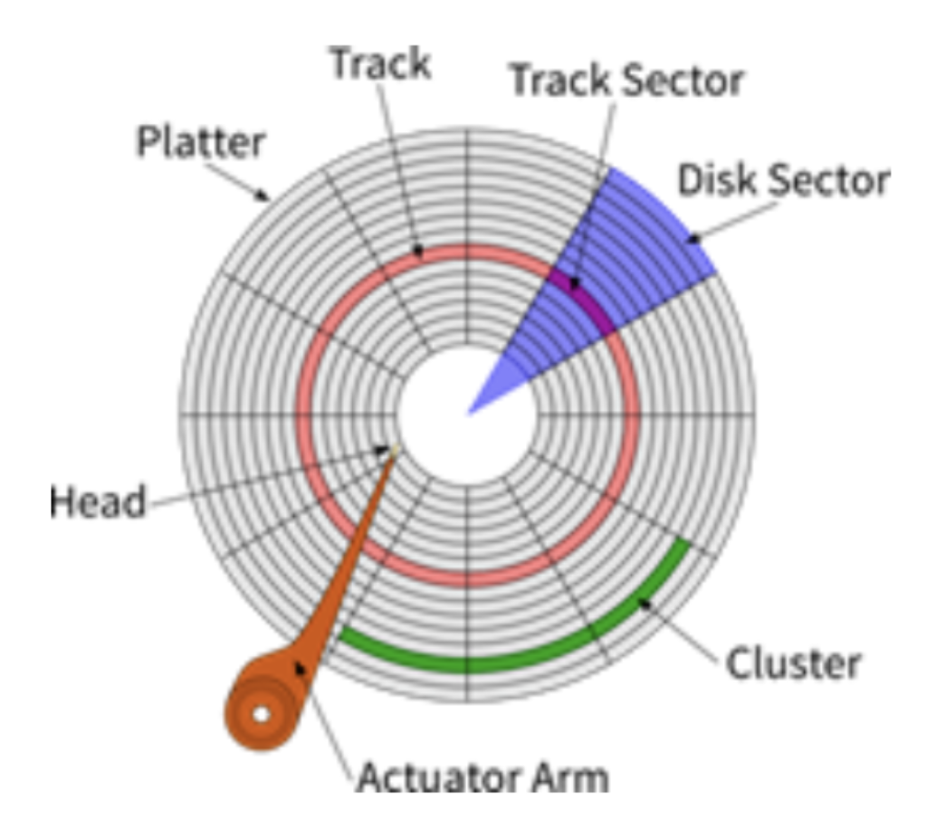
Question 1
hard disk drive (HDD)
Definitions of (sector / track / cluster)
Seek time delay
The period that the head of the arm moves from a position
to a required track.
Rotate time delay
The waiting period that the rotation of the disk brings the required
track sector to the head of the arm.
Is it possible: (Seek time+Rotate time = 0)?
solid state drive (SSD): There is no seek delay or rotation delay in an SSD.

Slide 5
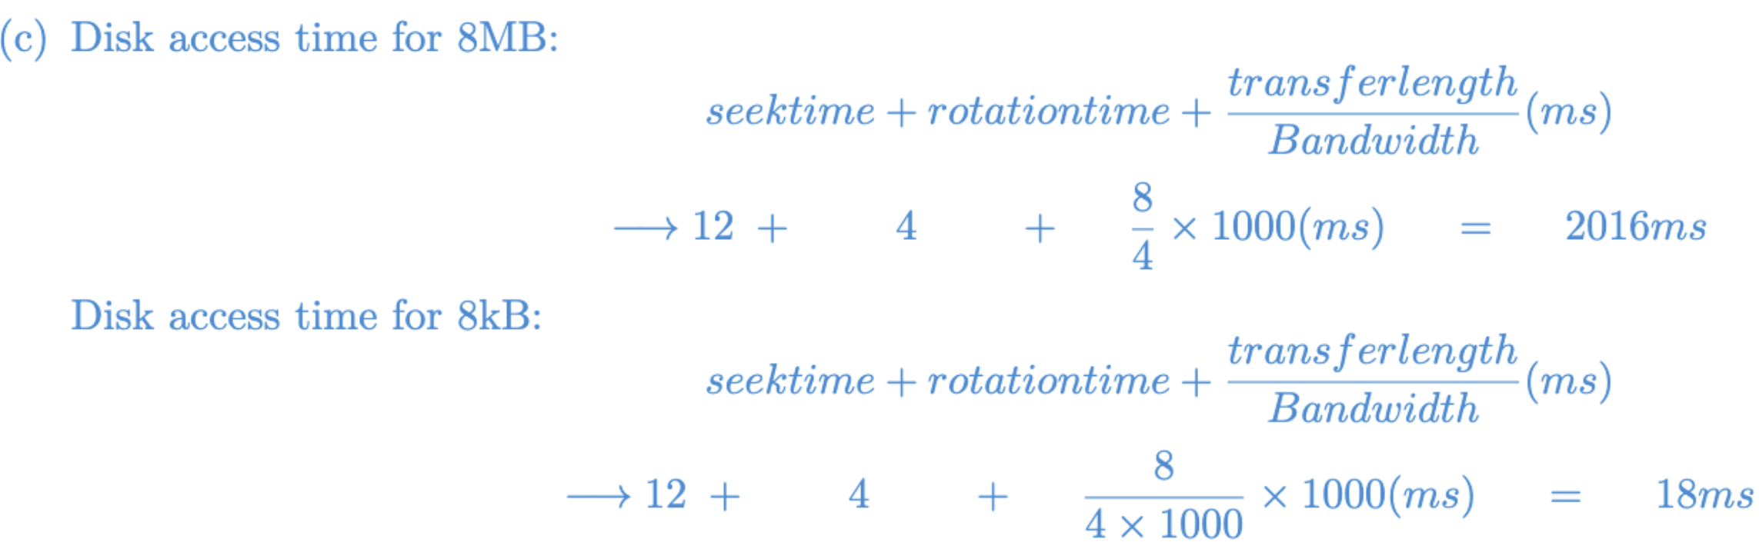
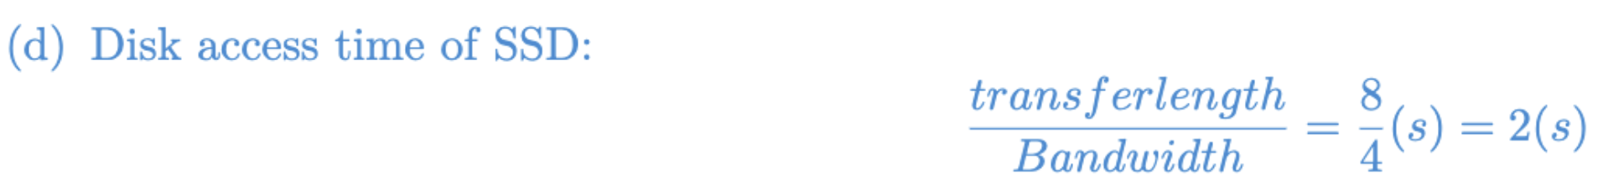
Question 1

Slide 6
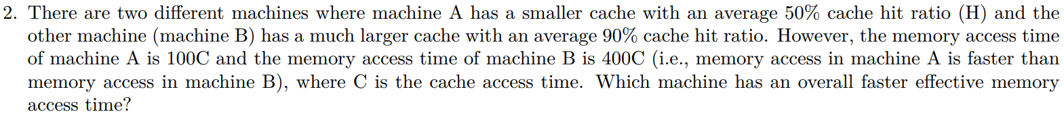
Question 2

Slide 7
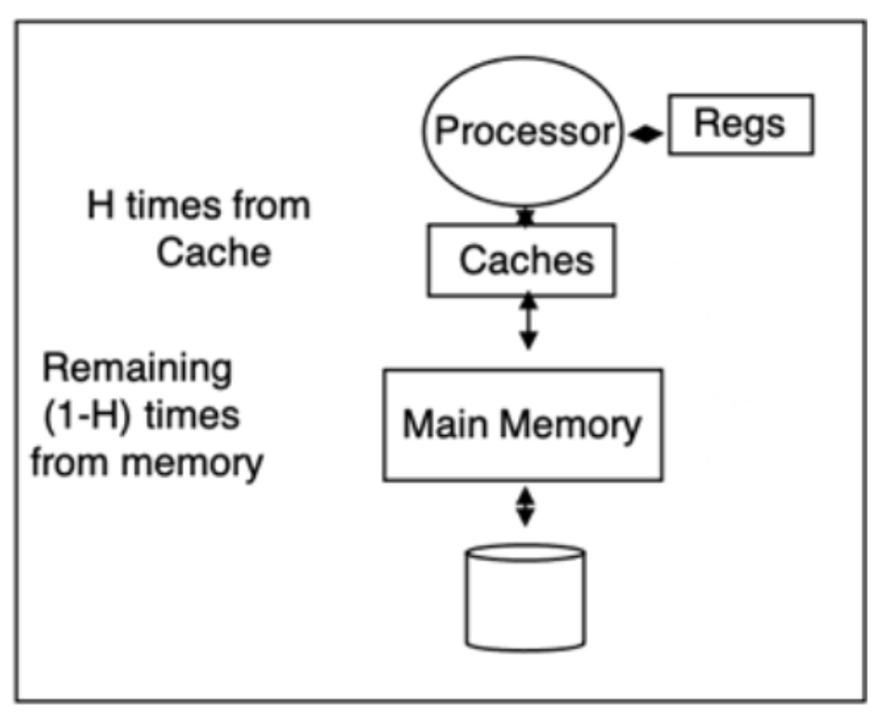
Question 2
Hierarchical Memory Structure
Definitions of (Cache / Main Memory)
Cache: smaller, faster, stores frequently accessed data
Main Memory: larger, slower, primary memory
cache hits ratio

Slide 8
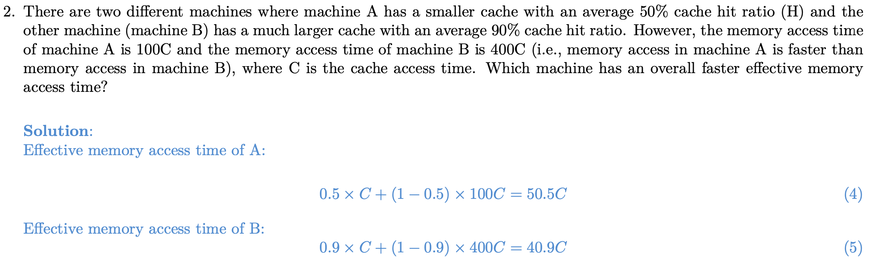
Question 2

Slide 9
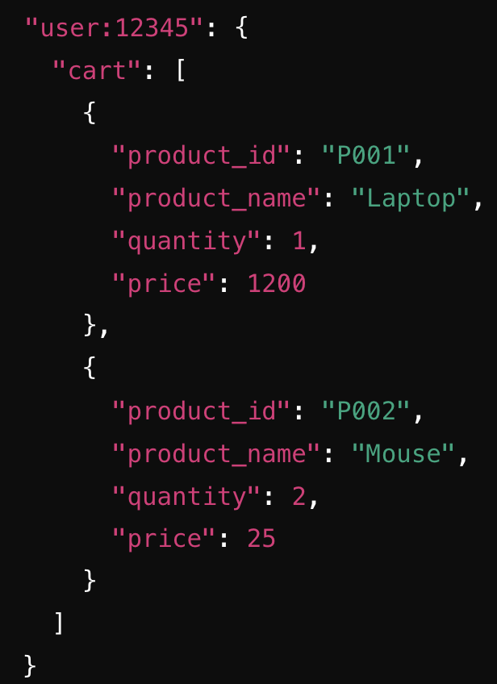
Question 3-4
Main difference between NoSQL and relational database
Key-value database: no need complex relational structure, only key-value pairs
Example:
Advantage: insertion / search fast / scale quickly

Slide 10
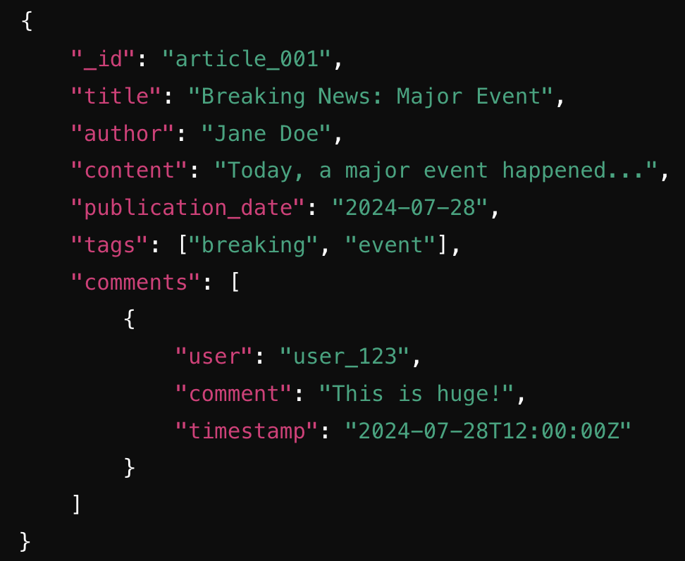
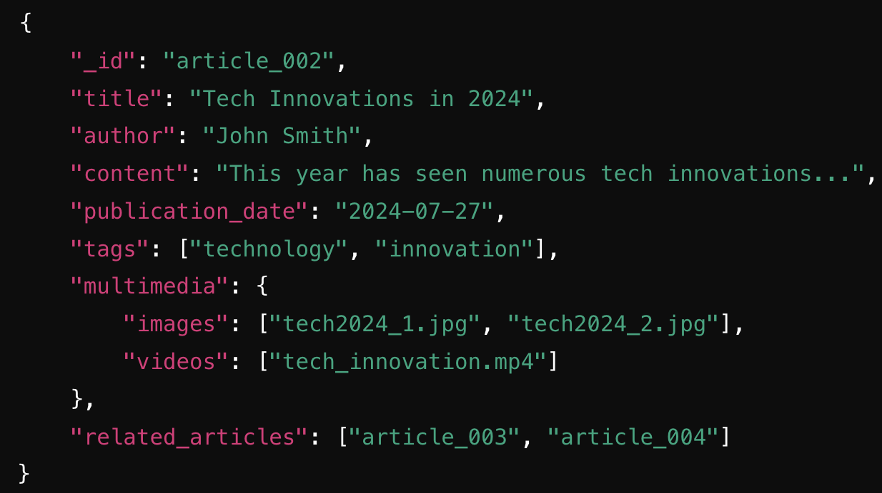
Question 3-4
Document storage:
Example:

Slide 11
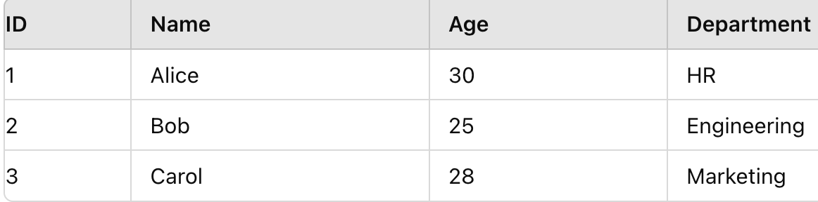
Question 3-4
Column-based NoSQL vs Relational database (Row-based)
Q: How is the data stored in a relational database / column-based NoSQL?

Slide 12
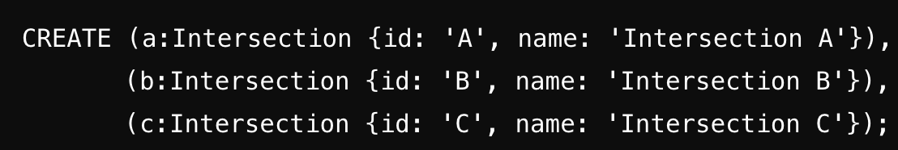
Question 3-4
Graph storage:
Example: Neo4j database

Slide 13
Question 5
Cloud storage vs WWW storage
Centralized vs Distributed
Cloud | WWW
Managed by provider | Require more hands-on requirements
Ideal for backup, disaster recovery, and data-heavy applications | Suited for hosting websites, static content
Centralized | Distributed
Data in single location | Data separated
Easy to manage | Complex due to data distribution, consistency
Central server failure can lead to inaccessible | Higher availability

Slide 14
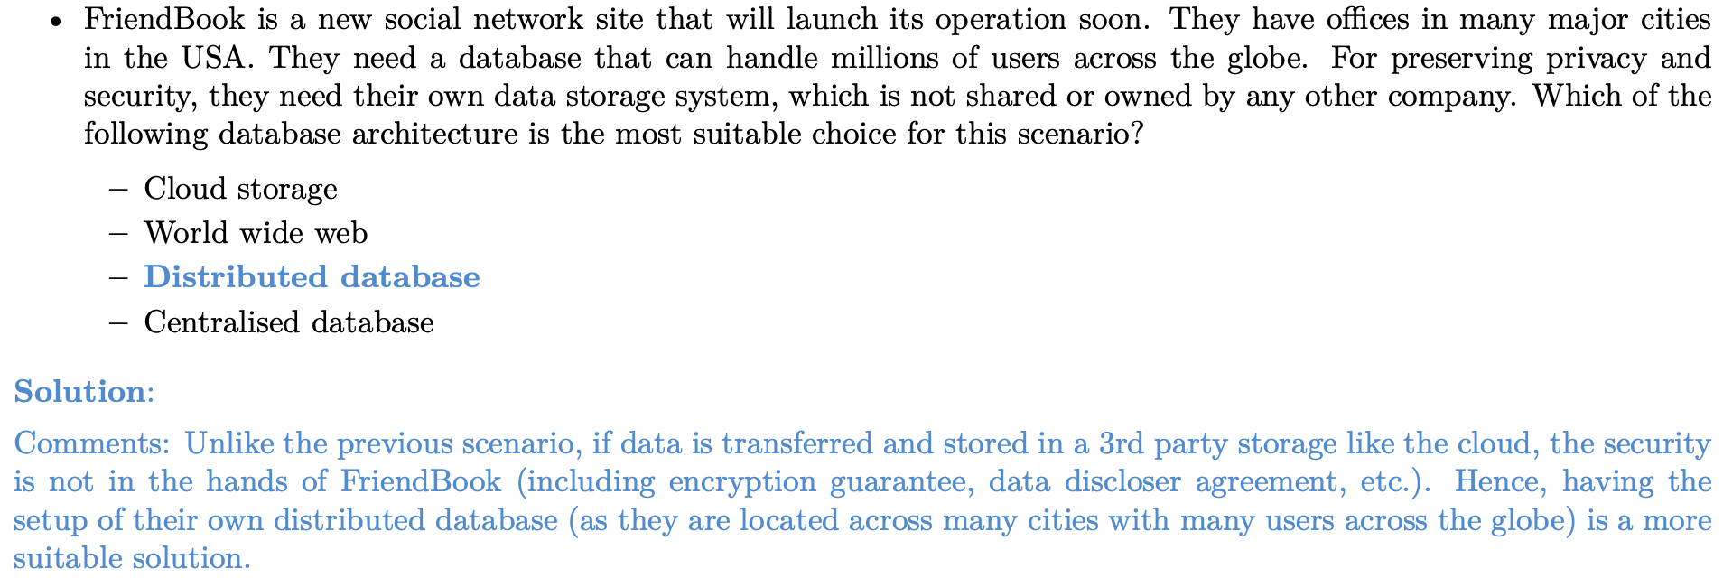
Question 5

