Slide 1
Week 8 tutorial
Deadlock
Dependency graph
Well-formed transactions / Two-phase transactions

Slide 2
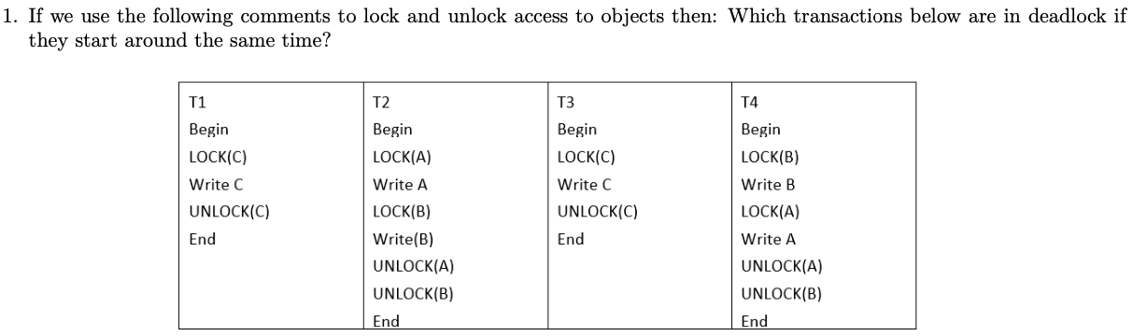
Q1

Slide 3
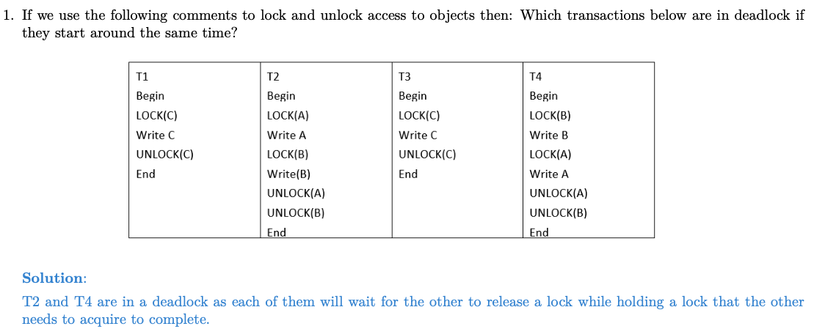
Q1

Slide 4
How to solve deadlock
Solutions:
1. Have enough resources so that no waiting occurs
2. Do not allow a process to wait, simply rollback after a certain time.
3. Linearly order the resources and request of resources should follow this order. This type of allocation guarantees no cyclic dependencies among the transactions.

Slide 5
Q2+Q3

Slide 6
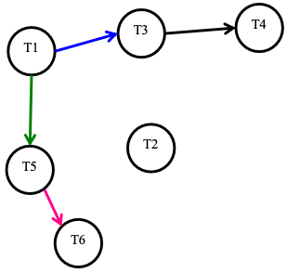
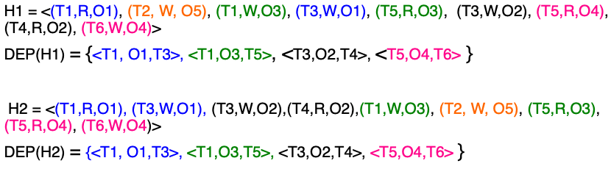
Dependency graph
Equivalence: a given database will end up in exactly
the same final state by executing either of the sequence
of operations in H1 or H2

Slide 7
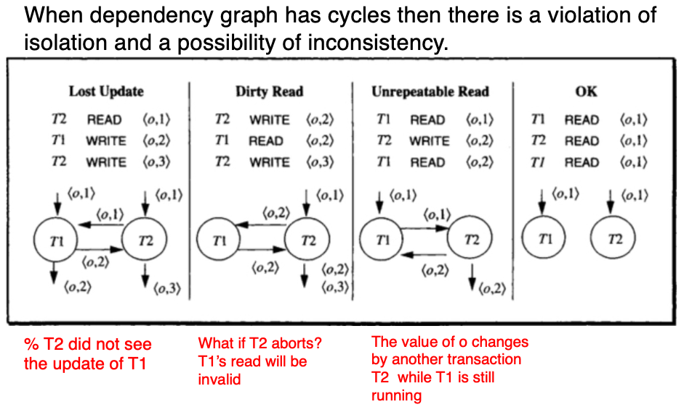
Dependency graph
Dependencies:

Slide 8
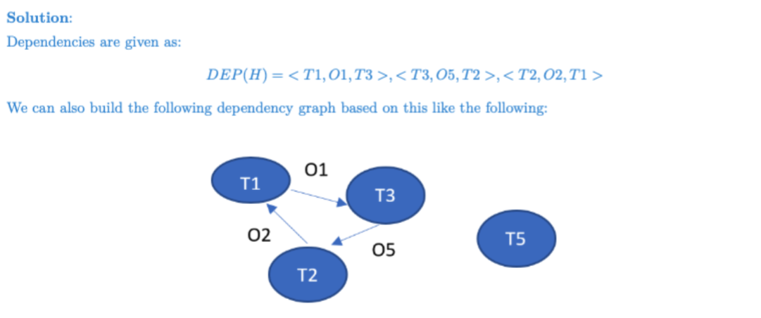
Q2+Q3

Slide 9
Q4
If we have H1= < (T3,W,O5),(T3,W,O1),(T2,R,O5),(T2,W,O2),(T1,R,O1),(T1,R,O2),(T5,R,O4),(T5,R,O3) >,
See whether DEP(H) = DEP(H1)

Slide 10
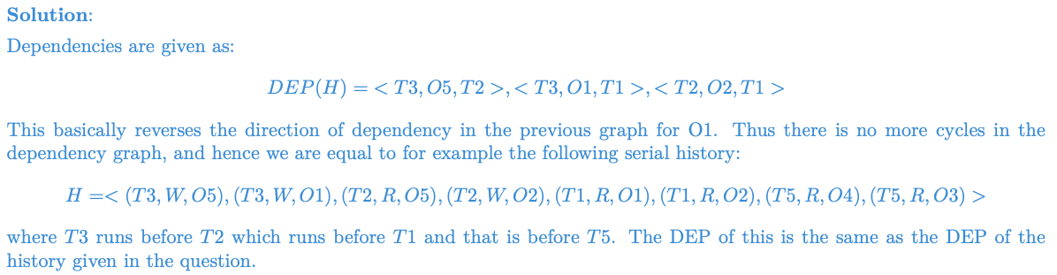
Q4
If we have H1= < (T3,W,O5),(T3,W,O1),(T2,R,O5),(T2,W,O2),(T1,R,O1),(T1,R,O2),(T5,R,O4),(T5,R,O3) >,
See whether DEP(H) = DEP(H1)

Slide 11
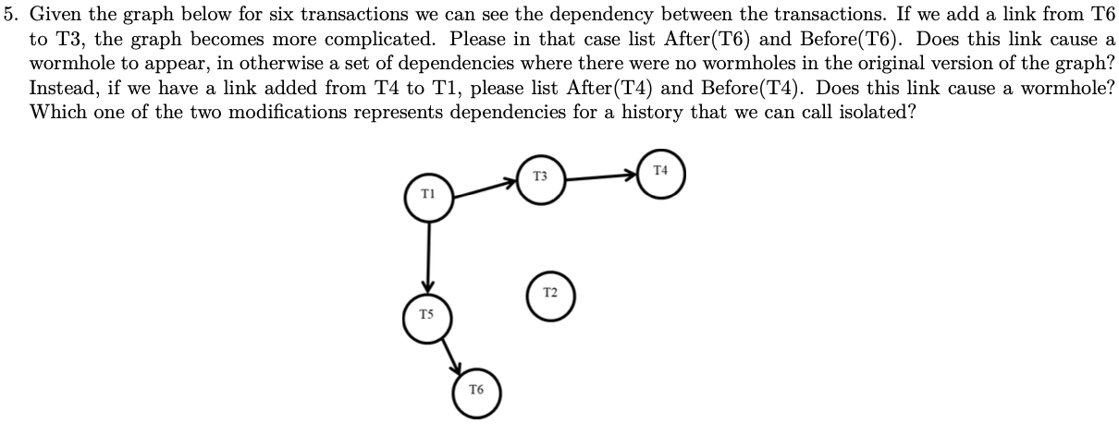
Q5

Slide 12
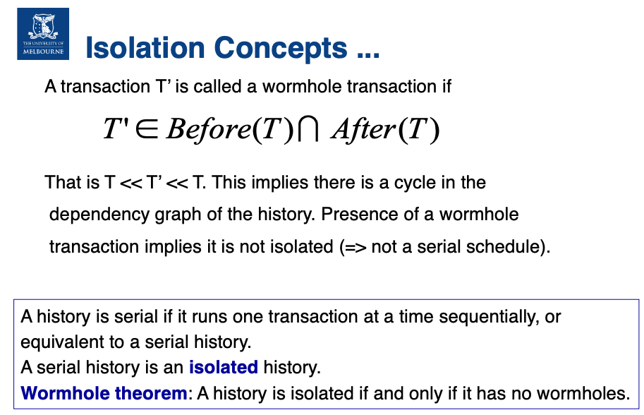
Dependency graph

Slide 13
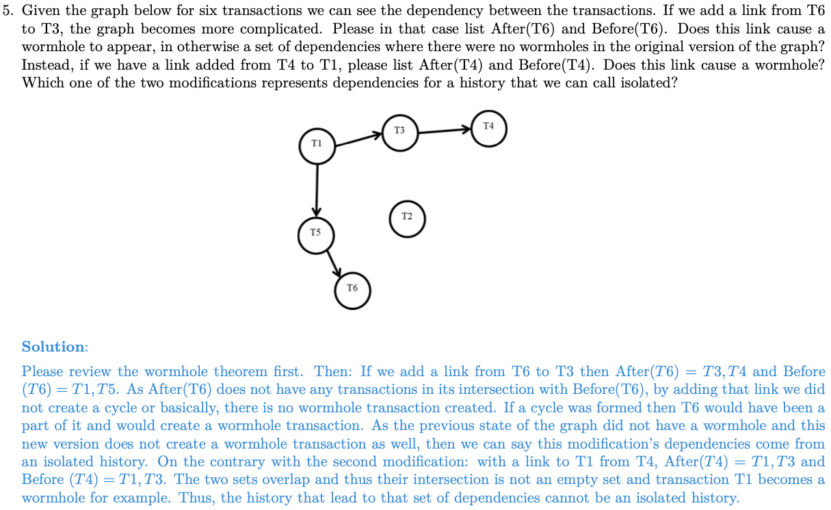

Slide 14
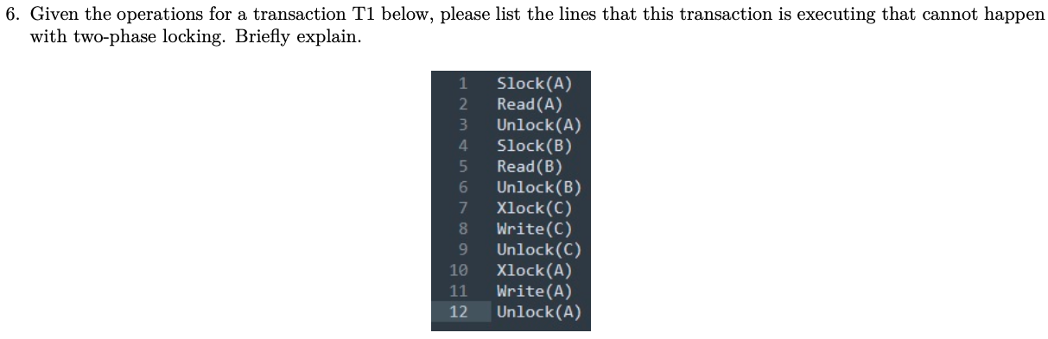
Q6

Slide 15
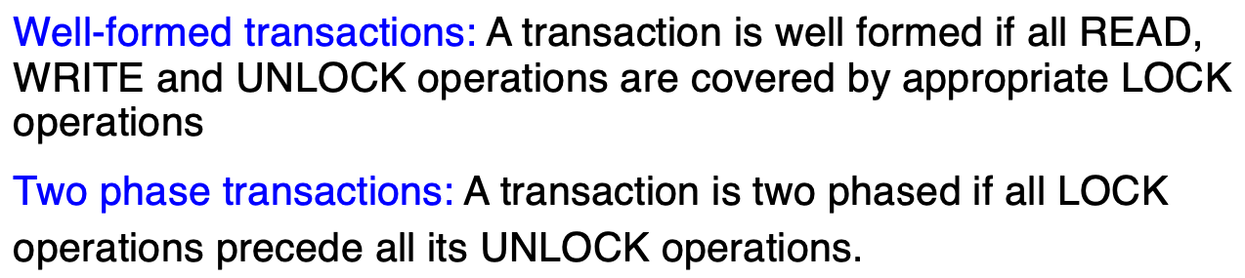
Well-formed transactions / Two-phase transactions

Slide 16
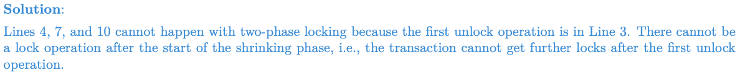
Q6

Slide 17
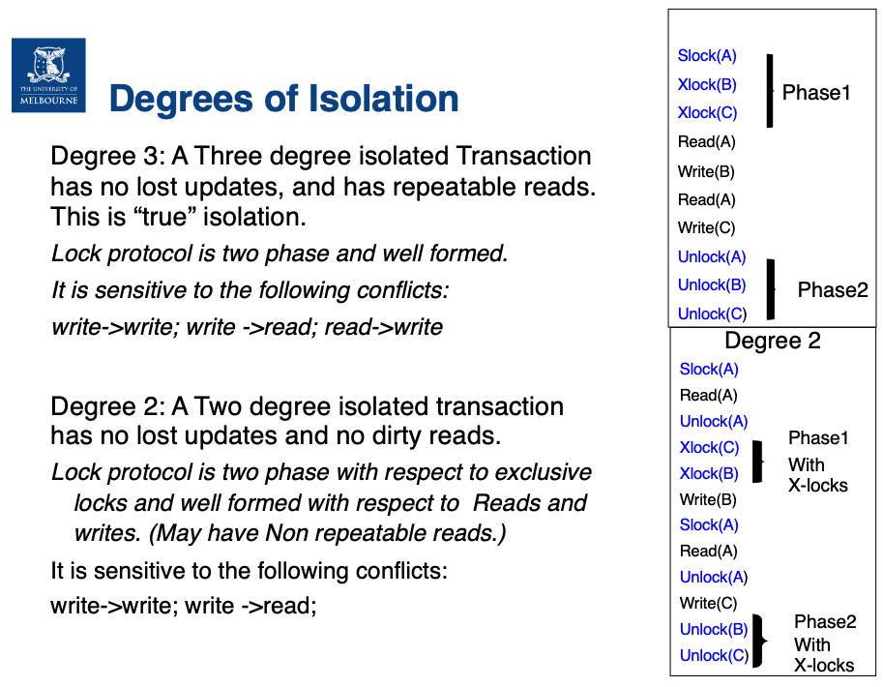
Well-formed transactions / Two-phase transactions

Slide 18
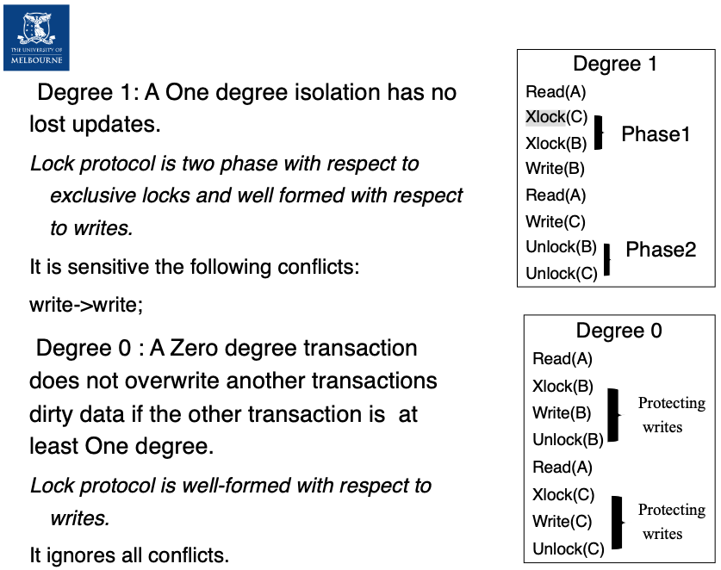
Well-formed transactions / Two-phase transactions

