Slide 1
Week 10 tutorial
Exercise (Intention locks)
Lab 3 (Intention locks)

Slide 2

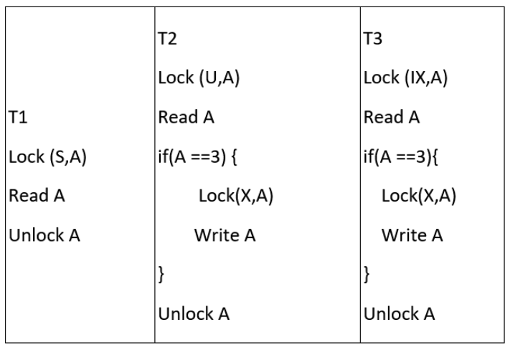
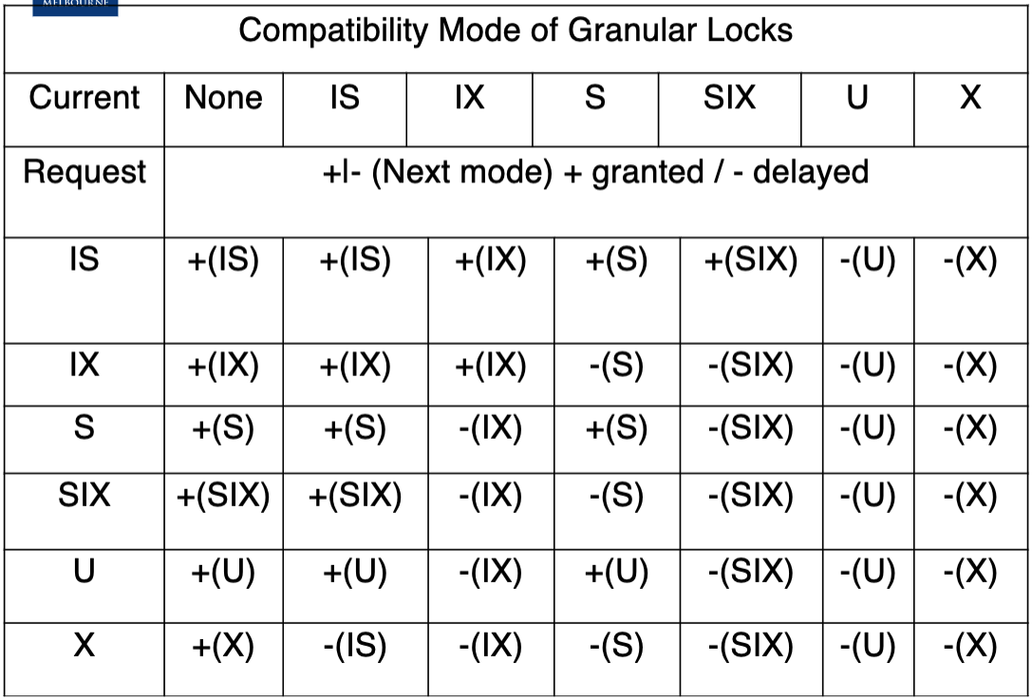
Question 1

Slide 3

Question 1

Slide 4
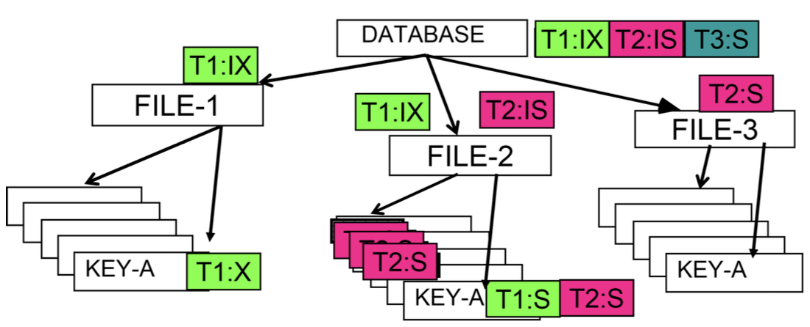
Question 2

Slide 5
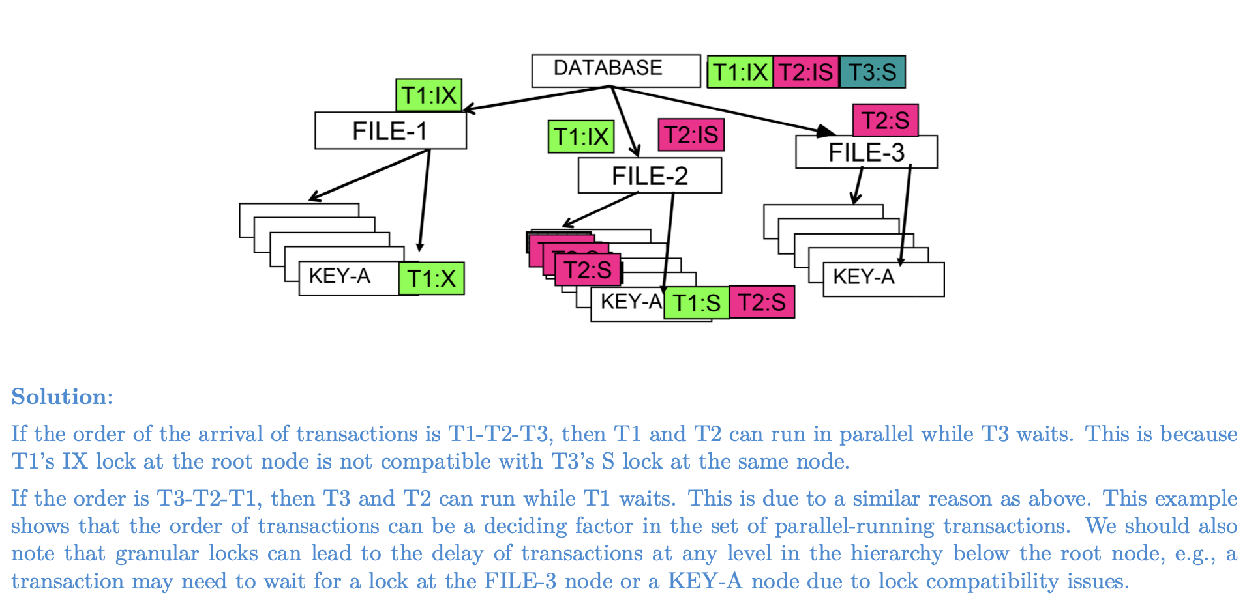
Question 2

Slide 6
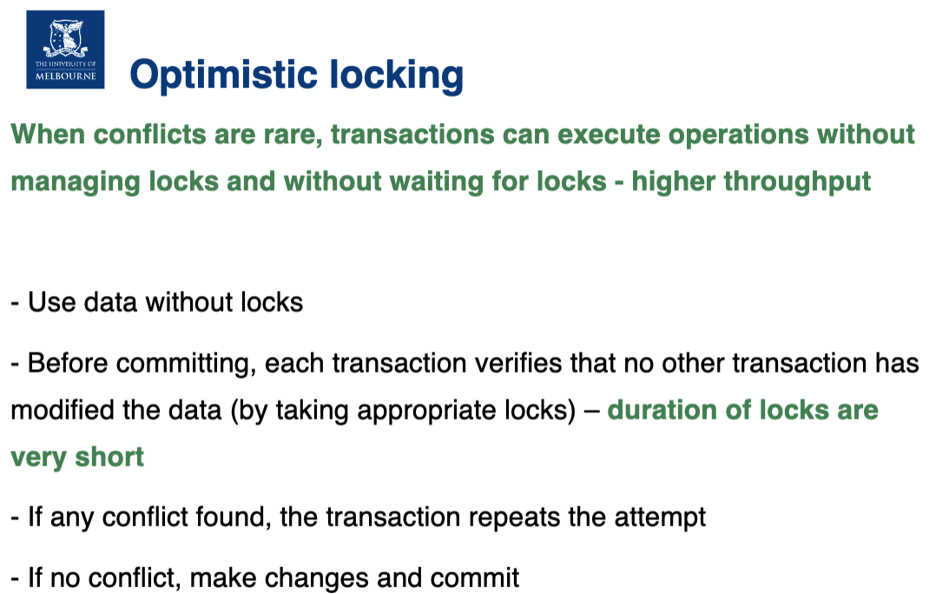
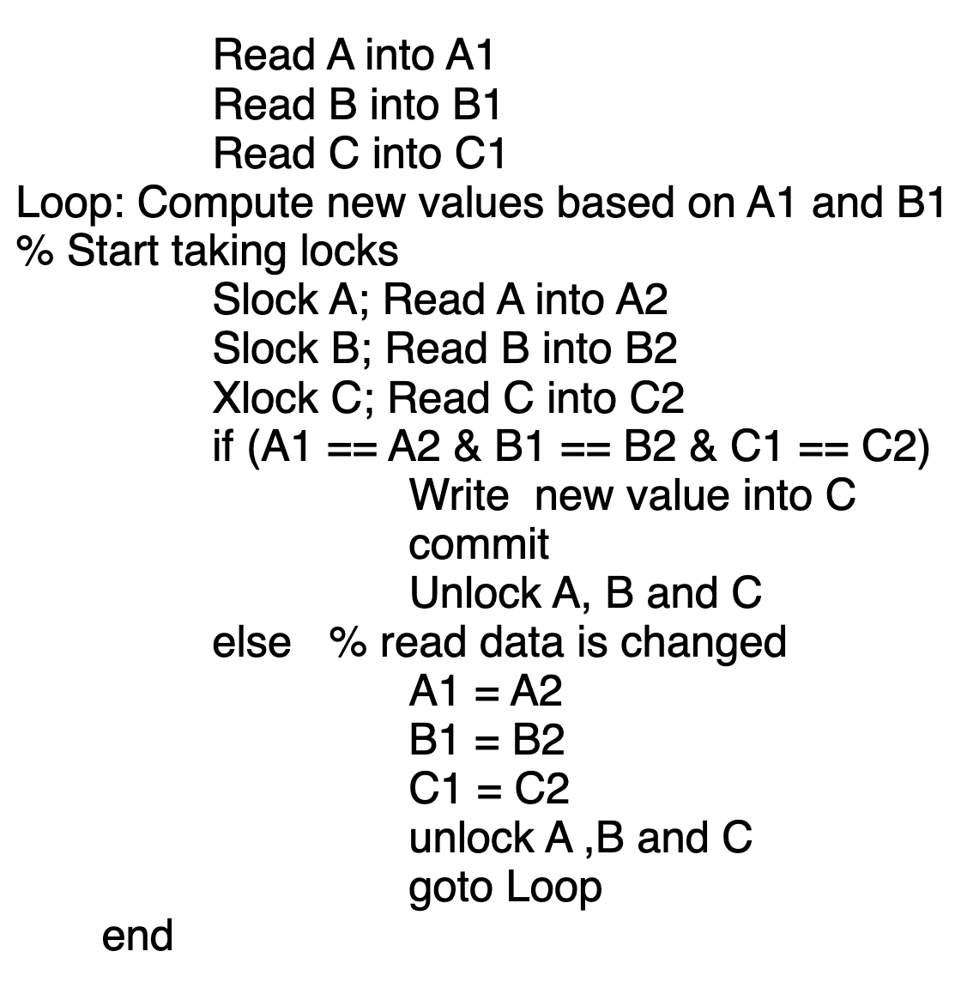
Question 3

Slide 7

Question 3

