Slide 1
Week 11 tutorial
RAID systems
Aries approach

Slide 2
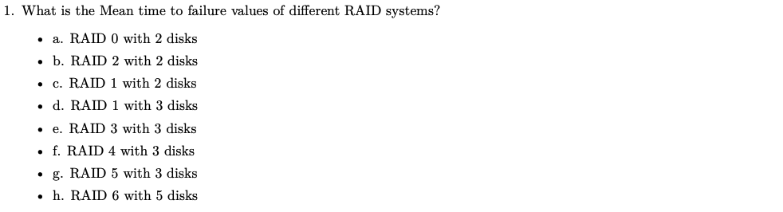
Q1

Slide 3
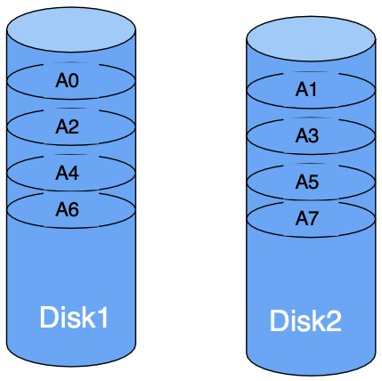
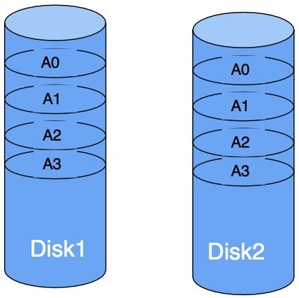
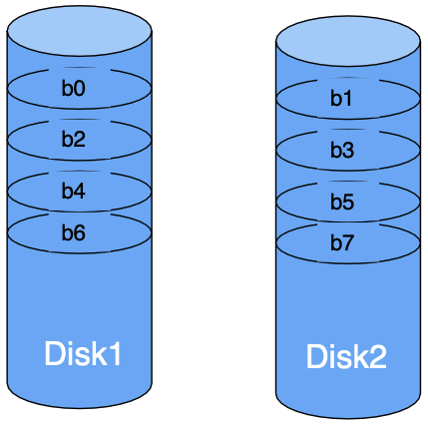
RAID 0-2
RAID 0 (block level striping)
RAID 1 (mirroring)
RAID 2 (bite level striping)
A0, A1, A2, ... are contiguous blocks
Double throughput
MTTF reduce
higher read throughput
lower write throughput
half storage utilization
MTTF increase
Striping at bit level
Higher transfer rate
MTTF reduce
Rarely used

Slide 4
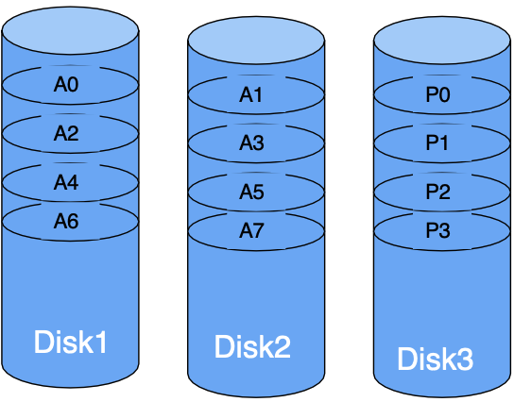
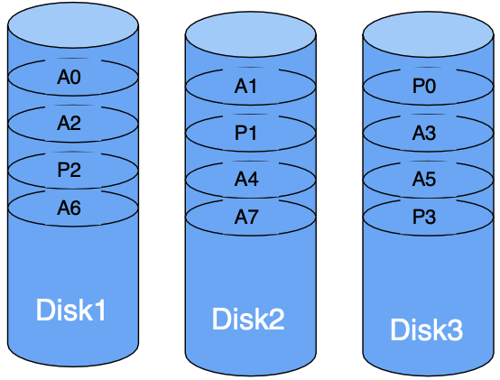
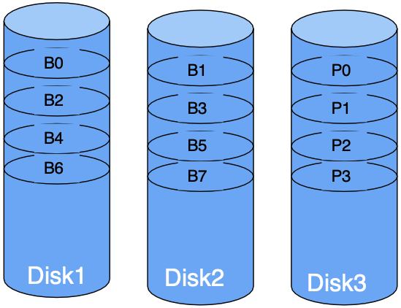
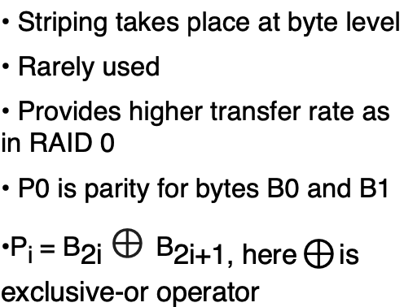
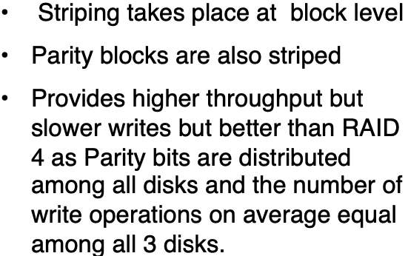
RAID 3-4
RAID 3 (Byte level striping)
RAID 4 (block level striping)
RAID 5 (block level striping)
Striping takes place at block level
Dedicated disk for parity blocks
Provides higher throughput but very slow writes.

Slide 5
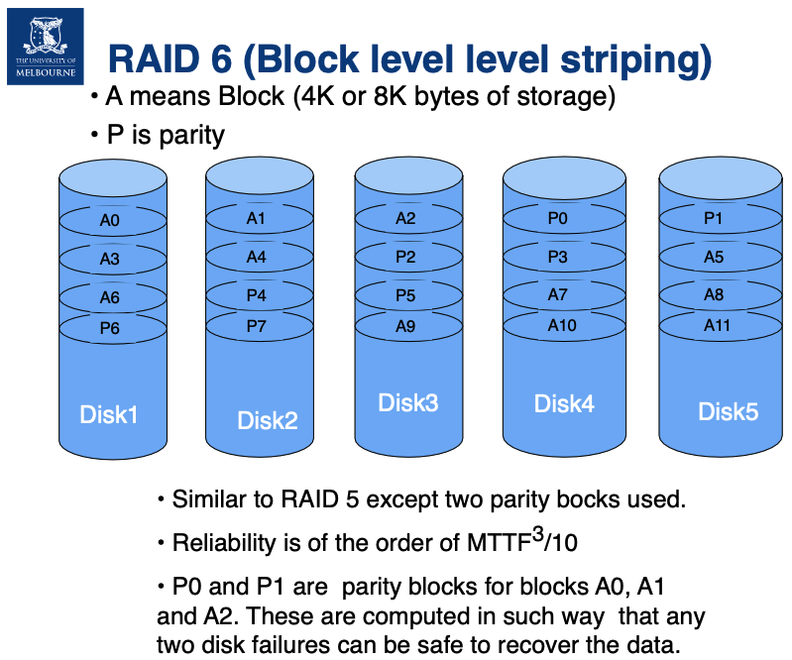

Slide 6
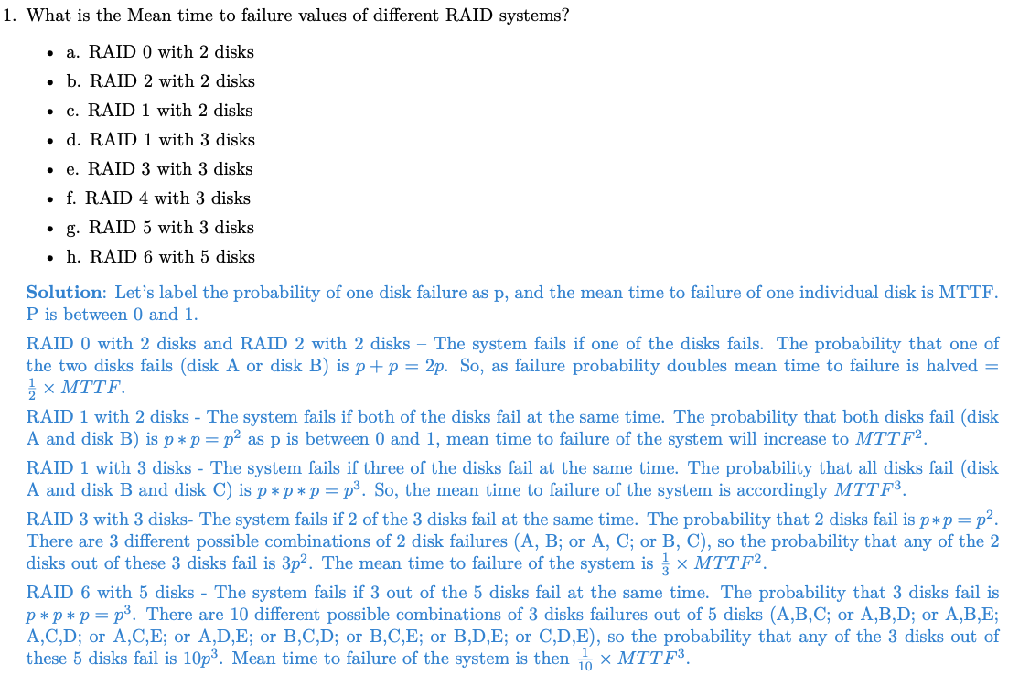
Q1

Slide 7
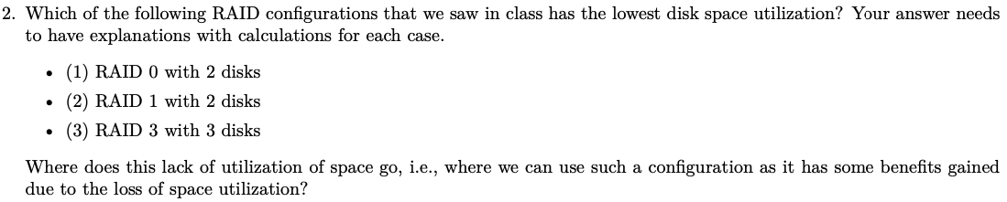
Q2

Slide 8
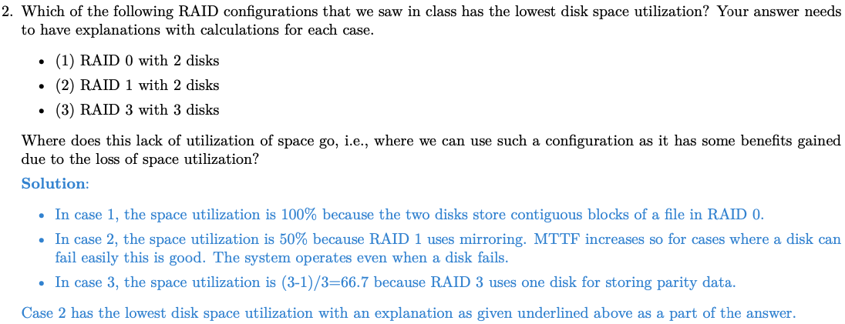
Q2

Slide 9
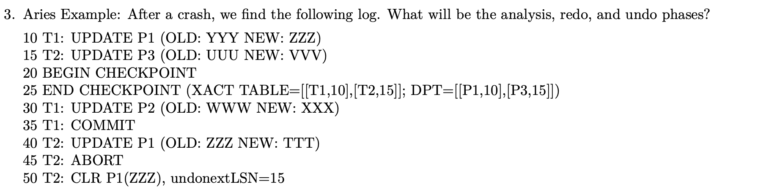
Q3

Slide 10
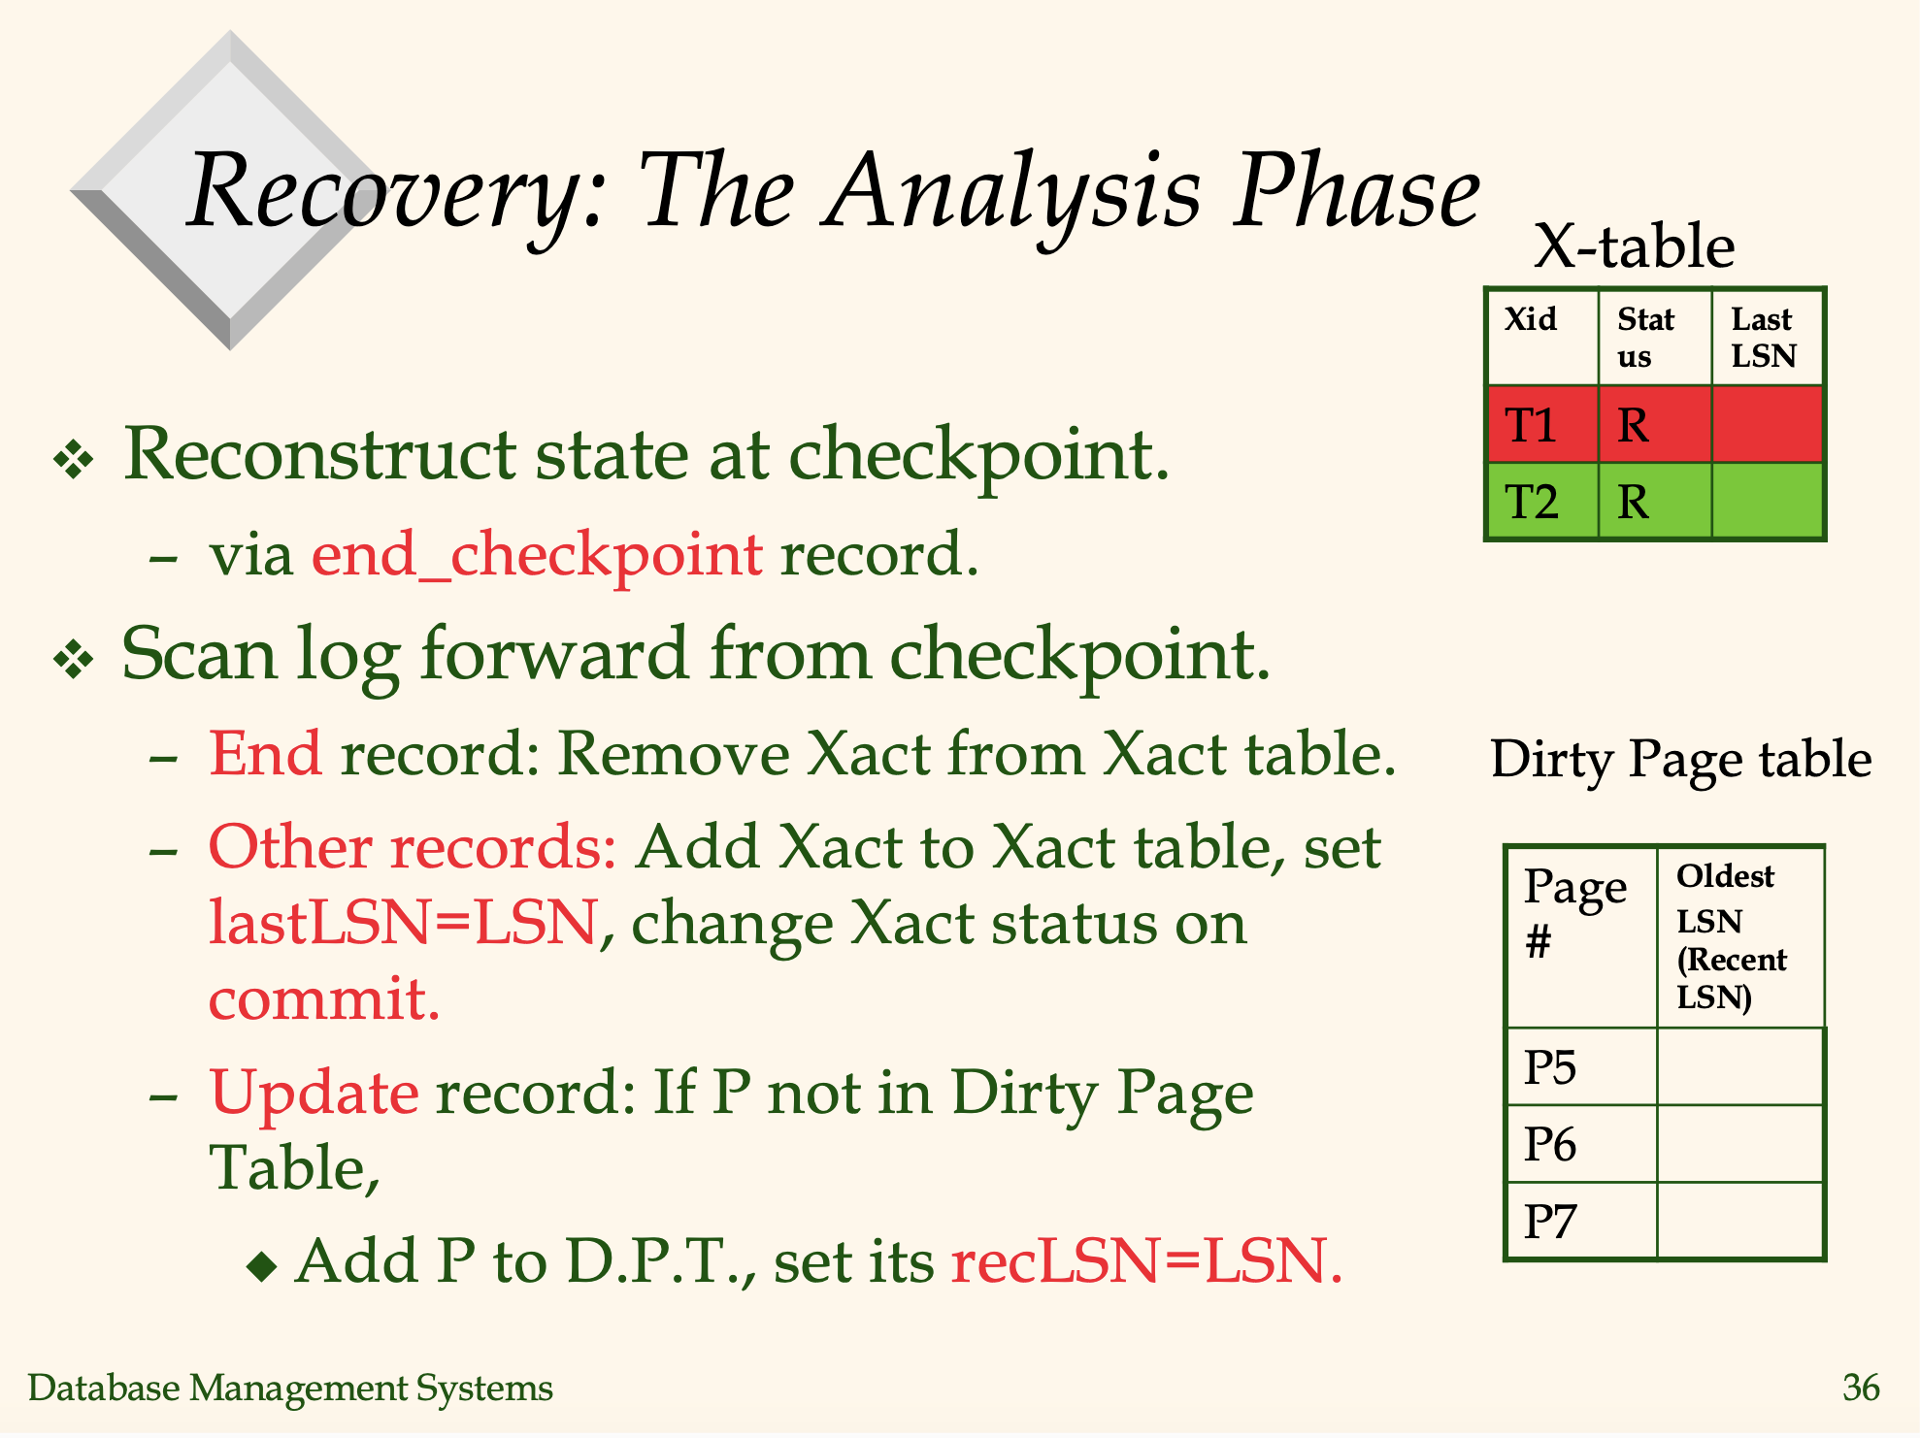
Aries algorithm Aries algorithm (Analysis)

Slide 11
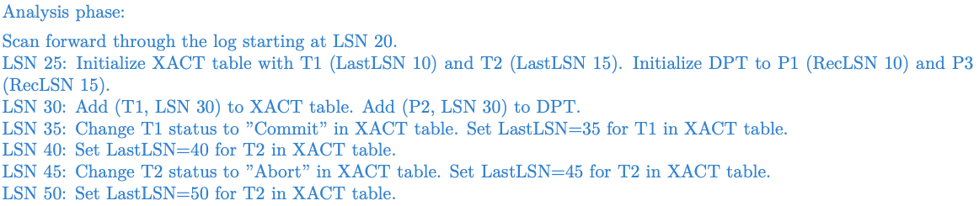
Q3

Slide 12
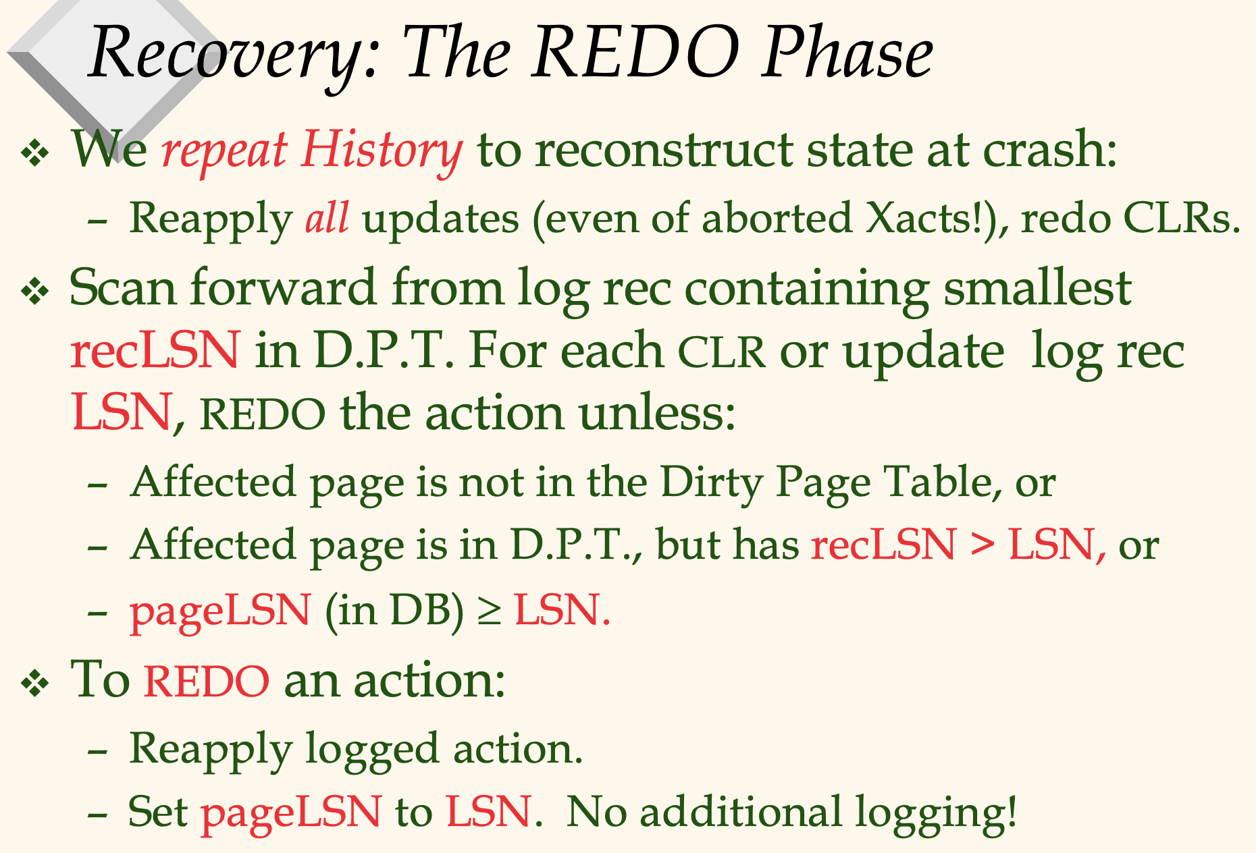
Aries algorithm Aries algorithm (Redo)

Slide 13
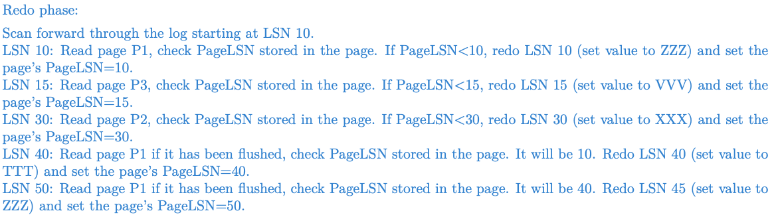
Q3

Slide 14
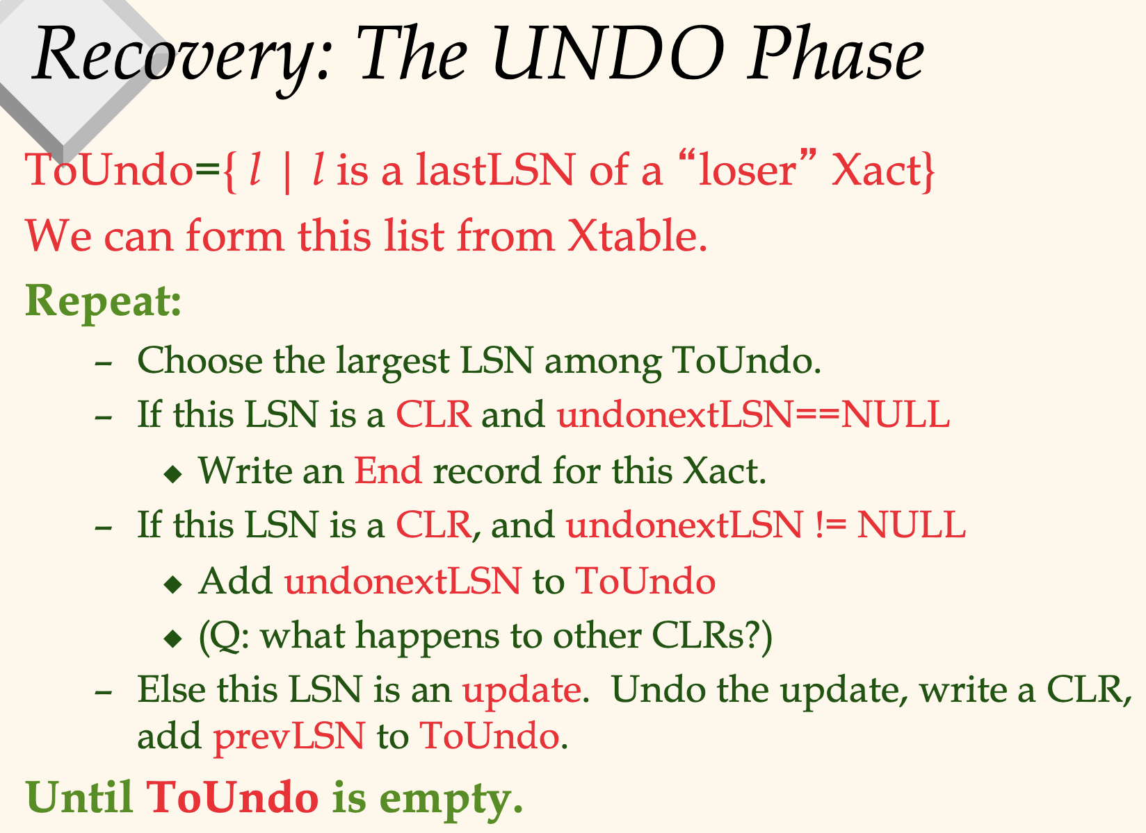
Aries algorithm Aries algorithm (Undo)

Slide 15
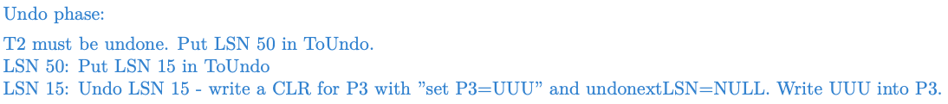
Q3

Slide 16
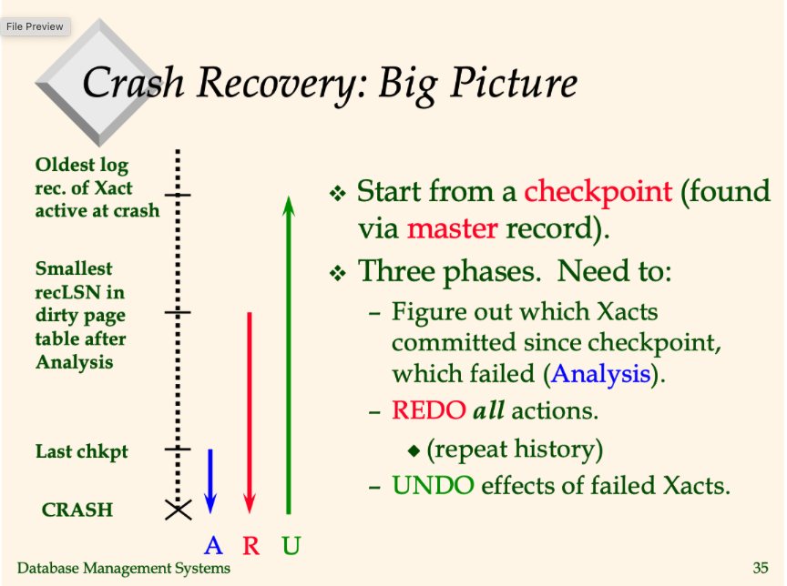
Aries algorithm

