Slide 1
Tutorial Week 12
Exercise 9: (checkpoint / distributed databases)

Slide 2
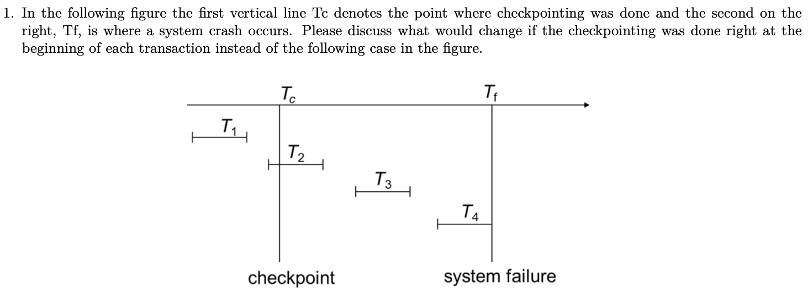
Q1

Slide 3
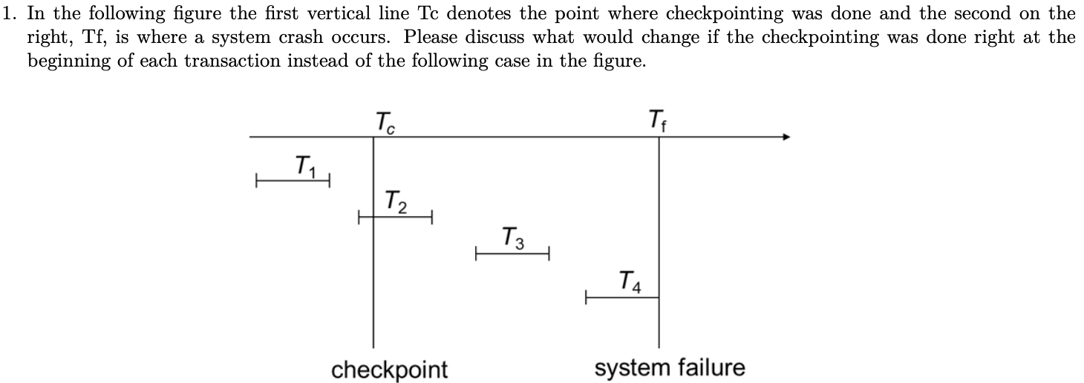
Q1
Benefits: much less to do during recovery time, much fewer transactions to consider for redo/undo, recovery becomes fast
Shortages: many output operations to the disk for each checkpoint as well as entries to the log regarding checkpointing
Suitable for many checkpoints: systems where immediate recovery is of utmost importance
Not suitable for many checkpoints: systems where transaction processing should be done fast, but recovery can take a long time

Slide 4
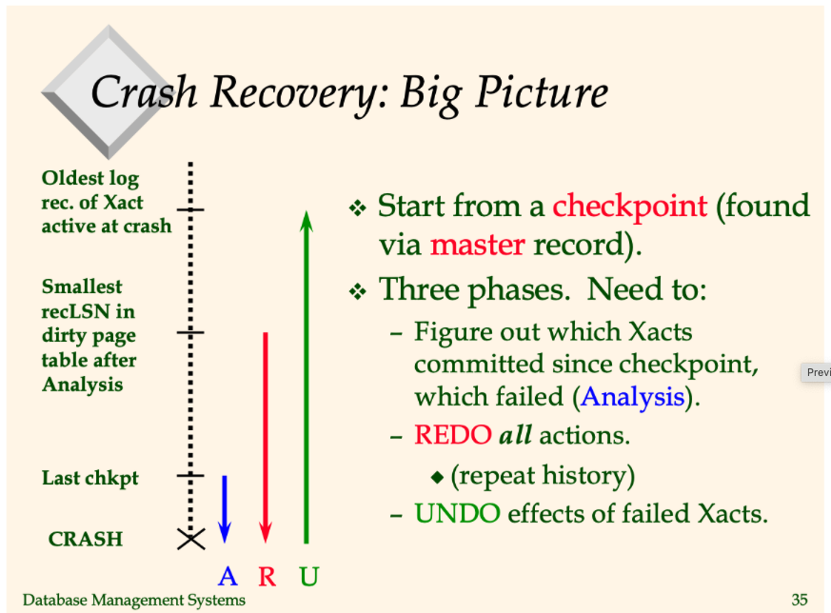
Q1

Slide 5
Q2

Slide 6
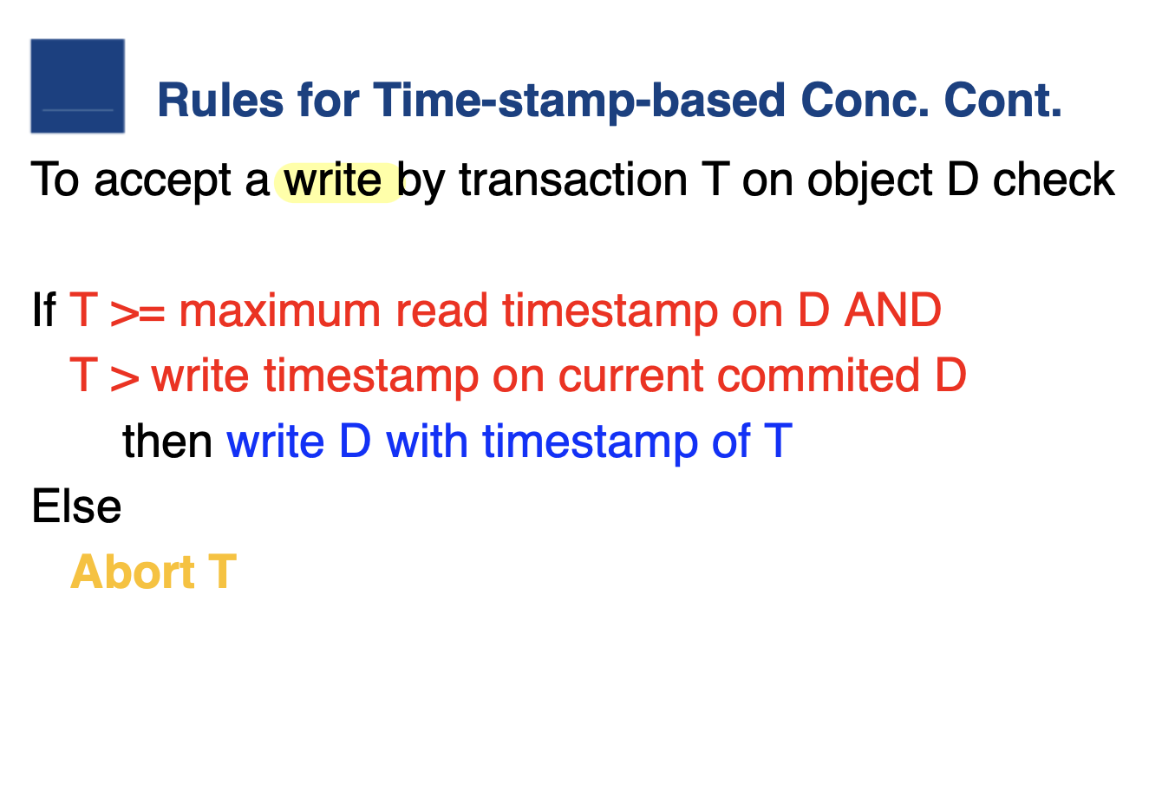
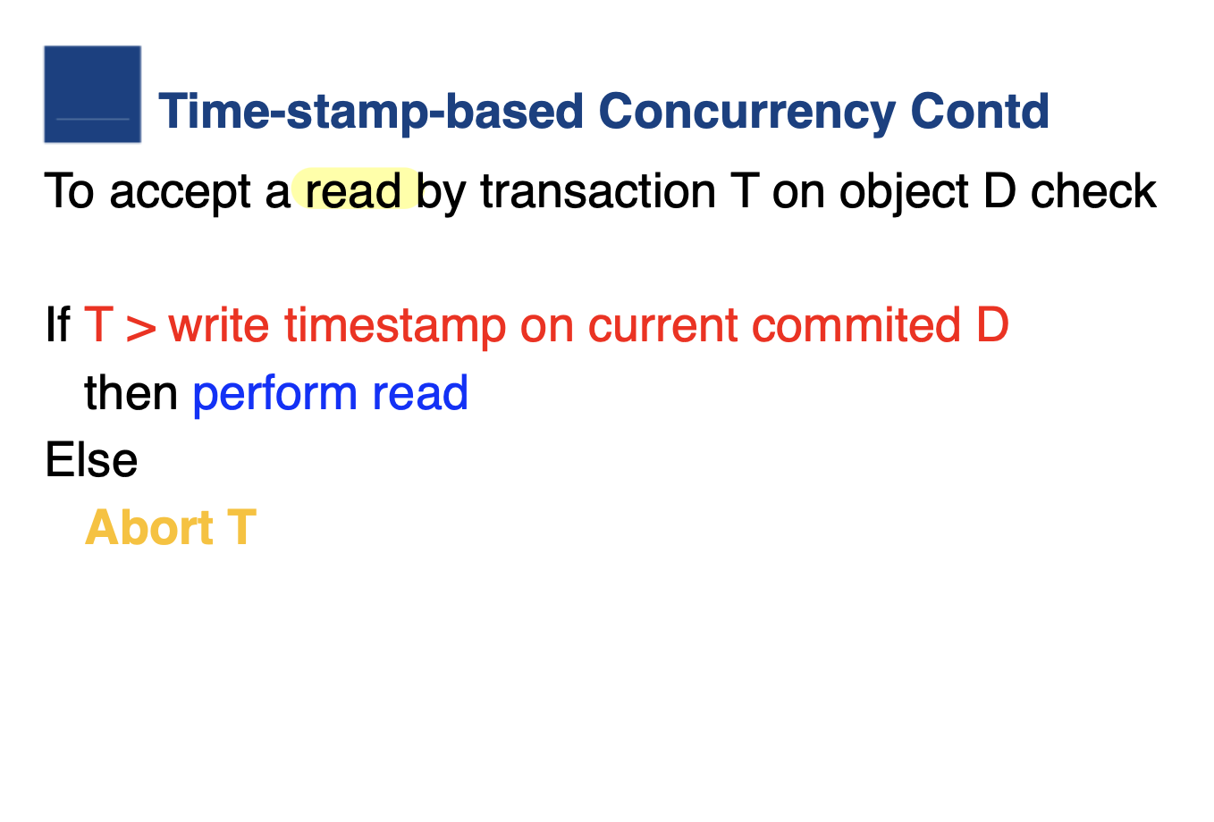
Q2

Slide 7
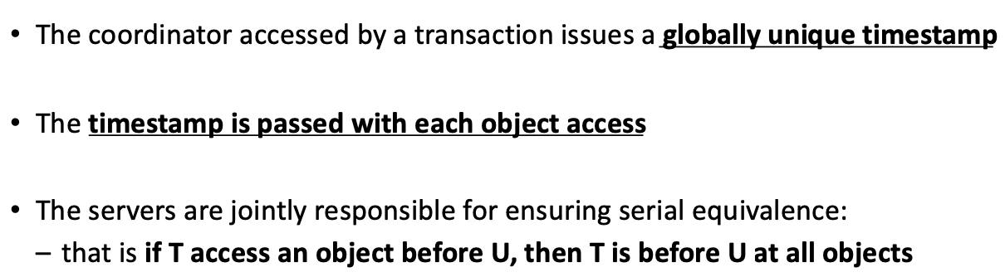
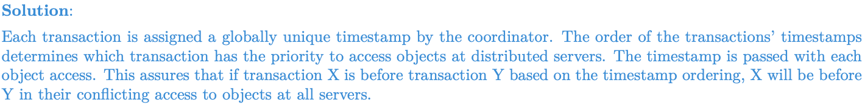
Q2

Slide 8
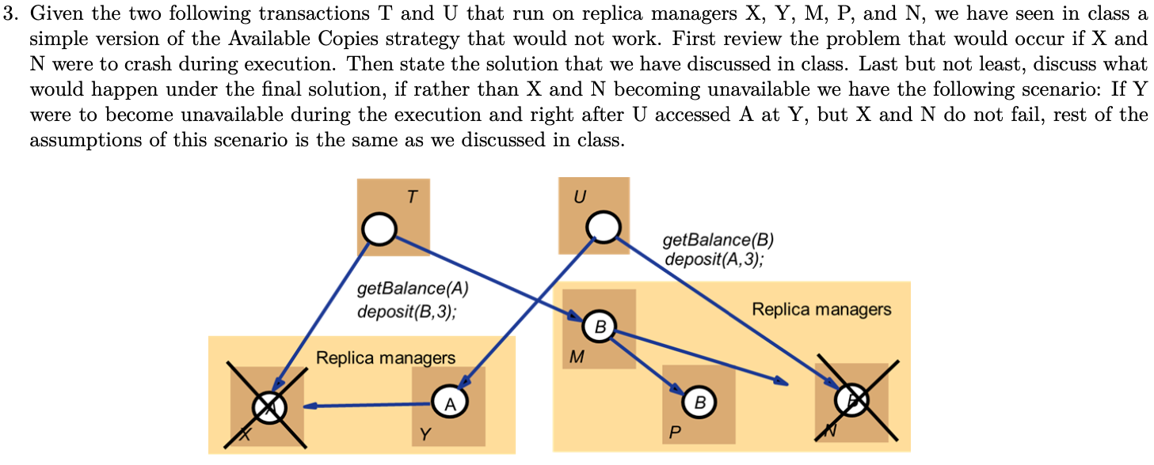
Q3

Slide 9
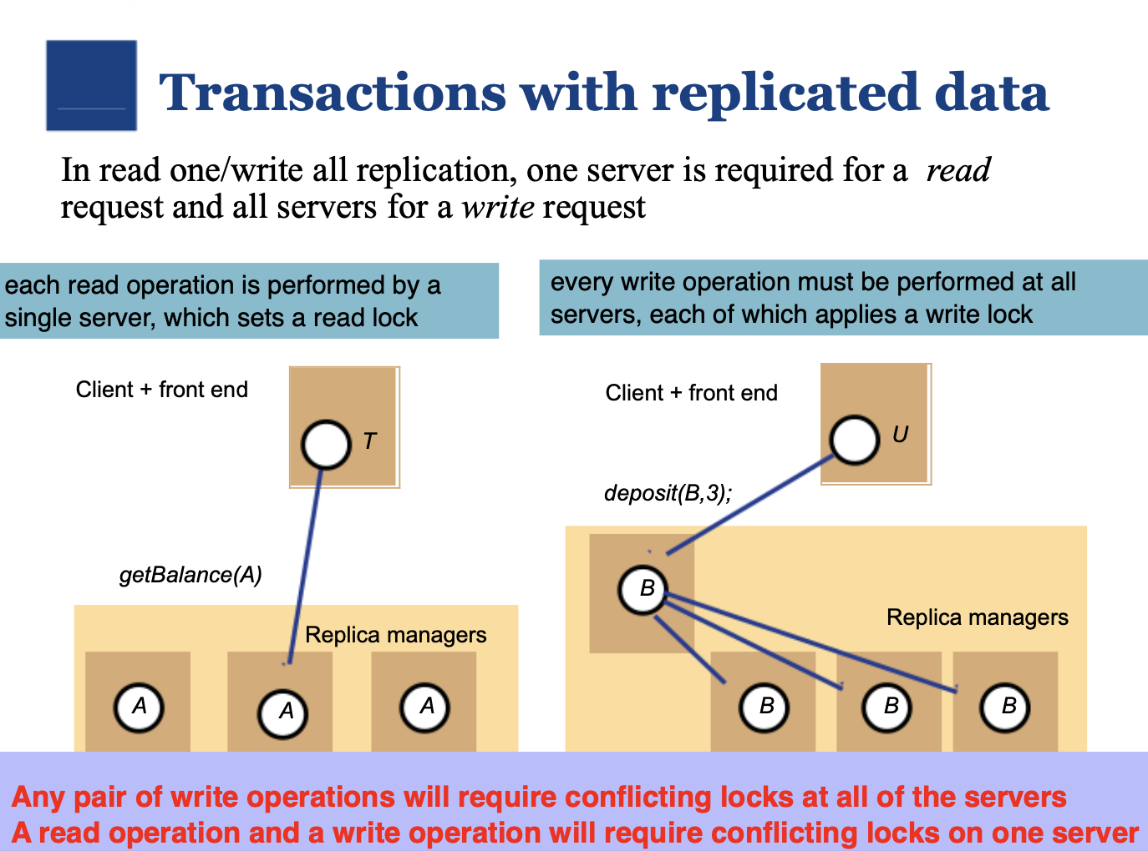

Slide 10
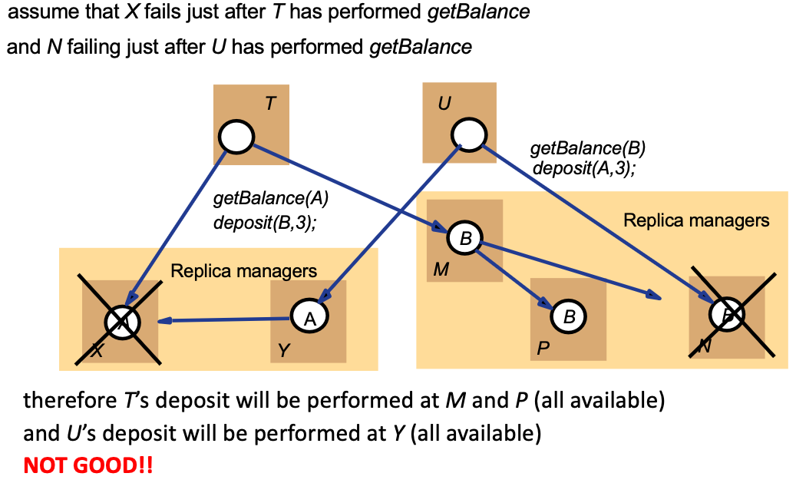
Replica managers in distributed databases

Slide 11
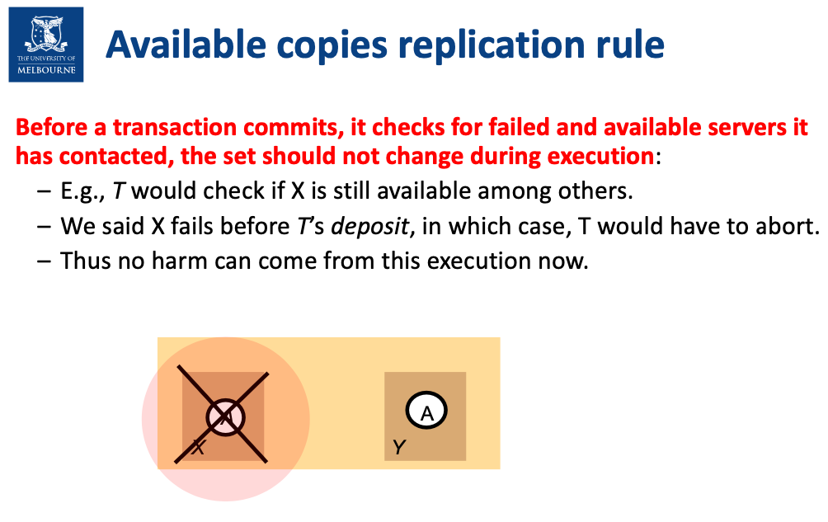
Replica managers in distributed databases

Slide 12
Q3
As you can see, the implementation of the final strategy we have seen, and in fact many strategies in DBMSs, are only
approximations and in general pessimistic ones so that they guarantee proper executions but sometimes terminate
transactions that would not really cause harm.

Slide 13
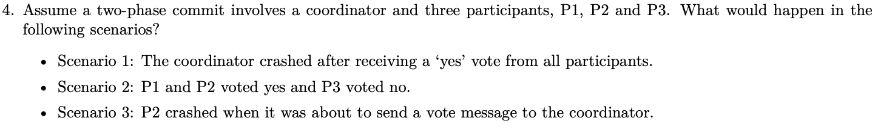
Q4

Slide 14
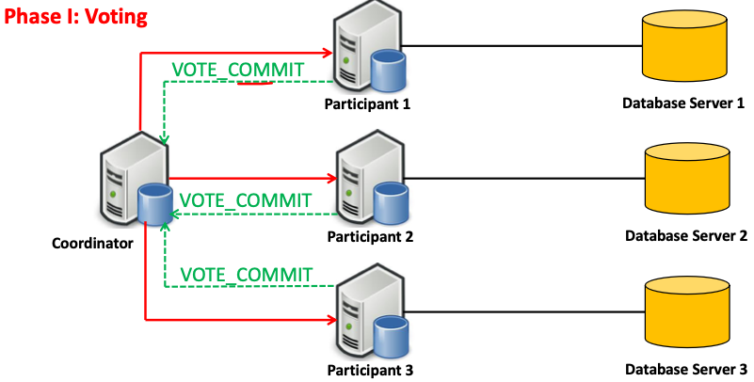
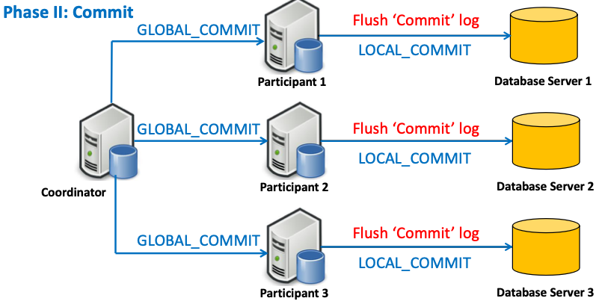
Two-phase commits

Slide 15
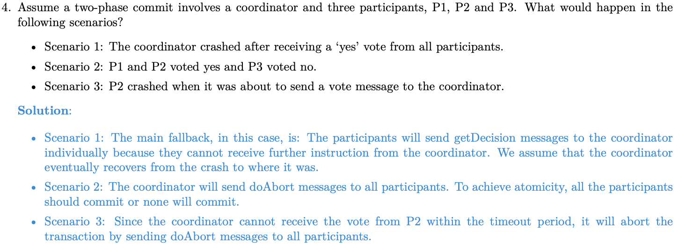
Q4

